Slide 1
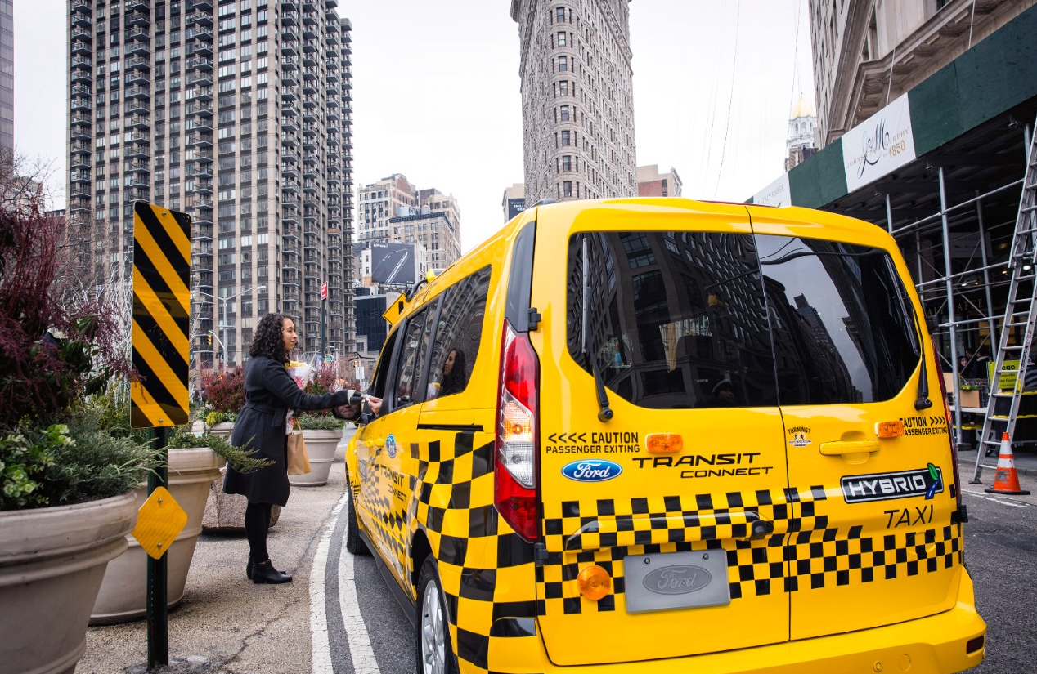
gINGER Kasanic
Fleet Sustainability & Advanced Technology Manager

Slide 2

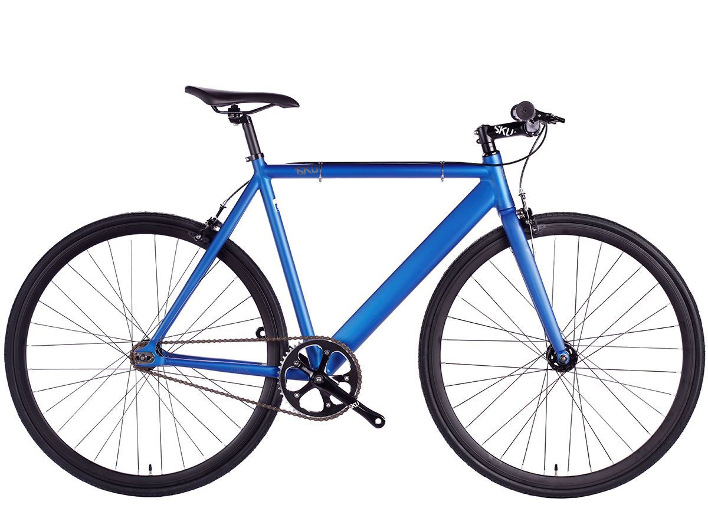



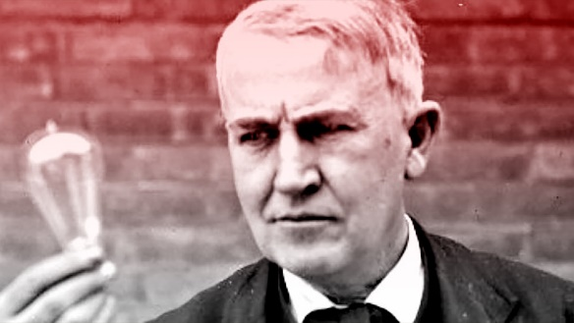


Slide 3


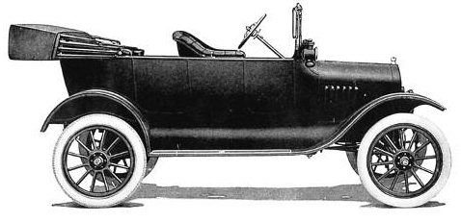
Our Vision And Mission
Making People’s Lives Better
by Changing the Way the World Moves

Slide 4

How We'll Get There
“THINK BIG, ACT SMALL, GO FAST AND CO-CREATE…”
-- Jim Hackett

Slide 5

Ford GoBike
Ford/Motivate, launched Ford GoBike in June ‘17 –
regional bike-share network designed to enhance sustainable transportation
Riders can access GoBike through the FordPass™ app
546 stations and 7,000 bikes – serving San Francisco, San Jose and East Bay

Slide 6

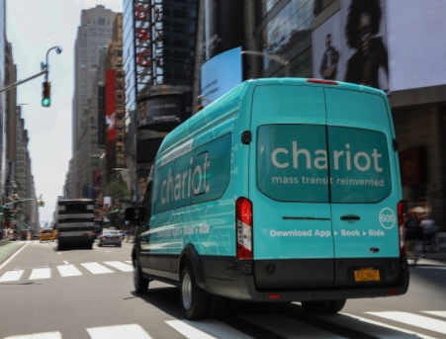
Ride sharing - Chariot
Crowd sourced shuttle service acquired in 2016
Currently serving - San Francisco, Seattle, Austin, & New York City
Wi-Fi capable, can carry up to 14 people ,flat rate of $4
Riders can use the Chariot app to search routes and reserve their seat
Helps commuters with their “first” and “last-mile” challenges
Aims to satisfy the transportation needs of underserved areas -“transit deserts”
Our Global Data, Insight and Analytics team is used in conjunction with Chariot’s routing algorithm, which is based on rider demand and behavior, & traffic data /available infrastructure
Notes:
In San Francisco, where Chariot was founded in 2014, about 20 % of its riders use it to connect to transit hubs.

Slide 7
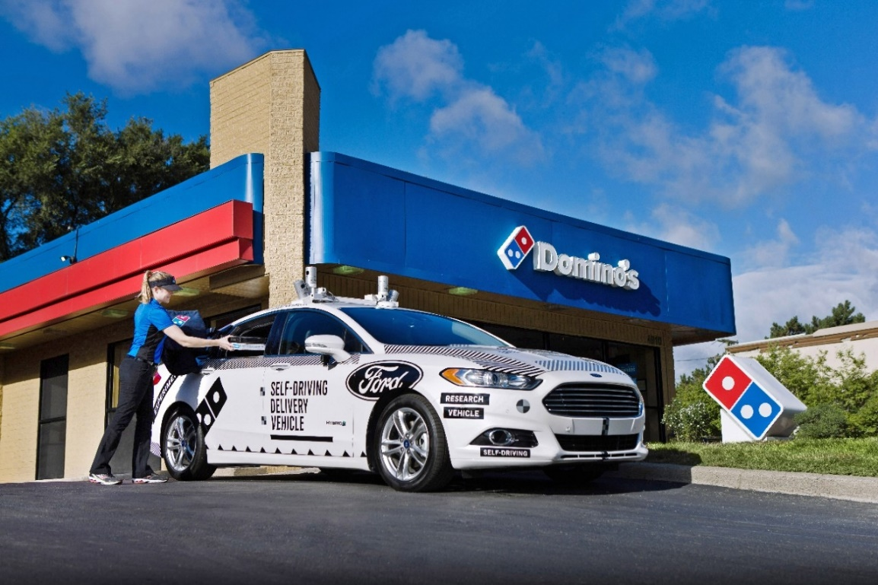
Autonomous Vehicles – Dominos Collaboration
Launched an industry-first collaboration to understand the role that self-driving vehicles can play in pizza delivery
Studying customer reactions to interacting with a self-driving vehicle as a part of their delivery experience
Understanding customers’ perspectives around the future of food delivery with self-driving vehicles
Notes:
Just one example of the many things we are doing with AVs.
A big part of the AV journey is how the vehicle interacts with the world around it and visa versa
Yes, miles logged are important, but solving these scenarios is where we are focusing our efforts

Slide 8
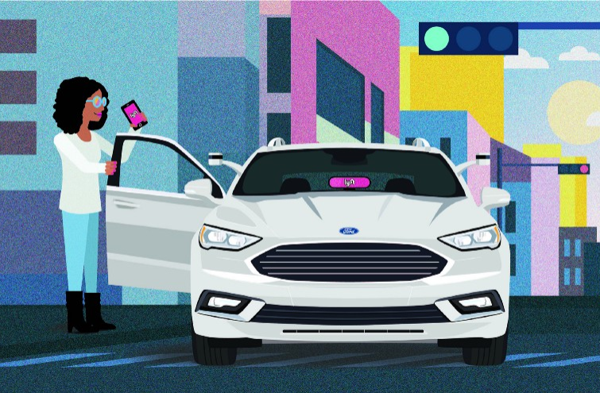

DATA & Technology - LYFT Partnership
How do we create a technology platform that it can easily connect with a partner’s platform (such as Lyft’s) to effectively dispatch a self-driving vehicle?
Based on our shared data and information, which cities should we work with to deliver our self-driving vehicle service?
What kind of infrastructure will be necessary to service and maintain a fleet of self-driving vehicles to ensure they are available whenever a consumer needs one?

Slide 9
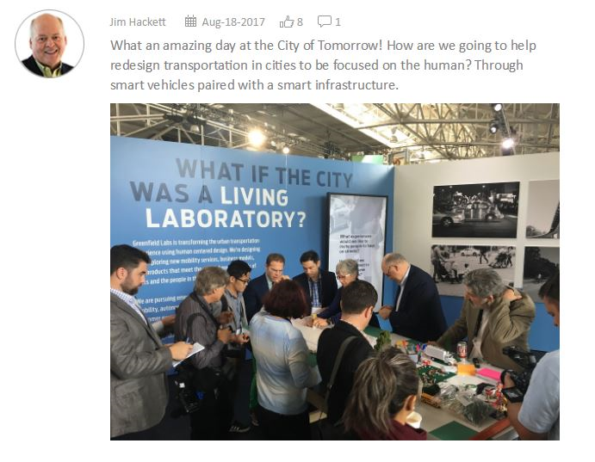
Smart Cities - City of tomorrow
Arriving at our desired state requires governments, cities, community members and the private sector to collaborate on a larger scale than ever before
Understanding how near-term mobility advancements -
  Autonomous and Electric vehicles
  Ride sharing
  Ride-hailing
  Connected vehicles
can potentially interact with urban infrastructure and create a more cohesive transportation eco-system
Notes:
Populations are steadily climbing, w UN reporting the global urban population is expected to grow by 2.5 B people by 2050, with most concentrated in already jam-packed cities. Aging transportation systems are failing. Solutions are needed to maintain people’s freedom to move .
Last September, Ford created a City Solutions team to help analyze and solve urban transportation problems
Aug ‘17 Forum Discussed – infrastructure, street usage, movement, data powered services

Slide 10
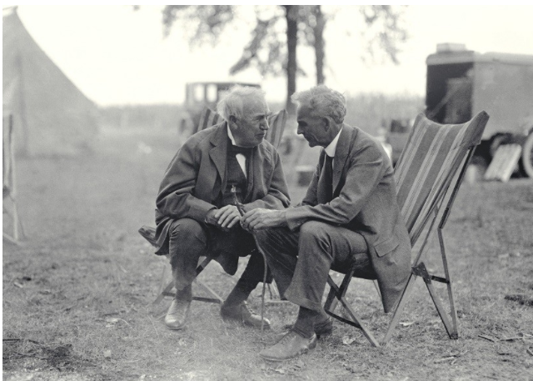

Electrification - Team Edison
A new, dedicated global electric vehicle organization – “Team Edison”
will focus on:
Rapidly designing and implementing new holistic, customer-focused BEVs, services and ownership experiences
Improving revenue through choices of nameplates and thorough understanding of customer trends and segmentation by market
Providing unique battery electric vehicle features and services, including over-the-air upgrades, charging, and customer experiences
Reducing cost through a focused strategy and new business models, scale, commonality of systems and partnerships
Notes:
As we move into a future of smart vehicles in a smart world, a large piece of that strategy will be the electrification of our products. Global trends are demanding this, and it also aligns with our company goals.

Slide 11
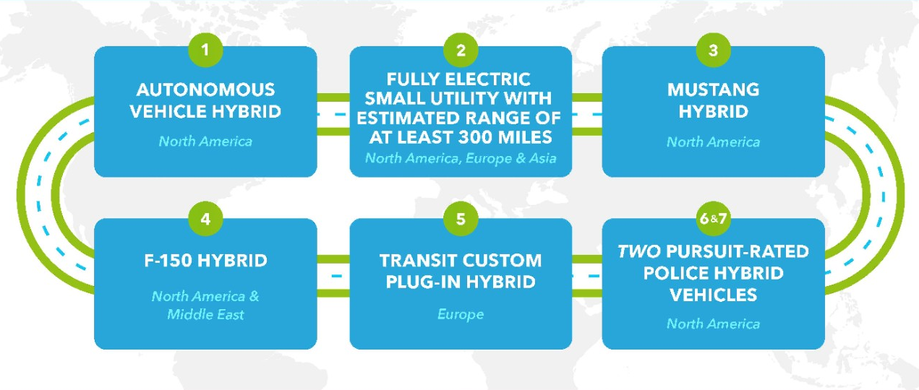
global ev ROADMAP - $4.5b investment by 2020
7 of 13 new global electrified vehicles coming in the next five years

Slide 12

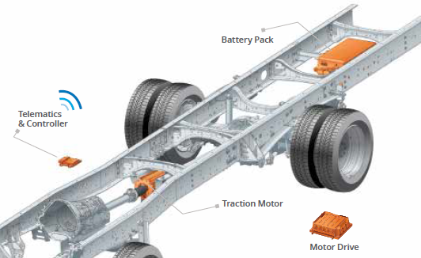
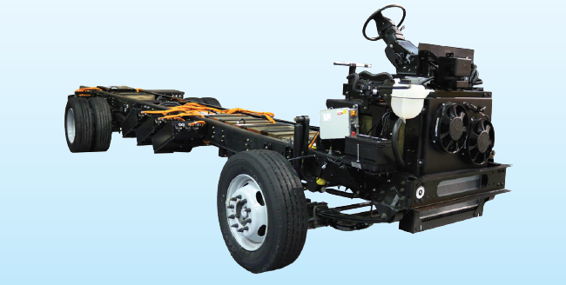
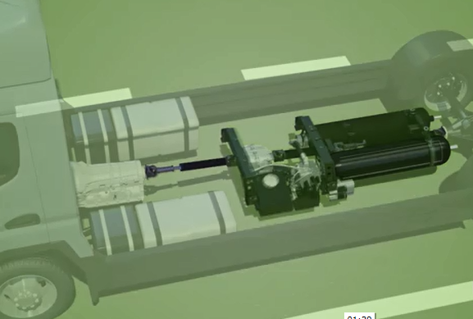


QVMs – Quality Vehicle Modifiers
eQVMs
New Efficient/ Clean Upfit Opportunities
HEV/PHEV
BEV
Hydraulic Hybrids/BEV
Notes:
Same high level of quality, convenience, & service from a Ford QVM Qualified Participant
Meets QVM Manufacturing & Assembly Requirements
Unique Electric and Hydraulic Assessment Criteria
Direct interface support from Ford Engineering
Can be installed during other QVM or Ship Thru Upfits
Maintains OEM warranty
Installations eligible for Ford Credit Financing

Slide 13
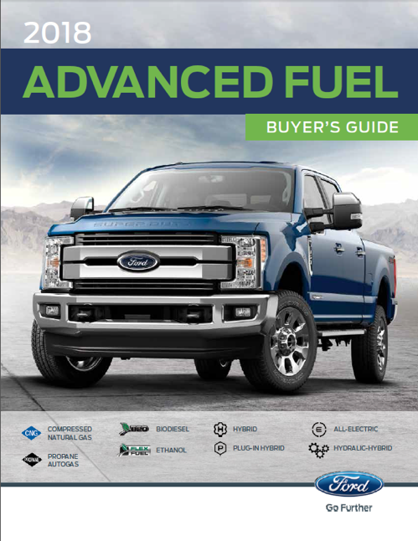
2018 ADVANCED FUEL BUYERS GUIDE
NEW/ENHANCED
Broad Portfolio of Vehicles
Cost of Ownership
Infrastructure Support
Customer/Engineering Support
List of Developers / Installers
Advanced Fuel Incentives
New eQVM Listings
Comprehensive document for Commercial Vehicle Centers and Customers offering solutions to their individual fuel needs
Notes:
Addresses Following Electric Drive Vehicle Types;
BEV - 100% Electric Vehicle (OEM engine / transmission removed, 100% propulsion provided by battery pack / electric motors, external battery charging and / or regenerative braking)
HEV - Hybrid Electric Vehicle (OEM engine / transmission removed, 100% propulsion provided by battery pack / electric motors, battery charging provided by IC engine or turbine driving onboard generator, regenerative braking, and / or external battery charging.)
PHEV - Parallel Hybrid Electric Vehicle (OEM powertrain remains, but is supplemented by battery pack / electric motors that provide additional torque during certain drive modes, external battery charging or regenerative braking.). OEM powertrain is the main propulsion power for the vehicle in all modes.

Slide 14

QVM Options
 | Transit Connect | Transit | Transit | E-450 | E-450
 | Van/Wagon | Van/Passenger | Cutaway/ | Cutaway | Stripped Chassis
 |  | Wagon | Chassis Cab | Chassis
Advanced Fuel Type
Ethanol (E85) | X* | X** | X** | X | X
Biodiesel (B20) |  | X | X
CNG | X | X | X | X | X
Propane |  | X | X | X | X
Electrification Options
HEV | ~ | X | X | X | X
PHEV | ~ | ~ | ~ | ~ | ~
BEV | ~ | ~ | ~ | X | X
Hydraulic Hybrid | ~ | ~ | ~ | X | X

Slide 15
QVM Options (cont.)
 | F-150 | F-250/350/450 | F-350/450/550 | F-650/F-750 | F59 Commercial/
 | Pickup | Super Duty® Pickup | Super Duty | Medium Duty | F53 RV
 |  |  | Chassis Cab | Chassis Cab | Stripped Chassis
Advanced Fuel Type
Ethanol (E85) | X | X | X
Biodiesel (B20) |  | X | X | X
CNG | X | X | X | X | X
Propane | X | X | X | X | X
Electrification Options
HEV | ~ | X | ~ | ~ | X
PHEV | X | ~ | ~ | ~ | ~
BEV | ~ | ~ | ~ | ~ | X
Hydraulic Hybrid | ~ | ~ | ~ | ~ | X

Slide 16
Thank you!!

Slide 17
Appendix

Slide 18

Sustainable Innovations | Ford
https://www.youtube.com/watch?v=Gy24EejkOjc&feature=youtu.be

Slide 19
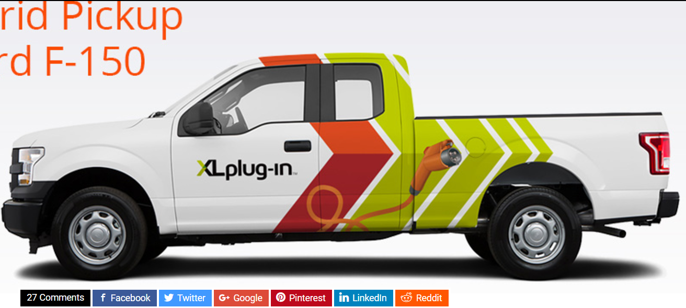
EXAMPLES: PILOT-PROJECTS WITH EV TECHNOLOGIES
London Urban EV Project
12-month trial of 20 new plug-in hybrid (PHEV) Ford Transit Custom vans that reduce local emissions running solely on electric power for the majority of city trips such as deliveries and maintenance work
DHL StreetScooter Work XL
Partnership with Deutsche Post DHL to support urban parcel delivery in Germany
2500 E-Vans scheduled for production in 2018, with each vehicle saving approximately 5 tons of CO2 and 1,900L of diesel fuel each year
The City of Tomorrow
Explores how near-term mobility advancements such as autonomous and electric vehicles, ride sharing, ride-hailing, and connected vehicles could potentially interact with urban infrastructure and create a more cohesive transportation eco-system
eQVM: PHEV F-150 Pickup, BEV F-59 via eQVM
Select Upfitters can now add a plug-in and BEV technology on Ford products
Ford Medical Transport Van
Upfitter friendly van for mobility equipment upgrades
Easy ingress/egress and loading
Seat configurations allow for spacious cabin environment
eQVM more robust than prior EV partnerships
Allows faster solutions, test bed for future Ford designed and build solution

