Slide 1
2018 Chevrolet Bolt EV & Silverado Hybrid –AltWheels 2017
Jay Ferraro- Regional GM Fleet Account Executive

Slide 2
Chevrolet
BOLT EV
NOT JUST A GREAT ELECTRIC CAR
IT’S A GREAT CAR

Slide 3
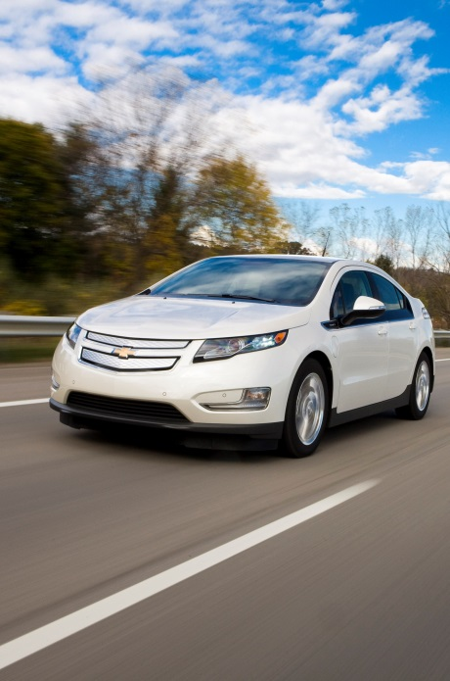
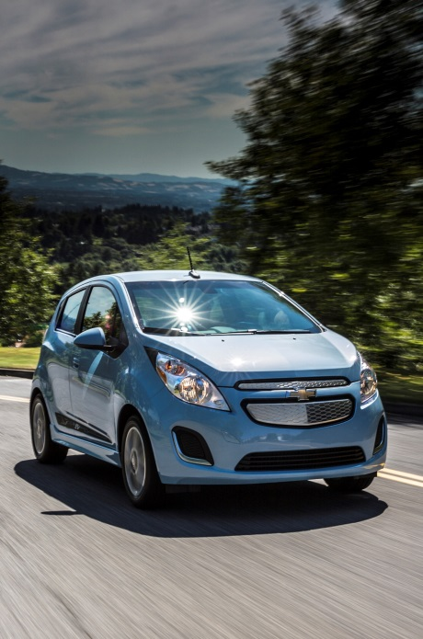
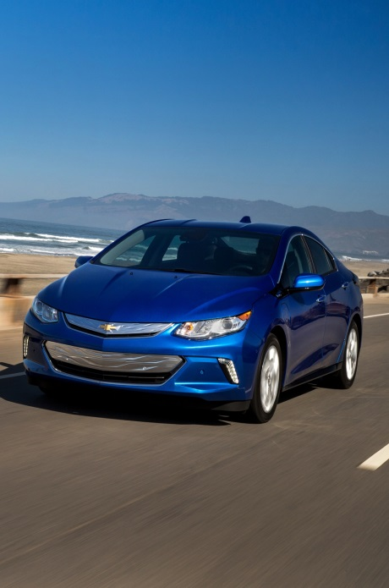
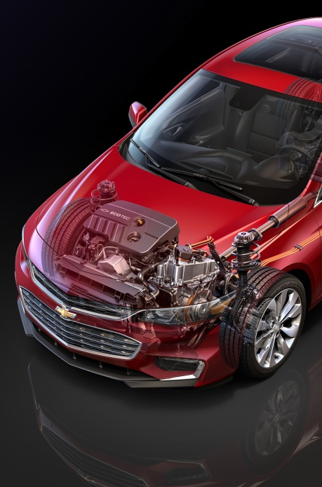
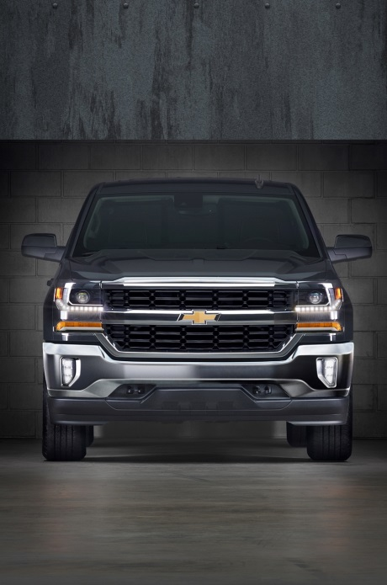
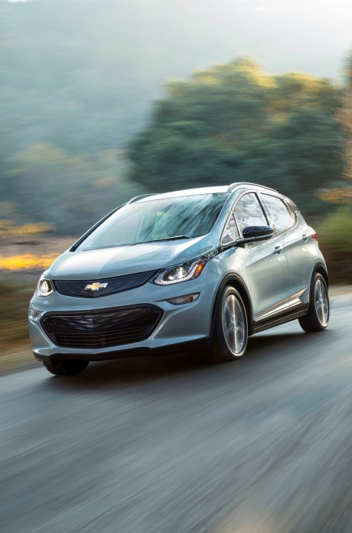
TODAY Wouldn't BE POSSIBLE WITHOUT. . .
Expertise, experience, commitment
Volt is best selling EV plug-in of all-time
More than 100,000 units sold
SILVERADO E ASSIST
VOLT GEN 1
SPARK EV
VOLT GEN 2
MALIBU HYBRID
BOLT EV
Source: PIN Share Cube (9/1/16)

Slide 4
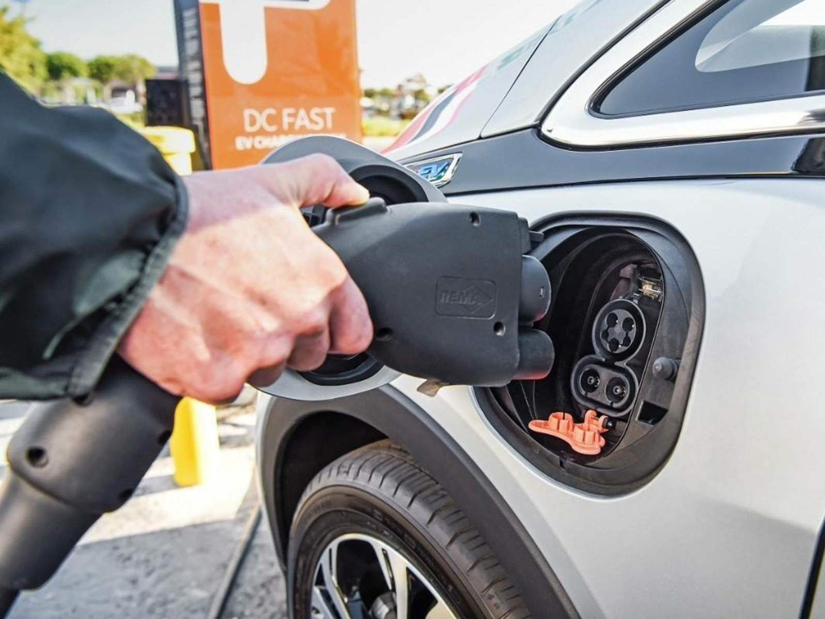
SALES AND SERVICE
READINESS
3,000 dealers | 2,000 trained GM Service Technicians |
Special tools and training . . . and investment
240-Volt charging unit available via GM Accessories…ability to finance
Notes:
We’re fortunate to have roughly 3,100 Chevrolet dealers nationwide that we rely on to sell and service our portfolio of great products
Of the 3,100 dealers, we have about 2,000 that sell and service the Volt. We are finalizing our numbers now, but we expect roughly 1,200 dealers to be certified and trained to sell and service the Bolt EV
There is required training for sales consultants, as well as required investments for charging infrastructure at the dealer, which we expect to translate into more engagement and commitment from our dealers, and better experience for our customers

Slide 5
2017 Chevrolet
Bolt EV
BEST INVENTION
CAR OF THE YEAR
CAR OF THE YEAR
DRIVELINE TECHNOLOGY OF THE YEAR
READER’S CHOICE COMPETITION: MOST ECO-FRIENDLY
BEST NEW ELECTRIC VEHICLE
BEST HATCHBACK TO BUY 2017
BEST ELECTRIC VEHICLE TO BUY 2017

Slide 6
New Chevrolet Bolt: 5 things
1
2
3
4
5
Chevrolet Bolt is unique there’s no class for it yet. Bolt is a 5-door Compact Utility Vehicle (CUV) with an all-new, all-electric powertrain that can deliver 200+ miles on a single charge , dramatically farther than any all-electric currently available.
Power comes from a single, high-capacity electric motor. Compact, powerful and quiet, the motor offers 266 lb.-ft. torque and 200 horsepower , with 0-60 under 7.0 seconds.
Regenerative braking allows highly advanced – and enjoyable – single pedal driving which can allow the vehicle to slow to a complete stop without using the brake pedal.
Engineered with a billion customer miles of experience, the all-new lithium ion battery pack can go up to 238 miles; a typical 50- mile commute can be recharged in less than 2 hours. Overnight charging is accomplished with standard 240V household current.
A new body structure is stronger for a quieter ride, while advanced brakes with improved capability and even heated rear seats make it fun to drive.
Notes:
SME APPROVAL:________________ DATE:______________________
NOTES – COMMENTS:
_______________________________________________________________________________________________________________________________________________________________________________________________________________
1:GREAT PRODUCTS
2:CHEVROLET PASSENGER CAR
3:BOLT
KEYWORDS: Chevy Bolt, 5 things, New Chevy Bolt, Chevrolet Bolt, electric, hybrid, SME=PPDE
Q2:Great Products|Chevrolet Passenger Car|Bolt

Slide 7
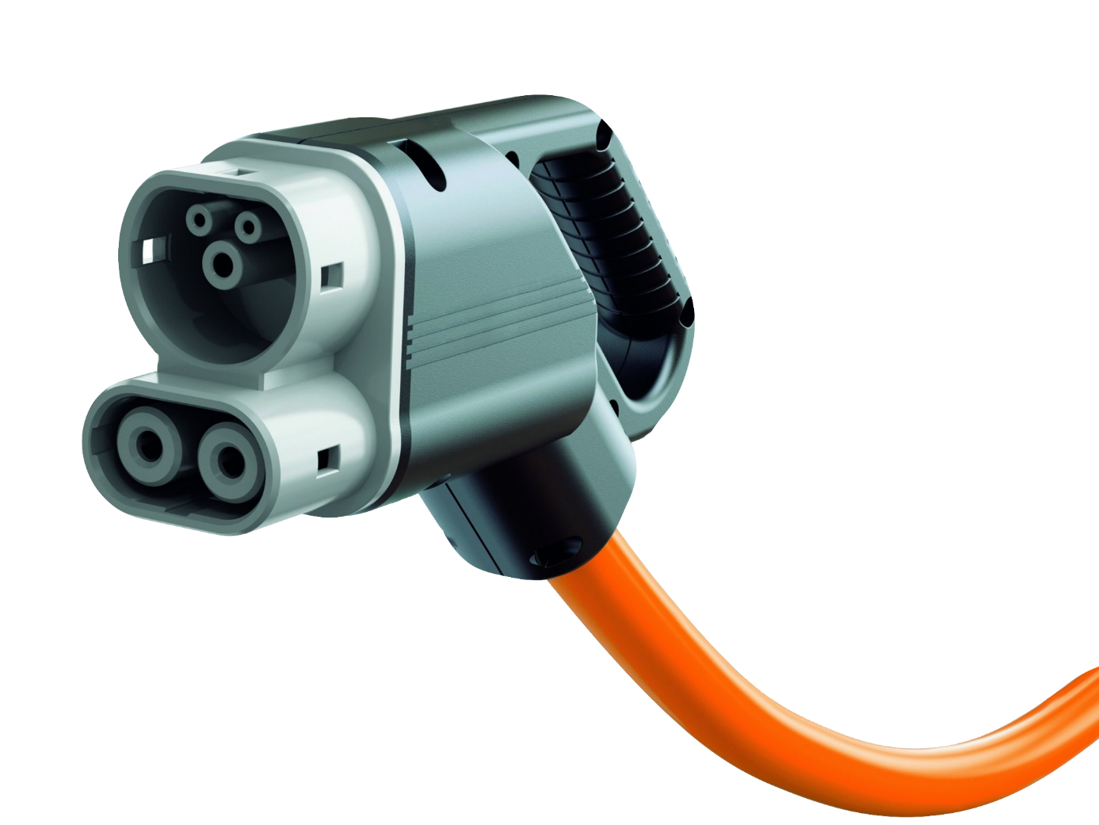
WITH DC FAST CHARGER: ADD 90 MILES IN 30 MINUTES
160 MILES IN AN HOUR
Notes:
1:GREAT PRODUCTS
2:CHEVROLET PASSENGER CAR
3:BOLT
KEYWORDS: Chevy Bolt, 5 things, New Chevy Bolt, Chevrolet Bolt, electric, hybrid, SME=PPDE
Q2:Great Products|Chevrolet Passenger Car|Bolt

Slide 8
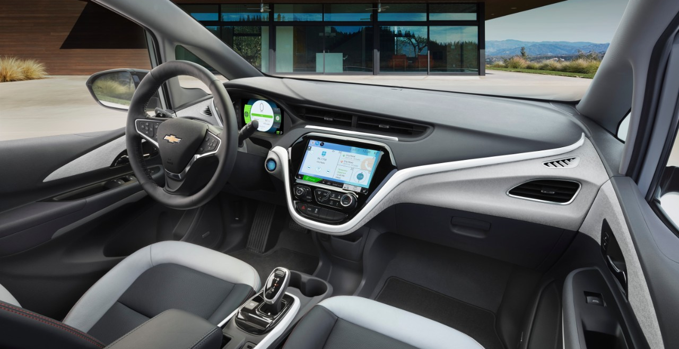
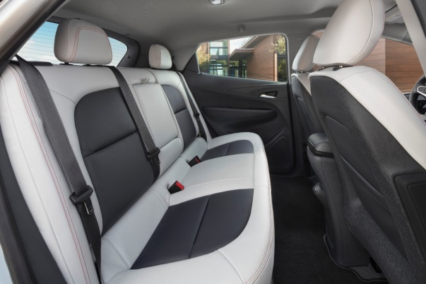
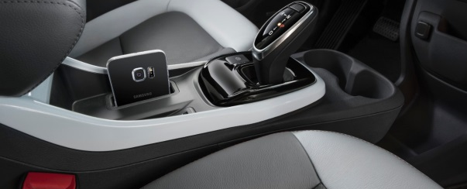
INSIDE THE BOLT – Simple and clean
Notes:
SME APPROVAL:________________ DATE:______________________
NOTES – COMMENTS:
_______________________________________________________________________________________________________________________________________________________________________________________________________________
1:GREAT PRODUCTS
2:CHEVROLET PASSENGER CAR
3:BOLT
KEYWORDS: Inside the Bolt, Chevy Bolt, Chevrolet Bolt, Bolt interior, electric, hybrid , best buy, awards, electric, plug-in, SME=PPDE
Q2:Great Products|Chevrolet Passenger Car|Bolt

Slide 9
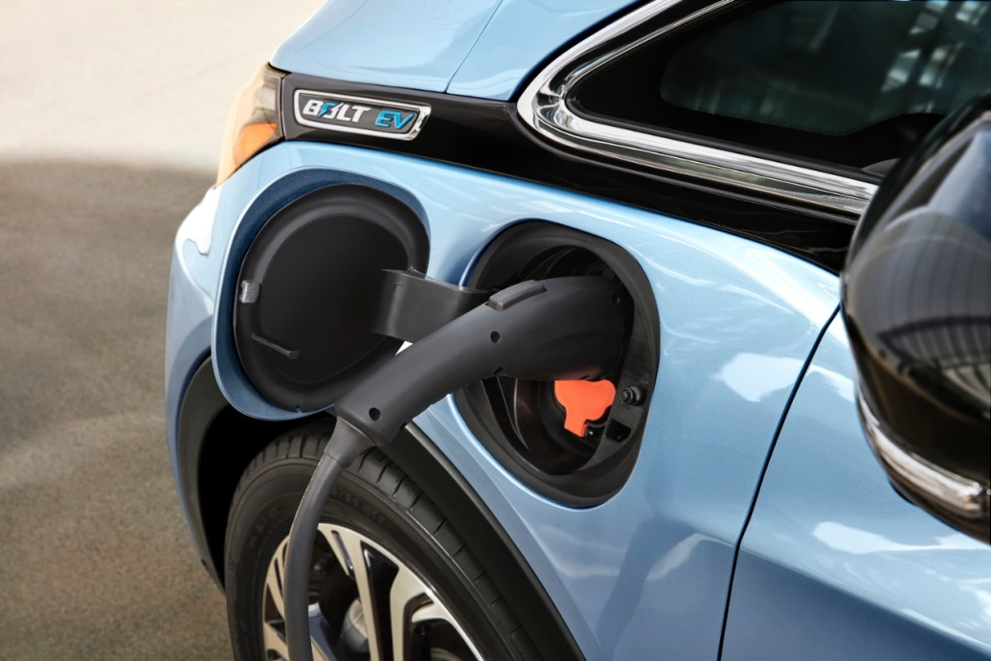
Fast charging technology
7.2 kW onboard charger for overnight household 240V charging.
2-hour recharge time for 50 mile commute
Fast charging optional direct current (DC) uses the standard connector to charge Bolt’s EV battery to 90 miles of range in 30 minutes
Notes:
SME APPROVAL:________________ DATE:______________________
NOTES – COMMENTS:
_______________________________________________________________________________________________________________________________________________________________________________________________________________
1:GREAT PRODUCTS
2:CHEVROLET PASSENGER CAR
3:BOLT
KEYWORDS: Fast Charging Technology, Bolt Charging, Bolt charge time, Bolt Range, electric, hybrid, range, all-electric, fill ups, SME=PPDE
Q2:Great Products|Chevrolet Passenger Car|Bolt

Slide 10
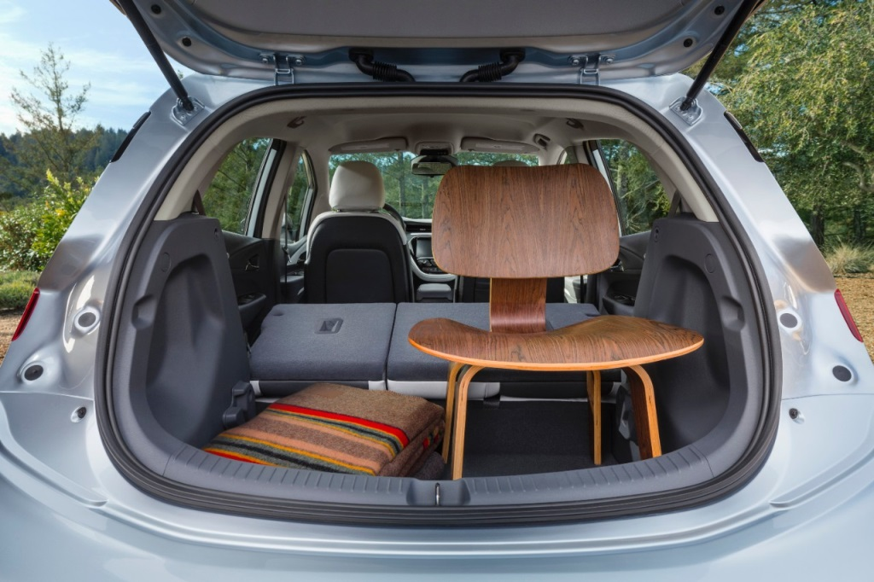
Surprising capacity
16.9 cu.-ft. cargo capacity behind rear seats
47.7 cu.-ft. cargo capacity with rear seats folded (shown)
3-passenger rear seating
Notes:
SME APPROVAL:________________ DATE:______________________
NOTES – COMMENTS:
_______________________________________________________________________________________________________________________________________________________________________________________________________________
1:GREAT PRODUCTS
2:CHEVROLET PASSENGER CAR
3:BOLT
KEYWORDS: Surprising Capacity, New Bolt, Chevy Bolt, Bolt Interior, Bolt capacity, Bolt cargo room, SME=PPDE
Q2:Great Products|Chevrolet Passenger Car|Bolt

Slide 11
Silverado/Sierra eAssist “BAS Hybrid”
What does eAssist system do to save fuel?
Start/Stop technology: Turns off engine under certain conditions (like at a stoplight) and restarts when brake is released or accelerator is pressed
eAssist system: Provides electric boost to help launch the vehicle or enable longer periods in 4-cylinder mode
Regenerative braking: Uses electric motor to recover energy while braking to charge batteries
Active aero shutters & tonneau cover: Improves aerodynamics
What are the results?
Fuel Economy: City Highway Combined
2WD eAssist: 18 24 20
4WD eAssist: 16 21 18
Up to 13% fuel economy improvement (2WD vs non-eAssist 5.3L with 8-speed transmission)
Enhanced performance due to electric boost when accelerating off-the-line, hauling loads or passing

Slide 12
Silverado/Sierra eAssist Hybrid
What does eAssist system do to save fuel?
Start/Stop technology: Turns off engine under certain conditions (like at a stoplight) and restarts when brake is released or accelerator is pressed
eAssist system: Provides electric boost to help launch the vehicle or enable longer periods in 4-cylinder mode
Regenerative braking: Uses electric motor to recover energy while braking to charge batteries
Active aero shutters & tonneau cover: Improves aerodynamics
What are the results?
Fuel Economy: City Highway Combined
2WD eAssist: 18 24 20
4WD eAssist: 16 21 18
Up to 13% fuel economy improvement (2WD vs non-eAssist 5.3L with 8-speed transmission)
Enhanced performance due to electric boost when accelerating off-the-line, hauling loads or passing

Slide 13
Silverado/Sierra eAssist Hybrid
Available nationally for 2018 MY on LD Crew cab w/5’8” box:
Silverado LT (PDE) 2WD & 4WD
Silverado LTZ (PCQ) 4WD
Sierra SLT (PCQ) 2WD & 4WD
Includes:
5.3L V8 EcoTec3 eAssist engine (L8B)
8-speed eAssist automatic transmission (M5X)
Soft folding tonneau cover (5JY) & LED cargo box lights (UF2)
Driver interface:
Efficiency gauge in Driver Information Center (DIC)
AutoStop position on tachometer
Power Flow & Histogram screens in MyLink/IntelliLink display

Slide 14
Thank you!!

