Slide 1

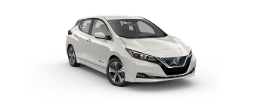
Nissan
Intelligent Mobility embodies our goal of
Zero Emissions and Zero Fatalities and differentiates our Brand
Advancing the way vehicles are
Powered, Driven, & Integrate into society.

Slide 2

For the past 400,000 Years
Temperature and Sea Level Have mirrored CO²
The Warmest Year Ever was!
2014
2015
2016
2017
2018
2019
Notes:
Well there’s Good News on availability, and Bad. With new discoveries we’ve found enough Oil to last us 1,000 years! Unfortunately severe weather and melting icecaps mean our descendants won’t be here to see it, unless “We” change.

Slide 3



A Single
Gas Powered Car,
Replaced
with a
Zero Emissions
100% Electric
Nissan LEAF
Reduces
CO² emissions
6 to 9 Tons
annually
Equal to Planting 2,500 Trees
Notes:
We haven’t even talked about the positive impact on the environment. Fleets, exchanging a gas guzzler, for a zero emissions Nissan LEAF, cut C0² by 6-9 Tons annually. That’s 12,000 to 18,000 pounds of greenhouse gas avoided, up to 5-times the weight of a LEAF. EV’s are a practical, cost effective, environmental solution, that doesn’t require significant lifestyle change.

Slide 4
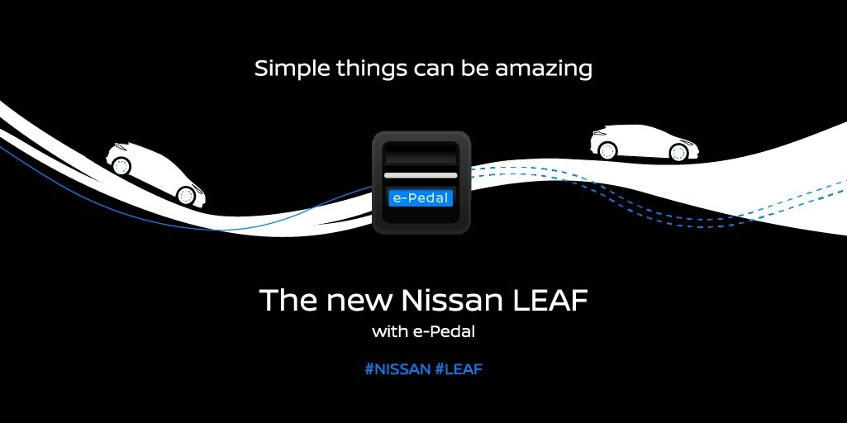
Nissan LEAF
can’t Eliminate Traffic
but
Intelligent Mobility
makes it Tolerable
The Cure for TIC
(Traffic Induced Crazy)

Slide 5

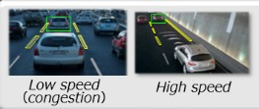


2019 Nissan LEAF Driver Assist Technology
New Technology
Automatic Emergency Braking, Standard all models
Combined L1 & L2 Charge Cable (120V/240V)
Intelligent Around View Monitor & LED Headlights
Apple CarPlay™
& Android Auto™
e-Pedal Mode
Driving with One Pedal is easier, allowing quicker response, with less stress & fatigue
It loves city traffic, making even the worst congestion tolerable.
Accelerate or come to a full stop, even on hills. Holding till traffic resumes
ProPILOT Assist
Next Generation, Driver Assist Technology.
Combines Steering Assist and Intelligent Cruise
Flow with traffic on both Highways & Single-lanes
Perfect for stop & go traffic, or long highway drives
Consumer Electronics Show
Innovation Award Winner
Intelligent Mobility Reduces TIC
(Traffic Induced Crazy)
Notes:
While we’ve shared a lot about EV’s, there are other LEAF features which may equal or exceed all the rest. Intelligent Mobility, is the driver assist technology that truly separates LEAF from the rest of the pack. Already the “World’s Best Selling Electric Vehicle”, Intelligent Mobility allows Nissan to move beyond its goal of zero emissions, to now strive for zero fatalities. LEAF’s driver assist technology, manages mundane tasks, to actually make you a better, safer driver. It even makes Traffic Congestion tolerable (nothing can make it good), easing your driving workload and stress. Many don’t realize just how much effort driving requires, until they experience LEAF. Intuitive features like e-Pedal , Intelligent Cruise and Steering Assist take considerable burden off a driver. This is just one reason, the famed Consumer Electronics Show, which usually focuses of Tech like smartphones and computers named LEAF, with Intelligent Mobility, its Innovation Award Winner.

Slide 6
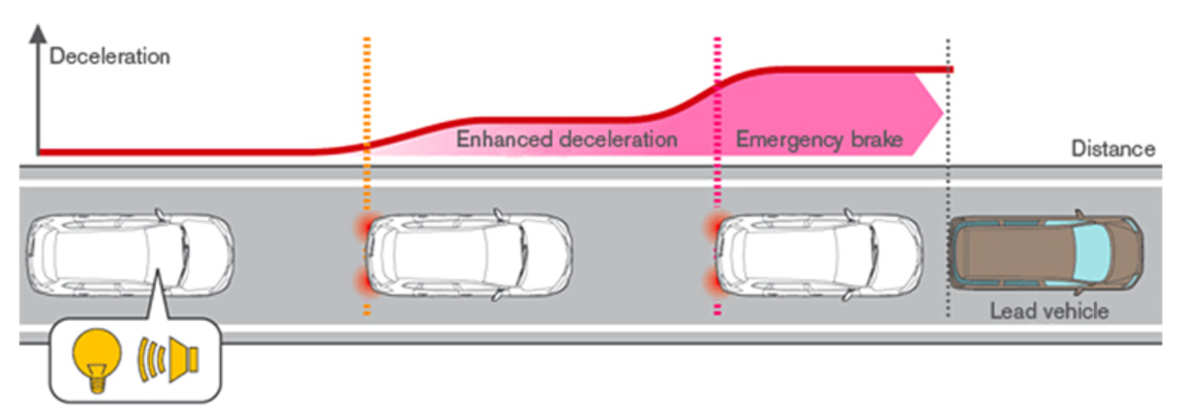
Nissan LEAF
Automatic Emergency Braking
Standard Equipment on all Models
1/3 of all Accidents are Rear-End collisions
Most often by the Distracted, Young Inexperienced or Elderly with diminished reaction times

Slide 7

Nissan Intelligent Mobility
360⁰ Safety Shield Technology
Study by the
Highway Loss Data Institute (HLDI) and Insurance Institute for Highway Safety (IIHS) (April 2019)
Looked at
Crash Avoidance features,
in police reported Crashes, Compared to vehicles without those technologies
Forward Collision Warning
27% Fewer, Front to Rear crashes
Automatic Emergency Braking
56% Fewer, Front to Rear injury crashes
Lane Departure Warning
21% Fewer sideswipes and head-on injury accidents
Blind Spot Detection
23% Fewer Lane Change crashes with injuries
Rear Cross Traffic Automatic Braking
78% Fewer Backing Crashes, (rear camera-parking sensors)
Rear/Around View Cameras
22% Fewer In-Reverse Crashes

Slide 8


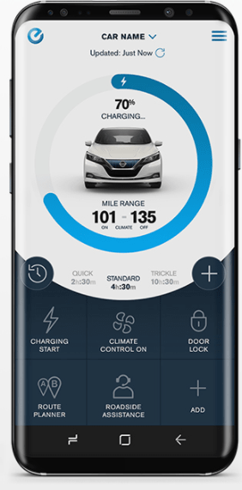
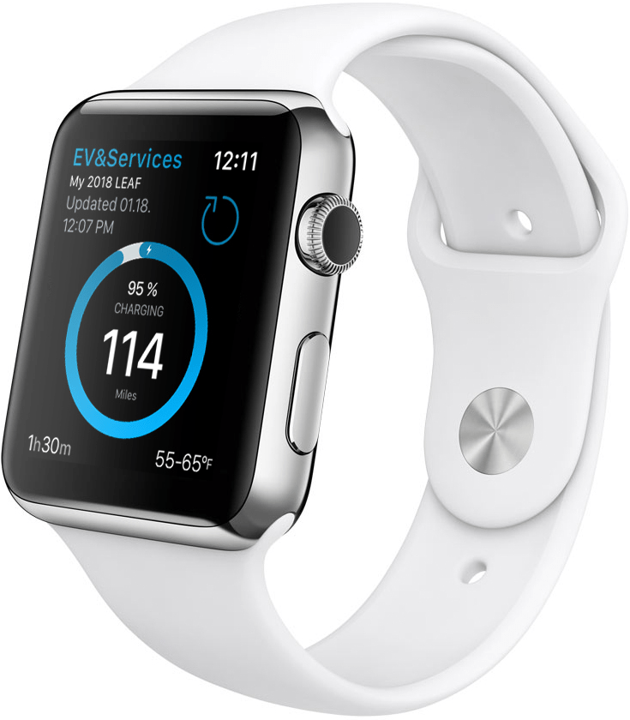
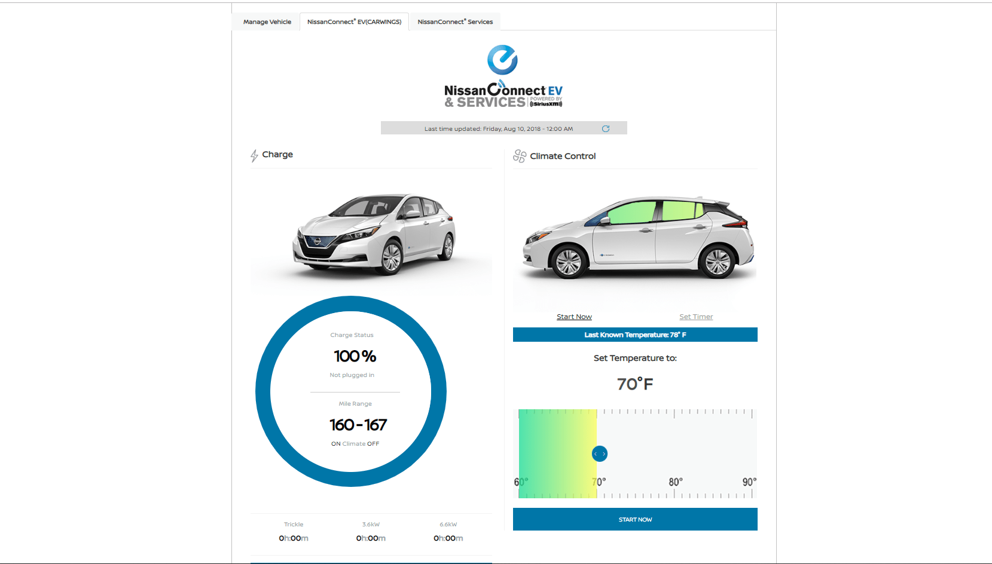

NissanConnect EV
Technology that brings it all together
Control select vehicle functions remotely, and monitor your LEAF, using compatible smart devices.
Smart Wrist
Wearable app
Smart Phone
NissanConnect EV
& Services app
Connected Home
Amazon Alexa and
Google Assistant
Personal Computer
Nissan Owners Portal
Access from Home, Office, or On the Go

Slide 9
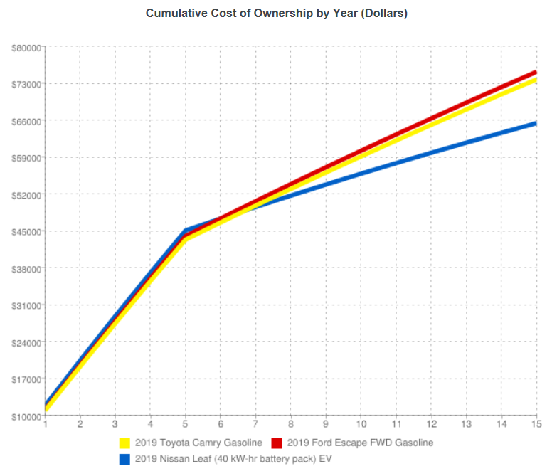
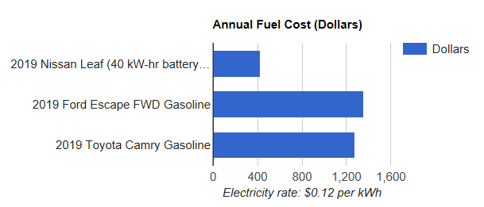
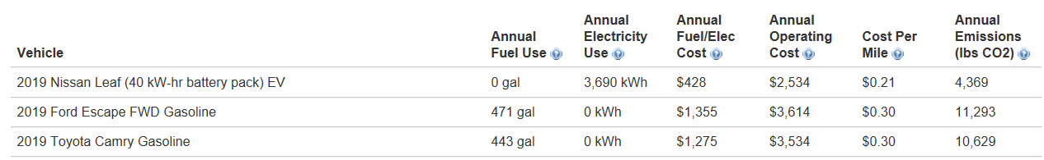
Nissan LEAF simply Costs Less to Own
https://afdc.energy.gov/calc

Slide 10
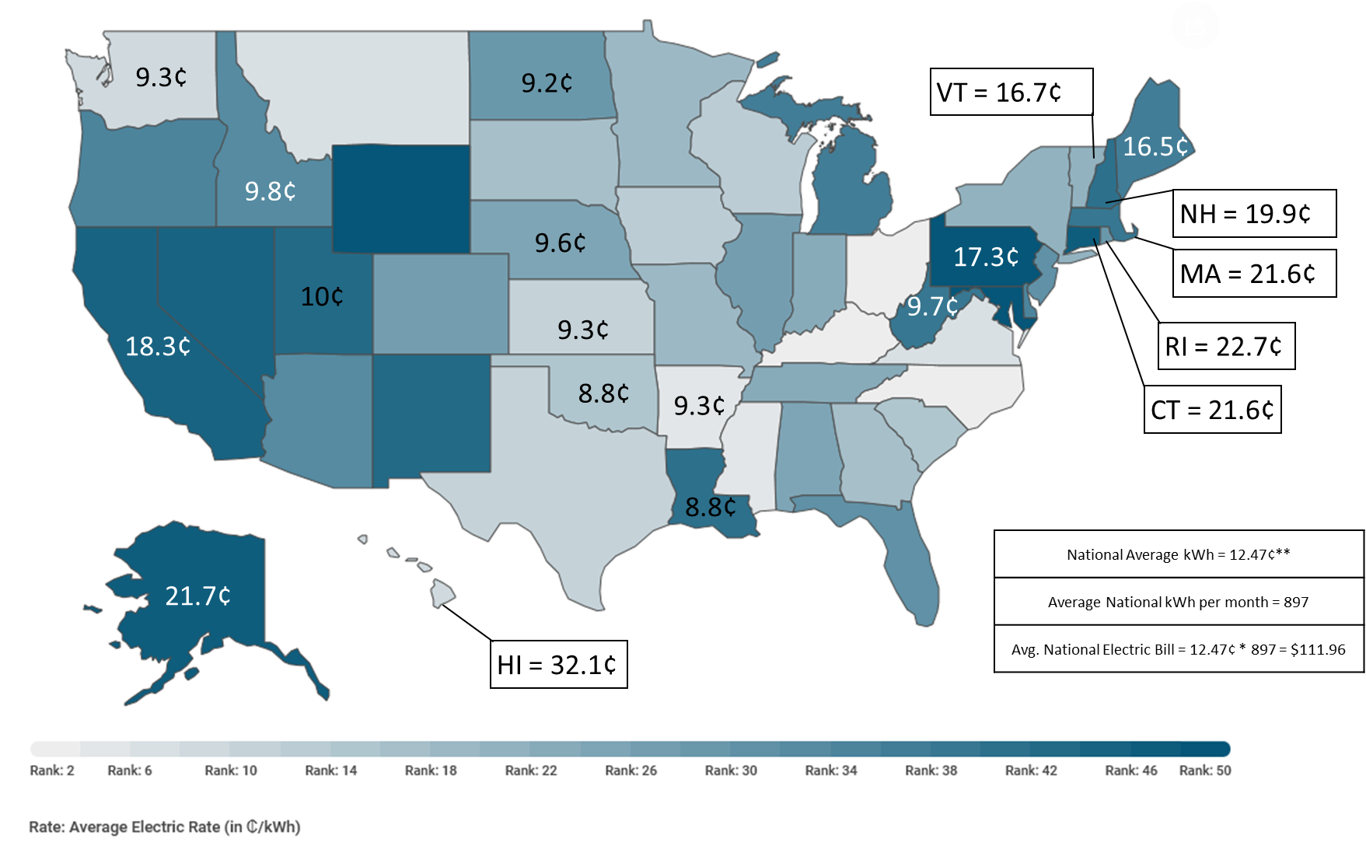
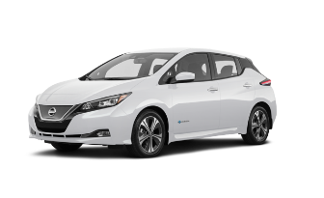
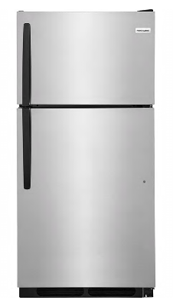

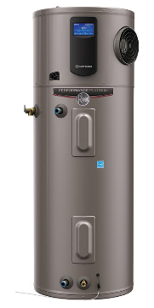


How much does charging a LEAF cost?
Equipment | Avg. Usage Day/Week/Month | Monthly Consumption kWh | Monthly Cost @ 13¢ per kWh***
2019 Nissan LEAF | 30 miles/day* 210 miles/week 840 miles/month | 5.7 kWh/day 40 kWh/week 160 kWh/month** | $20.80
Refrigerator (14 cu.ft. 505-615 Watts) | 12 hours/day 84 hours/week 336 hours/month | 5.8 kWh/day 40.3 kWh/week 161 kWh/month | $20.93
Dehumidifier (500 Watts) | 12 hours/day 84 hours/week 336 hours/month | 6.4 kWh/day 45 kWh/week 180 kWh/month | $23.40
Electric Water Heater (4,500 Watts) | 3 hours/day 21 hours/week 84 hours/month | 14.7 kWh/day 103.8 kWh/week 411 kWh/month | $53.43
42’ Plasma TV (320 Watts) | 5 hours/day 35 hours/week 140 hours/month | 1.6 kWh/day 11.2 kWh/week 44.8 kWh/month | $5.82
100 Watt Light Bulb | 4 hours/day 28 hours/week 112 hours/month | 0.43 kWh/day 3 kWh/week 12 kWh/month | $1.56
https://www.chooseenergy.com/electricity-rates-by-state
About $21 per month
Equal to a second fridge in the basement
*In 2016-2017, the American Driving Survey found that US motorists (on average) spent 51 minutes driving 31.5 miles per day (making 2.2 trips).
**Based on Jason Moore’s last six LEAF charges (at >20% charge) at a free ChargePoint station in Rocky Hill, CT.
***Calculation for cost per month: total kWh per month times average US kWh price. LEAF = 160*0.13¢ = $20.80 per month (on your electric bill)
A kilowatt-hour is 1,000 watts used for one hour. A 100-watt light bulb operating for 10 hours uses one kilowatt-hour.
Reference: https://www9.nationalgridus.com/niagaramohawk/non_html/eff_costappliance.pdf
Notes:
The best part is you get to drive those miles for less! How may enjoy paying 10₵ - 20$₵$ per mile, consuming oil from a foreign country. Wouldn’t we all benefit from using 1₵ - 2₵ of domestically produced, clean electricity? The average driver pays $21 per month, compared to over $200 for gas. Less than half the cost of your electric water heater.
The reality is we’re parked 95% of the time anyway, which is why 80% of LEAF owners charge overnight at home. That makes it perfect for commuters, or fleets whose routes are easily defined. LEAF also loves traffic, consuming very little propulsion power while stuck in congestion. EV’s don’t Idle, so they don’t care how long it takes, only the distance. A 40 minute, 8 mile commute, only costs 8 miles of electricity, even less with regenerative brakes. Not the quarter tank your gas guzzler burns just sitting there.

Slide 11
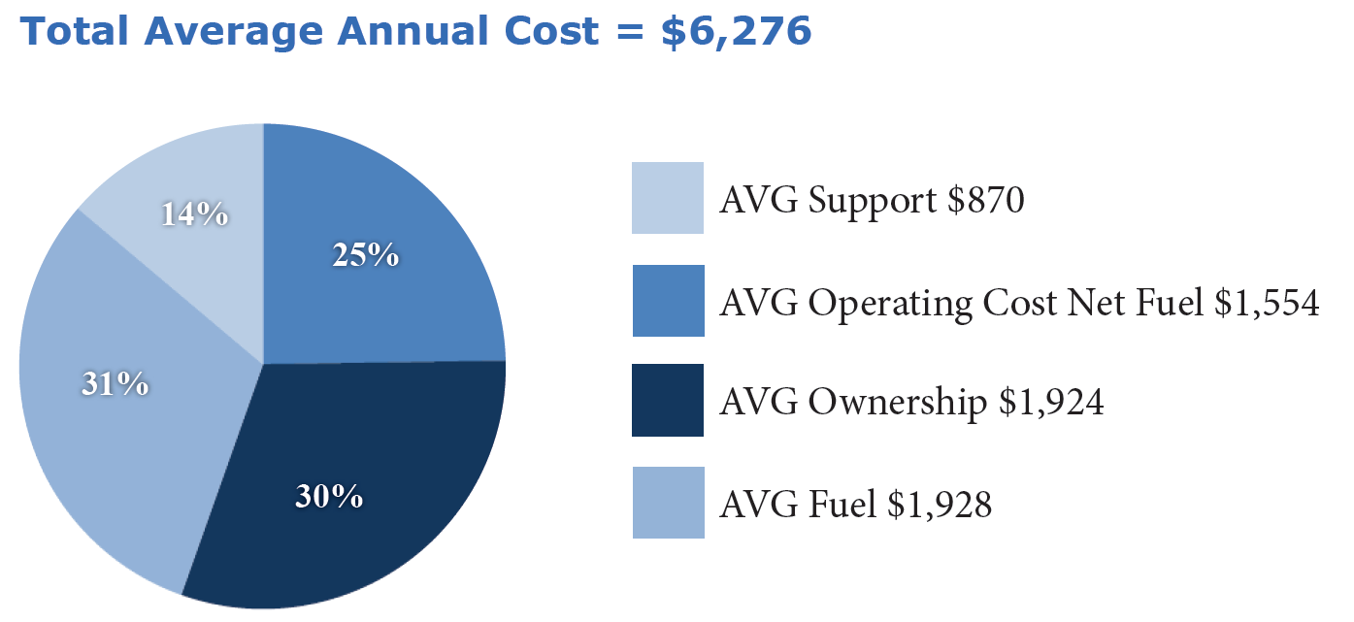

Lowest Fleet Operating Costs
While Reducing CO² Emissions
No Oil Changes or
Check Engine Lights, Ever!

Slide 12
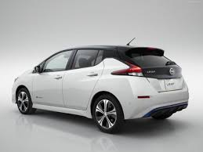

The Era of Practical Electric Vehicles has Arrived
Substantially Lower Operating Costs
No Greenhouse Gases, Zero Emissions
Less Maintenance & Fewer Repairs
Quiet, Comfortable, and Smooth Ride
Spirited Performance & Handling
Great Reliability, with Fewer Parts
Intelligent Mobility, NissanConnect EV
Nissan LEAF
the Range and Utility Commuters and Fleets need

