Slide 1
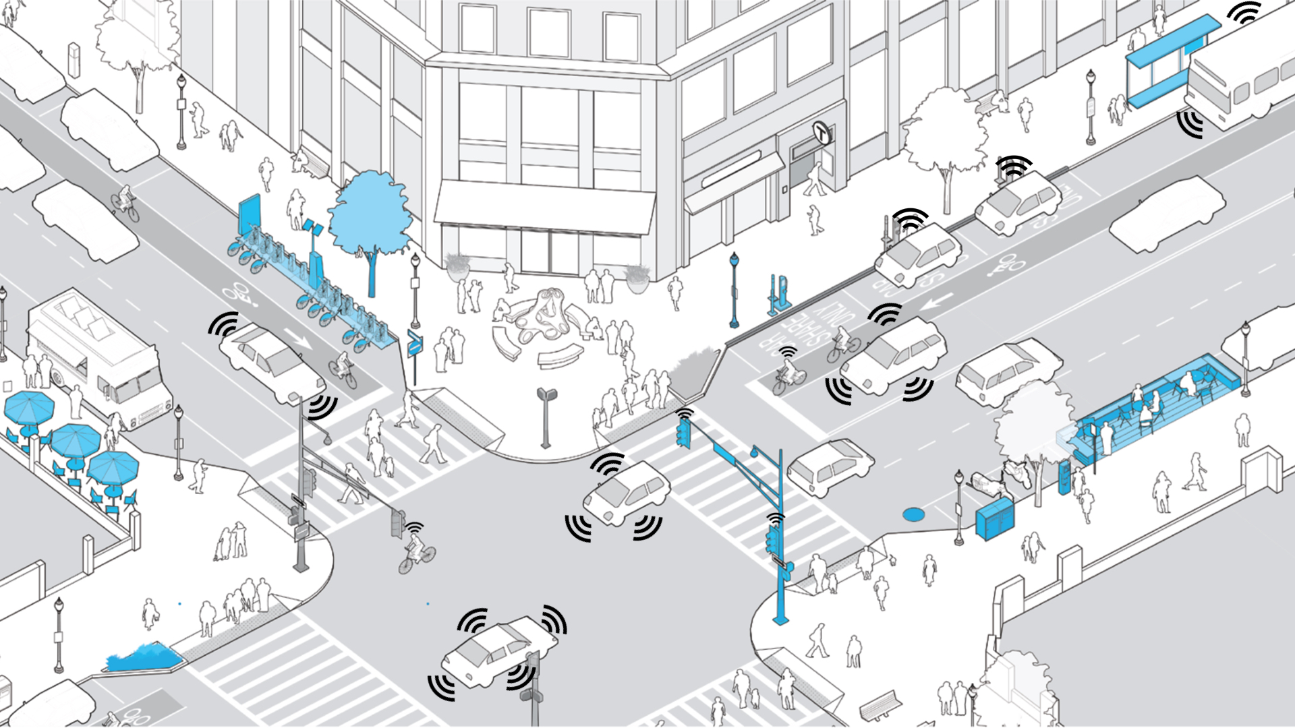
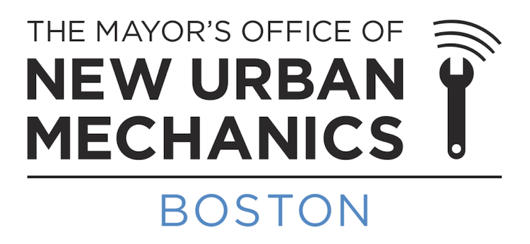
Kris Carter, Co-Chair
Mayor’s Office of New Urban Mechanics
AltWheels 10.2.17

Slide 2
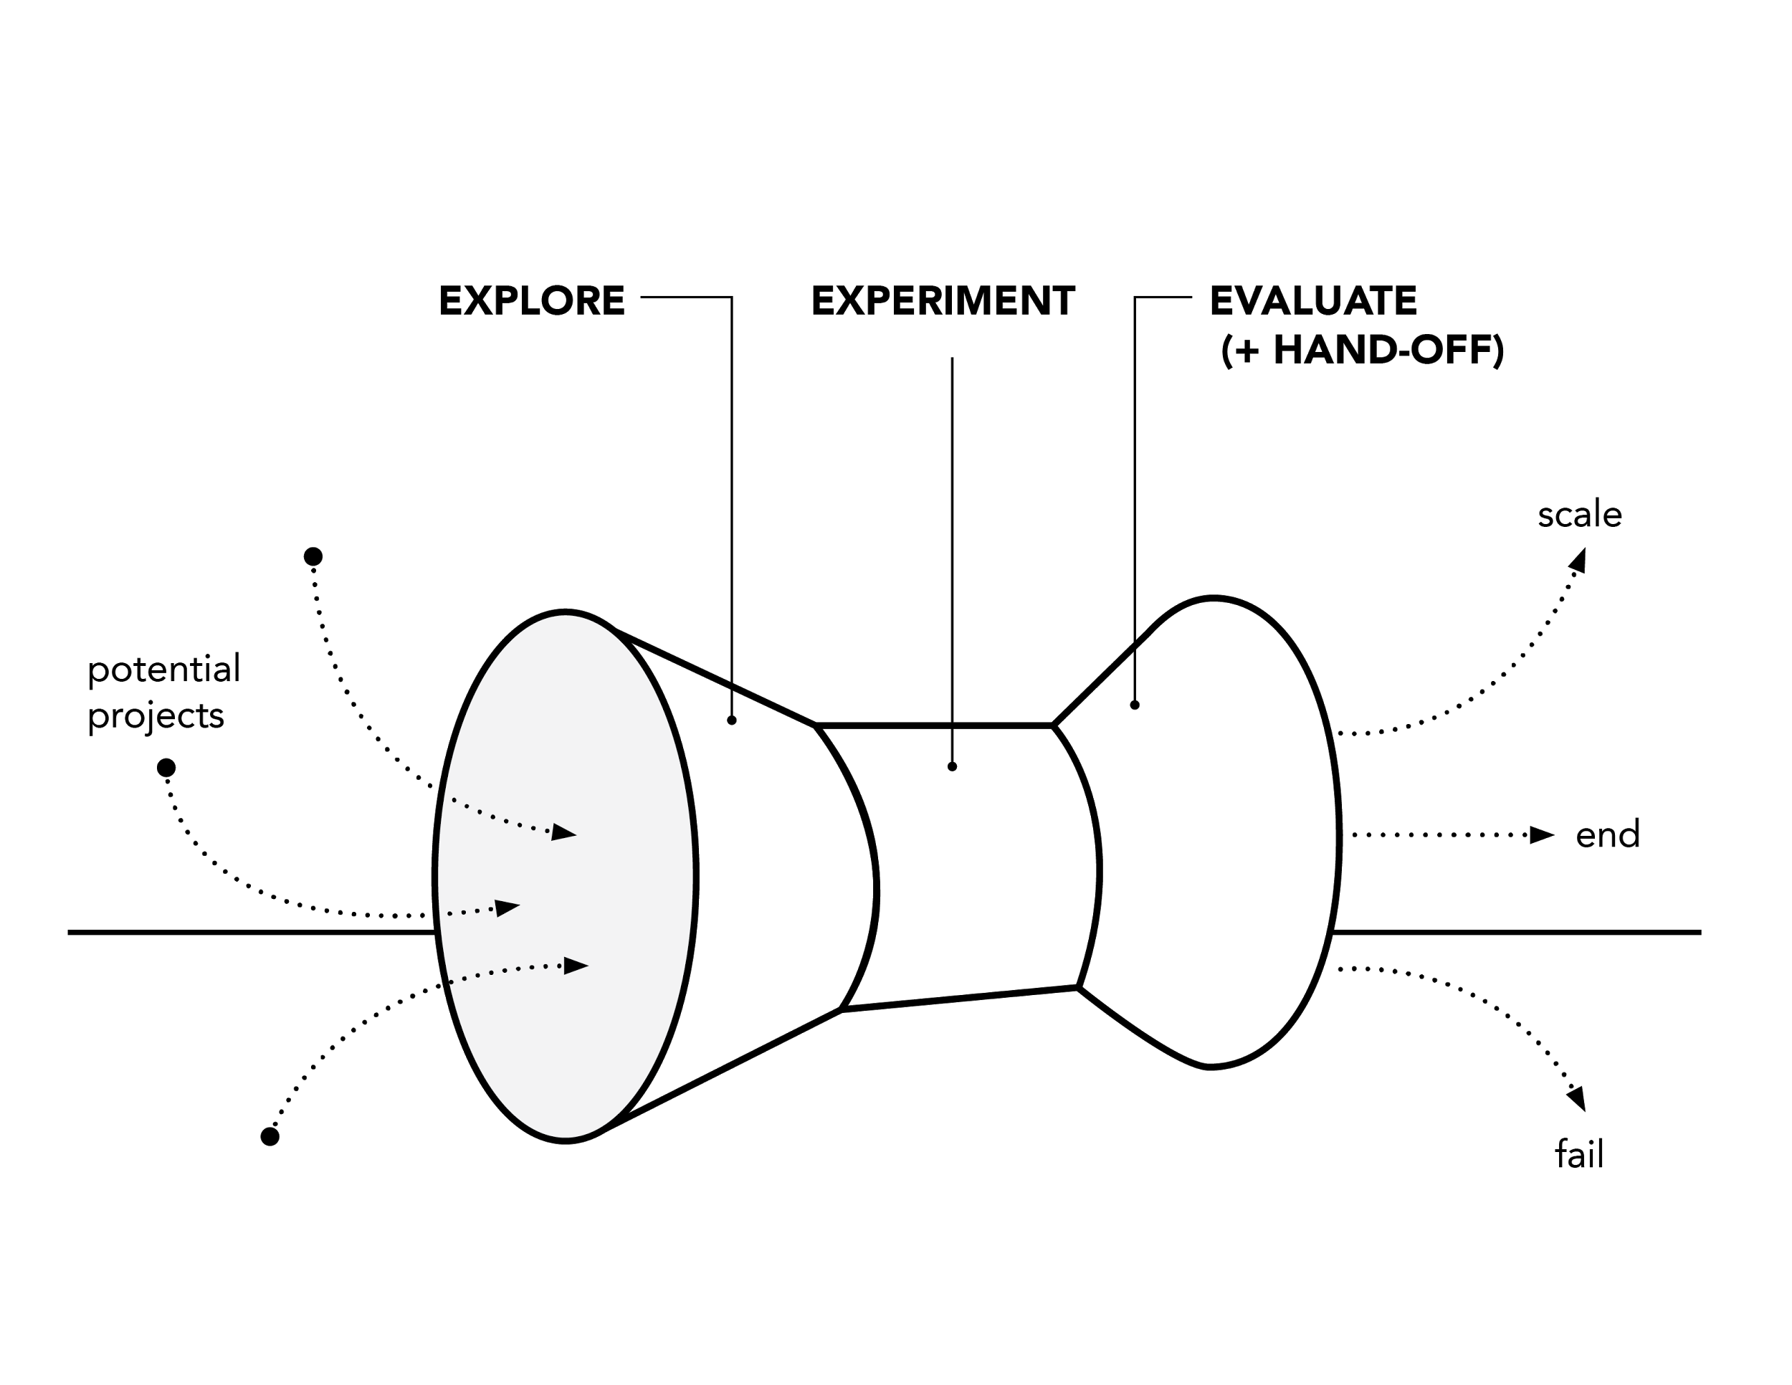
Department of Yes

Slide 3
Boston Context: Two sides of a coin
- Launch the Question Campaign
- Announce Early Action Projects
Thriving economy
Growing inequities
Growing and young population
Limited connections to new jobs
Vision-building Public Forums
Declining GHG emissions
Limited extreme-event preparedness
Release of Go Boston 2030 Vision and Goals Plan
Development of long-term projects and policies
Release of Go Boston 2030 Projects and Policies Plan

Slide 4
Citizen-voiced goals through GoBoston 2030
Access
Make Boston’s neighborhoods interconnected for all modes
Safety
Substantially reduce through design and education
Reliability
Make travel predictable on transit and roadway networks

Slide 5
Citizen-informed vision
How can autonomous vehicles support the goals in GoBoston 2030?
Access
better connections to major transit lines, for those with mobility impairments, and an aging boomer population
Safety
a reduction in human-error caused crashes by 90%
Reliability
connected vehicles could mean better efficiency and more predictable transportation

Slide 6
Three Numbers to Remember
22
24
17.8
Notes:
2015 stats for Boston

Slide 7
Motivation: Safety
Boston
22 4,548
Source: 2016 Boston Vision Zero
Notes:
2015 stats for Boston

Slide 8
Motivation: Safety
2 455
90% reduction
Notes:
2015 stats for Boston

Slide 9
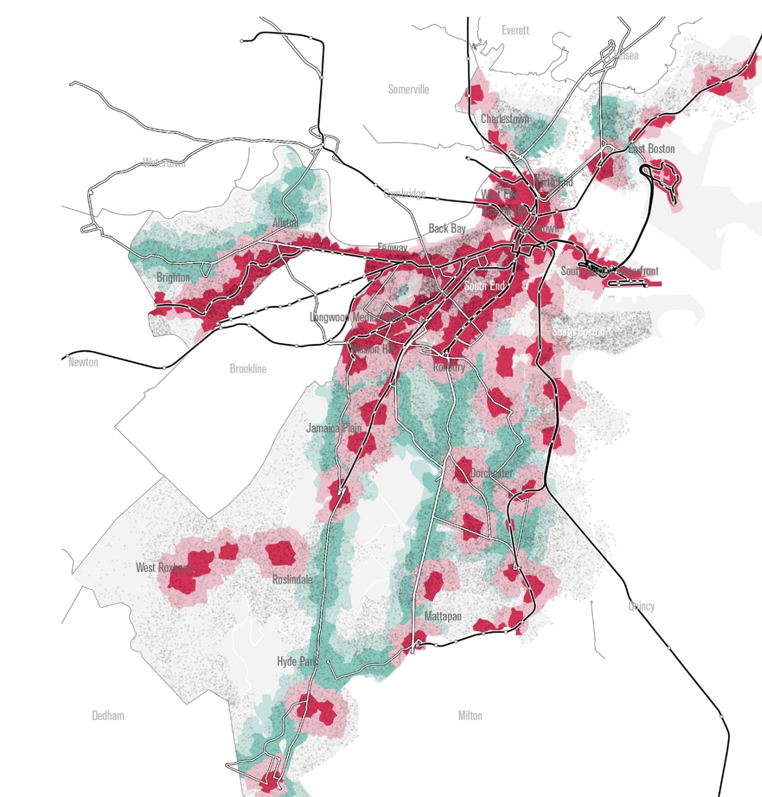
Motivation: Better Access & More Reliable Trips
Many neighborhoods are outside 5 and 10 minute walk sheds along transit corridors.
Average commute is 29 minutes
24% of Mattapan residents have a commute over 60 minutes
Notes:
2015 stats for Boston

Slide 10
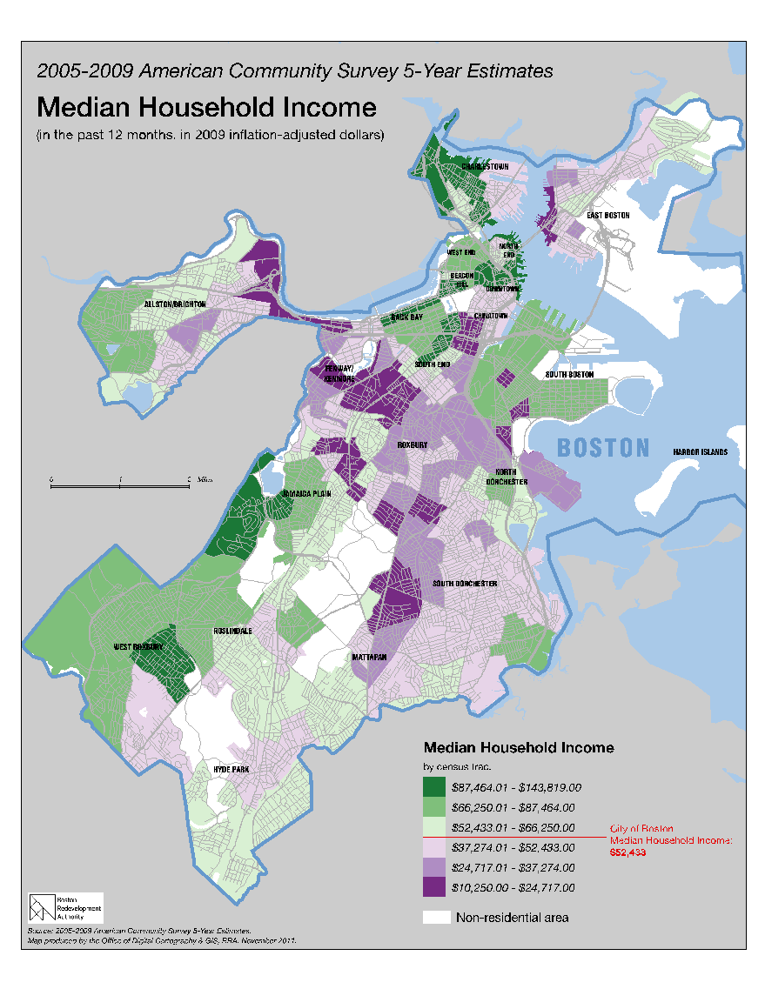
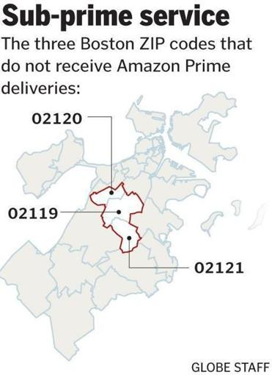
Motivation: Ensuring Equity
Source: Boston Globe
Notes:
Below Median income is in purple. How do we ensure equitable services in a new paradigm. Algorthyms for justice How do we best enable freedom of Choice for people.

Slide 11
If you’re not at the table, you’re on the menu

Slide 12
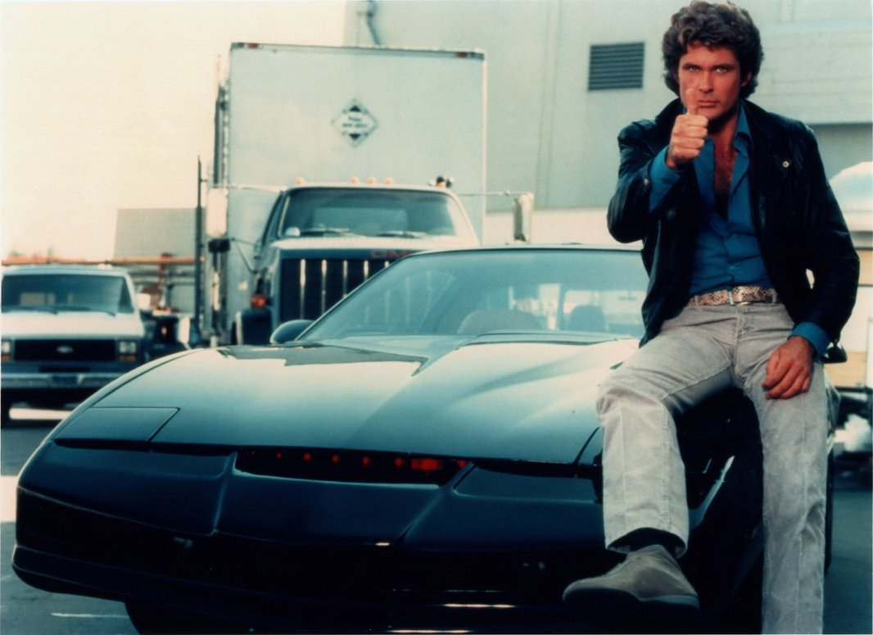
AV TESTING FIVE BUCKETS OF WORK
Vehicle Technology
Infrastructure
Business Models
Governance
Workforce

Slide 13
Let’s Learn by Doing!
Adapt USDOT application to WEF Smart Mobility Focus City project
Optimus Ride approved to test
Over 600 miles of AV testing on Boston streets
Kick-off WEF AV initiative
Sign MOU
with nuTonomy
Jan ‘17
May ‘16
June ‘16
Sept ‘16
Oct ‘16
Nov ‘16
May ‘17
June ‘17
Sept ‘17
Start talks with nuTonomy & Optimus Ride about testing
Issue Executive Orders
nuTonomy
begins testing
in the Ray Flynn Marine Park
Delphi approved to test

Slide 14
Testing Governance: Boston’s Approach
1
2
3
Sign an MOU
Develop a testing plan with the City
Application
to the State

Slide 15
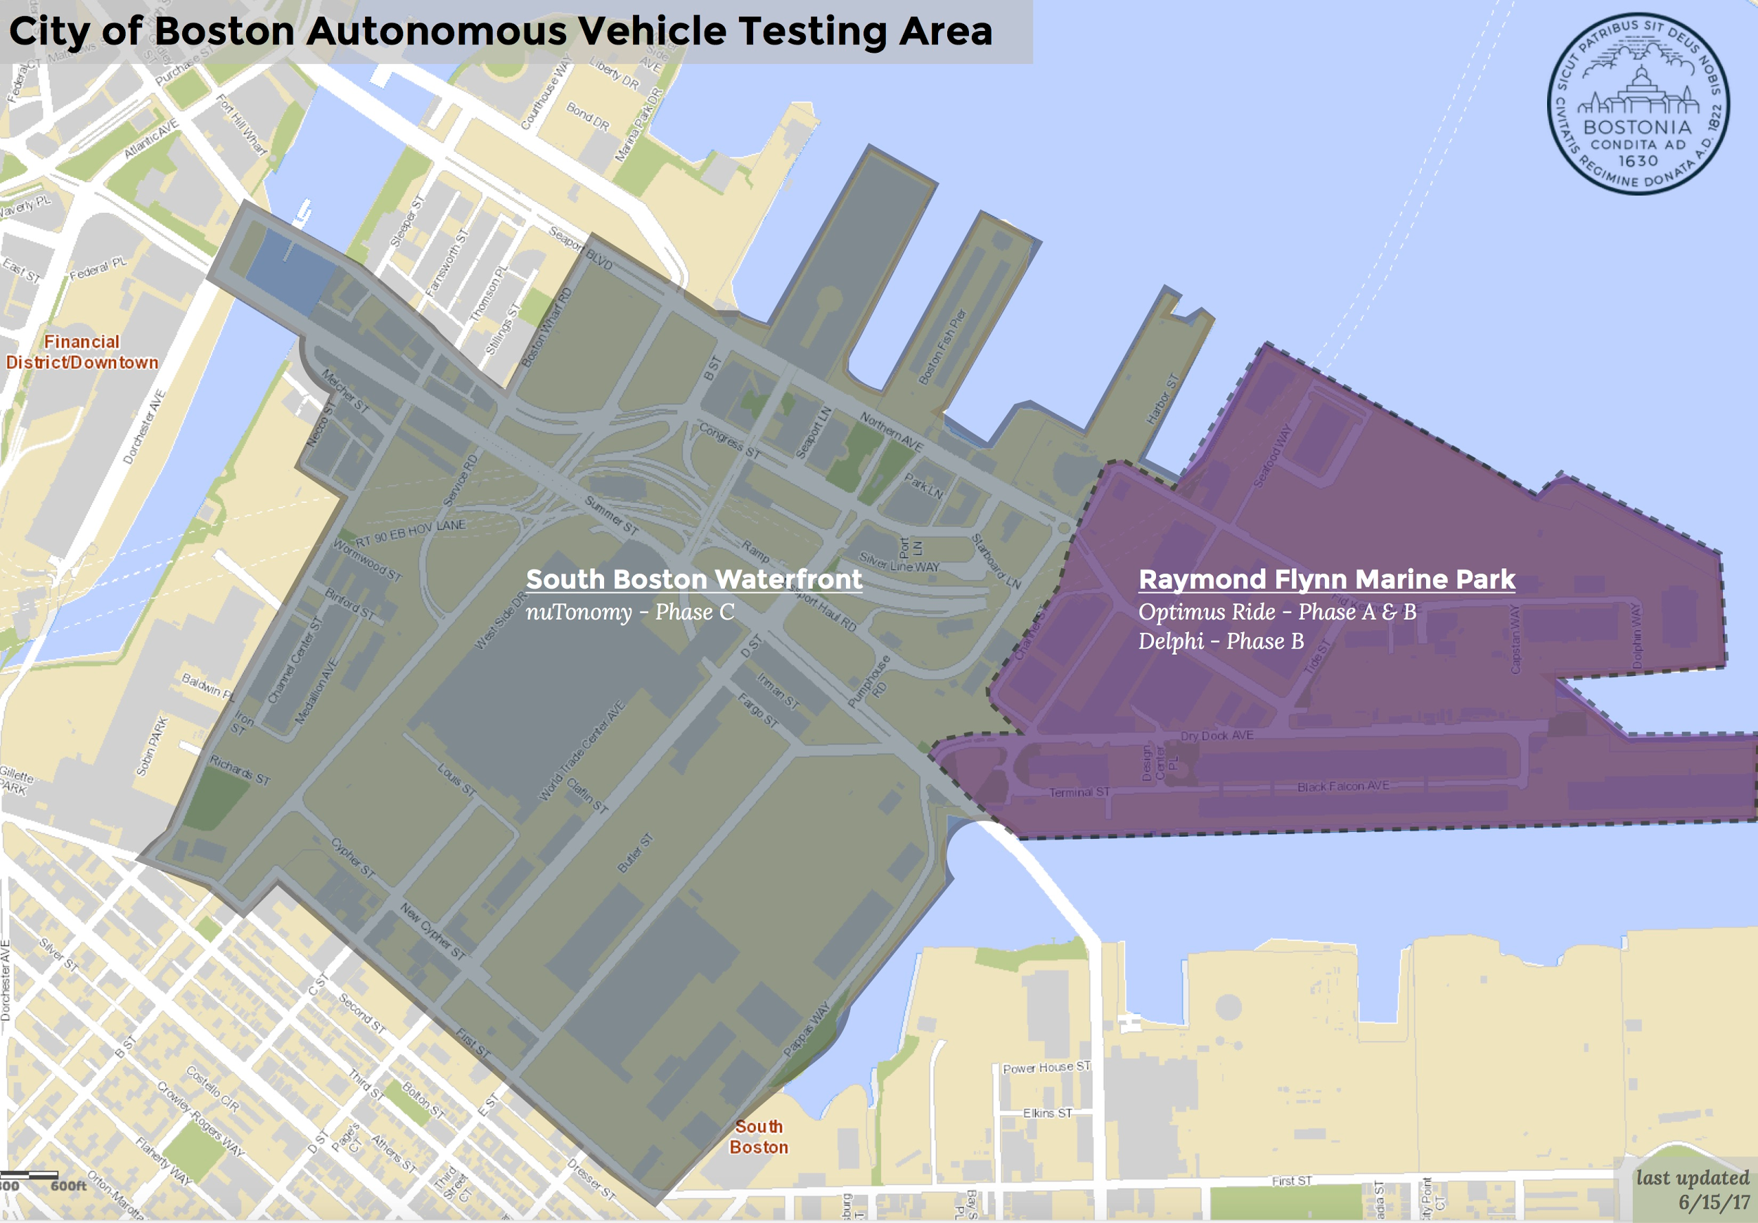
Current Vehicle Testing Locations
Marine Park (191 acres)
no traffic signals
limited traffic
Seaport Area (1,000 acres)
Signalized intersections
Bridges
Left turns
Multi-lane roadways
Pedestrian activity
Bike lanes
Underpasses / Overpasses
Rotaries
On-street parking
Next Step: City-wide testing

Slide 16
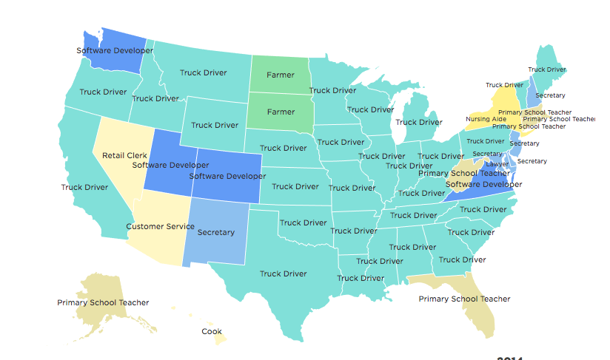
Workforce + Pathways
Source: NPR News | 2014 Census data
Notes:
28 states driver + 1 Insurance claims investigator (AZ)
Funding: user fees, parking, fines, registrations, gas tax

Slide 17
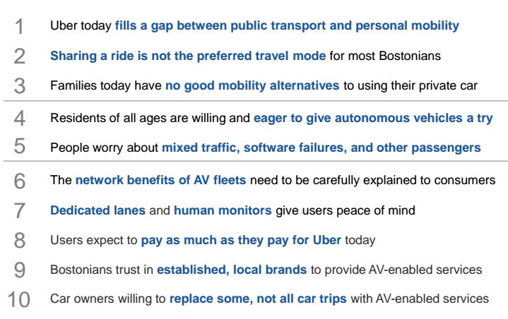
Business models: sharing isn’t easy
source: World Economic Forum; BCG analysis, August 2016

Slide 18
Business models: focus groups
44% of people said the number one reason for having a self-driving car is to not have to park.
source: World Economic Forum; BCG analysis, August 2016

Slide 19
Infrastructure: How do we fund roads in the future?
City of Boston Roadway Projects (FY16):
$45M road reconstruction & bridge maintenance
$9M Resurfacing roadways
$21M in Trasnportation Improvements
Transportation Related Revenue:
$58M in Vehicle Excise Tax payments (FY18)
$61.3M in Parking Fines (FY18)
$16M in Parking Meter Fees (FY18)

Slide 20
Thank you
@Kris_W_Carter
Kristopher.Carter@Boston.gov
Boston.gov/Boston-av

