Slide 1
Hydrogen and Fuel Cells Overview
Pete Devlin, Market Transformation Program Manager – Fuel Cell Technologies Office
AltWheels
October 2, 2017 – Washington, DC

Slide 2



2016 Global Shipments – Trends
Total power (in MW) shipped by application
Total power (in MW) shipped by fuel cell chemistry
Growth in Transportation
Growth in PEMFC
500 MW
62,000
Approximately
$1.6 Billion
fuel cell power shipped worldwide
fuel cell units
shipped worldwide
fuel cell revenue
Source: E4tech
Notes:
We continue to see growth in fuel cell power shipped annually.
Mostly in transportation, and mostly in PEM over the last year.
With 500 MW of fuel cell power shipped worldwide and a $1.6B in fuel cell market revenue
This is a very exiting time for growth of the fuel cell industry!

Slide 3
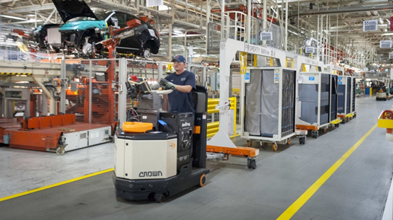
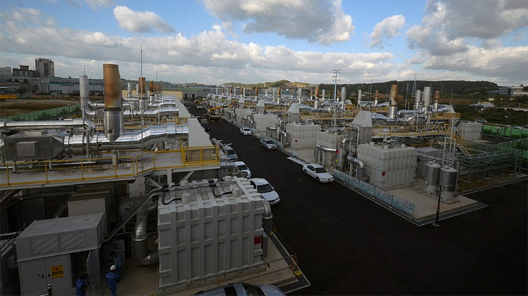
Industry Orders for Fuel Cells on the Rise
More than 7,500 backup power (BU) units
Credit: BMW Manufacturing
More than 16,000 forklifts
Total:
900 BU units
700 forklifts
Credit: Fuel Cell Energy
Supported by prior DOE funds
Supported by industry
Notes:
Our market transformation program cost-shared early fuel cell forklifts and backup power for cell phone towers and now we’re tracking over 20,000 being deployed by industry.
Over 15,000 just for forklifts, with major companies- even Walmart.
Over 6 million H2 fuelings- unheard of just a couple of years ago.
Additional Info:
From the 2017 Record- to be published
- MHE: The successful deployment of more than 700 MHE fuel cell units with U.S. Department of Energy (DOE) funds has led to more than 15,800 MHE fuel cell shipments and units on order with no DOE funding. The 16,518 MHE fuel cell shipments and units on order equate to more than 105,000 kW of fuel cell systems.
- BUP: The successful deployment of more than 900 BuP fuel cell systems with U.S. Department of Energy (DOE) funds has led to more than 7,600 BuP fuel cell shipments and units on order with no DOE funding. The 8,597 BuP fuel cell shipments and units on order equate to almost 43,000 kW of fuel cell systems
Photo source in EERE website: https://energy.gov/eere/success-stories/articles/eere-success-story-one-mans-trash-another-mans-fuel-bmw-plant-converts
http://news.nationalgeographic.com/news/energy/2014/04/140403-fuel-cells-hydrogen-wal-mart-stationary/#/79750.jpg

Slide 4
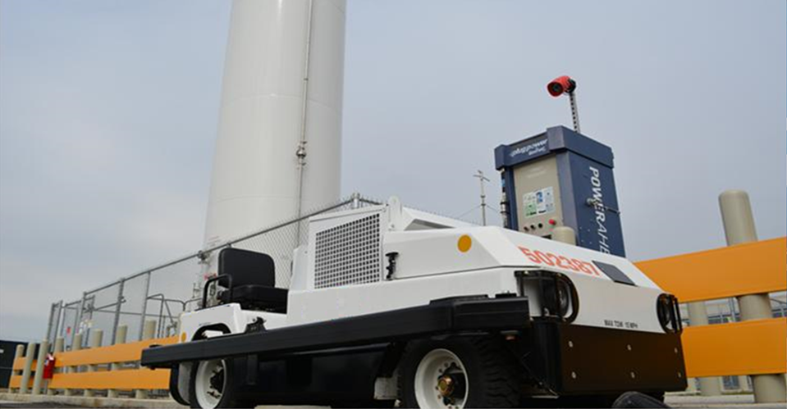
New DOE-Industry Cost Shared Prototypes
New DOE-Industry Cost Shared Prototypes
1st fuel cell cargo tow trucks at U.S. airport
Notes:
Keeping with the airport theme, and back to a DOE example- with FedEx and Plug Power, we have the first fuel cell baggage tow tractor fleet at Memphis airport
Not only can you transport luggage from the plane but what’s most exciting this year-

Slide 5
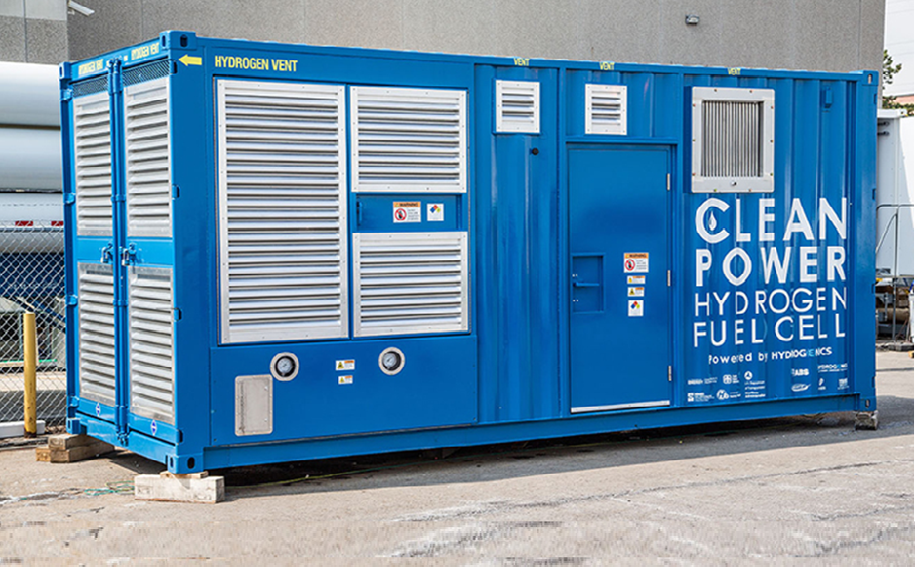
Fuel Cells: New Applications Demonstrated
Fuel Cells: New Applications Demonstrated
World's first fuel cell for maritime ports
Notes:
Shorter TPs:
Air quality is a huge issue at ports and you’ll also get an update on our cost shared project with the Maritime Administration and Sandia- on fuel cells instead of diesel generators at ports- or even onboard ships as APUs.
Additional Info:
Hydrogen fuel cells have a long track record of supplying efficient, clean power for a wide range of applications, including forklifts, emergency backup systems, and vehicles. An analysis by Sandia and DOE showed that due to fluctuating loads in maritime auxiliary power applications, a hydrogen fuel cell, which follows the load, is more energy efficient than a diesel engine. A hydrogen fuel cell only supplies power when it is needed. The Maritime Hydrogen Fuel Cell Project is a demonstration of this analysis in a commercial port setting.
The project began its field trials in August 2015 with a six-month deployment hosted by Young Brothers Ltd., a subsidiary of Foss Maritime Co., at its facility in the Honolulu Harbor. The U.S. Department of Energy’s Fuel Cell Technologies Office and the U.S. Department of Transportation’s Maritime Administration are cofunding the pilot. The pilot hydrogen fuel cell unit will replace a diesel generator currently used to provide power for refrigerated containers on land and on transport barges.
Hydrogenics Corp. designed and manufactured a containerized 100-kilowatt hydrogen fuel cell unit, which includes the fuel cell engine, a hydrogen storage system, and power-conversion equipment. Built into a standard shipping container, the unit has an outward appearance and functionality similar to maritime diesel generators that are currently in use.
As the primary interisland shipper of goods within Hawaii, Young Brothers Ltd. has a strong environmental and financial interest in the project. After initially using the hydrogen fuel cell unit on land, Young Brothers Ltd. will deploy the unit to power refrigerated containers onboard barges traveling between the Honolulu and Kahului harbors.
During the six-month deployment, performance feedback and data will be collected to determine the environmental, energy, and cost savings from the hydrogen fuel cell unit. Sandia will analyze the operational, safety, and cost performance data to develop a business case for using hydrogen fuel cells at other commercial ports. In addition, the safety aspects and feedback from the unit’s design and operation may guide regulators toward formal codes and standards for hydrogen and fuel cells in maritime applications, thereby increasing the likelihood of this clean-energy technology being adopted for maritime use.

Slide 6
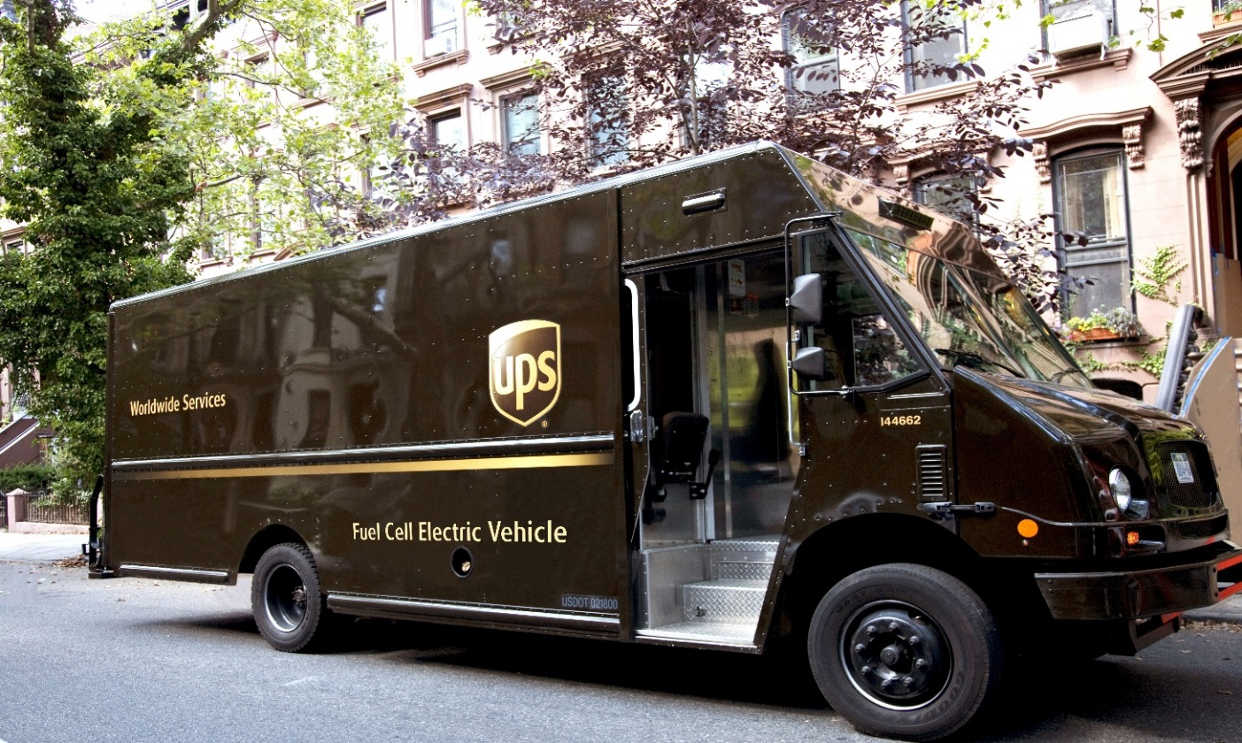
New DOE-Industry Cost Shared Prototypes
New DOE-Industry Cost Shared Prototypes
Fuel Cell Electric Delivery and Parcel Trucks
First of its kind demonstration starting deliveries in the summer!
Notes:
Our UPS and FedEx projects for larger vehicles can potentially double the range compared to BEVs.
Demo trucks will be tested this summer on actual deliveries in Sacramento and Albany.
Additional Information:
UPS Photo: https://www.pressroom.ups.com/pressroom/ContentDetailsViewer.page?ConceptType=PressReleases&id=1493730807330-217
FedEx Photo:
AMR presentation 2016

Slide 7
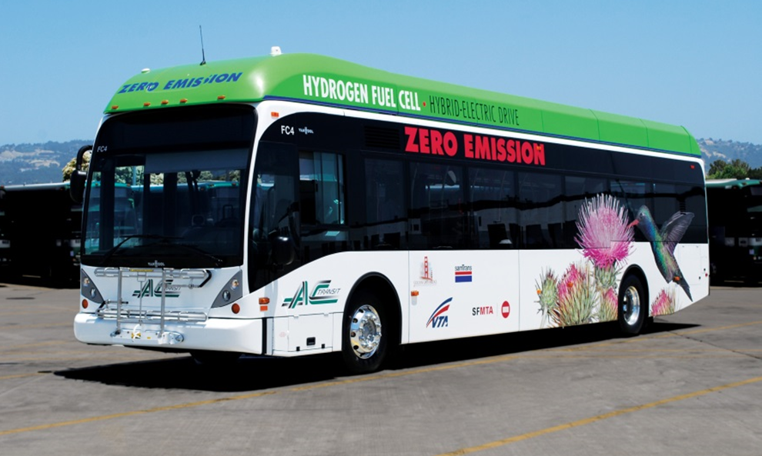
Fuel Cell Buses: Recent Progress
Exceeded DOE-DOT 2016 Durability Target:
Nearly 25,000 hours (June 2017)
Fuel Cells: Big Leaps in the Last Year
Source: AC Transit
By 2017: Served 17 million passengers
Notes:
Short TPs:
Now, in the next few slides I show the extent of commercial progress- these are not just powerpoint products.
Buses in CA have serviced over 17 million passengers and surpassed durability targets. We have about 25 buses in the US but China just placed orders for several hundred.
Long TPs:
Great progress with fuel cells in the mass transportation sector and here is just one example.
Fuel cell buses are now operating and transporting close to 17,000 passengers since they first stated operating and (animation)
have recently exceeded the DOE-DOET durability target reaching nearly 25,000 operation hours (actual number as of May 2017 is ~24,700 hours) for the fuel cell stack.
Additional Info:
From Jamie Levin at CTE on June 2 email:
Cumulative ridership as of this year is 17 million passengers. The increase from last year (15 million cumulative) to this year (17 million cumulative) was 1.99 million.

Slide 8


Fuel Cells: Recent Progress
ZH2: U.S. Army and GM collaboration
First of its kind
Notes:
Shorter TPs:
To top it off, GM and the Army announced its silent militarized fuel cell vehicle which provides power and even drinkable water.
Longer TPs
The U.S. Army will test the Colorado ZH₂ in extreme field conditions next year to determine the viability of hydrogen-powered vehicles on military missions.
GM and the U.S. Army Tank Automotive Research, Development and Engineering Center (TARDEC) collaborated to develop the Colorado ZH₂ from contract to concept in less than a year.
The Army will evaluate the ZH₂ fuel cell for:
Near-silent operation enabling silent watch capability
Reduced acoustic and thermal signatures
High wheel torque at all speeds via electric drive
Low fuel consumption across operating range
Water by-product for field uses
Additional Information:
Source:
http://media.gm.com/media/us/en/gm/home.detail.html/content/Pages/news/us/en/2016/oct/1003-zh2.html
“The military vehicle (ZH2) is not the first one to pack the alternative technology, but it is the first one to be seriously considered as an official battlefield adoption.” USBPort 4-3-17 (http://theusbport.com/u-s-army-will-use-the-zh2-a-hydrogen-fuel-cell-truck-by-gm/26743)

Slide 9
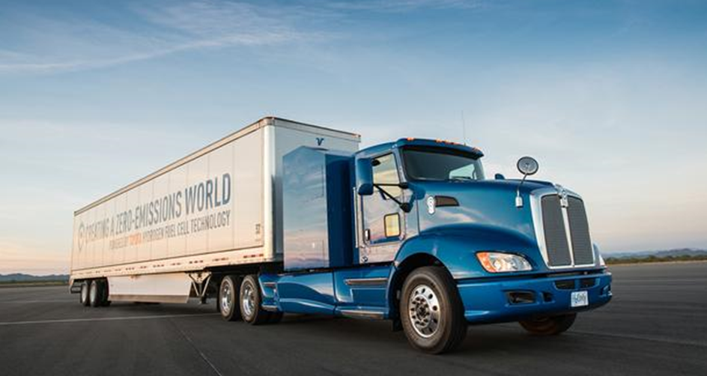
Fuel Cells: Heavy Duty Trucks
Industry demonstrates first heavy duty truck
Notes:
Shorter TPs:
Speaking of heavy duty vehicles, major press by Toyota last month showed its fuel cell drayage truck for marine ports, for 80,000 lbs capacities and 200 mile range and of course completely zero pollutants and quiet performance.
Additional Info:
Early this month, Toyota revealed plans to test “Project Portal” – a fully functioning heavy duty truck prototype with the power and torque capacity to conduct port drayage operations while emitting nothing but water vapor. Announced at a press conference with Port officials and representatives from California Air Resources Board (CARB) and the California Energy Commission (CEC), the zero-emission truck proof of concept will be tested between the ports of Los Angeles and Long Beach and various freight depots up to 70 miles demonstrating the potential of fuel cell technology in heavy duty applications. The study will begin this summer and is the next step in Toyota’s effort to broaden the application of zero-emission fuel cell technology that can serve a range of industries. If the prototype truck proves commercially viable, Toyota could become the first major automaker to enter the fuel cell market for Class 8 vehicles
Fuel Cell Stack Power Output
670 HP (500 kW), 2 fuel cell stacks
Torque
1,325 pounds- feet
Weight Capacity
80,000 lbs
Range
200 miles per fill, under normal drayage operation
H₂ Tank**
700 bar, 4 tanks, 40 kg of H₂ total

Slide 10




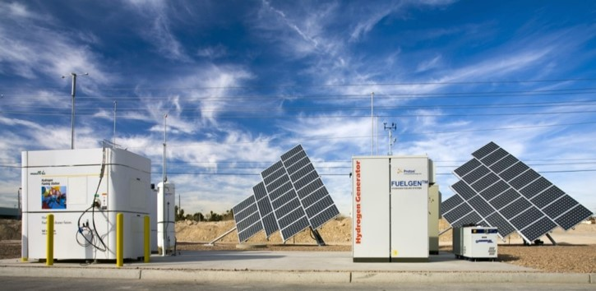
Stationary Fuel Cells- Opportunities Emerging
More than 235MW installed across the US
8,000 back up power units deployed or on order
Photo credit. Time.com
Notes:
We are tracking close to 8,000 backup power units being deployed or on order and over 235MW installed in fuel cell stationary power across the U.S.
Opportunities emerging for stationary fuel cell power:
Data centers require non-stop electrical power
Reliable power is vital at hospitals
New World Trade Center using fuel cells
Supermarkets- growing interest for reliable power

Slide 11







2017 Preliminary Jobs Analysis Updates
2017 Preliminary Jobs Analysis Updates
Approx. 16,000 jobs today
in the fuel cell car sector in the U.S.
Source: DOE, U.S. Energy and Employment Report (2017)
Over
200,000
potential jobs
in the future with fuel cell cars in the U.S.
Includes Direct and Indirect Jobs in
Manufacturing
Distribution and Sales
Approx.
Approx.
100,000
jobs
150,000
jobs
Multiple industries (manufacturing; professional services; wholesale, retail, transportation; etc. )
60% in industrial central region
50% in Western and Northeast (highest fuel cell car sales regions)
Multiple occupations available including retail sales, vehicle operators, supervisors of sales, mechanics, etc.
Source: Preliminary DOE ANL Employment Study, June 2017, updates underway
Notes:
Not only cars are here but they are also creating jobs.
Our study shows 16,000 jobs in the US already due to fuel cell cars.
And our preliminary jobs analysis (currently undergoing updates) shows the potential for over 200,000 jobs across manufacturing, distribution and sales.
Additional Information:
Projections based on 2050 timeframe– we say future as 2050 might sound way too distant.
Projections under “multimarket scenario” which assumes 75% of all cars and 80% of all light duty trucks are assembled in the U.S.
Market penetration projections are dependent on region but in general an average 20-30% market share of cars and LT sales, is assumed. Breakdown by area:
-For Car sales: 35% for Western and ZEV/Northeast states, and 16% for the rest of the US
- For Light trucks sales: ~32% for the West, ~28% for the east and 8% for the rest of the US
-
In Core Multi Market Scenario ~100,000 gross supply-chain jobs are associated with FCEV manufacturing in 2050.
Most manufacturing jobs are in Central Industrial region where existing motor vehicle supply chains are concentrated.
Manufacturing jobs are not only in manufacturing industries.
Most manufacturing industry jobs are in Central Industrial region, where existing motor vehicle supply chains are concentrated.
Top occupations benefiting from FCEV manufacturing are assemblers/fabricators and metal/plastic workers.
~70% of supply-chain manufacturing jobs are in other industries.
In Core Multi market Scenario ~150,000 gross supply-chain jobs associated with FCEV distribution & sales,
64% of supply-chain jobs associated with FCEV MDS are in distribution and sales industries.
Retail sales is top occupation.
Sales/distribution jobs concentrated in regions with highest FCEV sales.

Slide 12
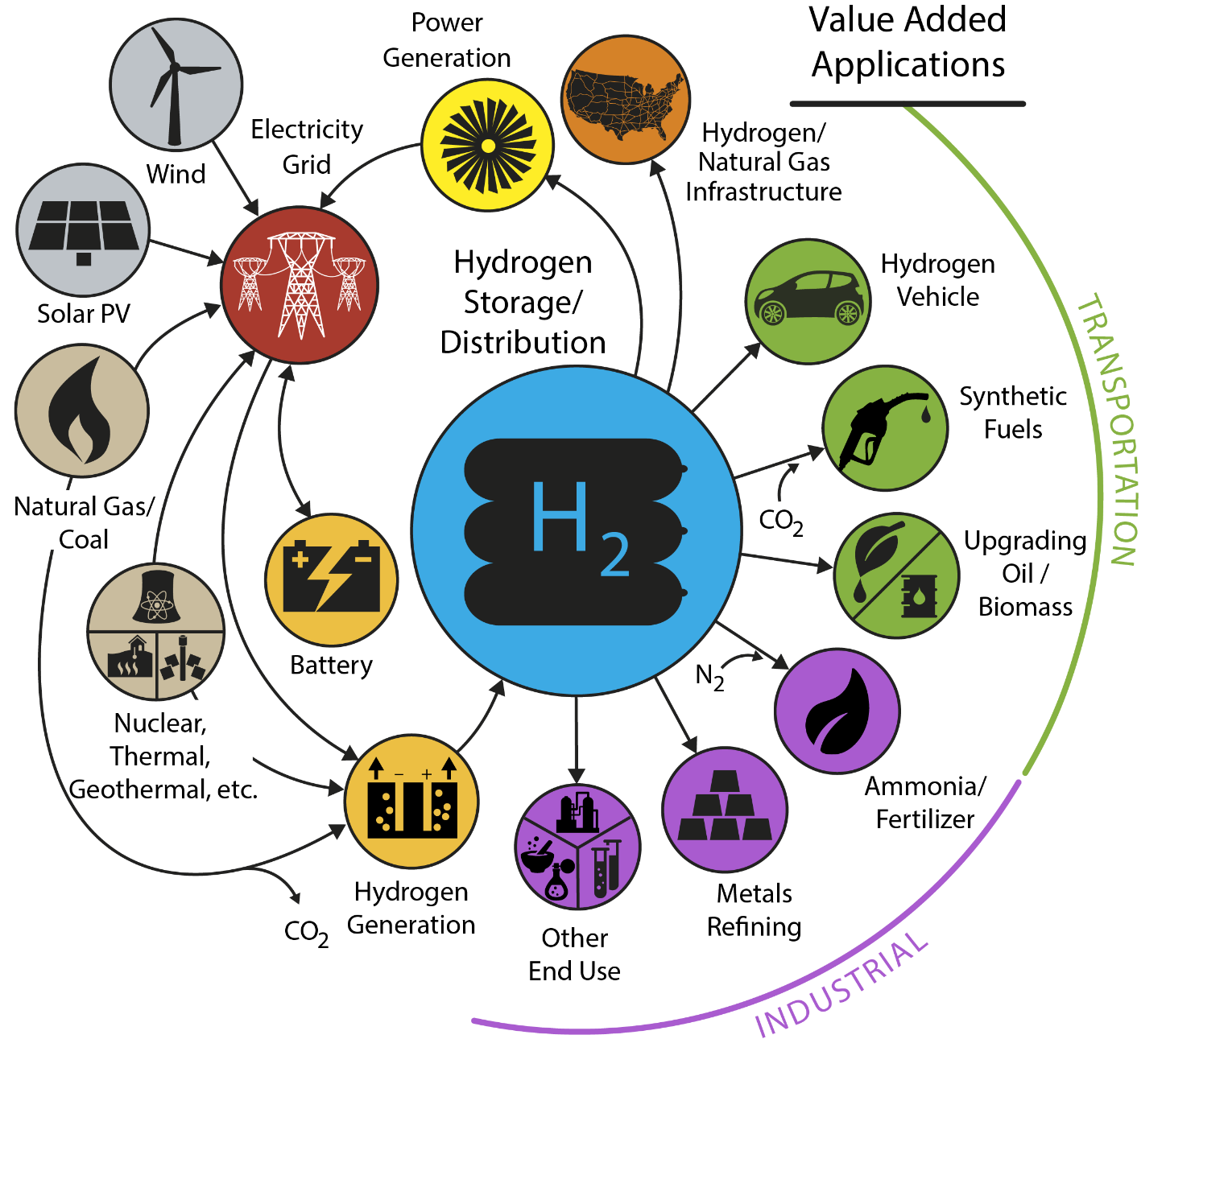
H2@Scale Energy System
*Illustrative example, not comprehensive
Adapted from NREL, Lab Big Idea Team
Notes:
Which, as a reminder shows, shows unique ways that hydrogen can couple and decouple from the grid and across multiple sectors.
Today if you look at energy storage using batteries, there are limited options- you only go from electrons to electrons.
If you can produce H2 at low cost, you open up cross sector possibilities, and can avoid curtailing renewables, you can feed back to the grid if needed and can actually enable battery electric vehicles, inject into pipelines, use H2 for liquid fuels or transportation, and it opens up many options for the industrial sector, even using nuclear plants that are being taken offline due to increased renewables.

Slide 13
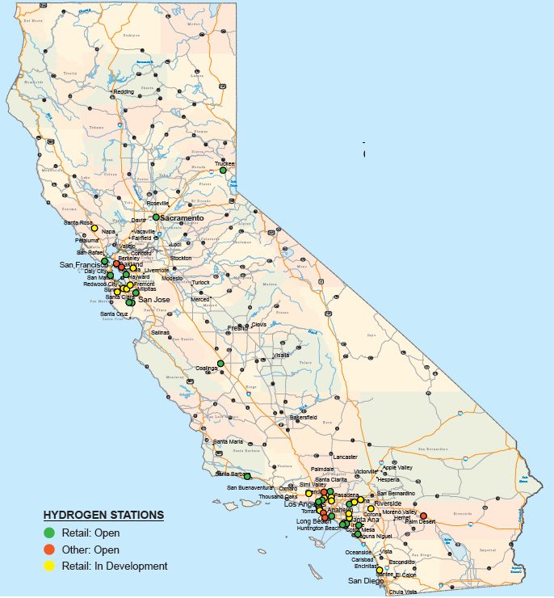
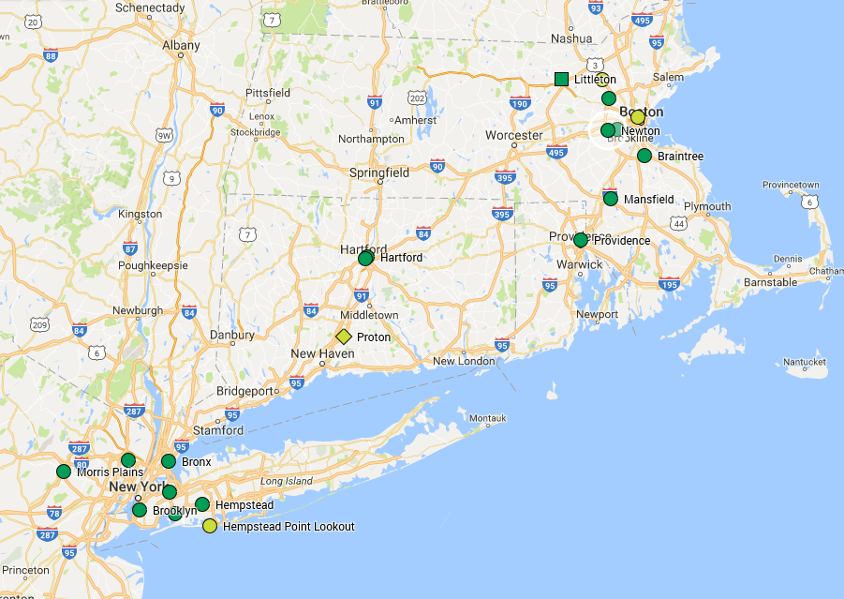

Hydrogen refueling stations: strong State support
California
Over 30 open retail
Funding for 100
Open - Retail
Open Non-Retail
In Progress
Hub
Northeast
Approx. 12 to 25 stations planned
Others with interest: Hawaii, Ohio, Texas, Colorado, South Carolina, and others
Notes:
There’s also been progress on stations. 31 retail stations in CA- many coming in the Northeast with private funding.

Slide 14

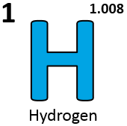
Take part in it!
Celebrate National Hydrogen & Fuel Cell Day on 10/8 (Held on its very own atomic- weight-day)
Learn more: energy.gov/eere/fuelcells
Notes:
ONE RECENT HIGHLIGHT THAT I’D LIKE TO SHARE WITH YOU IS: THE FIRST EVER NATIONAL HYDROGEN AND FUEL CELL DAY (HELD ON ITS VERY OWN ATOMIC-WEIGHT-DAY) WHICH HAD HUNDREDS OF EVENTS, PRESS RELEASES AND SOCIAL MEDIA ACTIVITIES ACROSS THE NATION WITH AN ESTIMATED REACH OF MORE THAN A QUARTER MILLION.
IN ADDITION TO PUBLIC EDUCATION ABOUT HYDROGEN AND FUEL CELLS, THOUSANDS OF PEOPLE ARE NOW AWARE OF THAT THE ATOMIC MASS OF THE SIMPLEST AND MOST ABUNDANT ELEMENT IN THE UNIVERSE IS 1.008!

Slide 15
Thank You
Pete Devlin
Market Transformation Program Manager
Fuel Cell Technologies Office
Peter.Devlin@ee.doe.gov
energy.gov/eere/fuelcells

