Slide 1


Aggregated Alternative Technology Alliance
Fleets for the Future: Innovative Procurement Strategies to Reduce Cost Through
Aggregated Demand
AltWheels Fleet Day
October 2, 2017
Norwood, MA
Sarah Reed
National Association of Regional Councils

Slide 2

National Association of Regional Councils
Membership organization in Washington, DC
Members include: councils of government, metropolitan planning organizations (MPOs), planning commissions, other regional entities
Work on a wide range of issues such as: transportation, aging, housing, brownfields, etc.
MAPC is a member

Slide 3
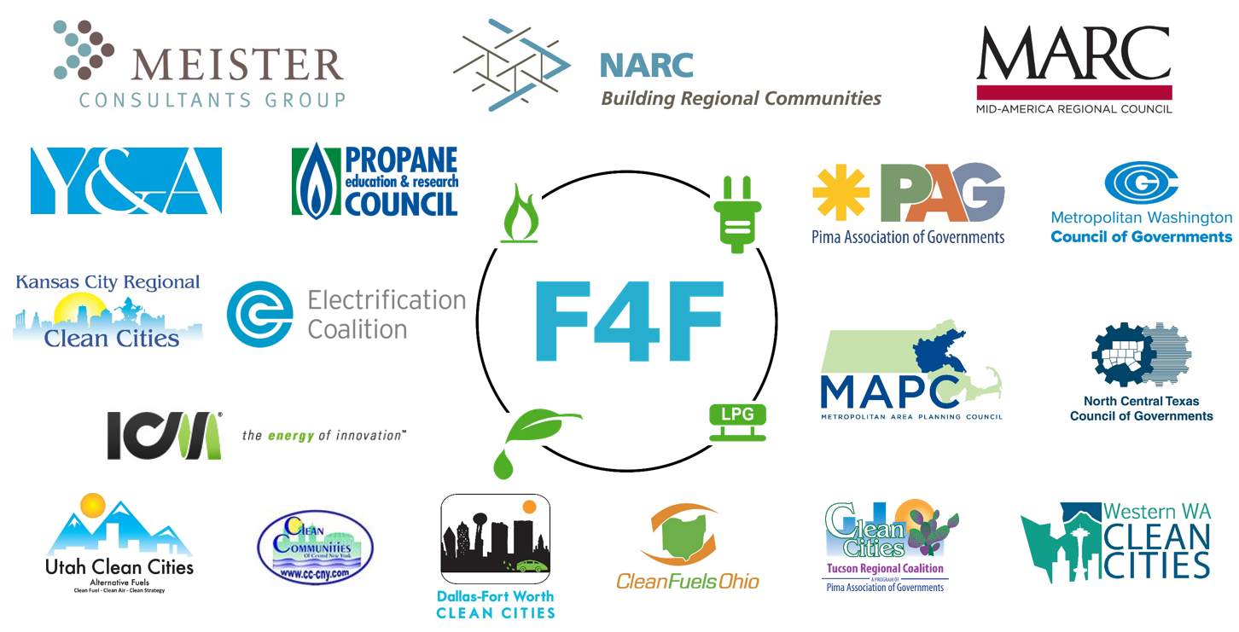
F4F Partners

Slide 4

F4F Goals
Aggregate demand for propane, electric, and CNG vehicles and infrastructure
Reduce the cost for fleets
Develop resources
Catalog lessons learned
Notes:
Reduce the cost for fleets using cooperative procurement to obtain competitive pricing
Develop resources to guide participating fleets through procurement implementation
Catalog lessons learned to enable future cooperative procurement initiatives

Slide 5
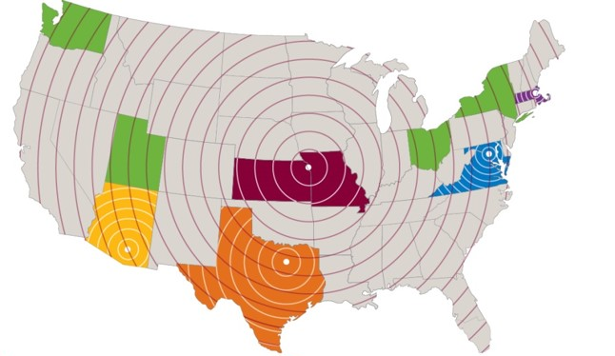
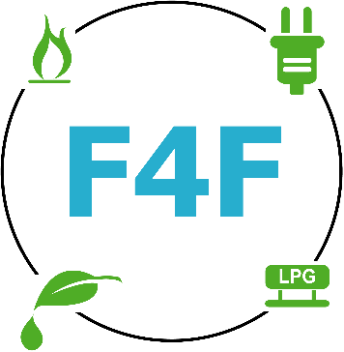

F4F – Project Design
Collective buying power
  Surveys indicate that across our 5 regions 10,000+ vehicles need replacement in next 3 years.
Fuel-agnostic approach
  We deploy a broad array of clean fuels: EVs, CNG vehicles, LPG vehicles, and FFVs.
Step-by-step guidance and education
  We wrote procurement best practices, timelines, and checklists to enable fleet managers to plan and optimize alt fuel usage across their fleets.

Slide 6
Two parallel efforts under F4F
National procurement
Selected an established buying cooperative to pilot test these concepts
Any public fleet in the country can join
Partners: National Joint Powers Alliance
Regional procurements
Local RPCs and COGs develop their own contracts, tailored to regional stakeholder input
Procurements mainly open to local public fleets
Partners: MARC, NCTCOG, MAPC, MWCOG, PAG

Slide 7

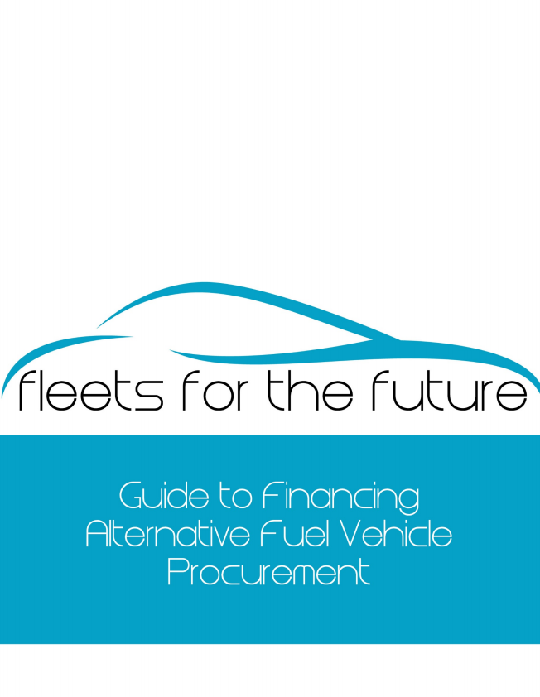
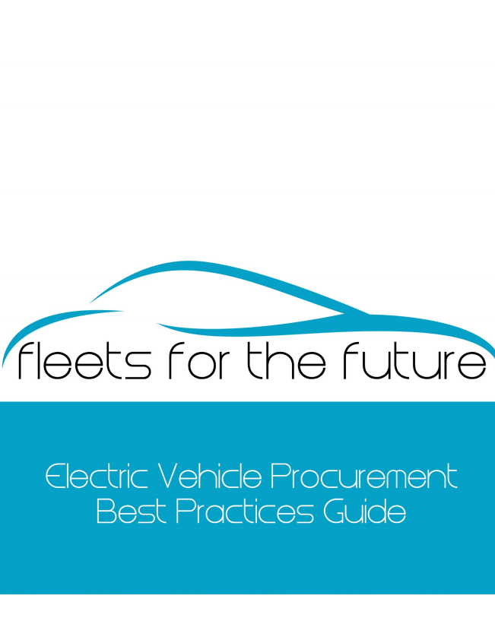

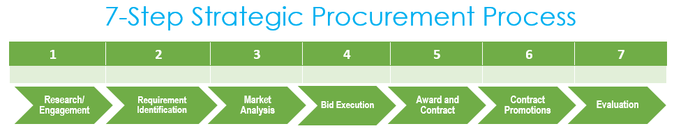
For more details on how to buy AFVs…
Notes:
Find these on our website

Slide 8

Public National Procurement Partner: NJPA
National Joint Powers Alliance
A government agency, governed by a publicly elected board of directors (M.S.123A.21)
NJPA facilitates a 12-step competitive solicitation and contract award process nationally
Membership
  State and local government agencies
  Public and private education
  Other tax exempt organizations
Notes:
National public fleet procurement
F4F has found a great partner in NJPA. They use aggregation power from across the country to chose the best bids for you and help us reach our objectives by offering extremely competitive prices. We are working with them to go beyond their current scope to continue to help us reach our goals.

Slide 9

What does NJPA offer?
Industry–leading vehicle vendors offering alternative fuel options
  OEM offerings
  Turn key units
  Alternative Fuel upfitting
  Standard upfitting
  EVSE
Competitively awarded Leasing options
  National Cooperative Leasing
Notes:
Have a leasing partner for any leasing needs

Slide 10


Value of NJPA Membership
Membership is at no cost, no obligation and no liability
Choose from over 200 contracts
Streamline the purchasing process
Save time and money by bypassing the bidding process
NO NEED TO DUPLICATE THE PROCESS
Notes:
My key point here is that NJPA takes out the time and effort of evaluating and awarding bids and has extremely competitive pricing and that we are working with them to continue to offer new and innovative options and deals.
nationally leveraged and competitively solicited purchasing contracts

Slide 11



























Vendors available through NJPA

Slide 12





NJPA - Electric Vehicle Supply Equipment
Network solutions
Charging station solutions
Maintenance and Installation
Turn-Key Solution
Available on a rolling basis

Slide 13
NJPA – October Opportunities
National Auto Fleet Group
  6 alternative fuel vehicles
  Extremely competitive pricing
Zenith Motors
  3 fully electric vehicles
  Bulk discounts

Slide 14
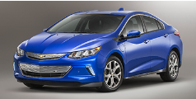

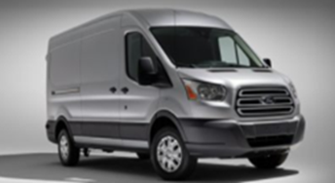
NJPA - National Auto Fleet Group
October Offerings (Oct. 1-31, 2017):
2018 Chevrolet Volt
2019 Ford Police Responder Hybrid Sedan
2018 Ford Transit Van T-150 *
2018 Ford F-150 XL 2WD *
2018 Ford F-150 XL 2WD Supercab *
2018 Ford F-150 XL 2WD Supercrew *
* Includes GGE System

Slide 15
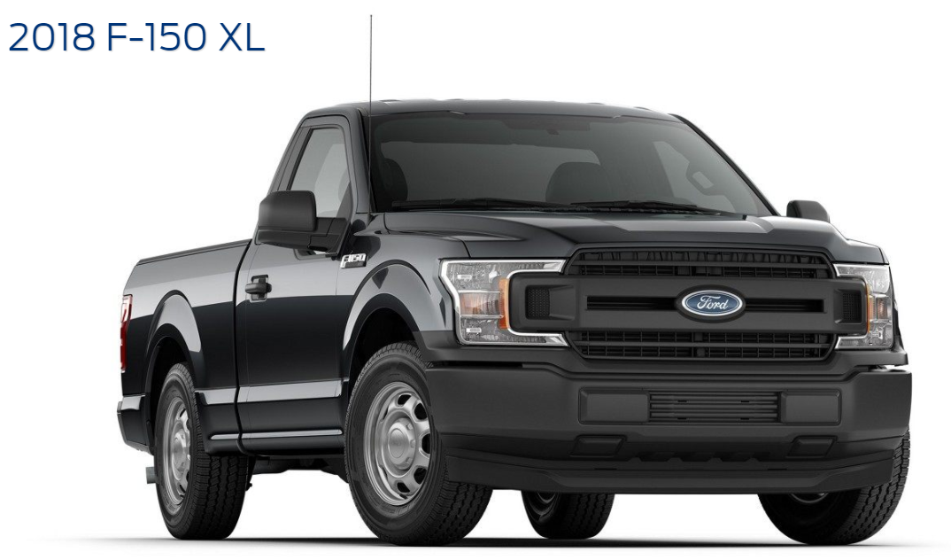

NJPA - National Auto Fleet Group
October Offerings (Oct. 1-31, 2017):
2018 Chevrolet Volt
2019 Ford Police Responder Hybrid Sedan
2018 Ford Transit Van T-150 *
2018 Ford F-150 XL 2WD *
2018 Ford F-150 XL 2WD Supercab *
2018 Ford F-150 XL 2WD Supercrew *
* Includes GGE System
Notes:
21 gas gallon equivalent CNG upfit system

Slide 16
NAFG October Opportunities Pricing Grid
Make/Model | Year | MSRP | NJPA Price
Chevrolet Volt | 2018 | $33,220.00 | $33,200.84
Ford Police Responder Hybrid Sedan | 2019 | $35,420.00 | $35,011.99
Ford F-150 XL | 2018 | $43,855.00 | $38,640.00
Ford F-150 XL Supercab | 2018 | $48,140.00 | $39,905.00
Ford F-150 XL Supercrew | 2018 | $50,905.00 | $42,761.00
Ford Transit Van T-150 | 2018 | $46,055.00 | $38,850.92

Slide 17

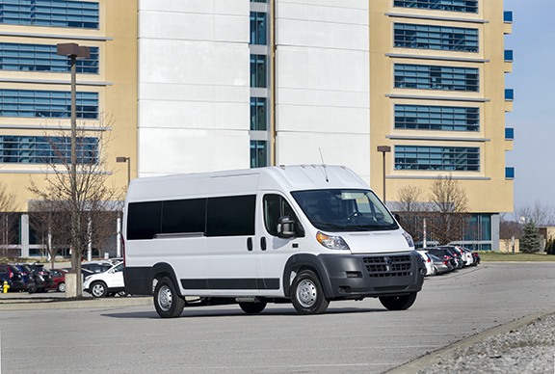
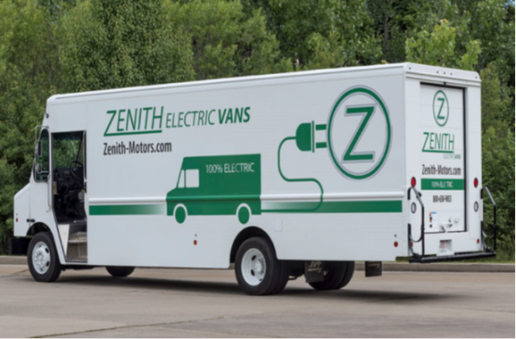
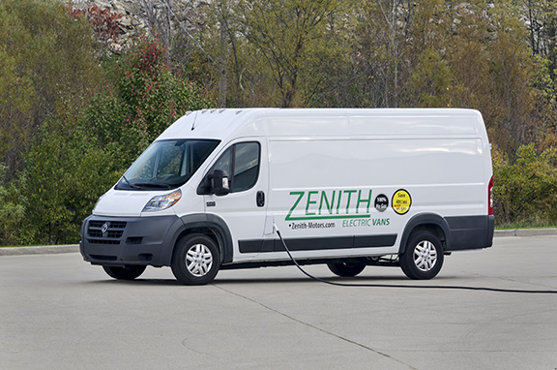
Zenith Electric: Product Line
Passenger Van
Step Van
100% Electric
Available October 1-31, 2017
Bulk Discount- Up to 7% off NJPA Prices
Cargo Van

Slide 18
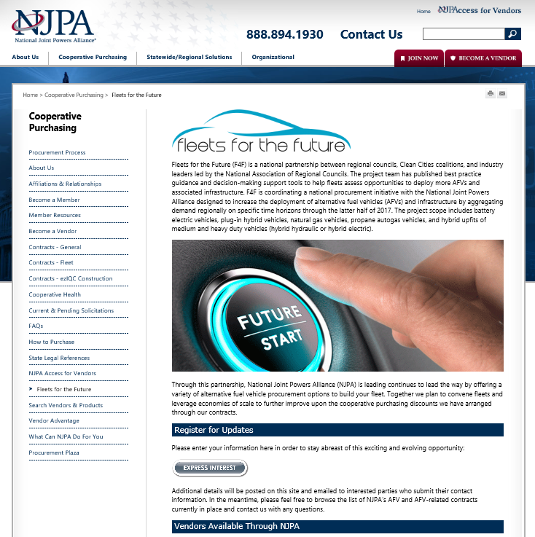
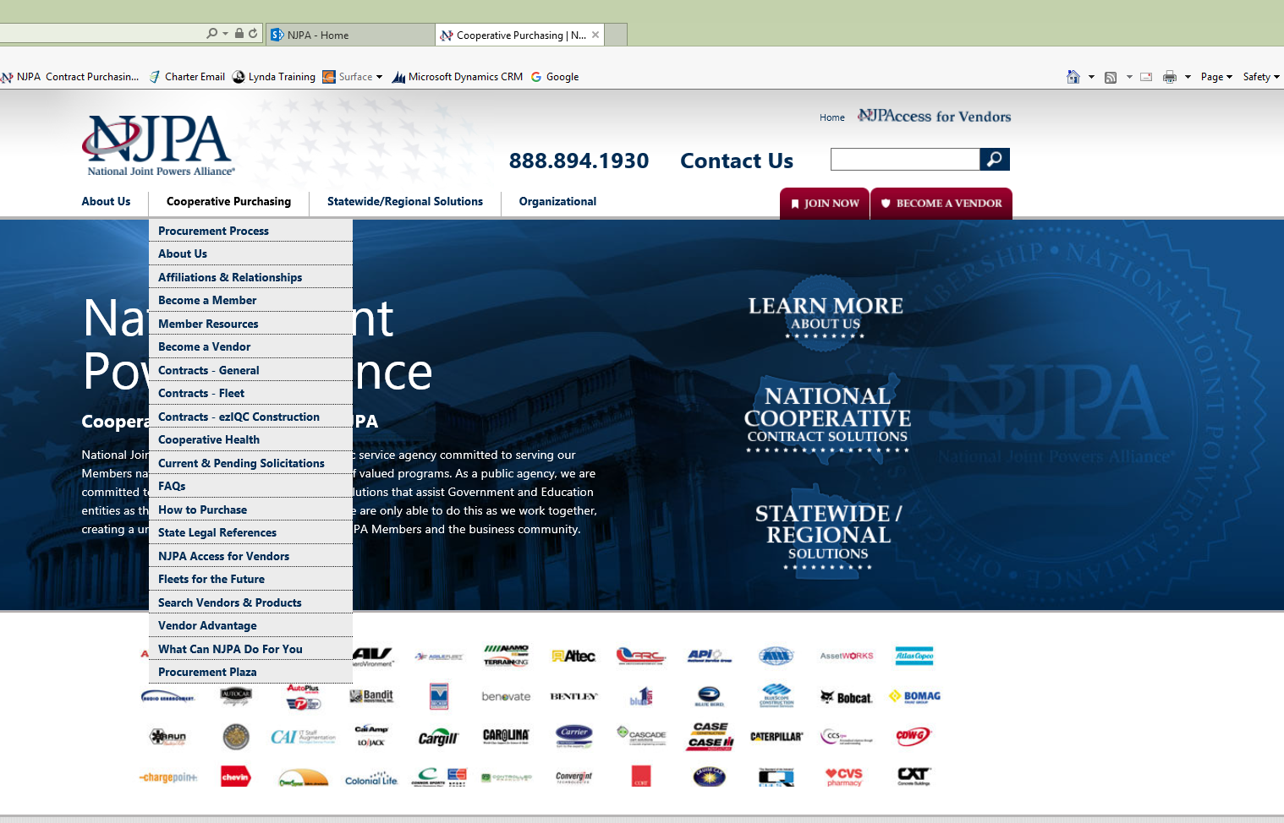
How to Participate
Notes:
This page will have a grid and spec information

Slide 19
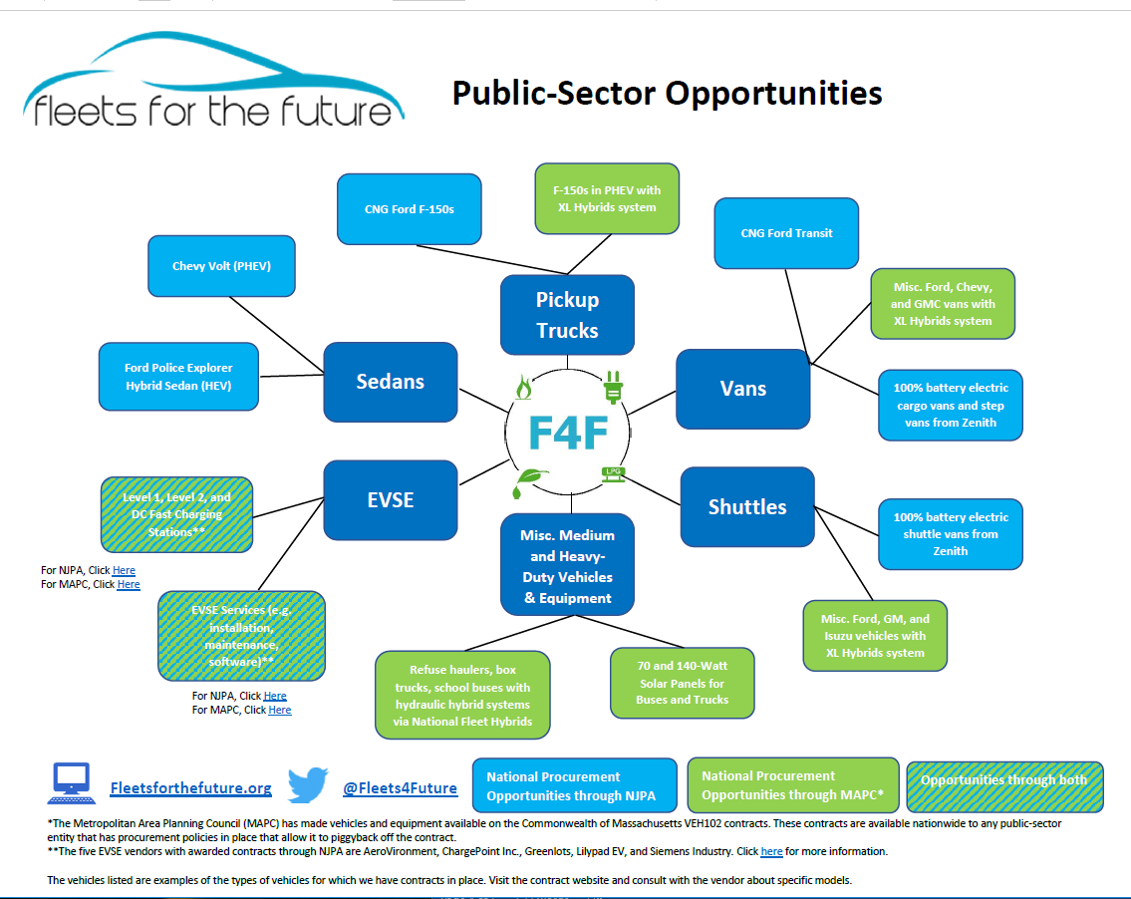
Contact Information
Notes:
You can find this on our website with links

Slide 20
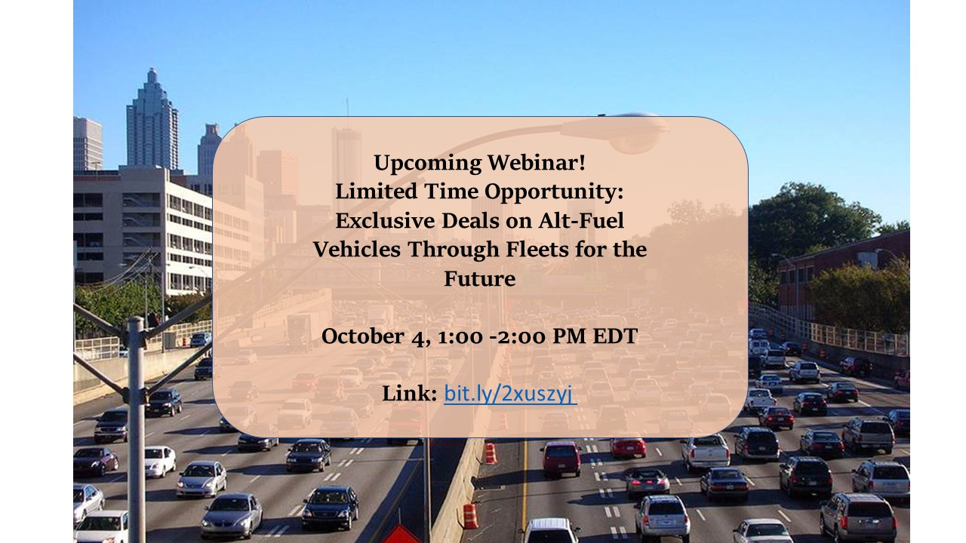
Webinar
Purchase Zenith Motors and NAFG now to receive discounts on NJPA’s website
Utilize MAPC’s VEH102 contract
Sign up for updates on fleetsforthefuture.org
Follow us on twitter @Fleets4Future
Look out for more information on upcoming opportunities including refuse haulers
Notes:
Link is on our website and on our Twitter page

Slide 21
Next Steps
Purchase Zenith Motors and NAFG offerings now to receive discounts on NJPA’s website
Utilize MAPC’s VEH102 contract
Sign up for updates on fleetsforthefuture.org
Follow us on twitter @Fleets4Future
Look out for more information on upcoming opportunities
Notes:
Hoping to have a special refuse hauler opportunity in early 2018 and Barry Carr who is in the audience is working hard on setting up a private fleet opportunity

Slide 22
Contact Information
National Joint Powers Alliance/National Auto Fleet Group
Mike Domin – Mike.Domin@njpacoop.org
Zenith Motors
Christine Smith – christine.smith@zenith-motors.com
National Cooperative Leasing
Chris Canavati – chris@lscfinancial.com
Fleets for the Future
Sarah Reed – sarah@narc.org
Website: http://www.fleetsforthefuture.org/
Twitter: https://twitter.com/Fleets4future
Notes:
Be sure to contact, Christine or Mike if you have technical questions for the vendors or join the webinar
You can also hand me or Barry your business card following this session and I can add you to the mailing list

