Slide 1

How can you benefit with telematics data?
Engage your fleet.
Notes:
Thanks for attending this conference
Today’s topic…
HOW CAN TELEMATICS DATA BENEFIT YOU?

Slide 2
Engage your fleet.
Engaged
Not all
GPS providers offer
the same level
of service
Enhanced
Effective
Notes:
Before discussing that, lets understand that not all GPS / Telematics vendors are created equal. Just like everyone in this room , you must support a wide range of services to your customers. I hear it all the time… “You guys are all the same”, but what we’ve found that we fall into one of three categories:
Effective Level vendors offer very basic features for businesses looking for a cost-effective technology. While these vendors may offer a lower price for their solution, they typically don’t offer customer service options. This is the best option if you are just looking for dots on a map only.
Enhanced Level vendors offer more features and reporting. These are usually larger companies and telecoms with vast resources so they definitely have cool features, but they can also leave you feeling like a number. This level is best for those that want to manage the roll out, training, and account setup on your own.
Fully Engaged vendors approach things differently. They seek to understand what the customer needs and goals are. They engage in strategic planning and ongoing progress reviews and give you personalized service with a vested interest in your success. They go beyond being just a vendor, they are a partner. While these telematics companies offer the best customer experience and technology, they will be priced higher than a basic telematics solution.

Slide 3


Engage your fleet.
Visibility
Efficiency
Safety
Notes:
Our industry has built a reputation for focusing almost exclusively on features of the product. While those look and feel pretty cool, sometimes they do nothing to help you and your business needs.
So rather than focusing on features, a true partner should focus on the RESULTS you expect. Those results can be categorized into these 3 main topics…

Slide 4

Engage your fleet.
Fleet touches EVERYONE
and
EVERYTHING
Notes:
Like it or not, your fleet often speaks about your organization louder than any marketing campaign could.
The bigger the fleet, the louder it speaks and the harder it is to influence the message it sends. That’s because your fleet is visible to everyone, even if the vehicles aren’t moving. Sometimes especially if they are not moving.
Your telematics partner should understand this in order for you to achieve the right message whenever a truck, van, or car rolls out.
We call this community value.

Slide 5
Engage your fleet.
Visibility
Efficiency
Safety
Notes:
The efficiency of your fleet might be hard to quantify
Does it mean more jobs in less time?
Does it mean the same jobs using fewer resources?
However you define that, the data you get from your vendor should support your goals. For example….

Slide 6
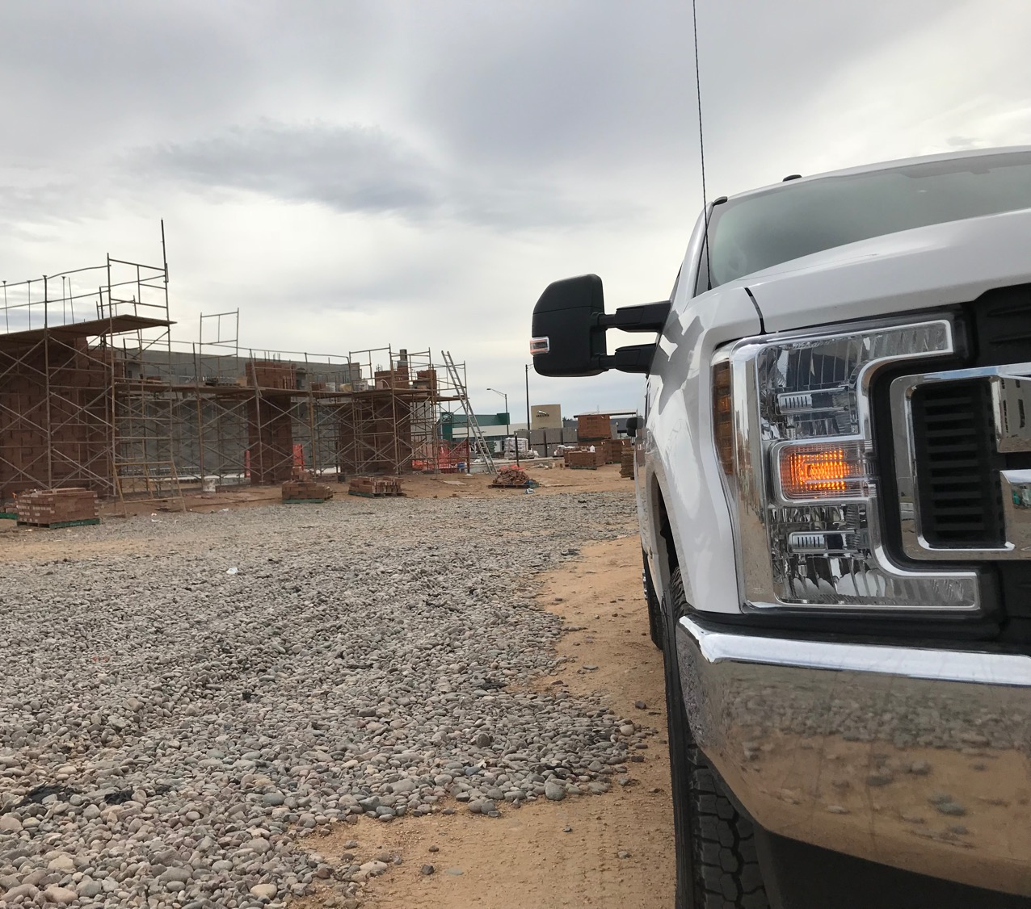

Engage your fleet.
$75,000
Notes:
What does $75,000 mean to you?
Hire a new Technician?
New Truck?
Pay Raises?
Overcome budget deficits?
Well unfortunately, $75,000 represents an average annual fuel loss of a 100 vehicle fleet from of idling.
I would ask you some basic questions…
Do you have a policy for idling? If no, don’t look for GPS telematics partner yet. You're just not ready.
If yes, then do have a GPS telematics partner to support it?
If you do, then great, otherwise you would not be able to measure the success of that policy or any ROI from your investment
Idle reduction is only one example of immediate savings… Here’s a few more.
Utilization = less vehicles? Less miles driven = more fuel savings and less maintenance
Then you have to account for driver behavior…
Speeding
Rapid Acceleration
Hard Braking
Also examples of wasted fuel and more wear and tear on your vehicles, but also adds more risk towards accidents… and what’s the cost of that?

Slide 7
API’S
GPS INSIGHT API
Notes:
More savings can be found with Automated Data Integration into other software platforms you maybe using today.
Fleet Management
Fuel Management
Motor Pool Management
Route Optimization
GIS Mapping
Automated data integration cuts dependency of manual input processes and the inherent mistakes from that, it can give you efficient ways to manage your fleet by pushing accurate telematics data into other systems which saves you time AND money.

Slide 8




PARTNER INTEGRATIONS
Notes:
Here is a handful of key partner you may be using. Its important to know there are many others and the list keeps growing.
When looking for a GPS telematics partner, you should find one that can expand to support and meet your growing needs without charging you extra.

Slide 9
Engage your fleet.
Visibility
Efficiency
Safety
Notes:
One of the most critical topics to be sure to discuss with any telematics partner you’re considering is Fleet Safety. The rolling liability you have every day and the greatest asset you have in your employees should be kept safe. And GPS data can be the lynch pin in any successful fleet safety policy.

Slide 10
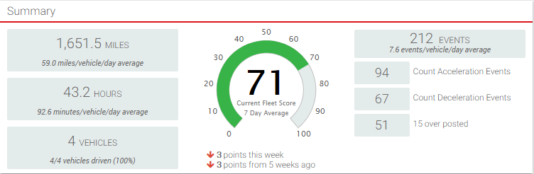
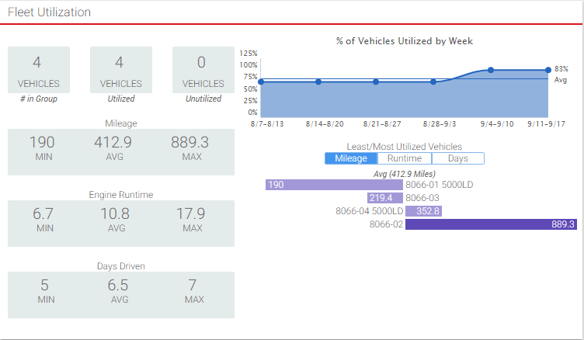
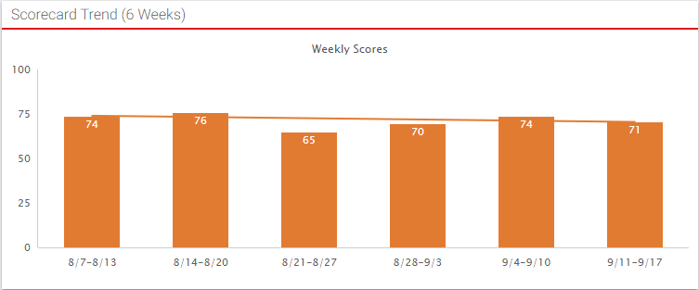
SAFETY SCORECARD
Notes:
The data is basic
Speeding / Rapid acceleration / Hard braking / High G turns; and yes, everyone can do that. Collecting that data isn’t hard – delivering it in a way that you can use it… is.
Having this data can support your current driver policy or help you create one.
It can also help enforce that policy, but this data has to come to you without being overwhelming.

Slide 11

Mike MacComiskey
Government Sales
816.345.0091
Mike.mac@gpsinsight.com
THANK
YOU!
Notes:
If you have a telematics vendor that isn’t addressing all these basic needs, I suggest you find one that does. When seeking a provider, I encourage you to share your goals, your initiatives with them. If their solution is to show you more cool features, you might want to start talking to someone else.
Telematics data can and should be a game changer. It can save you time, and money, but did you know it can also save lives? If you don’t believe that, stop by our booth and I’ll tell you exactly how one company did that. It’s an incredible story.

