Slide 1
AltWheels 2019- Clean Corridors for Natural Gas Vehicles
Mark Riley, Vice President-Canada and Eastern US

Slide 2
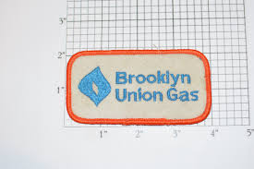
Where it Began: Utility CNG Networks
In the 1990’s, many natural gas utilities developed CNG fueling station networks throughout their distribution systems
Stations were designed and located to fuel the utility’s light duty vehicle fleets for EPACT compliance
For today’s CNG fleets, those station networks are generally “under-sized” and limited to major metropolitan areas

Slide 3
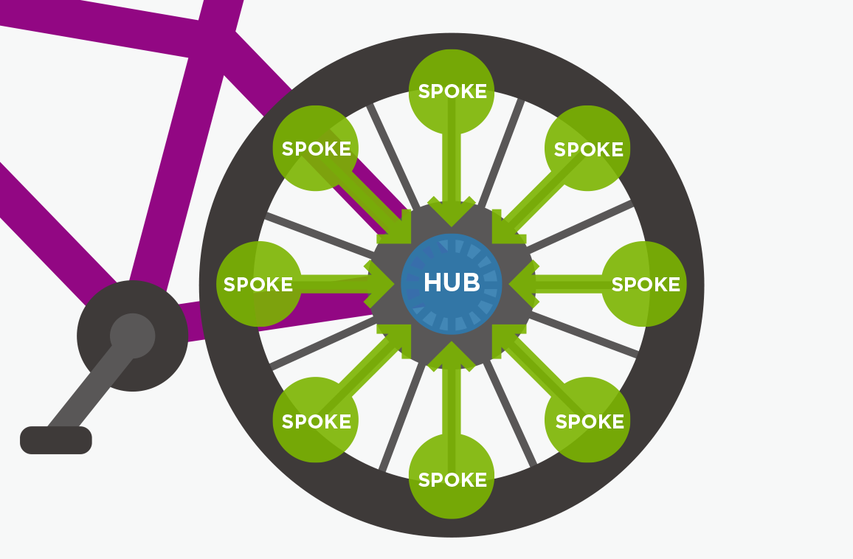
Hub and Spoke

Slide 4
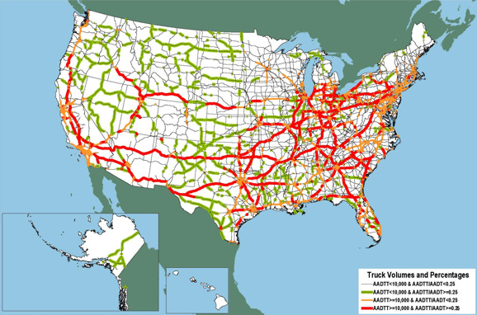
Corridors

Slide 5
Current CE CNG Fuel Stations

Slide 6
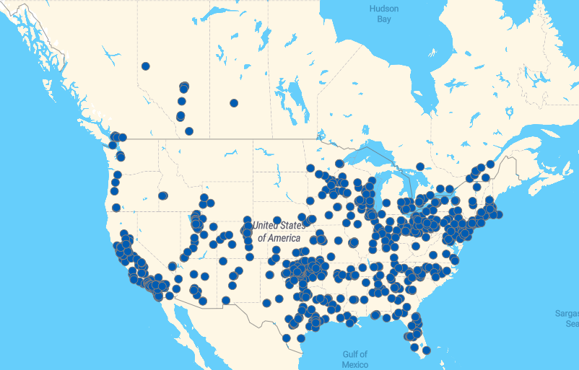
North America’s CNG Network

Slide 7
What is next?
Identify and build more hubs
Connect hubs along major transportation corridors with strategic spokes
Transition to Renewable Natural Gas nationwide

