Slide 2
Paul Minahan
Sr. Manager EV Fleet Sales Operations

Slide 3
LEAF Milestones to Date Nissan’s EV Evolution
75K
25K
75K U.S. LEAFs sold
(Mar 2015)
107 Mile Battery launch
(Nov 2015)
No Charge to Charge Launch
(Jul 2014)
All New LEAF Launch
1st LEAF sold
(Dec 2010)
LEAF S Trim SOS
(Feb 2013)
25K U.S. LEAFs sold
(Apr 2013)
2010
2016
2017
US LEAF Battery Plant Opens
(Dec 2012)
LEAF wins IHS Loyalty Award for 1st Time
(Jan 2015)
50K U.S. LEAFs sold
(May 2014)
2016 Nissan LEAF Announced in LA
(Sep 2015)
LEAF wins World Car of the Year
(Jan 2011)
First LEAF CPO sale
(Sep 2013)
LEAF wins IHS Loyalty Award for 2nd Time
(Jan 2016)
11 Consecutive Months of YoY Sales Growth
50K
100K

Slide 4
EV Volume Growth
Battery EV TIV is growing – expected to reach ~380k by 2023
Number of models will double between launch of B12P and 2023
37
EV Models
18
EV Models
12
EV Models
2
EV Models
Source: IHS Market Nissan US VPAC Customer Segment Forecast (Sep 2016)

Slide 5
“Simply Amazing” New Nissan LEAF

Slide 6
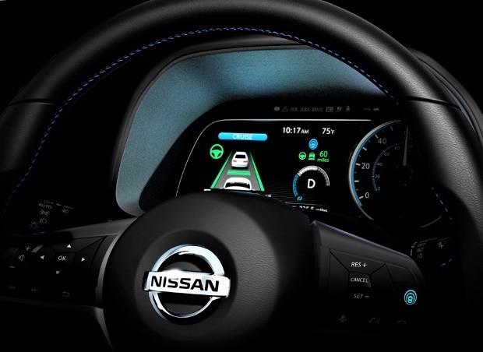
The All-New
2018 Nissan LEAF
World’s Best-Selling Electric Car
Automatic Emergency Braking standard
Available ProPILOT Assist combines intelligent cruise control with steering assistance
6.6kW onboard charger standard
37% more HP and 26% more torque than previous model
Lower maintenance costs than traditional internal combustion vehicles
S
Standard 8 year/100K mile battery warranty
SV
SL
Redesigned exterior and interior
110 kW electric motor (148 hp/236 lb-ft)
40 kWh Battery with 150 Mile Range
e-Pedal Mode with Slope Stop
6.6 kW onboard charger
Automatic Emergency Braking
Automatic On/Off Headlights
Nissan Intelligent Key® with Push Button Start
Bluetooth® Hands-free Phone & Audio
MSRP Starting at $29,990
S Content Plus:
Intelligent Cruise Control
NissanConnect℠ with Navigation featuring Apple CarPlay™ and Android Auto™
Quick Charge Port
Fog Lights
17" Alloy Wheels
Optional Technology Package includes ProPILOT Assist, Blind Spot Warning, Rear Cross Traffic Alert and High Beam Assist
MSRP Starting at $32,490
SV Content Plus:
Blind Spot Warning
Rear Cross Traffic Alert
Heated Front Seats
Intelligent Around View Monitor
Leather Appointed Seating Surfaces
Optional Technology Package includes ProPILOT Assist & High Beam Assist
MSRP Starting at $36,200
Note: Features in bold are new to the LEAF for 2018.

Slide 7
The All-New 2018 Nissan LEAF
Key Messages |  | Supporting Points
1 | Longer Range, Lower Price | 150mi range at a lower MSRP 40% range increase from a larger capacity 40kWh battery (150mi vs. 107mi with 30 kWh battery) Starting at $29,990 MSRP ($690 lower vs. MY17 $30,680)
2 | All-New Design | All new exterior and interior styling reflecting Nissan design language Exterior: Nissan V-motion grille, boomerang tail lamps, and floating roof Interior: Nissan Gliding Wing form instrument panel, clean and modern design Improved aerodynamics improves range efficiency and keeps the car stable in crosswinds
3 | Intelligent Power | Stronger acceleration from a 110kW motor (vs. 80 kW) 37% more horsepower (147 vs. 107 hp), 26% more torque (236 vs. 187 lbs-ft) Responsive acceleration from the all new e-powertrain
4 | Intelligent Driving | ProPILOT™ Assist makes highway driving easier and less stressful Follows the car in front of you and maintains a safe distance while keeping vehicle centered in the lane In stop & go traffic, it can come to a complete stop and resume without intervention from the driver
5 | Intelligent Integration | NissanConnect Services, Apple CarPlay & Android Auto NissanConnect Services includes Remote Lock/unlock, Speed Alert, Automatic Collision Notification, Emergency Call, and more Standard Apple CarPlay, Android Auto on SV & SL New NissanConnect EV smartphone and wearable apps lets you control the a/c, begin charging, and plan your route from your phone
6 | One-Pedal Driving | e-Pedal mode lets you drive with one pedal e-Pedal mode reduces fatigue, especially in traffic, by utilizing regenerative braking to minimize the need to switch between accelerator and brake pedals Nissan unique capability is that LEAF can come to a complete stop (and hold) without touching the brake pedal even on steep hills Brake pedal can be used at any time for conventional braking
7 | Safety Technology | Standard Automatic Emergency Braking and Available Blindspot Warning with Rear Cross Traffic Alert AEB uses radar to monitor the car ahead, and can apply the brakes to help avoid a collision or reduce the speed of impact BSW: An indicator appears in the driver’s or passenger’s side door when a vehicle is detected in the blind spot area RCTA: when backing out of a parking space, RCTA can warn the driver of vehicles that are approaching from the side

Slide 8
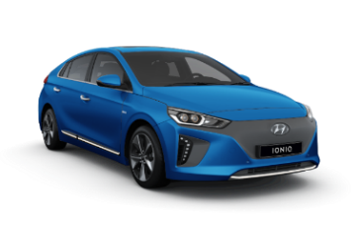
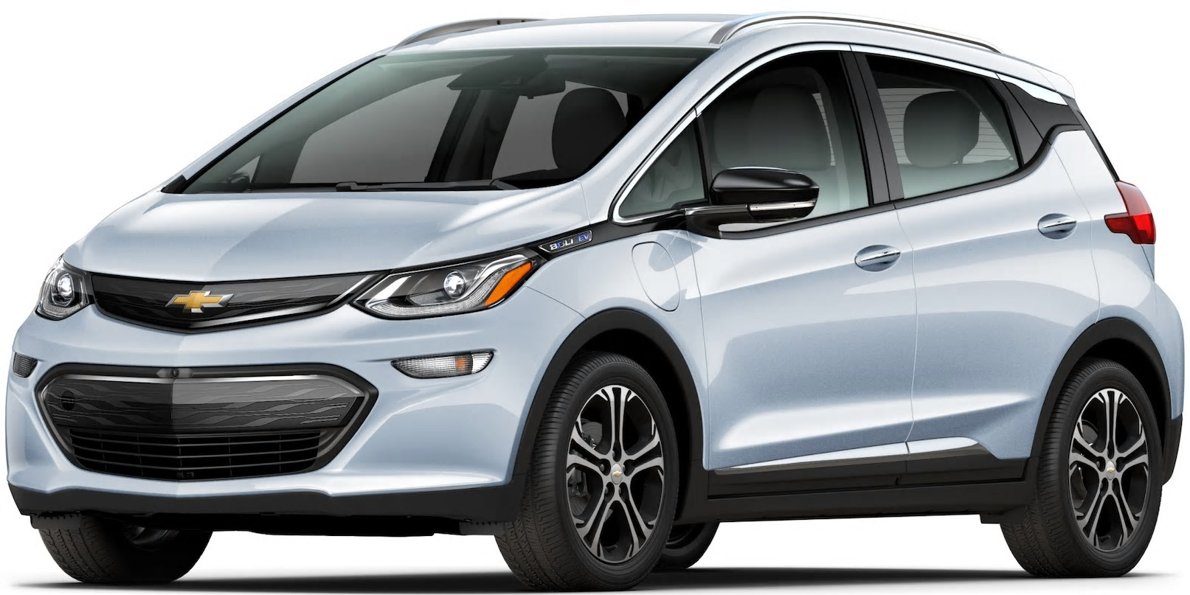
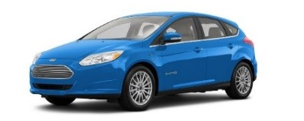
Introducing the All-New 2018 LEAF
The 2018 LEAF will be highly competitive within the BEV (Battery Electric Vehicle) segment due to price positioning and feature content.
 | 2018 Nissan LEAF | 2017 Chevrolet Bolt | 2017 Ford Focus EV | 2017 Hyundai Ioniq | 2017 Volkswagen e-Golf | 2018 Tesla Model 3
Starting MSRP | $29,990 | $36,620 | $29,120 | $29,500 | $29,000 | $35,000
Driving Range (Battery Capacity) | 150 miles (40kWh) | 238 miles (60 kWh) | 115 miles (33kWh) | 124 miles (28kWh) | 124 miles (36kWh) | 220 miles
Electric Motor Output | 110kW (147 hp) | 150kW (200 hp) | 107kW (143 hp) | 88kW (118 hp) | 100kW (134 hp) | TBA
Acceleration (0-60 mph) | 8.6 sec | 6.5 sec | 9.9 sec | 8.1 sec | 9.6 sec | 5.6 - 5.1 sec
Standard Features | Redesigned interior & exterior Automatic Emergency Braking e-Pedal with auto brake hold on all slopes Auto on/off headlights Easy-Fill Tire Alert Hands-free phone and audio streaming via Bluetooth® | Auto on/off headlights One pedal driving (no slope stop and hold) Low speed automatic emergency braking Hands-free phone and audio streaming via Bluetooth® | Auto on/off headlights Hill Start Assist Hands-free phone and audio streaming via Bluetooth® | Auto on/off headlights Hands-free phone and audio streaming via Bluetooth® | Hands-free phone and audio streaming via Bluetooth® Three regenerative braking modes | Automatic Emergency Braking 15” touchscreen w/ onboard maps & navigation Wi-Fi & LTE internet connectivity Keyless entry & remote climate control w/ app Voice activated controls Side collision warning Auto high beams
Available Safety Features | Automatic Emergency Braking with Pedestrian Detection Blind Spot Warning Intelligent Lane Intervention Rear Cross Traffic Alert Driver Attention Alert | Lane Keep Assist with Departure Warning | N/A | Automatic Emergency Braking Blind Spot Warning Rear Cross Traffic Alert Lane Departure Warning | Blind Spot Monitor Lane Departure Warning Automatic Emergency Braking | Lane Keep Assist
Available Advanced Technologies | ProPILOT Assist Intelligent Cruise Control Intelligent Around View Monitor High Beam Assist | Surround Vision Camera High Beam Assist | N/A | Smart Cruise Control | Entertainment screen with gesture controls Adaptive Cruise Control High Beam Assist Park Assist | 310 mile long range battery Enhanced Autopilot (ICC + auto lane change + self-park) Hardware for full self-drive (full functionality dependent on testing and regulatory approval);

Slide 9
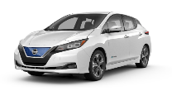
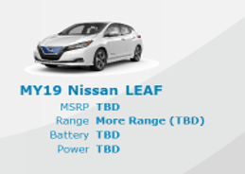
BEV Segment Range and Price Distribution
Q1 2018
Q3 2017
ON SALE
CA only (SOS – April ‘17)
ON SALE
<200mi
~$29k+
MY18 Nissan LEAF
Volkswagen e-Golf
Hyundai Ioniq Electric
Ford Focus Electric
MSRP | $29.9k
Range | 150 mi
Battery | 40 kWh
Power | 147 HP (110 kW)
MSRP | $29k
Range | 124 mi
Battery | 36 kWh
Power | 134 HP (100 kW)
MSRP | $29.5k
Range | 124 mi
Battery | 28 kWh
Power | 118 HP (88 kW)
MSRP | $29k
Range | 115 mi
Battery | 33 kWh
Power | 143 HP (107 kW)
>200mi
$35k+
Chevrolet Bolt
Tesla Model 3
MSRP | $36.6k
Range | 238 mi
Battery | 60 kWh
Power | 200 HP (150 kW)
MSRP | $35k
Range | 220 mi
Battery | 50 kWh
Power | 258 HP

Slide 10
Product Concept
Driving the Future of Mobility
New Styling
Definitively Nissan
Enhanced Tech Image
Enhanced EV Drive
EV Uniqueness
Advanced Safety Technology
Step Towards Autonomous Drive

Slide 11
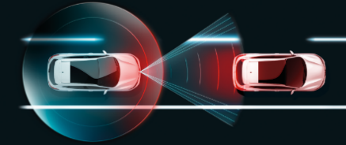
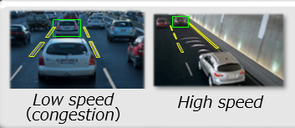
MY18 LEAF Key Highlights
New Technology
Standard Automatic Emergency Braking
Level 1/Level 2 Charge Cable (120V/240V)
LED Headlights
Apple CarPlay & Android Auto
e-Pedal Mode
1-pedal driving to reduce fatigue
Full stop and hold capability, even on hills
Useful in city traffic, very easy to learn
ProPILOT Assist
Stress relief in stop and go traffic
Single-lane highway capability

Slide 12
What is ProPILOT Assist?
ProPILOT Assist is a feature that combines:
Steering assist
Enhanced version of Intelligent Cruise Control (ICC)
Steering Assist
Provides steering assistance to help the driver stay in the center of the lane.
Only engages when system detects clear, consistent lane markings (after ICC is engaged)
Intelligent Cruise Control (ICC)
Maintains vehicle speed set by the driver or
Help maintain a gap to the preceding vehicle if speed drops below the driver set speed
Enhancement: slows vehicle to a stop and holds during traffic jam conditions
Steering Assist
Intelligent Cruise Control
ProPILOT Assist:
Is a “hands-on” driver assistance system
Is a feature that requires the driver to remain engaged in the driving task at all times
Is NOT a “self-driving” feature
Does not have the capability to drive safely with the driver’s hands off the wheel (same as vehicles today)

Slide 13
e-Pedal Technology
With the flip of a switch, the technology turns your accelerator into an e-Pedal, allowing drivers to accelerate, decelerate and stop using just the e-Pedal*. e-Pedal technology is the world’s first one-pedal operation that allows drivers to bring the car to a complete stop even on hills, stay in position, and resume driving instantly.

Slide 14
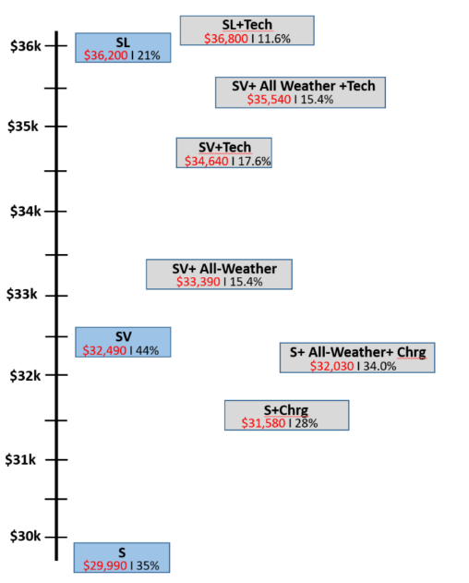
MY18 LEAF Grade Strategy
SL Key Features
Level 1/Level 2 charge cable (120V/240V)
Leather appointed seats, power DR seat
Around View Monitor
LED headlights
Bose premium audio
Heated seats, mirrors, steering wheel
SV Key Features
Quick charge port
Intelligent Cruise Control
NissanConnect with Navigation
Apple CarPlay/Android Auto
SiriusXM SAT/Traffic/Travel Link
17” alloy wheels
44%
S Key Features
40kWh battery (150 mi range)
6.6 kW onboard charger
ePedal Mode
Automatic Emergency Braking
Nissan Intelligent Key
RearView Monitor

Slide 15
MY18 LEAF Price/Value Positioning
MY17
S Features:
Redesigned exterior
Battery (40kWh vs. 30kWh)
40% increase in driving range
Motor (110kW vs. 80kW)
+37% horsepower
Standard Automatic Emergency Braking
e-Pedal with slope stop
7" Meter with Analogue Speedometer
Auto on/off headlights
S
$30,680
Lower MSRP
MY18
Add Value
S
$29,990
S Price Adjustment = $690 ( 2.2%)
+$4,500 in value vs. MY17 S
MY17
MY18
Lower MSRP
Add Value
SV includes S Features plus:
Carplay + Android Auto
Intelligent Cruise Control
SV
$34,200
SV
$32,490
+$5,000 in value vs. MY17 SV
SV Price Adjustment = $1,710 ( 5%)
SL includes SV Features plus:
Exterior mirrors with integrated turn signals
Bose premium audio
Blind Spot Warning
Rear Cross Traffic Alert
Around View Monitor+MOD+DAA
L1/L2 EVSE
MY17
MY18
Lower MSRP
Add Value
SL
$36,790
SL
$36,200
SL Price Adjustment = $590 ( 1.6%)
+$6,783 in value vs. MY17 SL
4

Slide 16
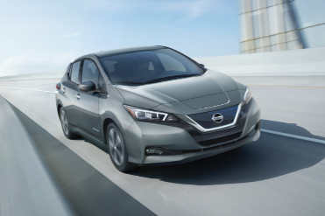
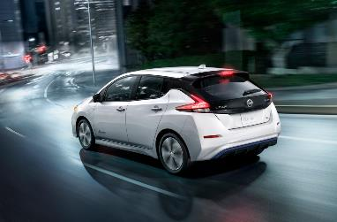
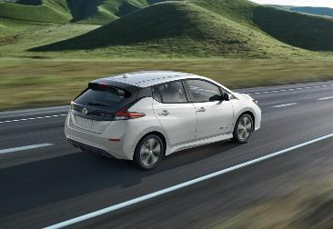
MY18 LEAF Key Takeaways
All New Design
40kWh Battery, +40% Range
+37% HP, +26% TQ
e-Pedal
ProPILOT Assist
Automatic Emergency Braking

Slide 17
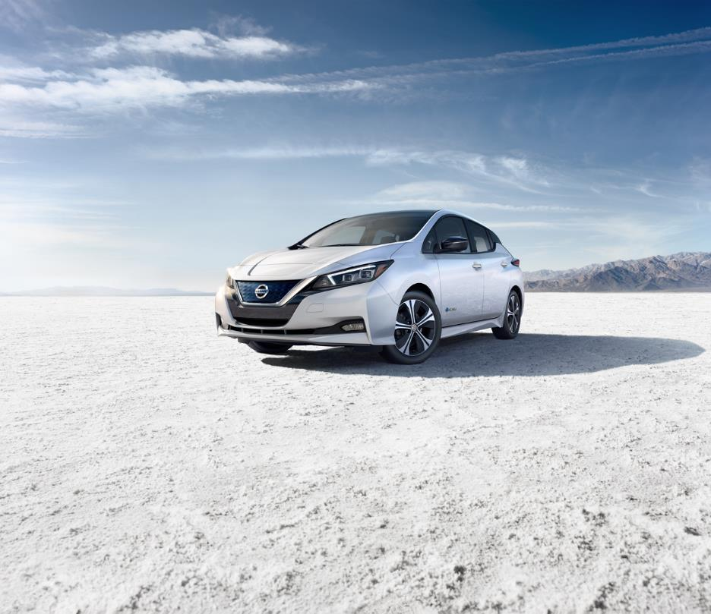
Thank you!

