Slide 1
Future of Mobility Trends
AltWheels 2017

Slide 2
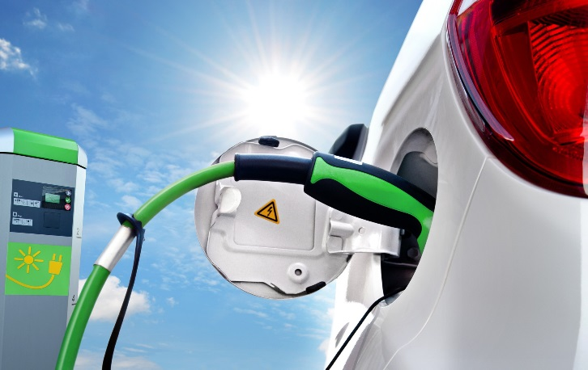
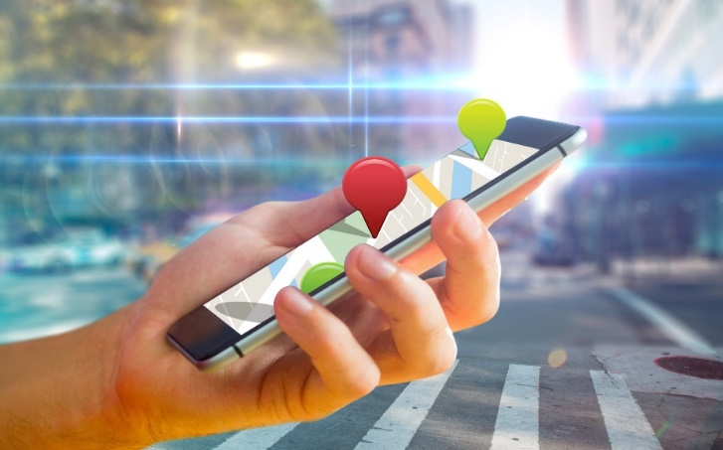
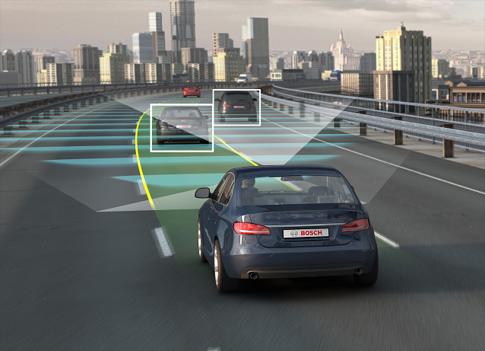
Three trends are road mobility game-changers: Electrification, new mobility services and self driving cars
1
2
SMART TRANSPORTATION
ELECTRIFICATION
3
AUTONOMOUS VEHICLES
The challenge for fleet managers is predicting the right timing

Slide 3
In predicting trends timing is everything

Slide 4
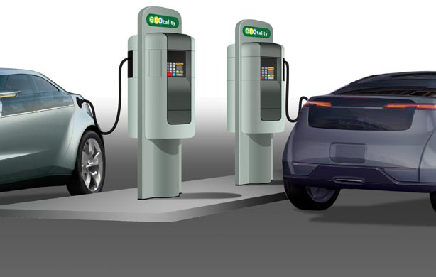
Switch from fossil fuels to EVs steady but slow 160,000 EVs sold in US in 2016 (vs 20,000 in 2011) but fraction of the total vehicles sold
Global LDV and EV yearly sales, 2015–2040 (m vehicles sold per year, %)
m of vehicles sold per year
New car sales (%)
35%
2015
2020
2025
2030
2035
2040
EV % of new sales
ICE + HEV
BEV
PHEV
Note: ICE+HEV = internal combustion engine and hybrid vehicles, BEV = battery electric vehicles, PHEV = plug-in hybrid electric vehicles
Source: Bloomberg New Energy Finance

Slide 5
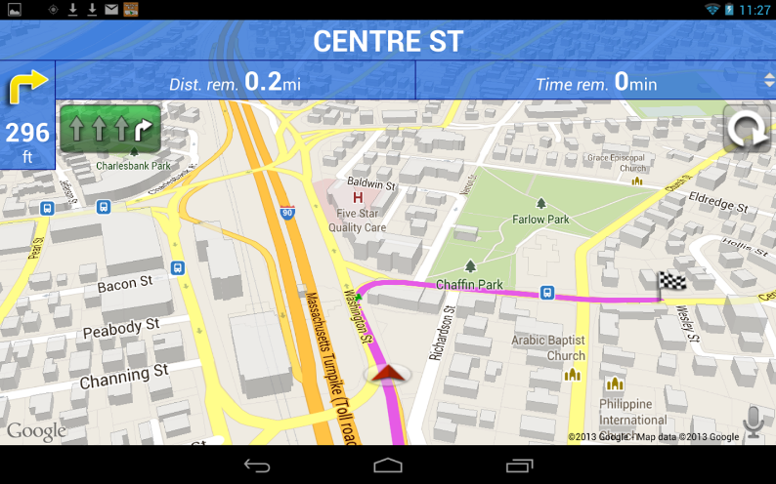
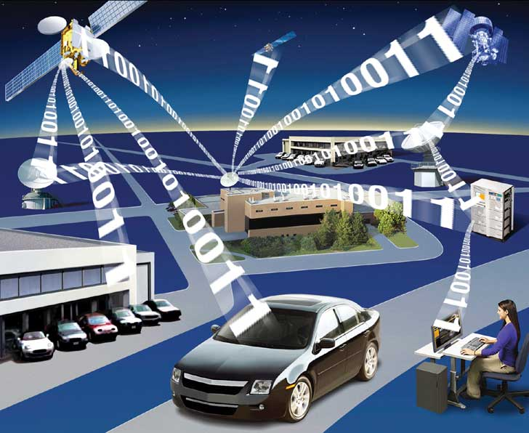
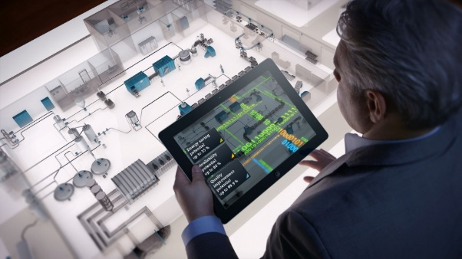
Rise of telematics and smart transportation fueling new mobility services
Global Smart Transportation Market Size and Forecast 2015–2024 ($B)
Solution Segments
Parking Management System
Ticketing Management
Traffic Management
Integrated Supervision System
Fleet management
Fleet efficiency services
Charging stations
Service Segments
Cloud Services
Business Service
Professional Services
300
200
19.4%
100
0
2016
2017
2018
2019
2020
2021
2022
2023
2024
Source: Variant Market Research

Slide 6
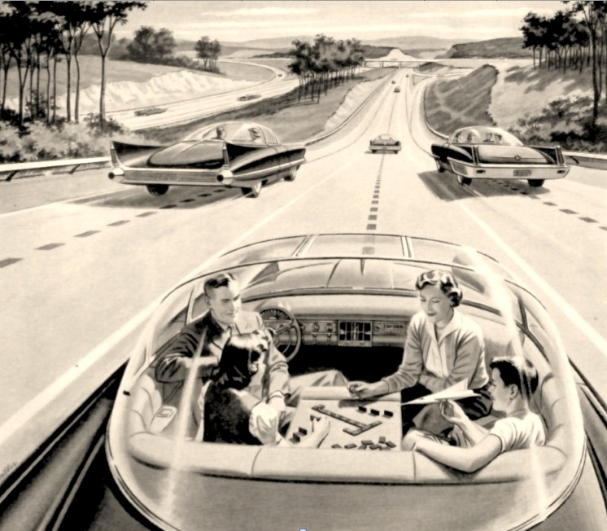
But one trend which many aren't tracking is on pace to grow faster than expected
For decades, self-driving cars were a futuristic concept …
Source: Print advertisement by a coalition of American electric light and power companies, 1957

Slide 7
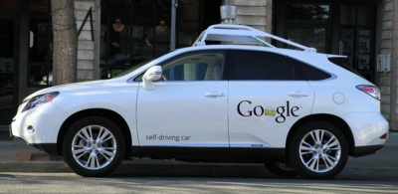
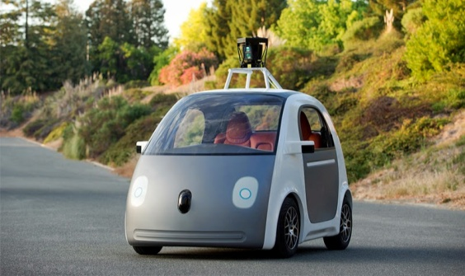
Predictions around autonomous vehicles are moving forward: Google car has travelled 2.3 Mill miles

Slide 8
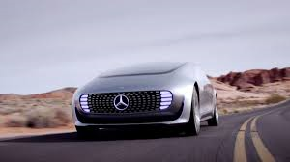
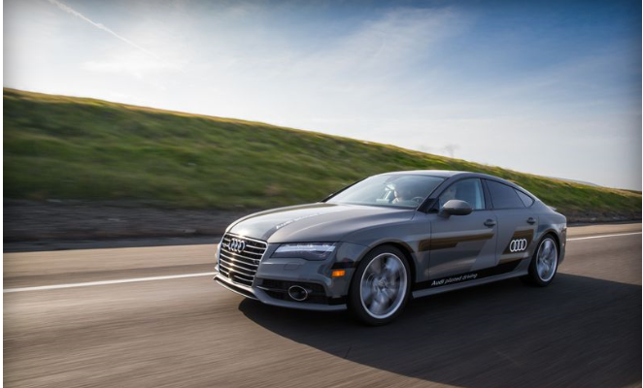
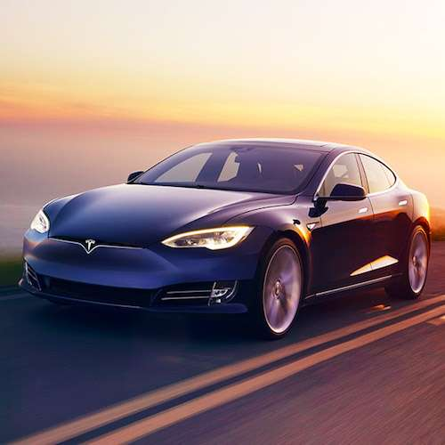
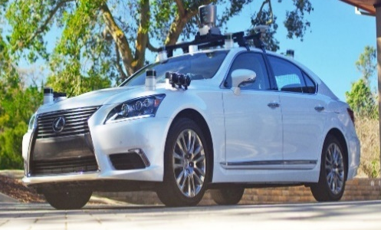
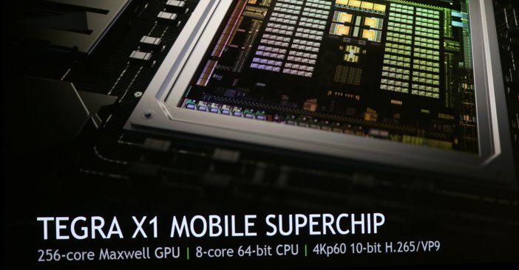
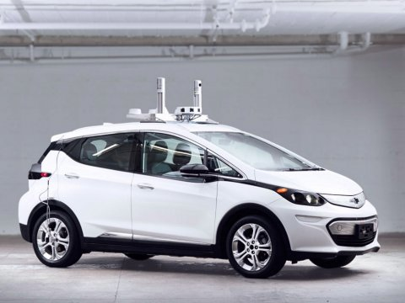
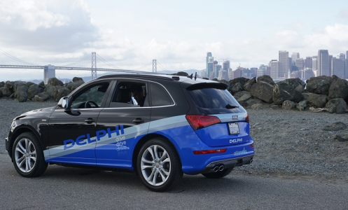
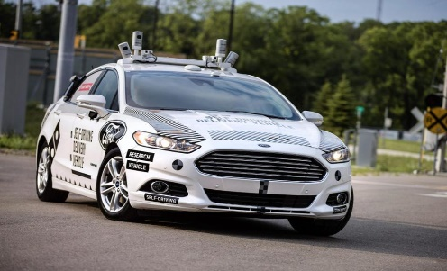
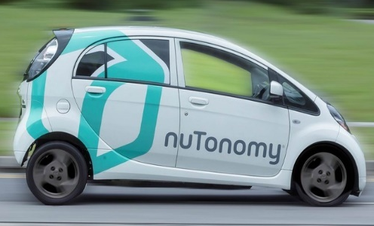
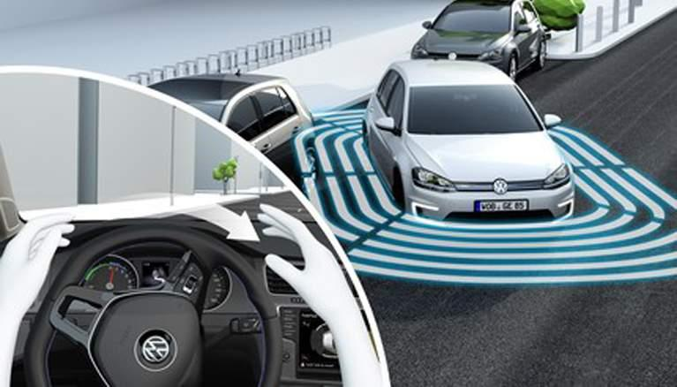
Autonomous driving: Focus for many companies
Mercedes
Autonomous F015
Audi
Autonomous A7
Tesla
Model 3 autopilot mode
Toyota
Lexus designed to learn
GM
Plans to launch on Lyft platform
Delphi
Urban autopilot
Ford
Tests Fusion with Dominos
Nutonomy
Testing vehicles in Boston

Slide 9
Mobility trends will reshape our future
Big data, hardware & software, and sensors all will play a role in defining future transportation—not only about drive trains & fuel types
1
Expect to see an increase in mobility as a service (smart parking, mapping & navigation, charging, vehicle sharing options) and smart transport
2
More disruptive innovation will take place in the next decade
of mobility than in the past 50 years
3

Slide 10
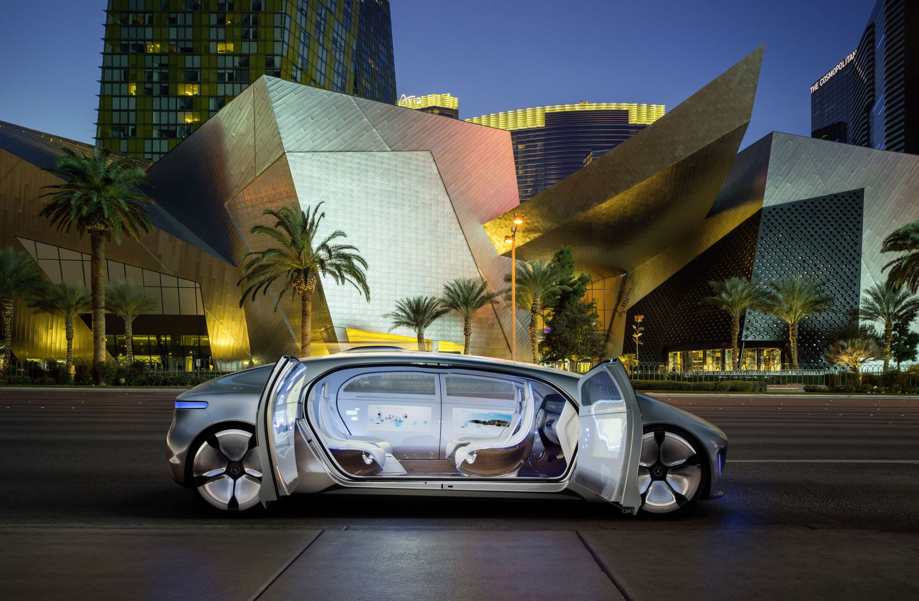
Thank you!

