Slide 1
AltWheels Fleet Day
Brookes Shean, GM USA East and Central Canada
October 7, 2019

Slide 2
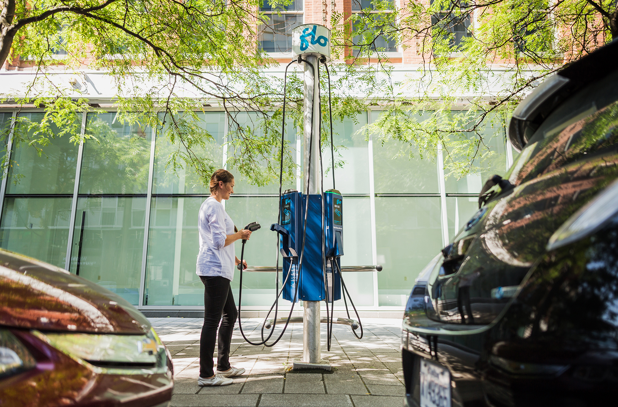
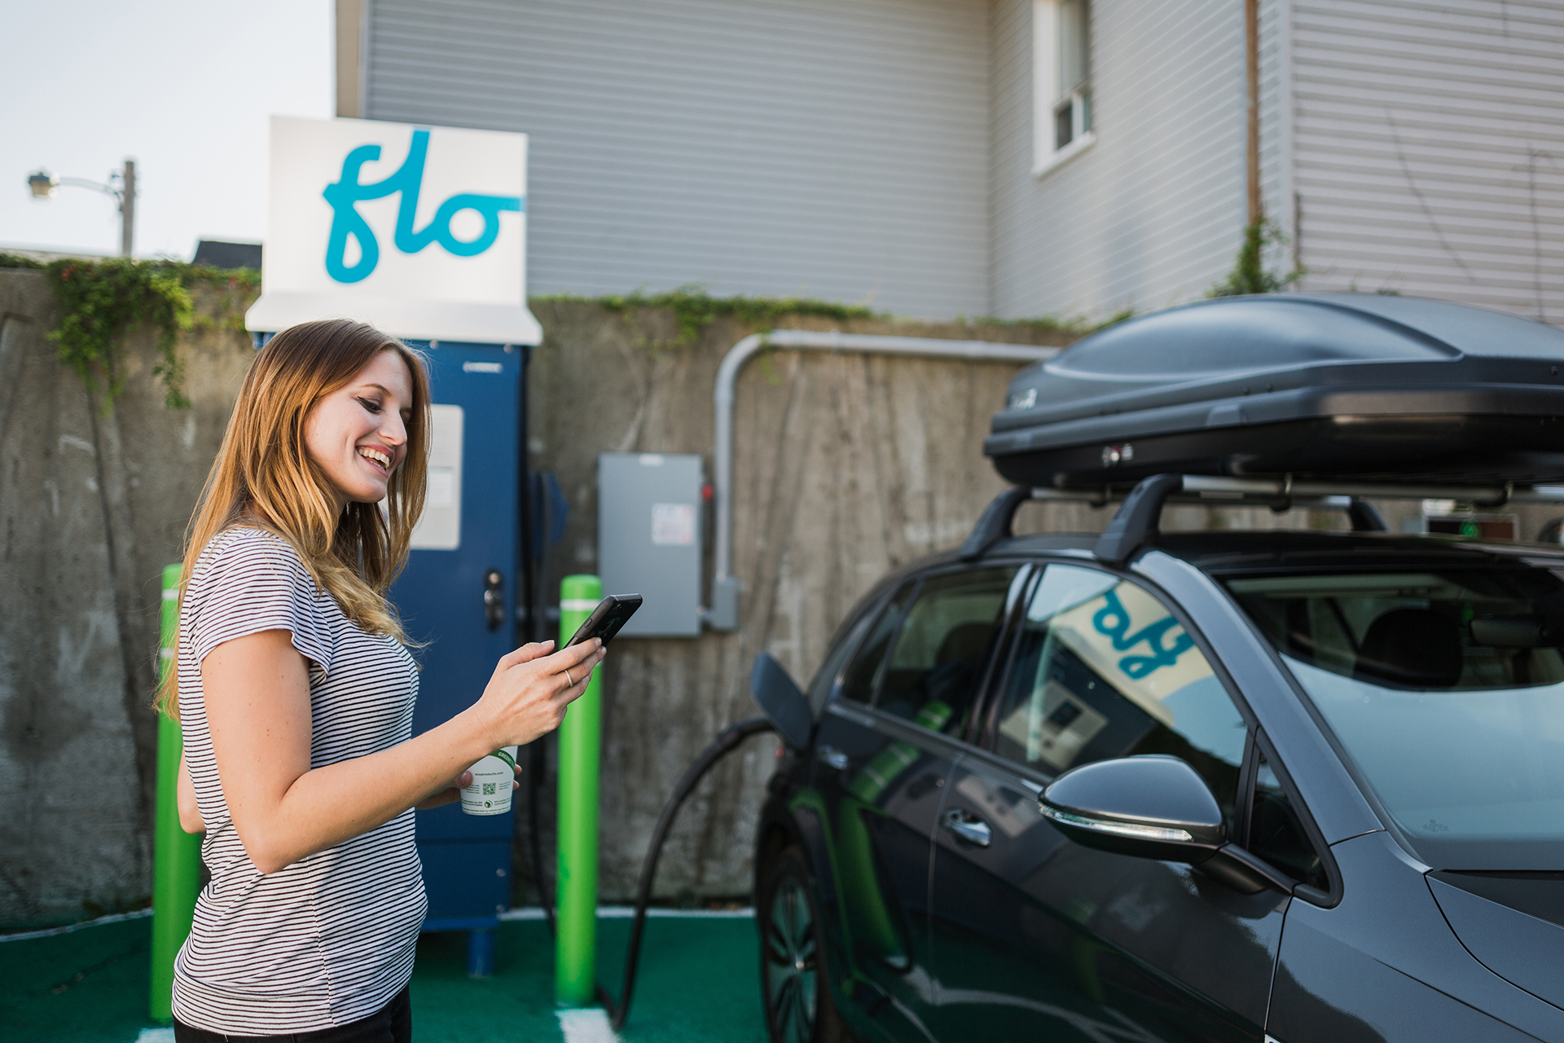
About Us
Founded in 2009 in Quebec City, Canada
Leader with more than 21,000 charging stations on its network
Vertically integrated: product, software, service and network
Charging solutions for many market segments
8 Office Locations – New York, Maryland, San Francisco, Quebec City, Shawinigan, Montreal, Toronto, Vancouver
Operator of Canada’s largest charging networks

Slide 3
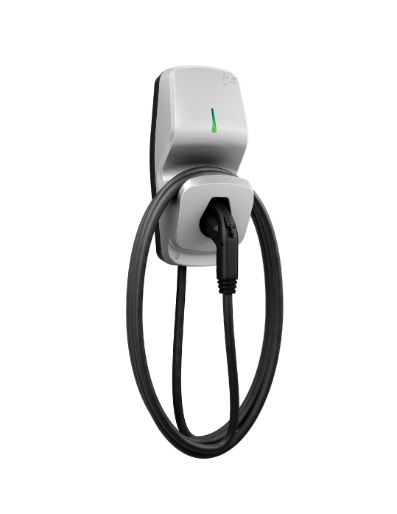
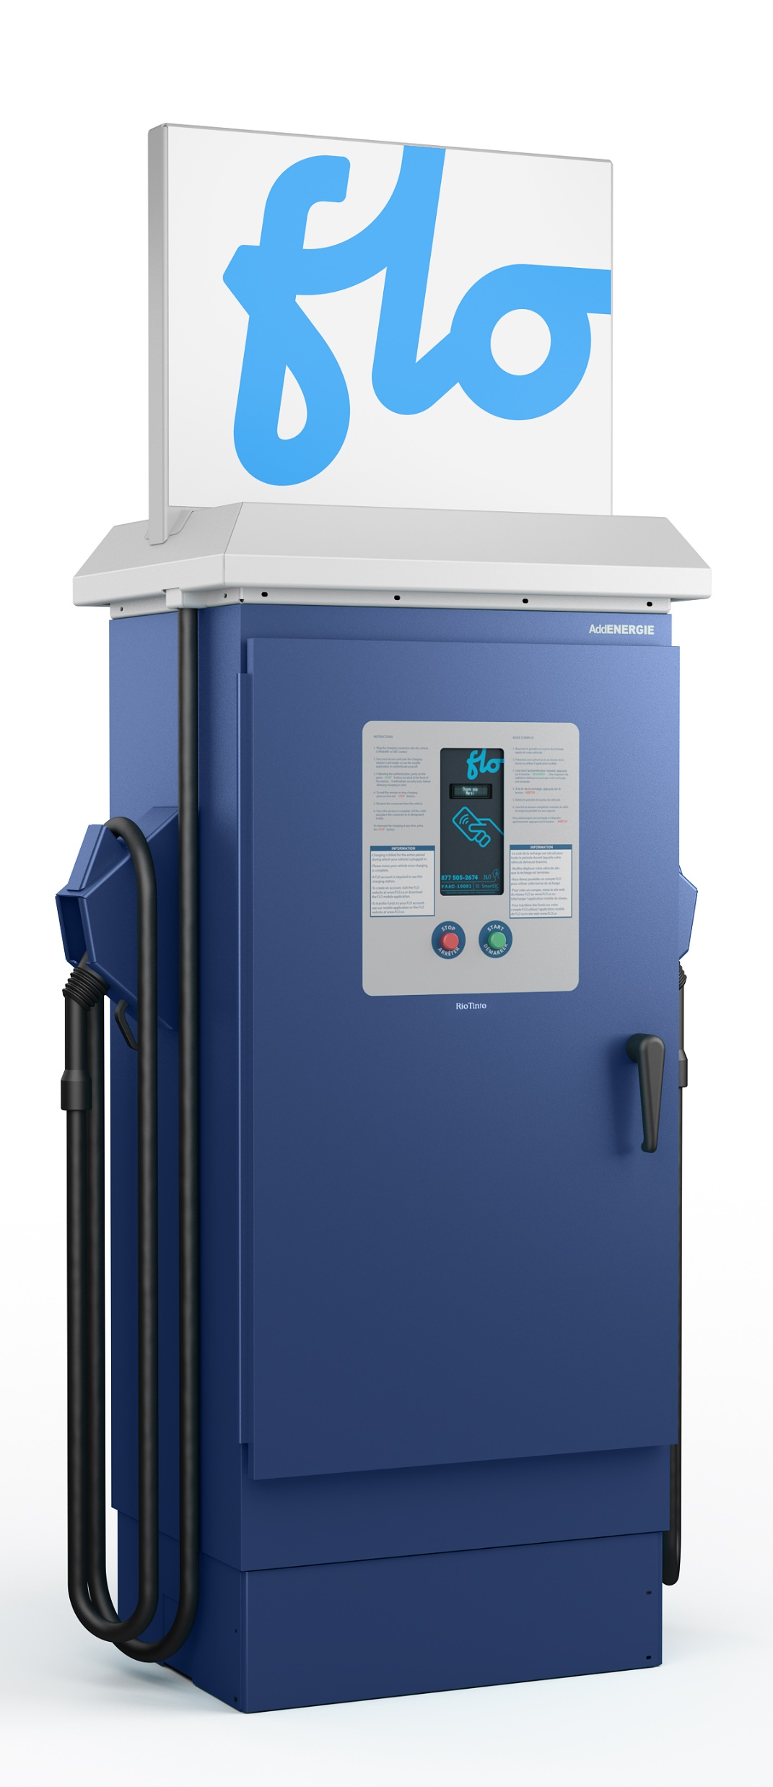
Solutions for All Market Segments
Residential
Multi-residential
Workplaces
Fleets
Public
Curbside

Slide 4
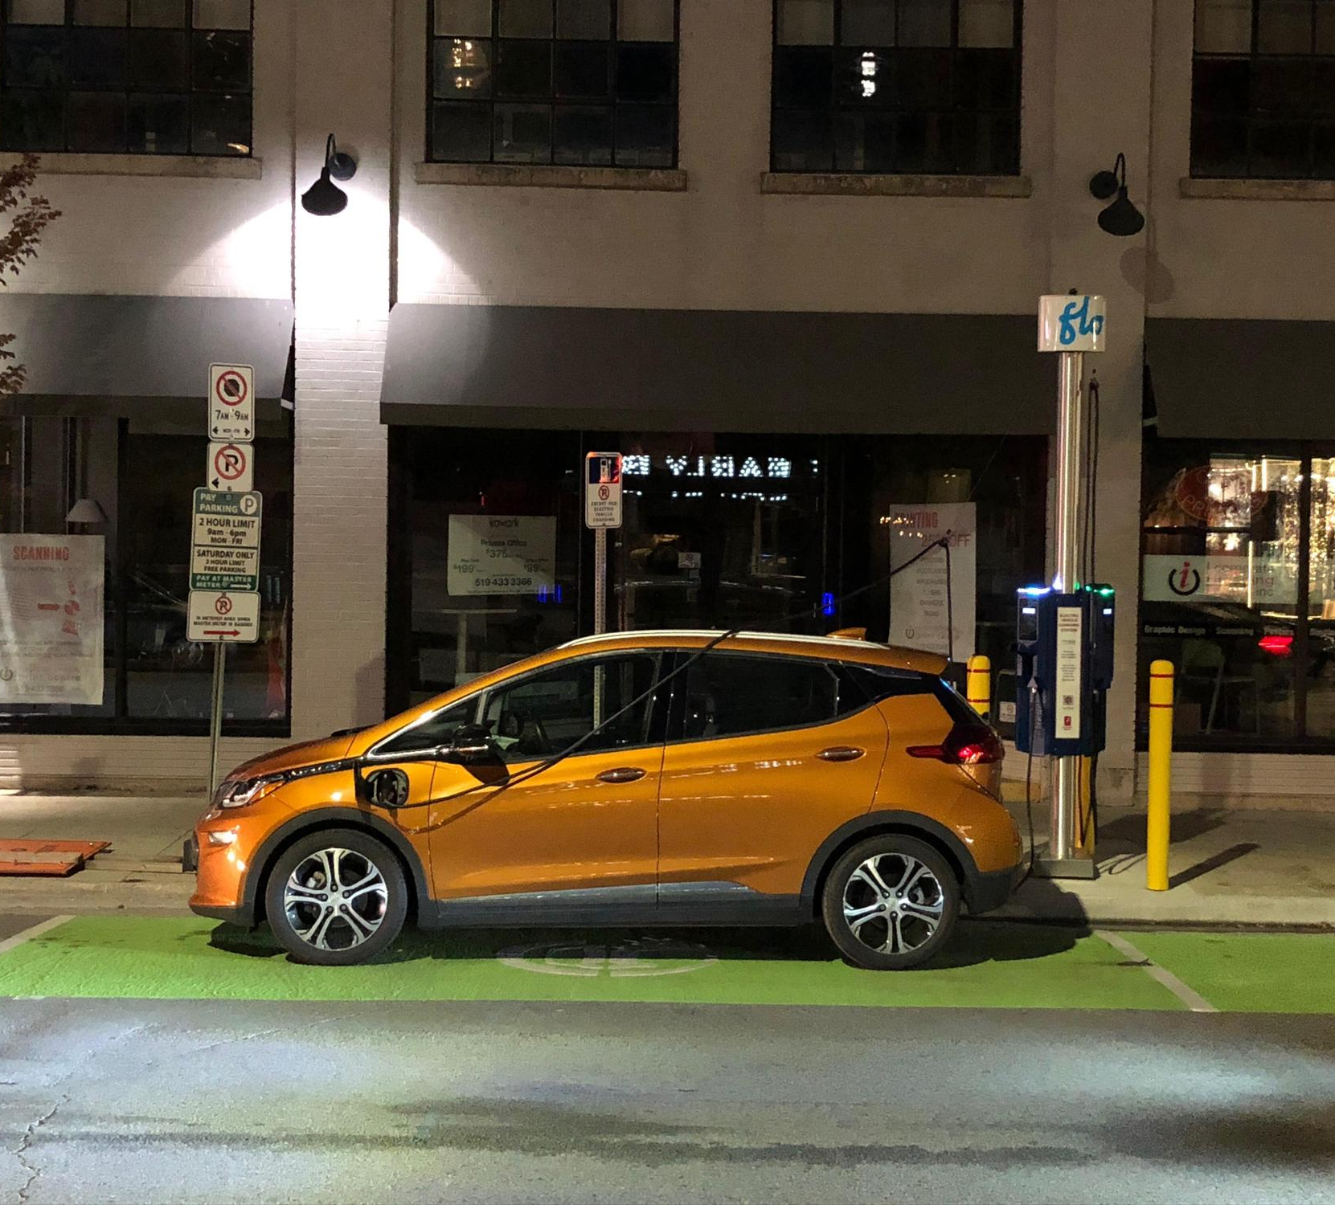
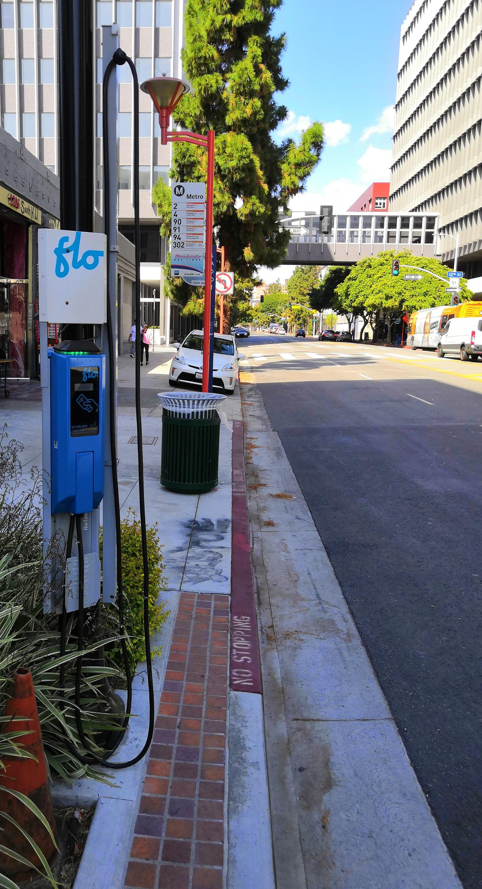
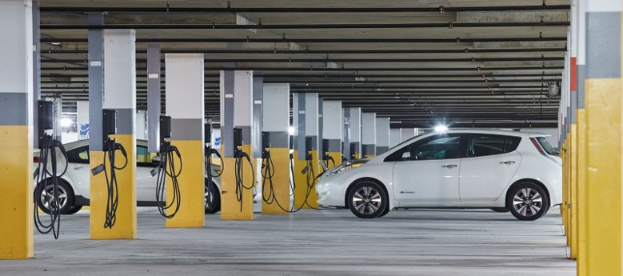
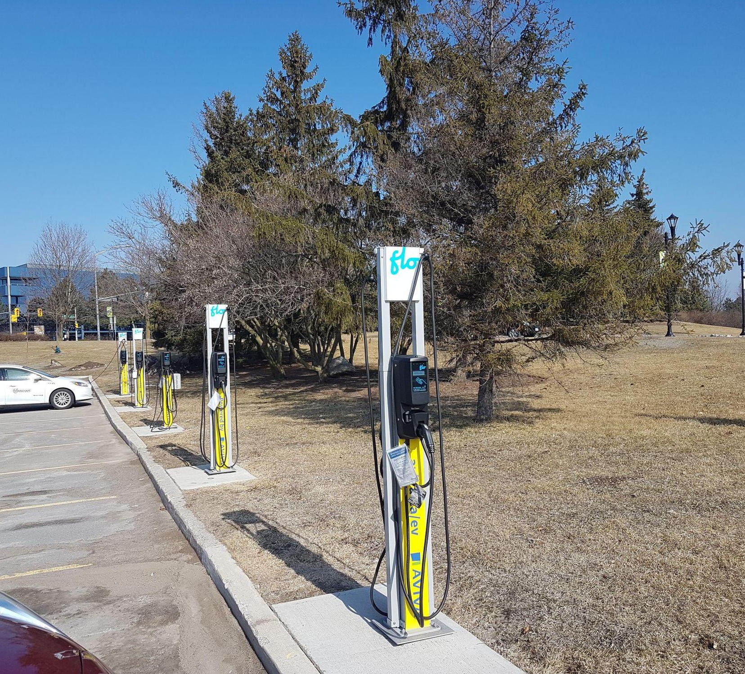
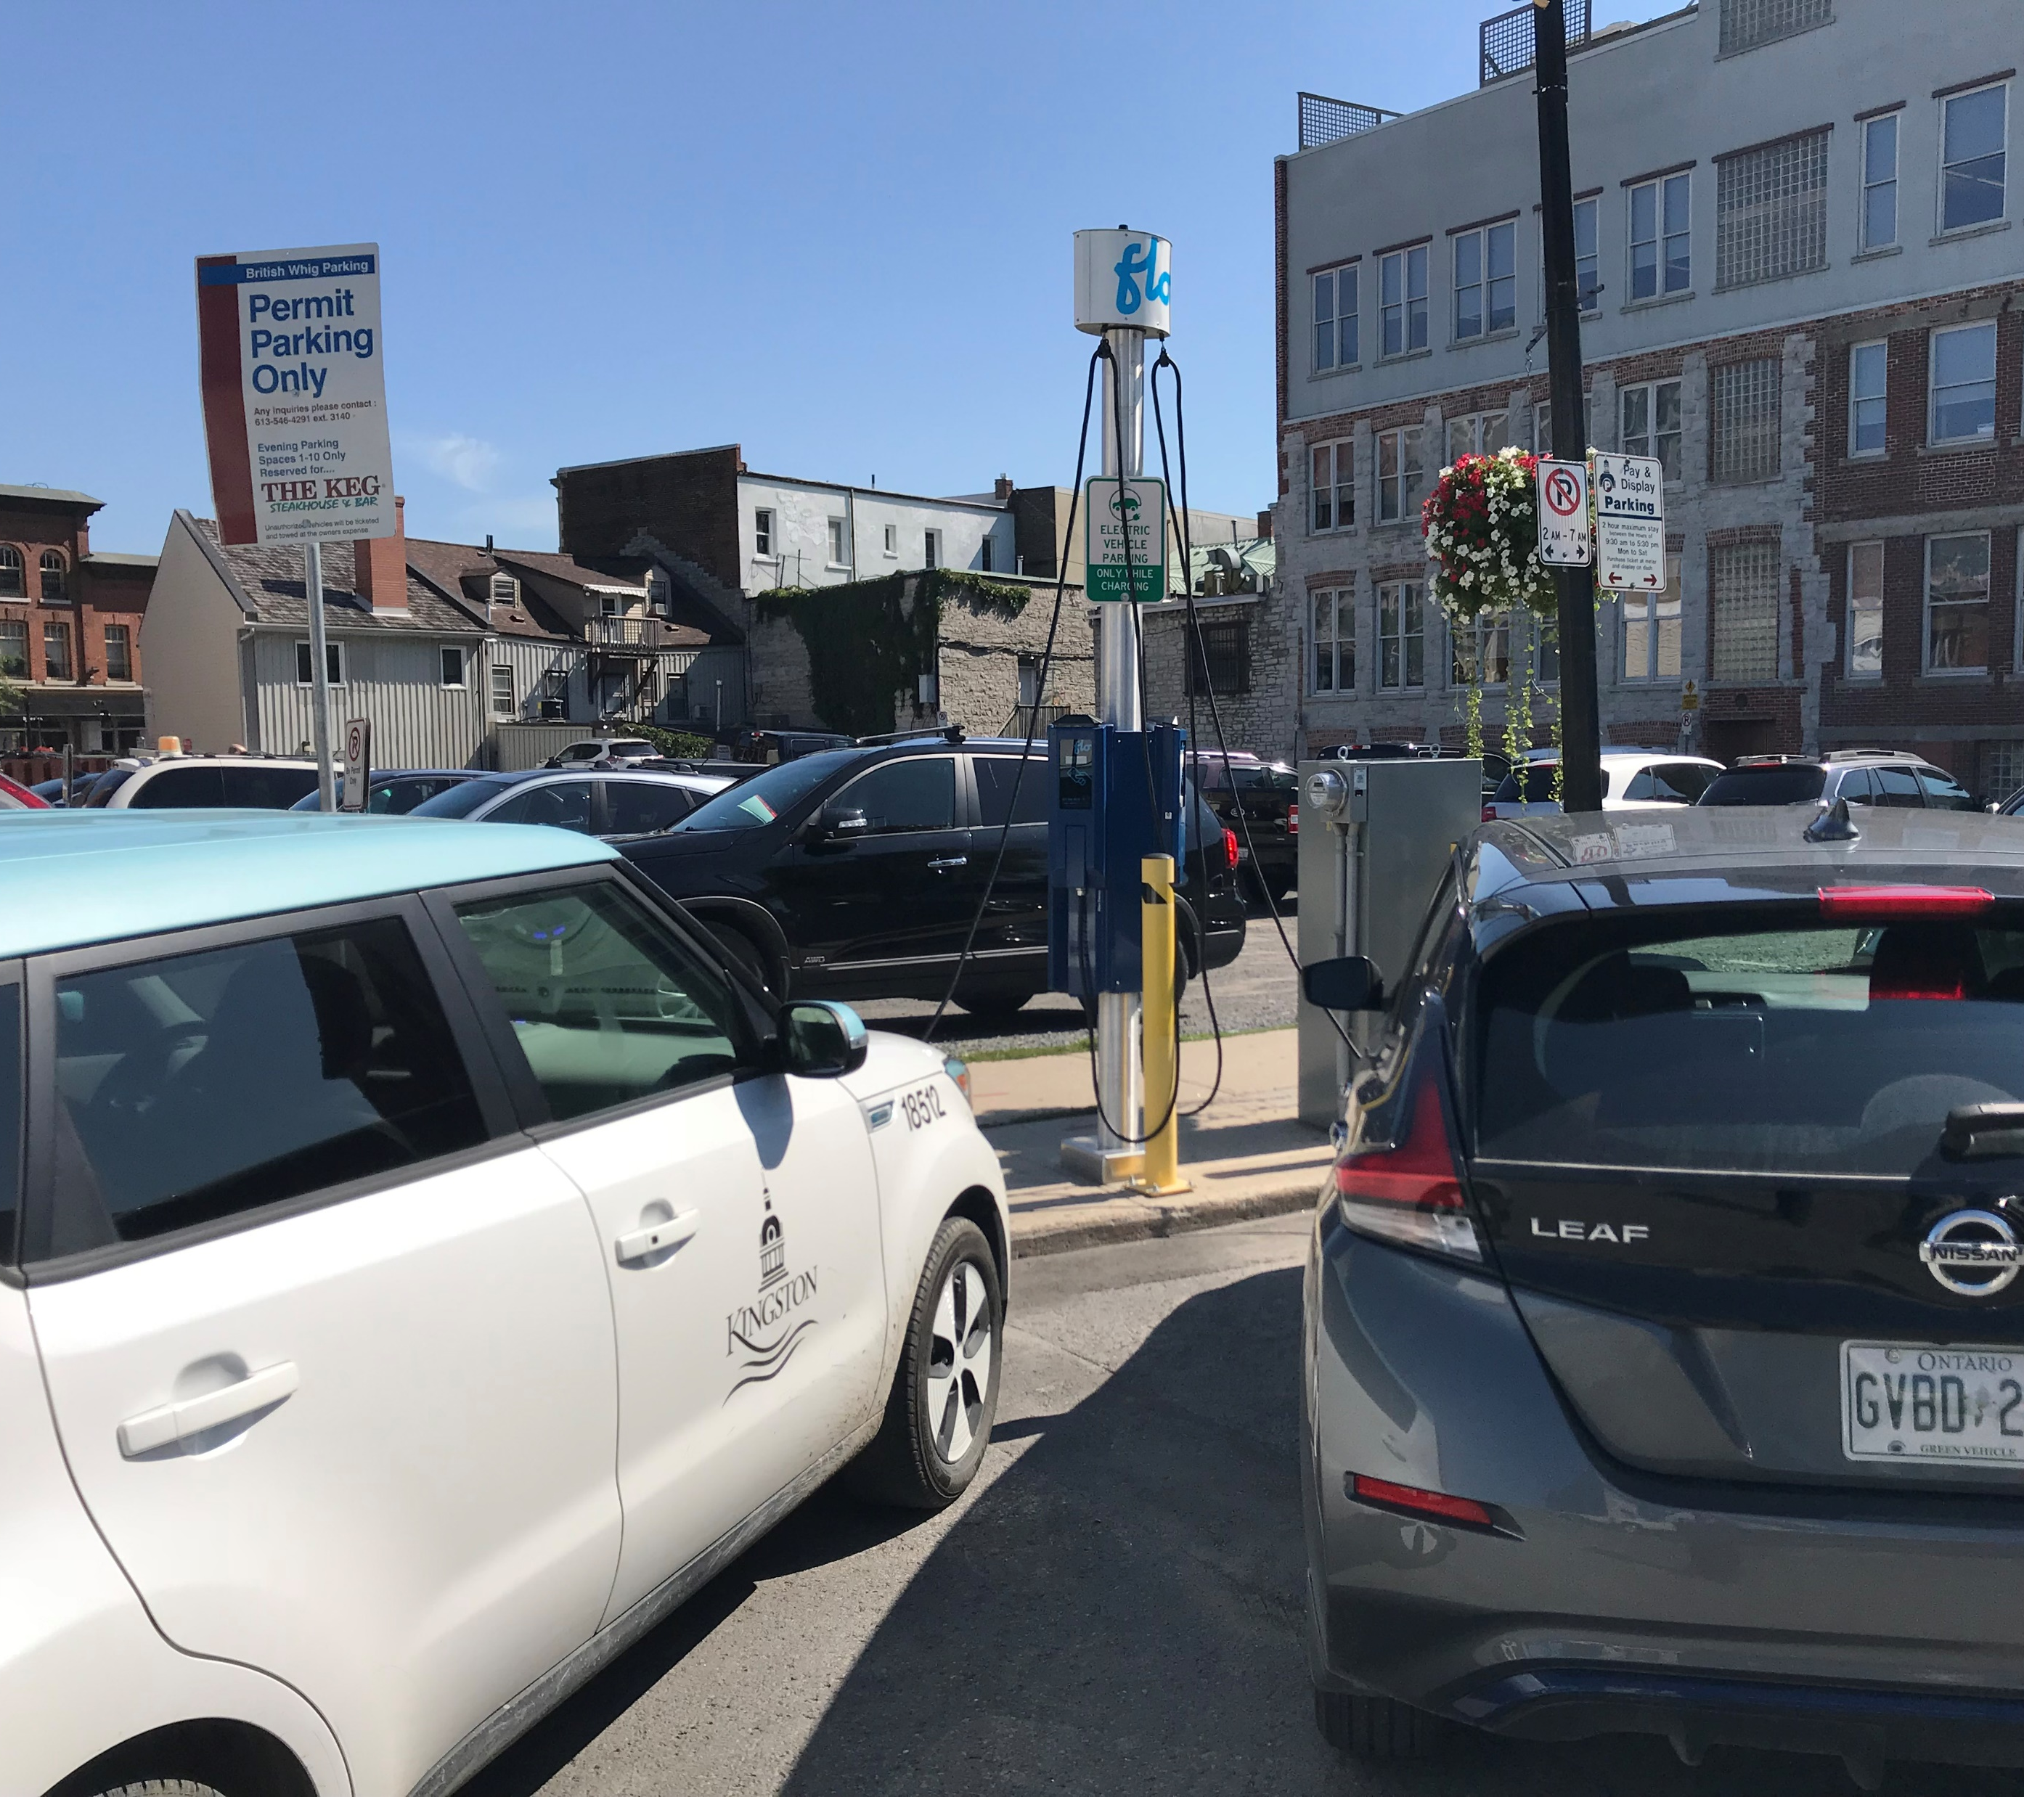
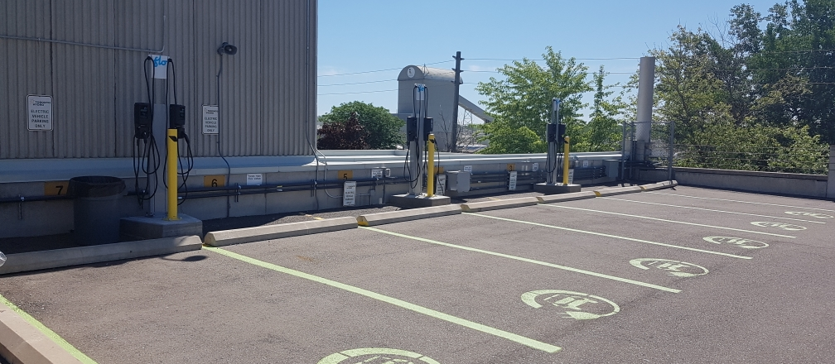

Slide 5
Key Points to Address – Electric Fleets
Fleet Depot
On the Go
Electrical infrastructure limitations
Demand charges
DCFC vs Level 2 charging
Available EV charging on my route?
How fast do I need to charge?
DCFC vs Level 2 charging
Considerations
Understand the different charging patterns
Charging availability and redundancy
Network operator and Manufacturer level of support

Slide 6
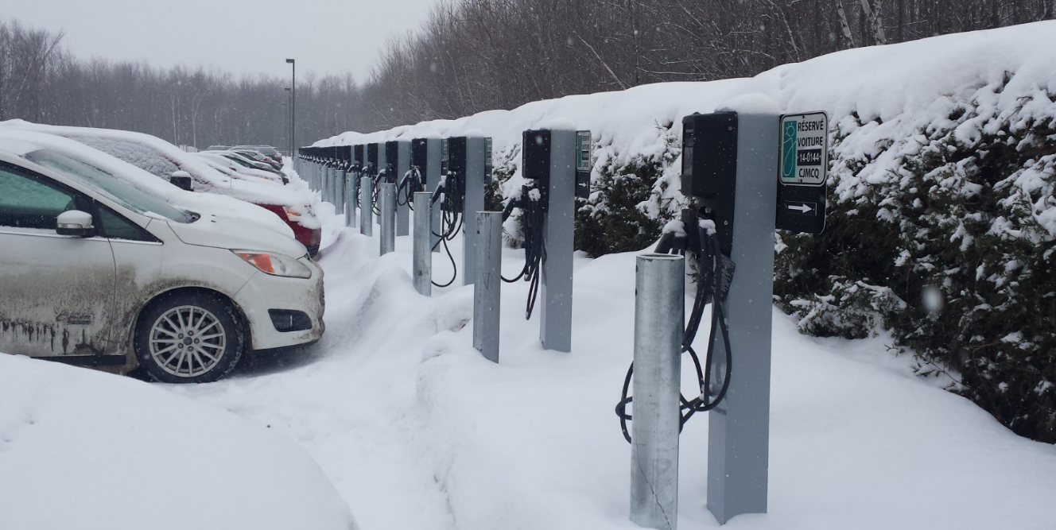
Electrical Infrastructure Limitations Our Solution
Power Sharing (U.S. Pat. No. 9,927,778)
Shares the remaining incremental capacity of an existing electrical infrastructure between multiple charging stations.
Benefits
Maximize the number of charging services offered with a limited electrical infrastructure
Unique priority system where certain users can charge faster

Slide 7
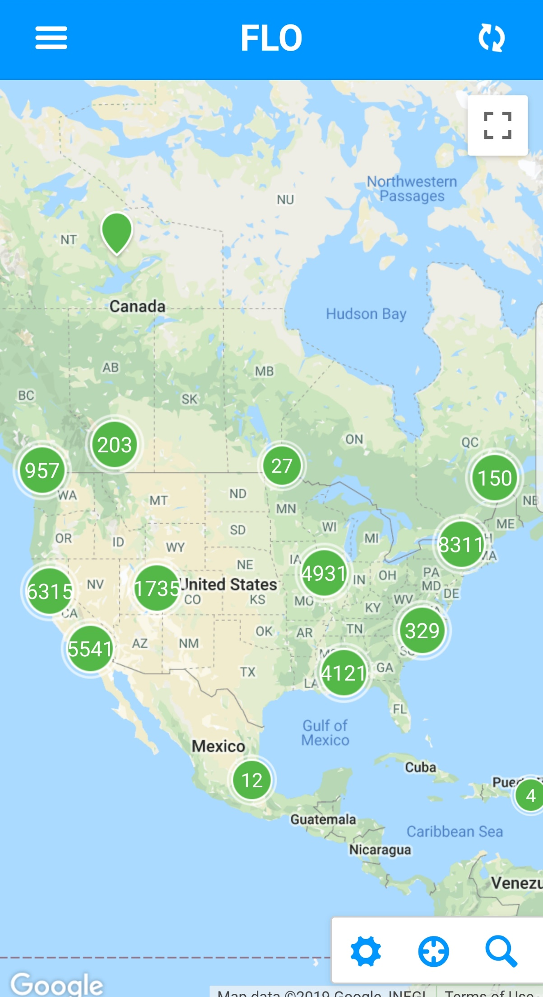
The power of the network
Network is growing at a fast pace
Benefits
Depending of your needs, you will have some level 2 or DCFC option to charge during your trip
Fix your route in advance

Slide 8
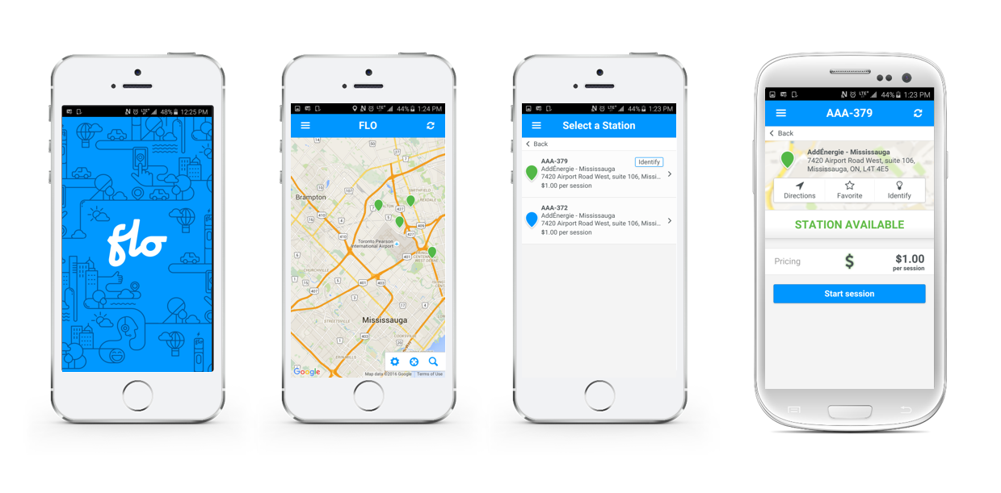
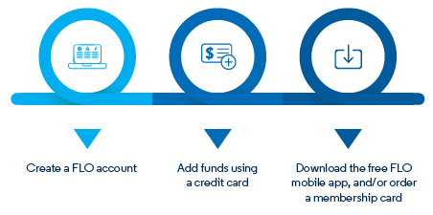
First-class User Experience
24/7 phone support
Proactive monitoring services
Mobile app or RFID access card
Real-time charging & billing data
Charging station locations
Cloud based reporting tools
PCI compliant payment system

Slide 9
Main take away
EV industry is moving fast
Don’t underestimate power management
Ideally start a pilot project as soon as possible
Partner up with a solution provider
#futureisnow
#leadtheway

Slide 10
Contact Information
Brookes Shean
General Manager, USA East and Central Canada
416.427.3339 | bshean@flo.com
flo.com

