Slide 1
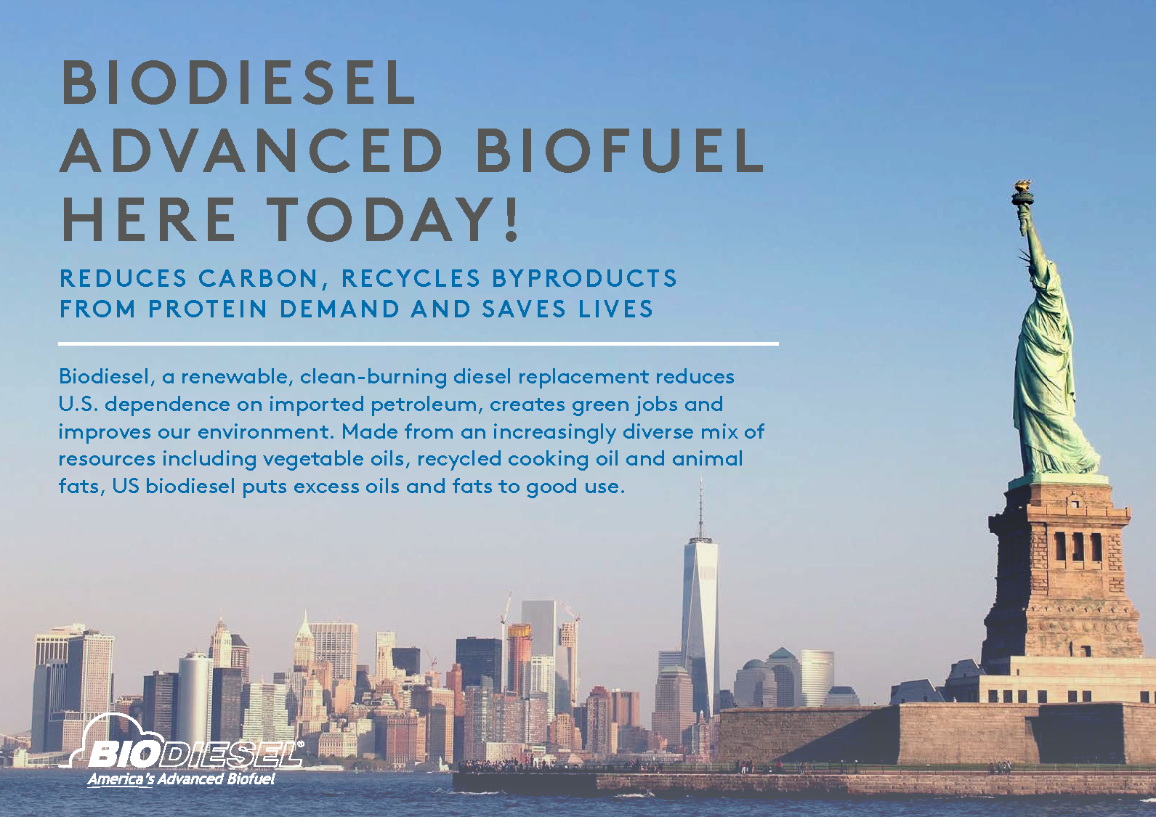
AltWheels
October 7, 2019
Ryan Lamberg

Slide 3
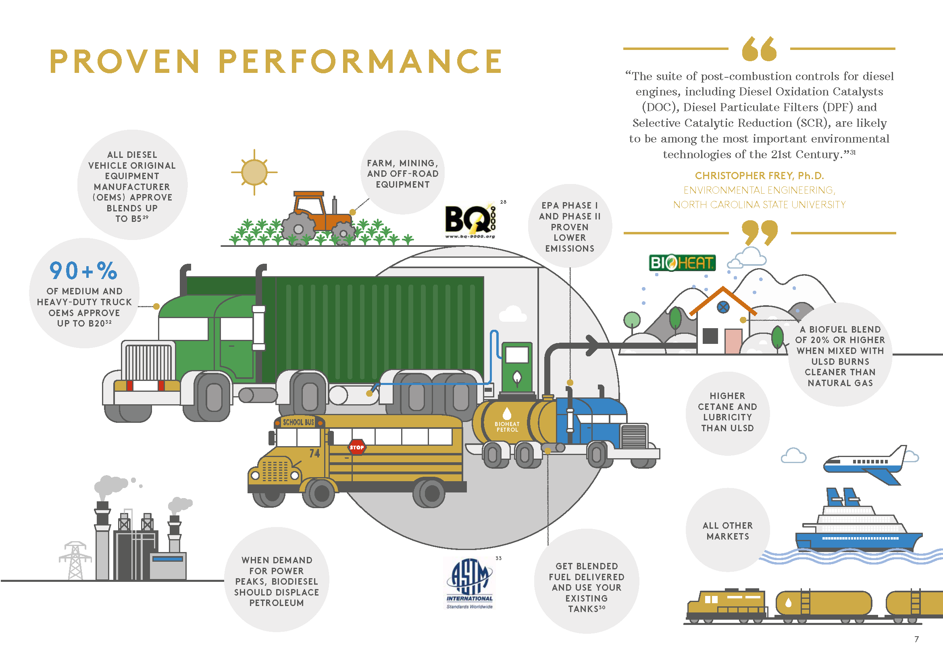

Slide 5
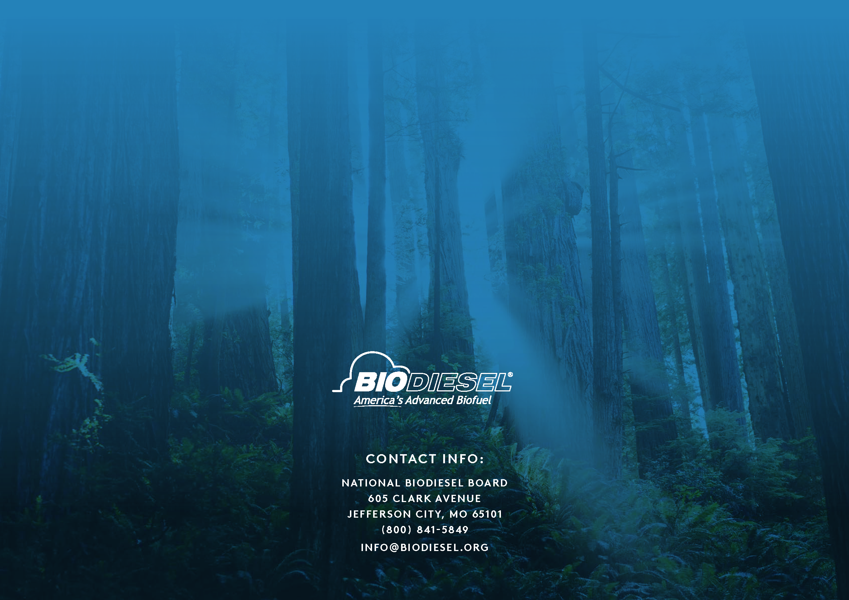
THANK YOU!
Ryan Lamberg
NBB Sustainability Consultant
rlamberg@californiabiodiesel.org
415-418-0964

