Slide 1
POWERING YOUR JOURNEY
SM

Slide 2
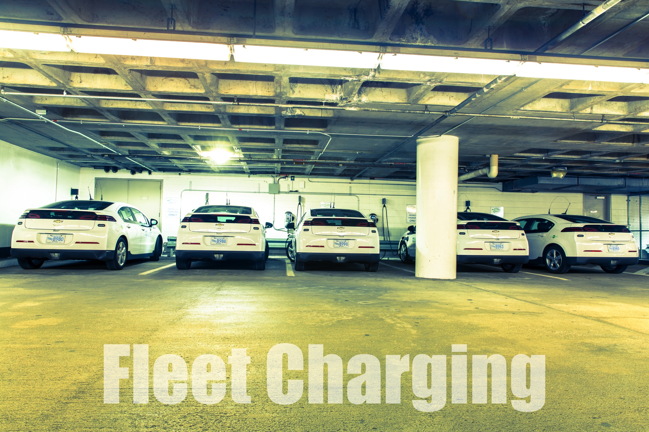
Typical Installation Examples
Audubon Society Newburyport, MA

Slide 3
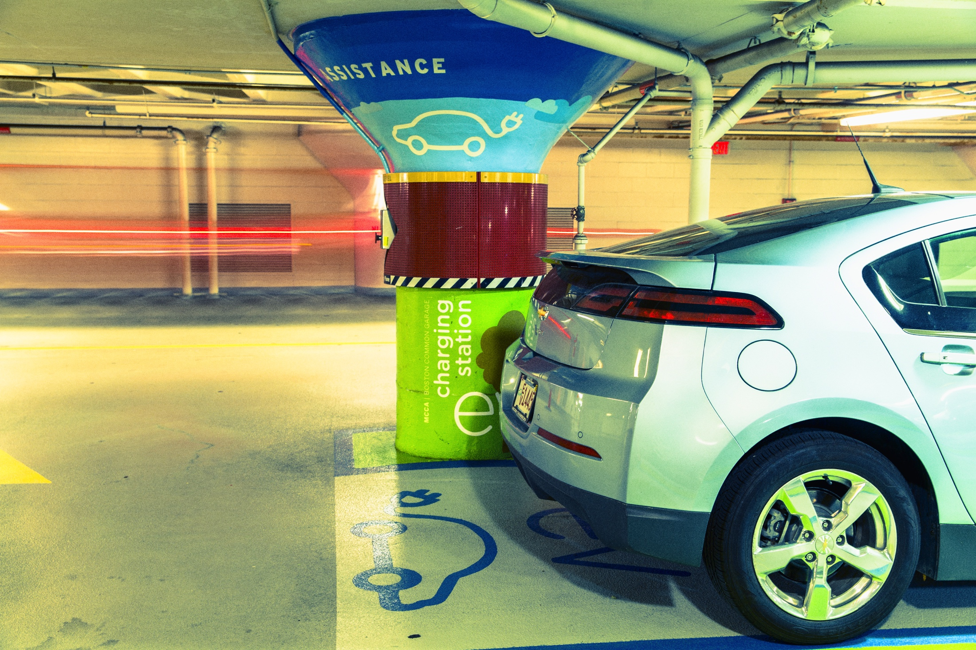
Making it Simple
Comprehensive Planning
Turn-Key Solutions
Equipment Sales
Data Mining & Reporting
Service & Maintenance

Slide 4
Some of Our Fleet Clients

Slide 5
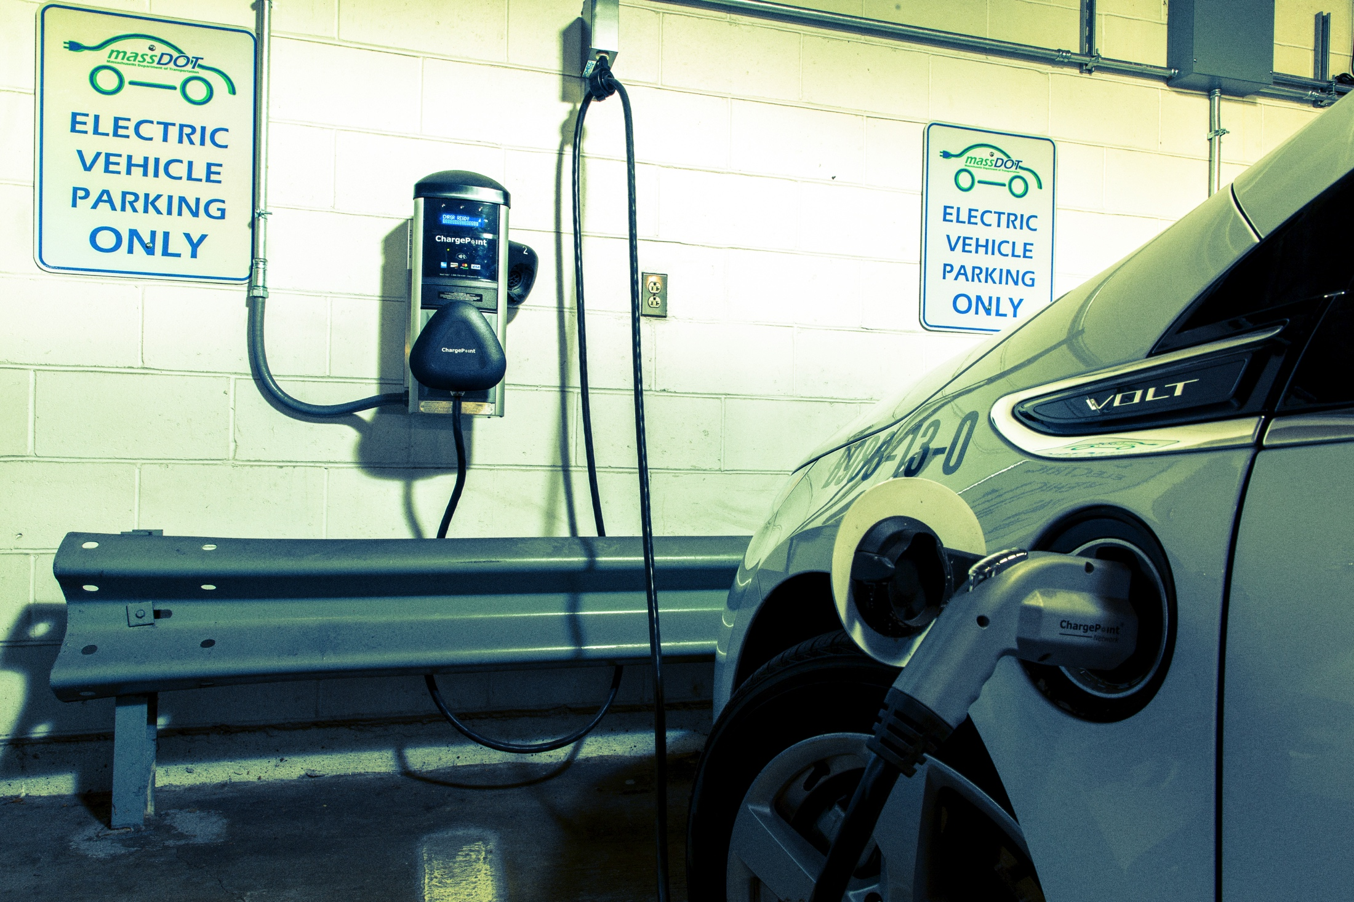
What is a Charging Station?
Comprehensive Planning
Turn-Key Solutions
Equipment Sales
Data Mining & Reporting
Service & Maintenance

Slide 6
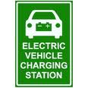
Electric Vehicle (EV) charging stations are essentially electricity vending machines

Slide 7
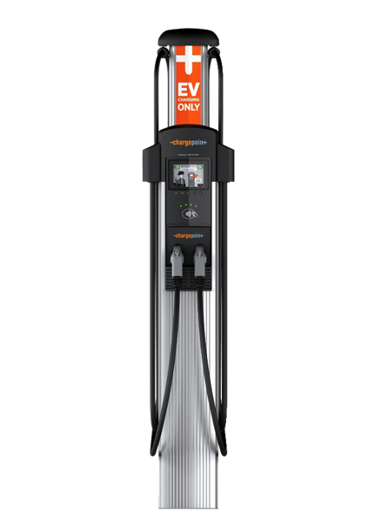
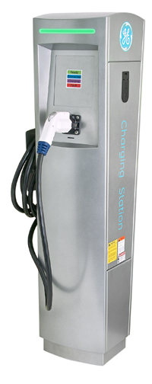
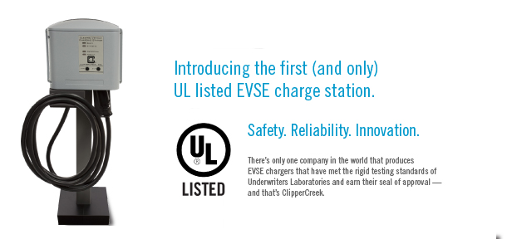
Charging Station Examples

Slide 8
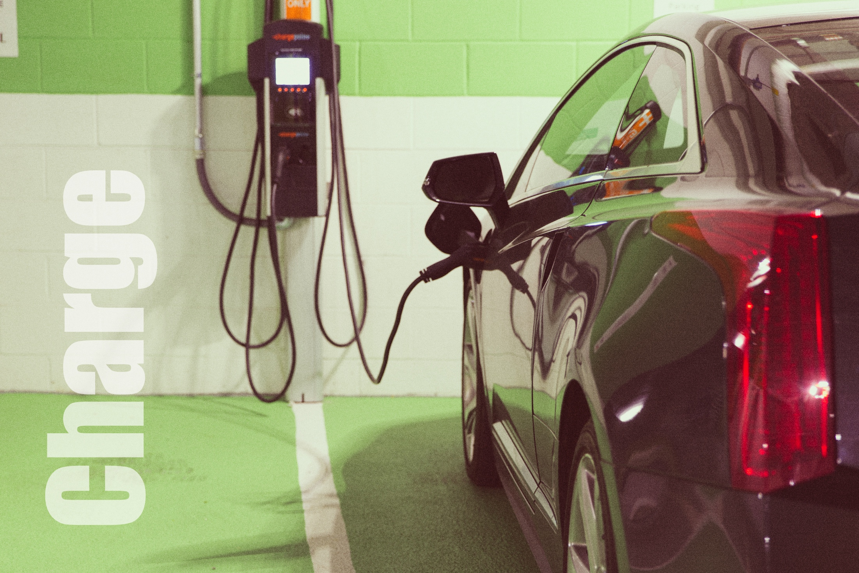
Levels 1, 2 & DC
Comprehensive Planning
Turn-Key Solutions
Equipment Sales
Data Mining & Reporting
Service & Maintenance

Slide 9
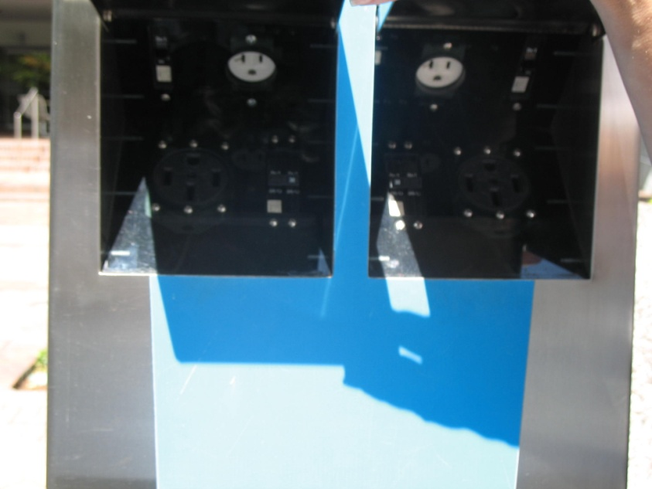
Charging Level 1
In 1991, the Infrastructure Working Council (IWC) was formed by the Electric Power Research Institute (EPRI) to establish consensus on several aspects of EV charging.
120V AC / 15-20APMs
Average 5 miles range per hour charge
Time for full charge up to 8-24 hours

Slide 10
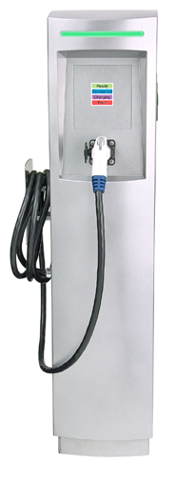
Charging Level 2
240V AC / Typically 32AMPS
Average 20+ miles range per hour charge*
Time to charge 4-8 hours
J1772 connector
* regulated by vehicle and dependent on charger

Slide 11
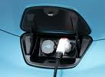
J1772 Connector
Standardized in 2010 All US vehicles comply (Tesla utilizes an adaptor)
Allows Communication Between Vehicle &Charging Station
Designed to last in all weather conditions
Engineered to prevent inadvertent disconnection
Grounded pole that is the first to make contact and the last to break
Interlock device that prevents vehicle startup while connected
De-energized until it is attached
De-energize prior to removal

Slide 12
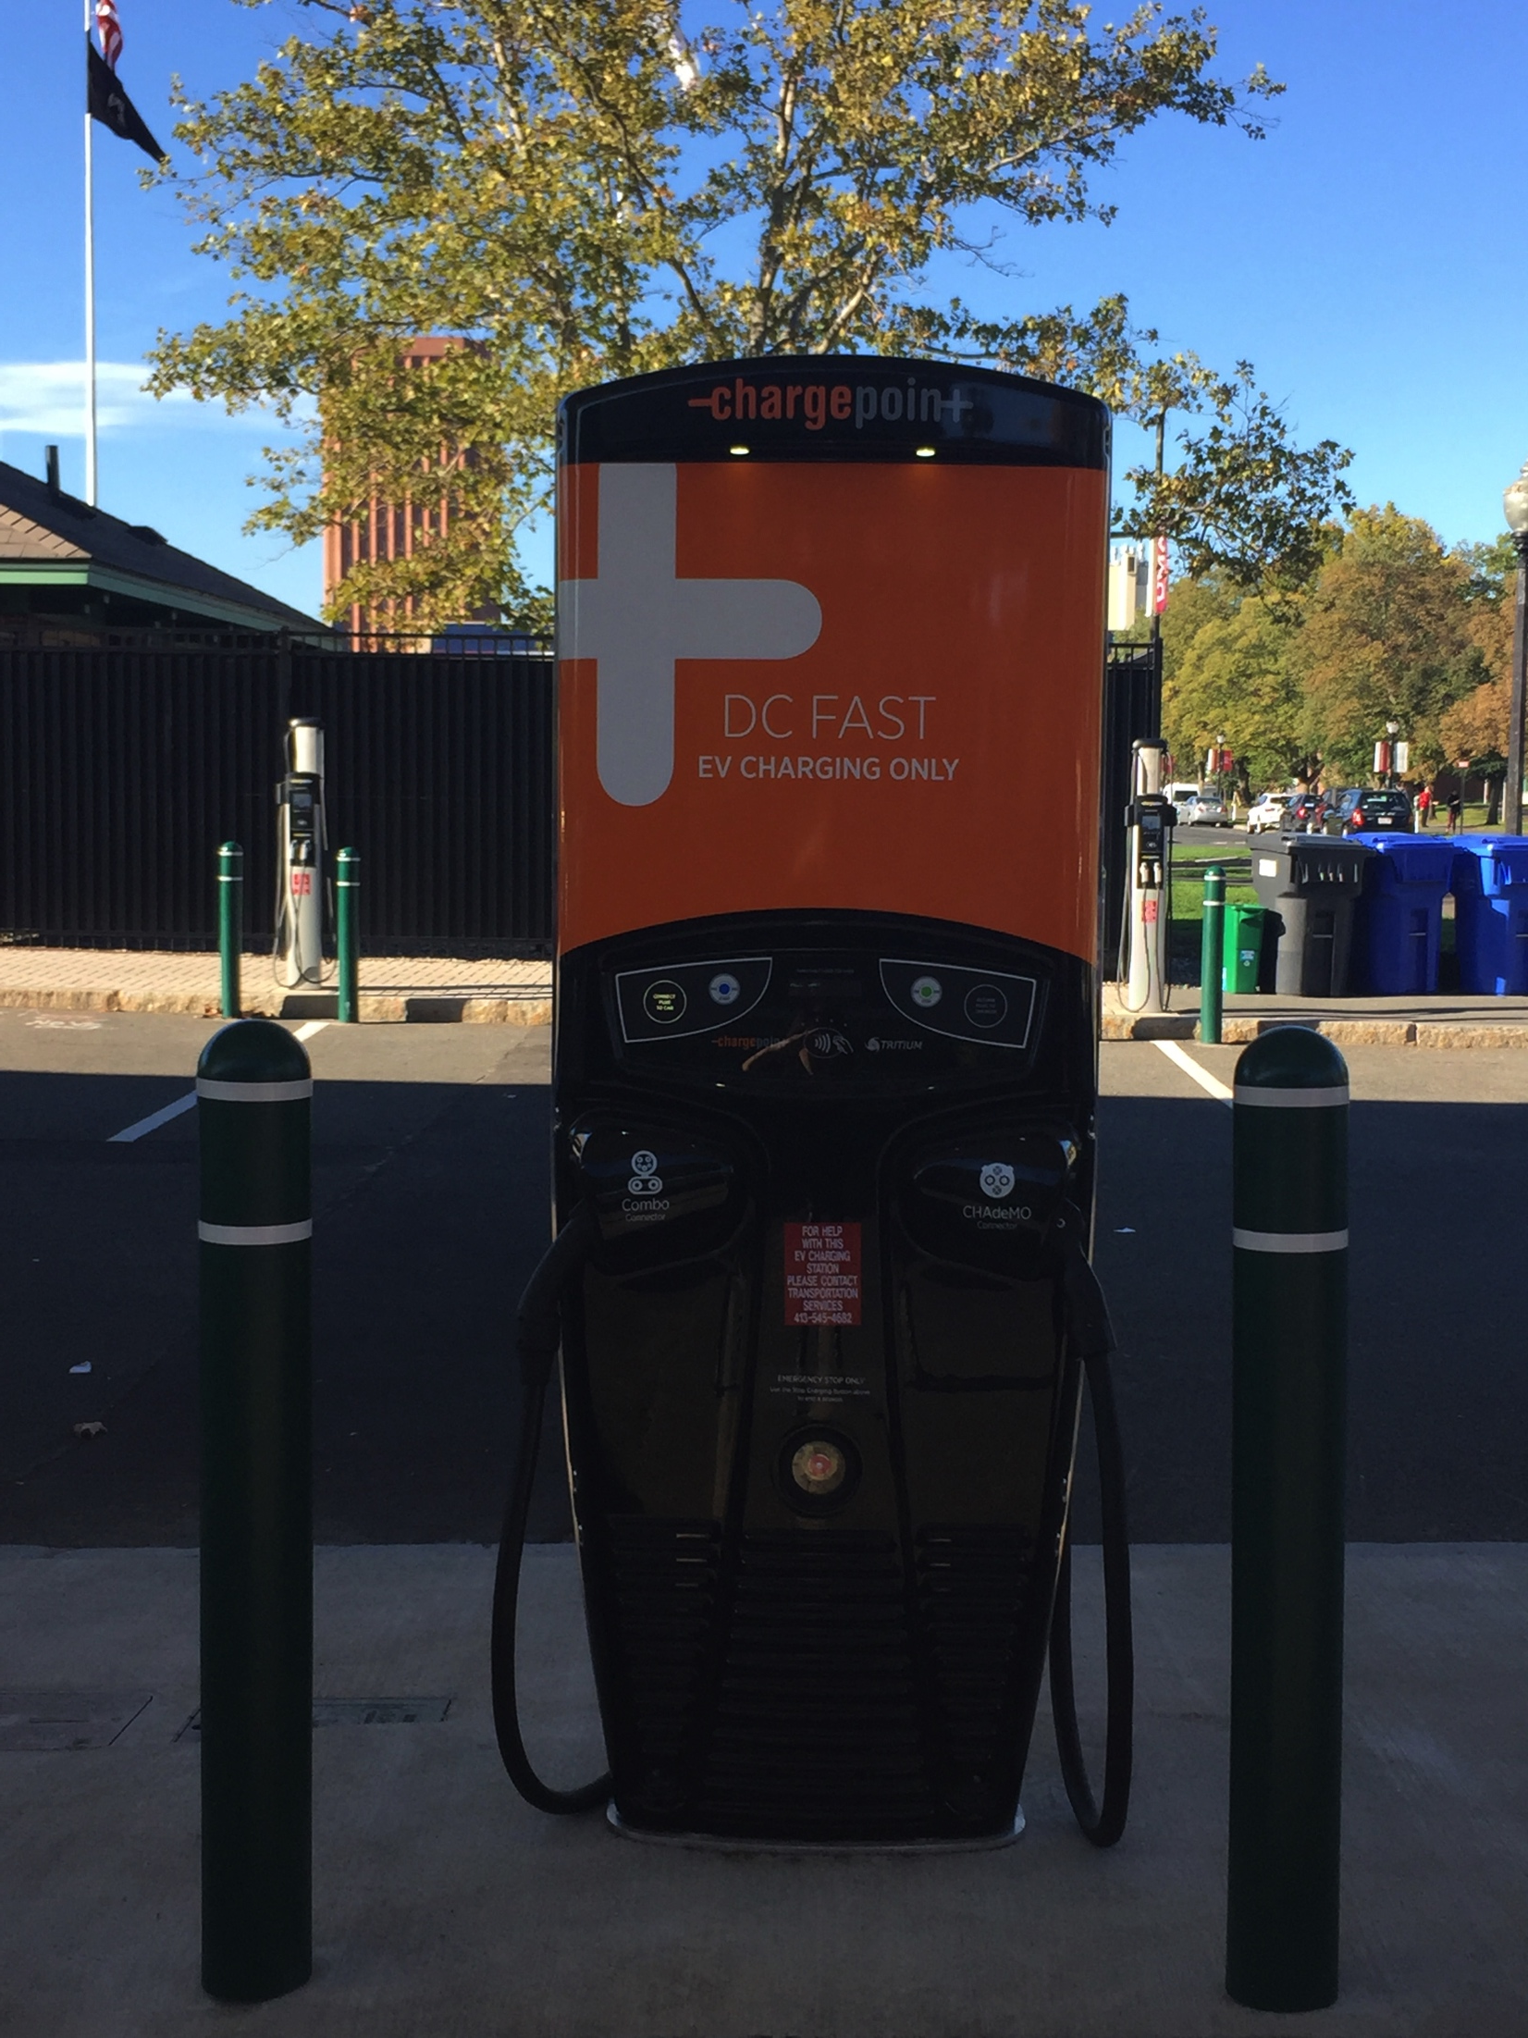
DC Fast Charging
208v or 480v / Amperage varies
50 kW- 150kW ( 300- 700kW in design)
Typical charge 15-35 minutes (average)
90 – 180 miles range per hour charge*
Only full Electric Vehicles have DC option
Multiple connectors
* regulated by vehicle and dependent on charger

Slide 13
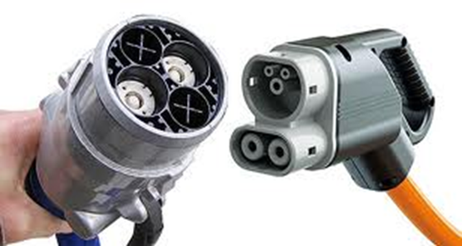
Tail of 2 DC Connectors
CHAdeMO -Japanese Standard
Compatible with Japanese Manufactured Plug-Ins (Nissan, Mitsubishi)
Tesla drivers have adapters for use with CHAdeMO
COMBO- US Standard
Compatible with New release US plug-Ins (BMW etc.)
Combined the J1772 with DC Charging in one Port

Slide 14
The Road to Fleet Charging
Phase 1- Planning, Planning, Planning
Vehicle selection and usage patterns
EVSE (charger) selection
Site assessment for power availability & site design
Usage policy & management plan
Phase 2- Implementation
Installation
Programing
Training
Phase 3- Maintenance & Management
Monitoring
Reporting
Servicing

Slide 15
Site Assessment Checklist
All EVSE must be installed on a dedicated circuit
Identify EVSE circuit requirements
Identify all potential power sources
Determine existing load capacity of panels and transformers
Determine requirements to plan for future additional stations
Identify potential mounting locations/ traffic flow / usage patterns
Determine cellular signal availability (if equipment is on cell based network)
Determine what protection is needed (bollards etc.)

Slide 16
Biggest Factors Impacting Costs
Availability of power
Proximity of mounting site to available power
Excavation
Mounting style/ configuration
Lack of planning for future

Slide 17
When Sighting Consider
Walk ways/ cords
Distance/ Reachability of Handle
Snow banks (outdoors)
Space size
Expected car/charging duration
Multiple Layout options
Protection
Future expansion

Slide 18
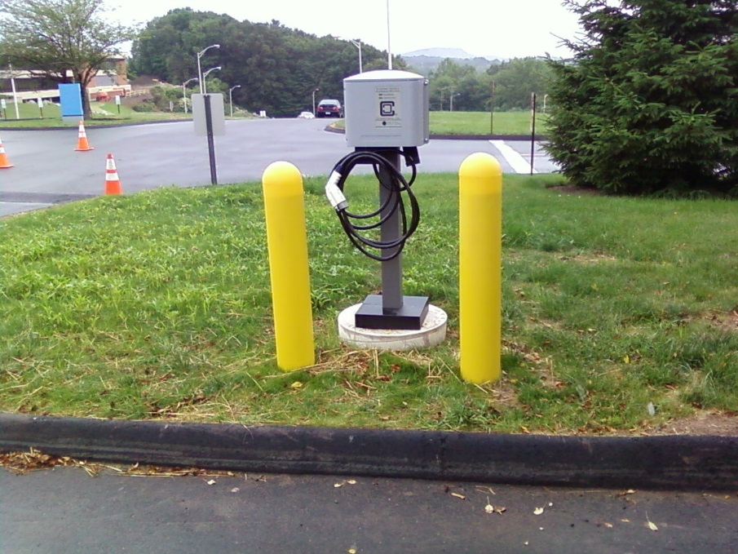
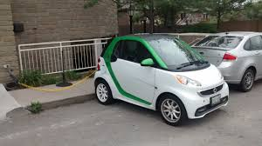
What’s Wrong with these photos?

Slide 19
Typical Layout

Slide 20
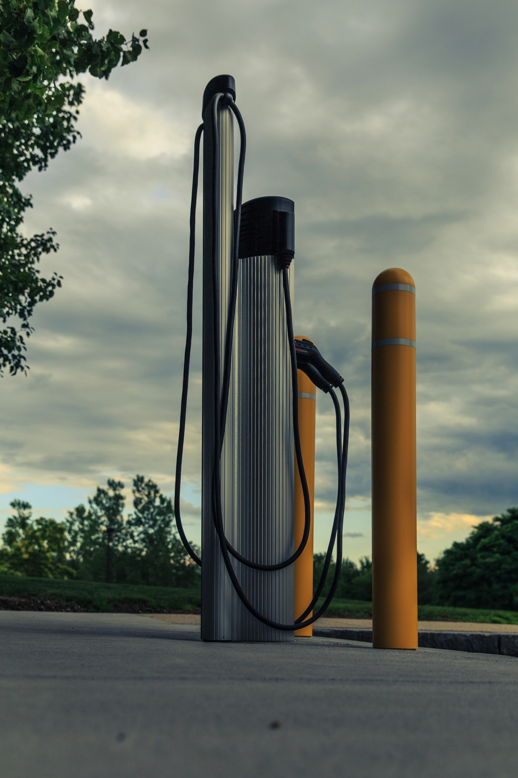
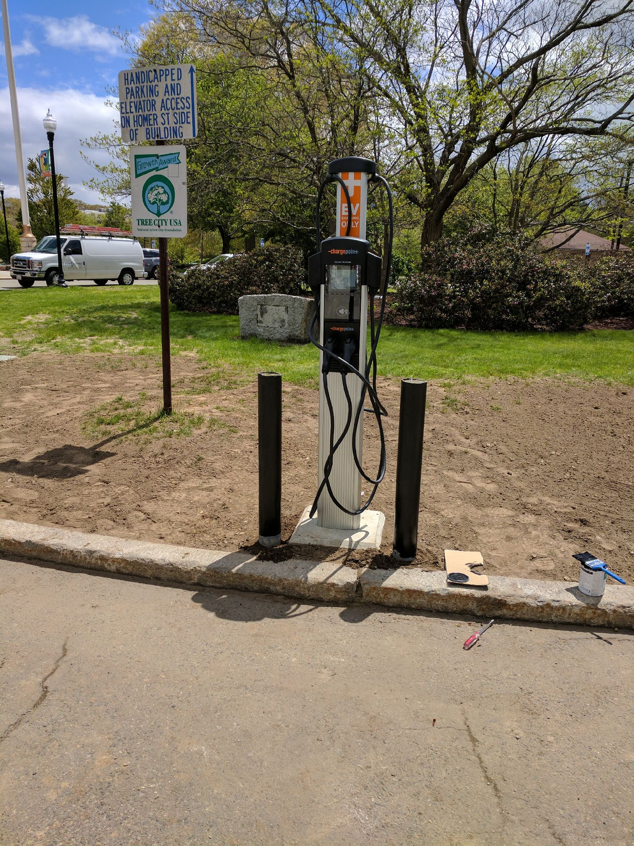
Typical Layout
Comprehensive Planning
Turn-Key Solutions
Equipment Sales
Data Mining & Reporting
Service & Maintenance

Slide 21
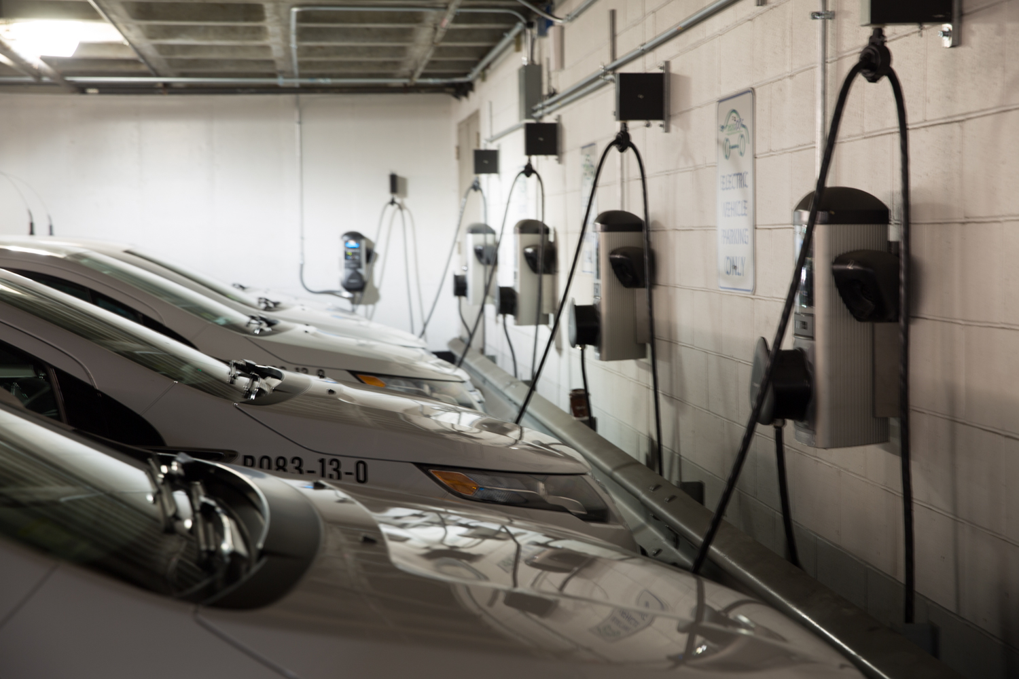
Typical Layout
Comprehensive Planning
Turn-Key Solutions
Equipment Sales
Data Mining & Reporting
Service & Maintenance

Slide 22
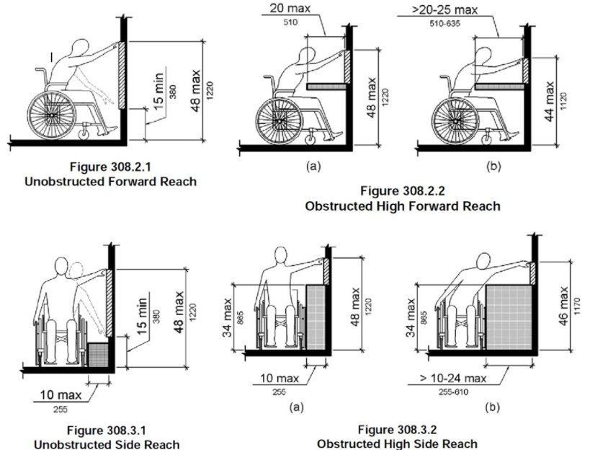
ADA Accessibility

Slide 23
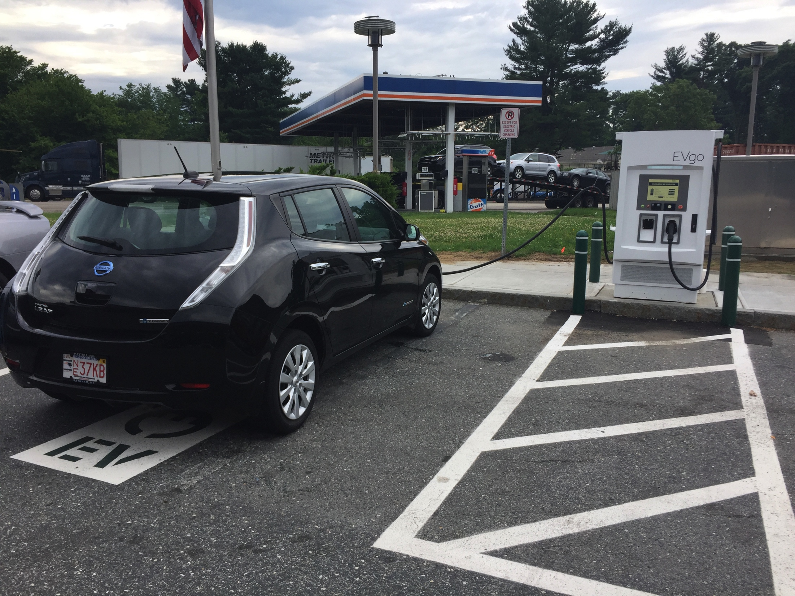
ADA Accessibility

Slide 24
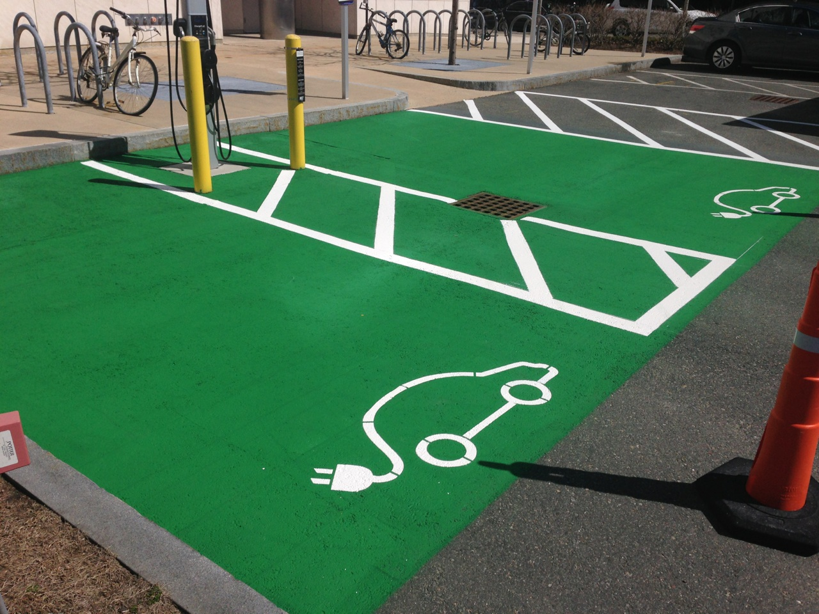
Multiple Levels of Accessibly

Slide 25
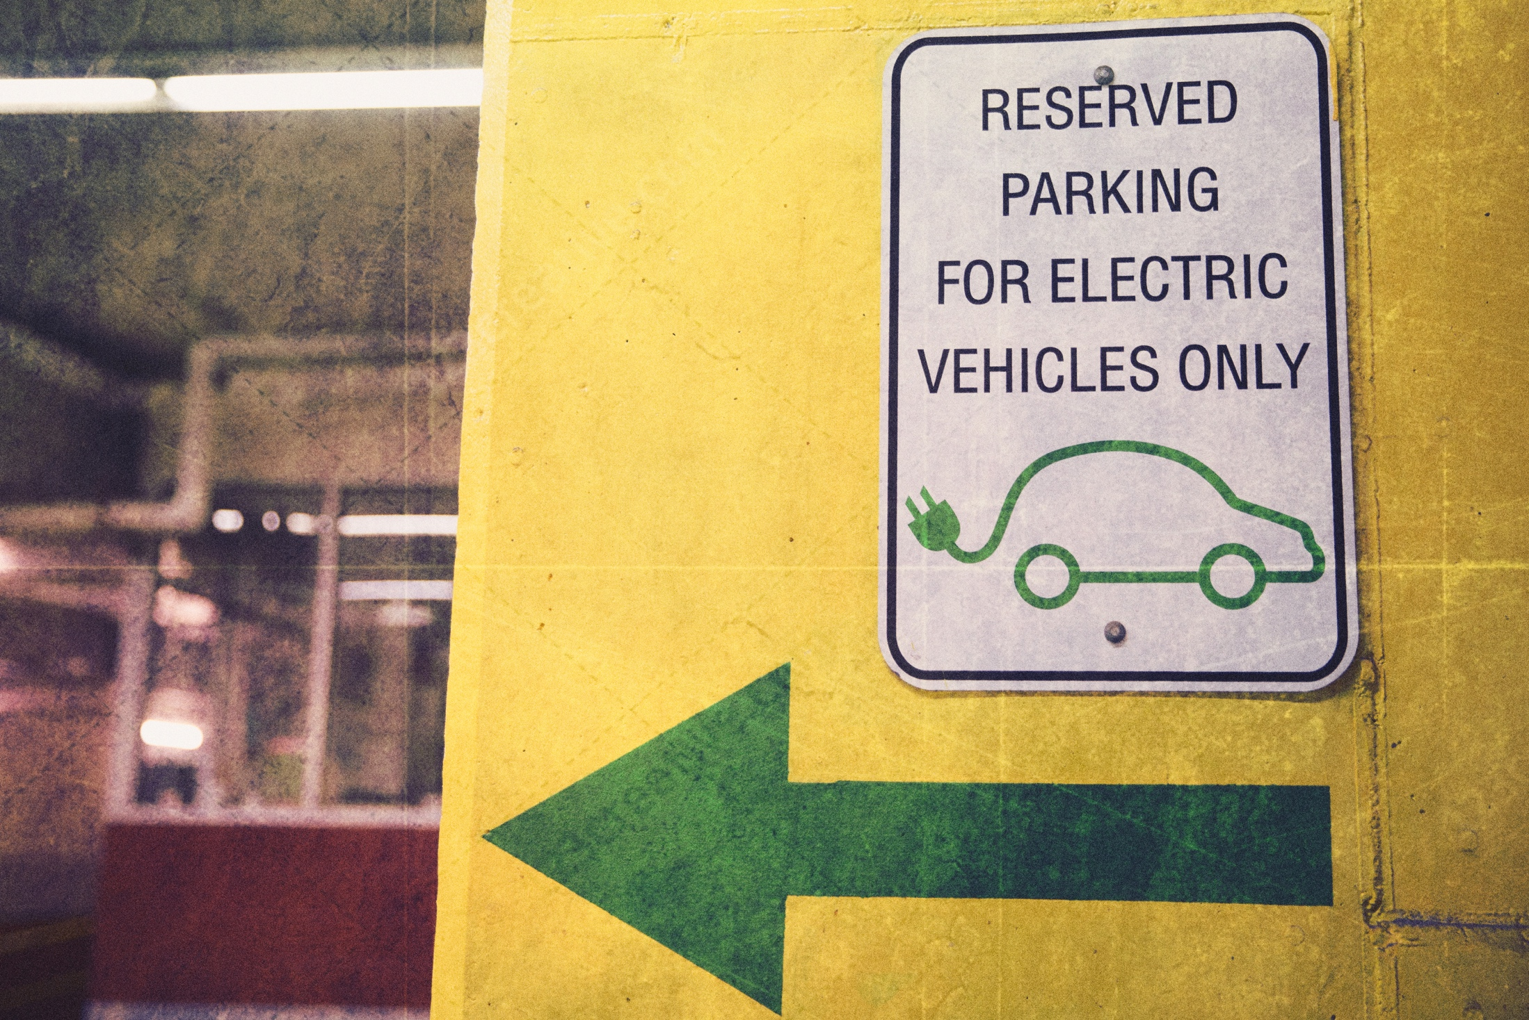
ABOUT VOLTREK
MA Company Founded in 2010
OSD Vendor
WBE/ DBE Certified
Installed 600 + Charging Ports
Leader in EVSE Project Management

Slide 26
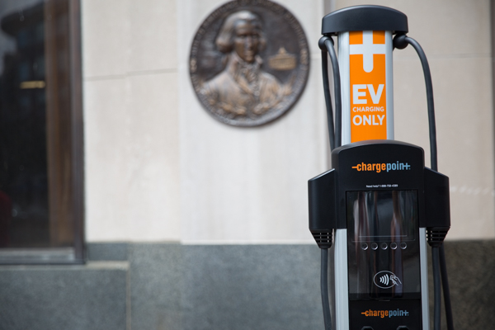
Contact Information
Voltrek, LLC
Andover, Ma 01810
978-378-0910
info@voltrek.com
www.voltrek.com

