Slide 1


ChargePoint & Fleet Solutions
Market data:
The numbers speak for themselves
Justin Ries, Account Executive, New England
October 2, 2017

Slide 2




The World’s Largest and Most Open
EV Charging Network
40,000+
Largest Community of EV drivers
+ 80% of new EV drivers join ChargePoint network every month
+ A driver plugs into our network every 2 seconds
Charging Everywhere
+ 40,000+ charging spots
+ 700+ ports added every month
We’re Established and Growing
+ Almost $500 million in funding
+ 74%+ share of commercial
smart charging marketshare
We Are the Industry Leader
According to Time, Bloomberg, CNBC, Navigant Research
and many others

Slide 3
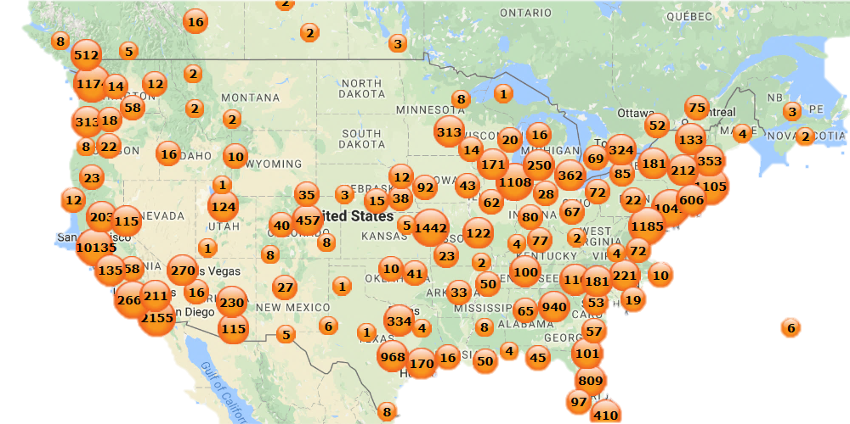
Largest EV Charging Network in North America
40,000+
Charging Spots
(600+ DC)
24M
Charges Delivered
Notes:
Born in 2007
250+ Employees

Slide 4






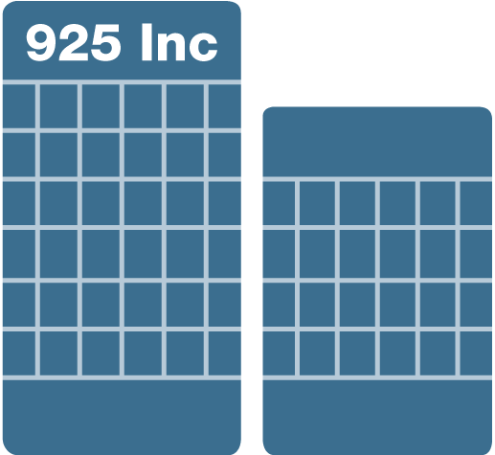



ChargePoint Mission: EV Charging, Everywhere
Get everyone behind the wheel of an EV and give them charging wherever they go.
Out of Town
Home
Convenient and connected charging for home, work, around town and out of town.
Work/Fleet
Around Town

Slide 5
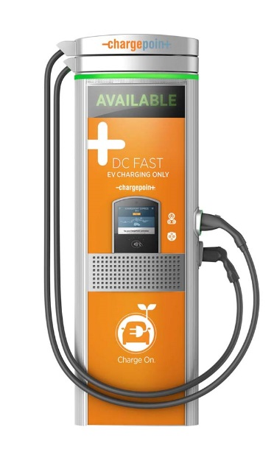
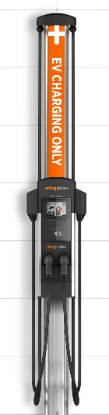
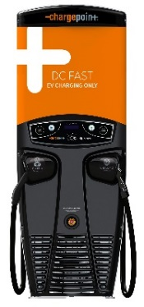
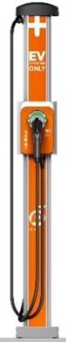
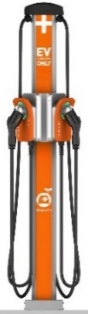
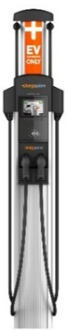
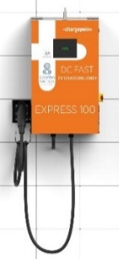
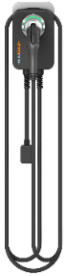
Stations for Every Application
Single Family
Home
Multi-Family,
Fleet
Commercial/ Multi-Family,
Mixed Use
On-Route,
Commercial, Fleet
Home
Level 2
CPF25
Level 2
CT4000
Level 2
CPE100
24kW
CPE200
50kW
CPE250
62.5kW
Express Plus
400kW
Fast DC Chargers
Ultra-fast DC Chargers

Slide 6

Trusted Partner for Fleets
ChargePoint has thousands ports serving fleets, and custom solutions for several fleet verticals:
Government
Transportation Network Co.
Utilities
Delivery Services
Workplace
Telecom
Marquee ChargePoint fleet customers
Notes:
There are many different kinds of fleets out there

Slide 7
Charging Stations – Where to Start?
Fleet Goals & Operations Data
Evaluate Electrical Infrastructure
Develop an EV Fleet Adoption Plan
1
2
3
Notes:
How to get started, Schedule a meeting with me, we will go through your questions/intentions. We’ll also take a look at your electrical infrastructure to determine how best to approach the site from a construction standpoint. Once we have a comprehensive view, we’ll schedule a second meeting with you to review your optimal charging solution setup including station hardware & software equip and costs, electrical requirements and costs, and review ROI & use case as it pertains to your site & place of business.

Slide 8


Data Gathering – Fleet Manager
Key Questions
  How many and type of vehicles today and in future?
  What is the average number of miles driven per day?
  Where do vehicles park?
  For how long do they park?
Data Gathering – Facilities Manager
Key Questions
  How many available circuit breaker slots are on the electrical panel?
  How much available capacity (amps) is on the electrical panel?
  What utility tariffs/rates apply to EV charging
  (look for demand and time-of-use energy charges)?

Slide 9


Data Gathering – Fleet Systems Integration
Do you use telematics for your vehicles?
  Who is your telematics provider?
  Have you talked to them about EVs?
Do you use a fleet card?
  Which fleet card do you use?
  How do drivers use them?
  How do you bill different users (i.e. charge-backs)?
Do you have an FMIS (Fleet Mgmt Info System)?
  Who is your FMIS provider?
  Does it integrate with your fleet card and telematics?

Slide 10


Connecting the Dots with Fleet and Facilities Mgmt
Key Questions
  How many vehicles can be charged with my existing electrical service?
  Are vehicles charging in the most efficient way possible?
  Will the electrical service or panel require an upgrade?
What You Learn
  Timing and budget for electrical upgrades
  How to minimize unnecessary electrical capacity upgrades
Pro Analysis
  If the vehicle charging time is less than 75% of the time the vehicle is parked, you should investigate if there is an opportunity to charge more efficiently (e.g., reduce power or allocate power to other vehicles when charging is complete).

Slide 11
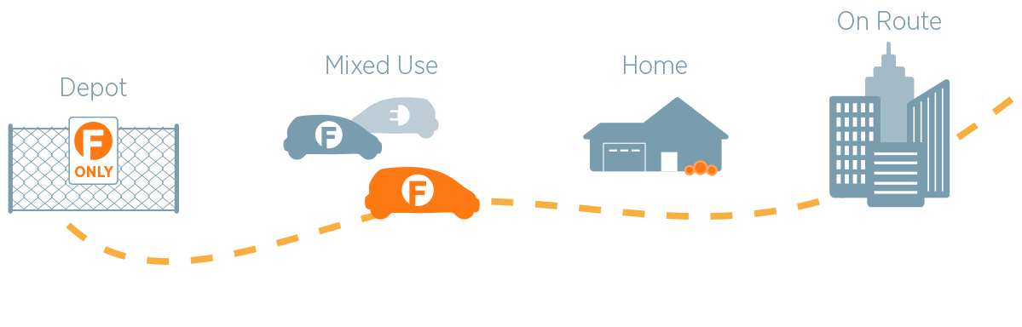
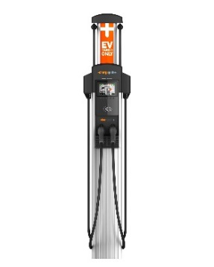
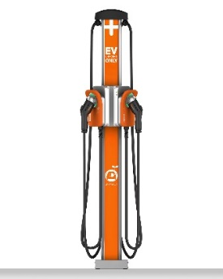
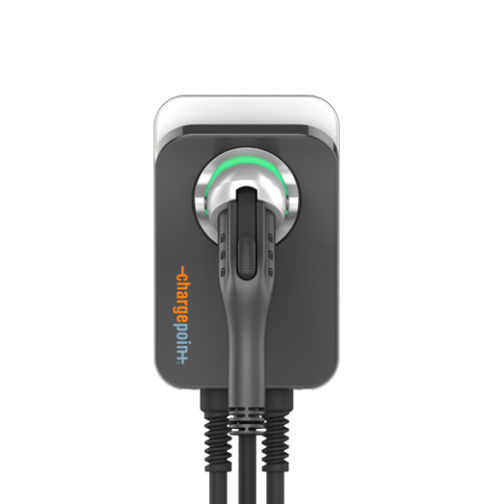
Addressing Every Fleet Vehicle Charging Need
Depot
Dedicated fleet vehicle charging in the depot parking area
Mixed Use
Fleet vehicles and employee personal vehicles share access to charging stations
Home Charging
Drivers can charge fleet vehicles at home and get reimbursed for electricity costs
On Route Charging
Fleets can easily pay for and use public stations that require payment (Fuel Card)
Notes:
We’ll assess the situation and make suggestions based on your needs. Whether it’s depot charging only, a mix of charging locations, drivers charge at home, or on their route.

Slide 12
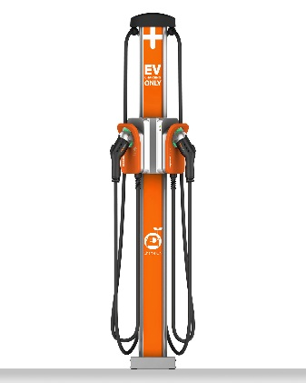
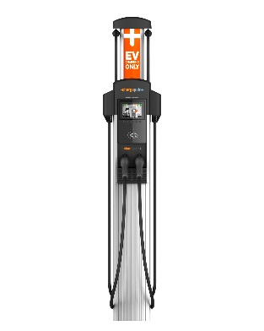
Most common fleet hardware: CPF25 vs CT4K
Dedicated fleet use
RFID can be disabled (behind fence)
Accepts only Fleet Accounts
Driver Accounts not accepted
Access control for individual fleets
Shared with non-fleet users
Requires RFID
Fleet & Driver accounts accepted
Driver & Fleet access control
CPF25
CT4000
Power
Data
Compatible
Cloud Plans
Commercial
Enterprise

Slide 13
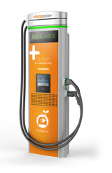
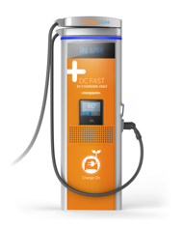
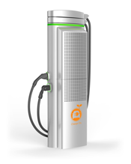
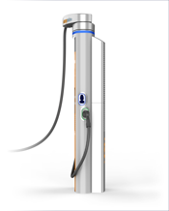
Just Introduced - Express Plus Station
Power Capabilities
  Standalone supports 2 power modules to deliver up to 62.5 kW
  Two stations can share power for 125kW available to either
  Power level can be augmented by sharing with nearby Power Cube with up to 16 more modules
  Capable of 400 A max @ 1000 V max (up to 400 kW output!)
Aesthetically pleasing, functional design
  Dual Displays (10” LCD w/touch for interaction, 20” LED display for status/notification)
  Light weight, flexible, liquid-cooled cables with cable management
  1 to 3 Connectors from the following types: CCS Type1, CCS Type2, CHAdeMO, GB, and others on an as needed basis
Future Proof Technology
  Add power cube with more shared power when needed
  Minimum of 250 RPH up to 5x as new EV’s technology allows
  License plate detection, occupancy detection, vehicle identification etc.
Notes:
Will be the standard for light/heavy duty trucks & buses, Depot charging or on-route.

Slide 14
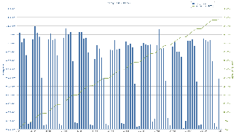
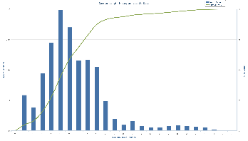
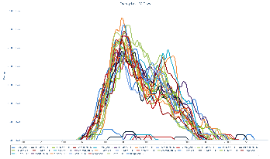
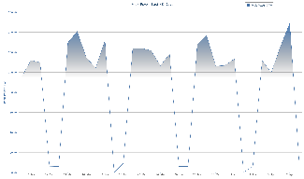
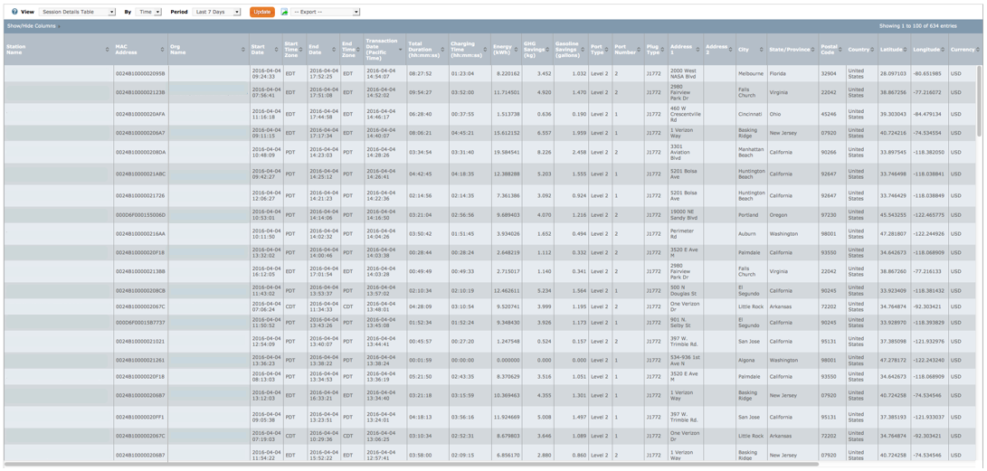


ChargePoint Vehicle and Station Data and Reporting
Measuring Success
Energy use (kWh) and cost
Peak Power Load, Average Power Load (kW)
GHG Avoidance and Gasoline Savings
Utilization of stations
Peak occupancy of stations
Charging session duration
Detailed transaction data
Integrate data into existing systems
Notes:
When we tailor a solution that best fits your needs, we can then view the data on a more granular level to re-assess and examine best practices based on real-time & real world usage patterns & empirical data.

Slide 15
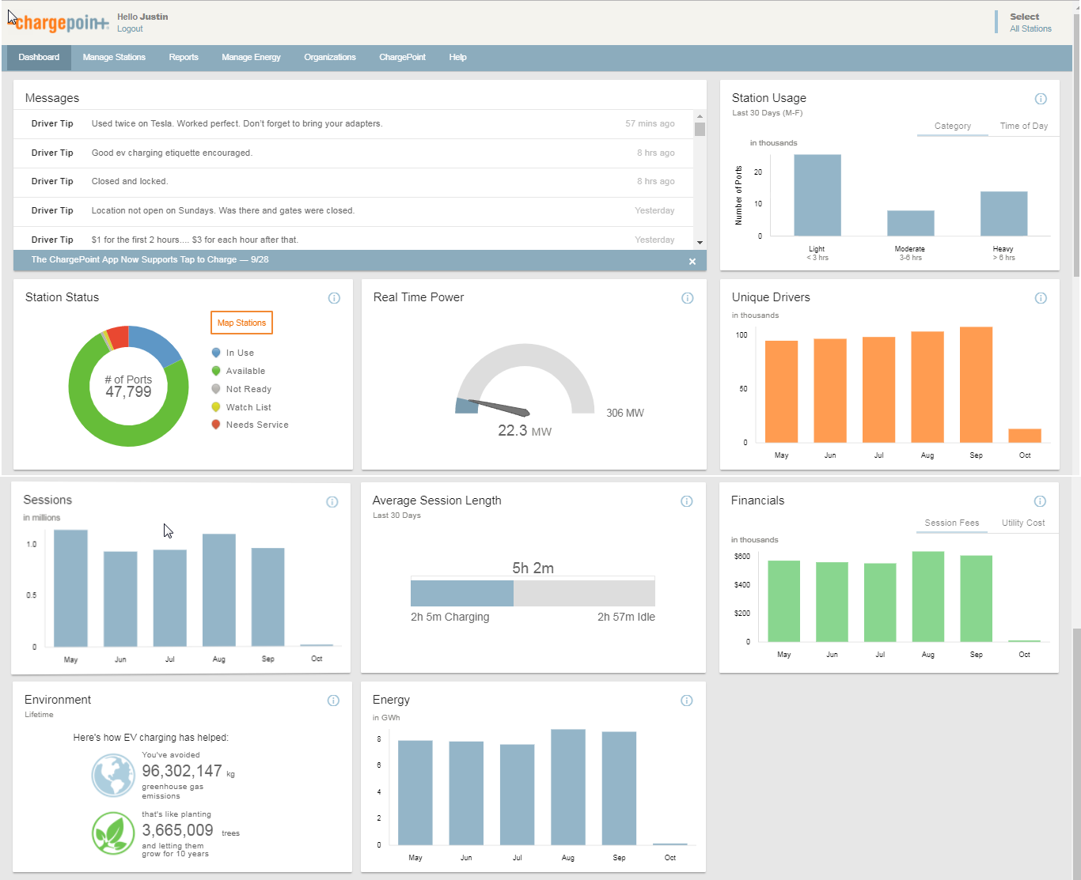

Slide 16


Energy Management
Feature | Description | Cloud Plans
 |  | CPF25 | CT4K
Power Select | Permanently de-rate power | Data | Commercial
Scheduled Charging | Plug-in and start charging at designated times | Power | Commercial
Power Sharing | Dynamically share power from 1 circuit | Power | Commercial
Panel Sharing | Dynamically allocate power from an electrical panel | Power | Commercial
Site Management | Dynamically manage power across multiple groups of stations or sites | Power | Commercial
3rd Party | Utility/BMS/etc. | Inquire | Enterprise
Control the flow of power
at sites with constraints
Panel
400A
capacity
Share a
circuit
Share a panel
Site
800A
capacity
Share site power
Notes:
Here’s an example of how we can save you money on infrastructure costs – whether it’s a new of existing building/electrical infrastructure. If you have a service that is limited in power output, we can solve for that case by sharing the power flowing through one circuit or panel to charge more cars with the same amount of power.

Slide 17
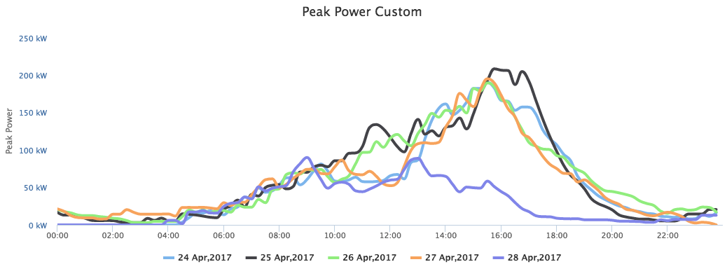
Smart Fleet Charging
Typical Fleet Charging Profile
Notes:
Here’s a real world scenario and how we can help. Chart shows the load on the electrical service at the times when fleets typically plug in. You’ll see a peak around 4 pm when shifts are ending, tapering off through the evening as vehicles fully charge in the first few hours. The electrical service needs to support the worst case – in this example would be 200+kW at one point in time.

Slide 18
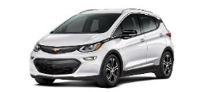
Notes:
How much power would be required if you had 45 fleet cars that needed to be plugged in at the same time if the stations had no brains?

Slide 19
40 Amps x 45 cars = 1800 Amps

Slide 20
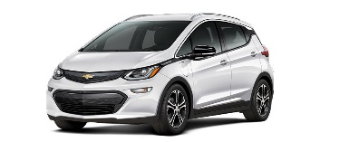
40 Amps x 15 cars = 600 Amps
600 Amps can charge 45 vehicles
1/3 of the infrastructure typically required
Notes:
With power sharing & panel sharing we can charge all 45 cars with 1/3 the electrical service.
we’ll tie stations together on shared circuits (will charge over 6 hours vs 3)
we’ll allow you to set charging times to avoid demand charges and to spread out the power load over time

Slide 21
Example: Capital Savings with Energy Management
Over 60% CapEx Savings
Assumes 45 EVs at a single site
Significant cost reduction in:
  Electrical Panels
  Conduit and Wiring
  Transformer
Analysis excludes cost of installing stations (this is common across both scenarios)
Key features:
  Scheduled Charging
  Panel Sharing

Slide 22
Example: Fuel Savings with Energy Management
57% Fuel Savings
Utilize utility off-peak energy rates
Significant demand charge reduction
Power allocation is flexible and will never exceed a static or dynamic power ceiling

Slide 23

ChargePoint Maintenance - Assure
ChargePoint Assure is a full service maintenance and support program designed specifically for ChargePoint customers
Assure’s #1 goal is customer satisfaction
  Greater satisfaction = more loyal customers = more repeat business
Assure Overview:
  All parts and on-site labor to repair or replace product defects
  1 business day response time
  Labor Coverage for Vandalism and Accidental Damage
  Proactive Station Monitoring and Proactive Dispatch
  Unlimited Software Moves, Adds and Changes
  Coverage in all 50 US states + Canada

Slide 24





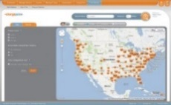

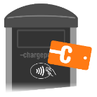

World Class Support
Station Support
Driver Support
Fleet manager
Fleet Drivers
ChargePoint Services
Cloud-based solutions for
managing your fleet
Charging Stations
Driver Applications & Services
Web, mobile, fleet card service

Slide 25
Fleetification Summation
Expert Guidance for Appropriate Stations & Services
Smart Networked Charging:
  Single dashboard to view and manager your fleet vehicles
  Access restricted to specific drivers
  Data analytics & reporting to make informed decisions
  Easy to use mobile app to locate stations and charge up
  Power Management – saving CapEx and OpEx
Assure Insurance, Parts & Labor, Fully Covered
  24/7/365 Driver support in 3 languages
  Proactive Monitoring & solution dispatch

Slide 26
Thank You
Justin Ries, LEED AP
Account Executive, New England
Justin.ries@chargepoint.com
+1.904.613.9363

