Slide 1
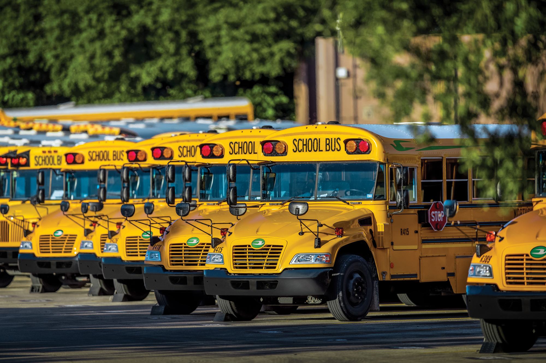
AltWheels Fleet Day
October 7, 2019
Propane School Buses
Stephen Whaley, Autogas Advisor
Propane Education & Research Council
Notes:
Self explanatory slide.

Slide 2
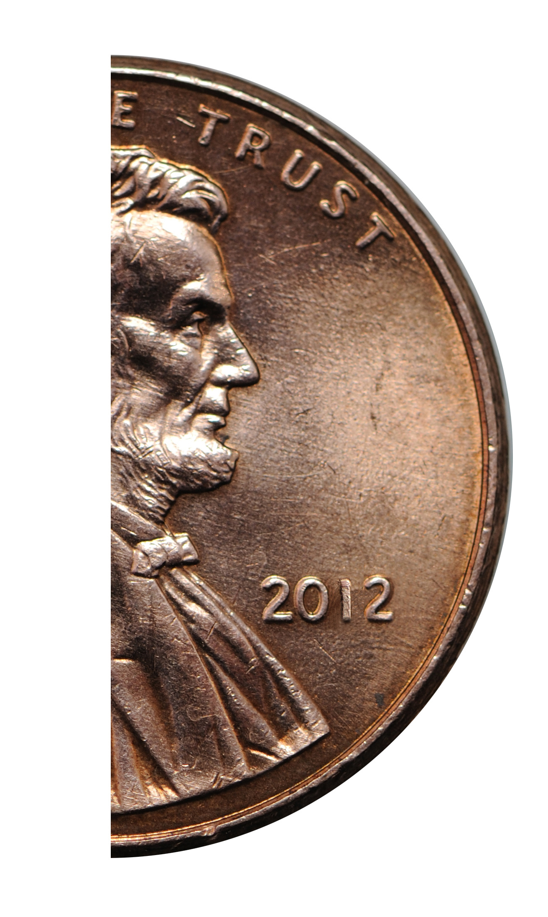
WHO IS PERC?
Propane Education & Research Council
PERC promotes safe, efficient use of odorized propane through investments in research, safety and consumer initiatives (created 1996).
It’s a checkoff program that is self-funded by the propane industry. PERC gets half a penny per odorized gallon of propane sold in the USA.
Notes:
Self explanatory slide.

Slide 3
WHAT IS PROPANE?
Affordable, Clean, American-Made Fuel
C3H8
Byproduct of natural gas processing.
100% Domestic
Commonly used for space and water heating, cooking, and as engine fuel.
Using Propane
48 million Households
900,000 Farms
175,000 On-Road Vehicles
600,000 Forklifts
25,000 Commercial Mowers

Slide 4
Propane comes from renewable and conventional sources.
It’s nontoxic, meaning it does not contaminate air, soil, or water resources.
Notes:
Renewable propane is made from animal fats and vegetable oils.
Conventional propane is a byproduct of natural gas processing and oil refining.

Slide 5
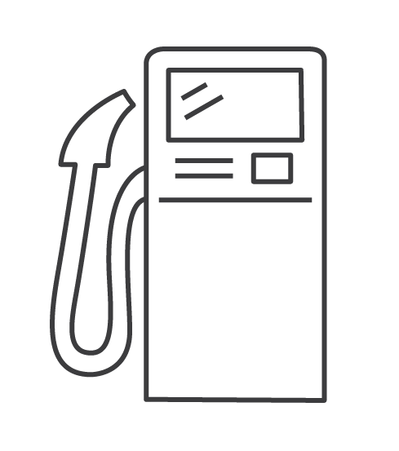
WHY FLEETS CHOOSE PROPANE AUTOGAS
Total Cost-of-Ownership
Emissions
Noise
Reduced Maintenance
Corporate Image
Employee Morale/Driver Retention

Slide 6
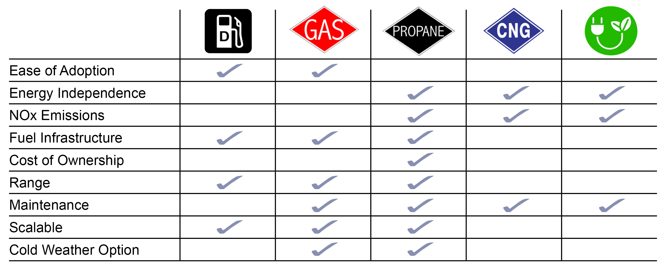
Ease of Adoption

Slide 7
US ENERGY PRICE COMPARISON 2006 – 2018
Source: EIA.gov
Notes:
By 90 days

Slide 8
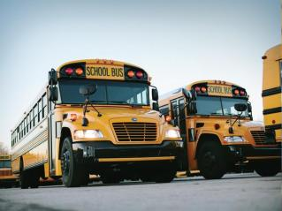
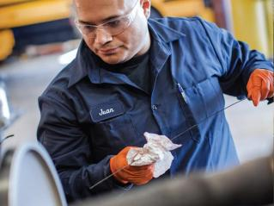
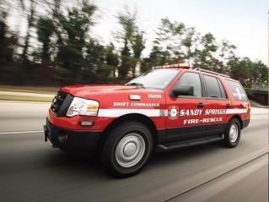
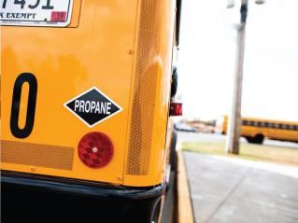
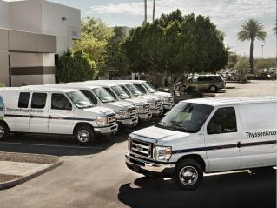
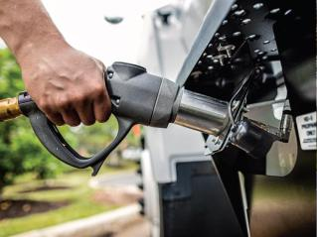
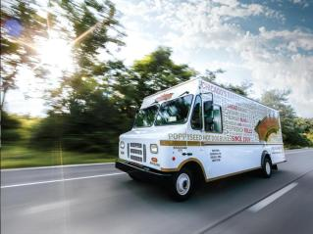
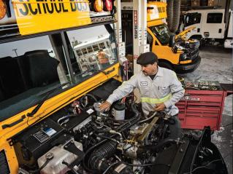
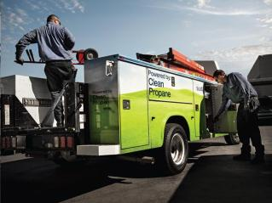
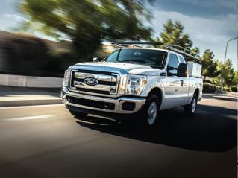
Notes:
Americans rely on propane at home, at work, and on the farm.
More and more, they’re relying on propane on the road, too.
They use propane autogas for school buses, cargo vans, police and fire vehicles, box trucks, and many other vehicle types.
It helps them save money and cut emissions. It also helps them recover from natural hazards and extreme weather events.

Slide 9
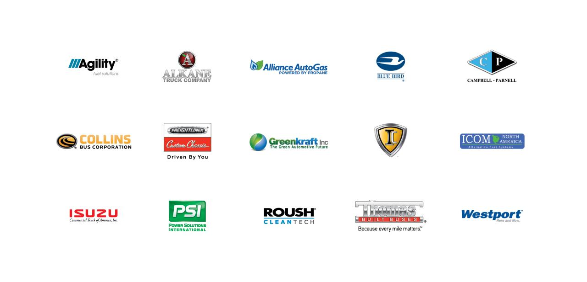
Notes:
Here are some of the companies we’ve partnered with. You’ll see some big names up there and they have developed plenty of vehicle options for your fleet. In some cases we’ve funded the development of the products and in some cases we help our partners with commercialization.

Slide 10
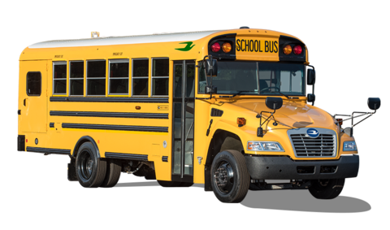
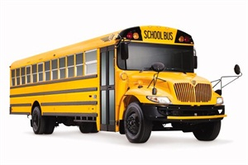
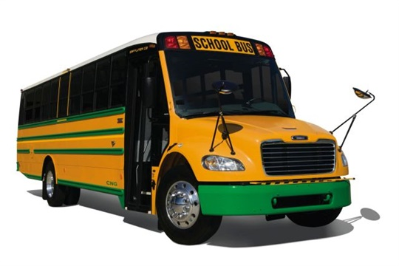

Slide 11
1980
Diesel is a great fuel.
Diesel engines last forever.
No one cares about emissions.
Propane buses are not available.

Slide 12
2019
Diesel is an endangered fuel.
Diesel engines breakdown a lot.
Everyone cares about emissions.
Propane buses are available from all of the major OEMs.

Slide 13
Notes:
If you operate a diesel vehicle…………you cringe when you see this warning lamp illuminate on your dash. This light indicates that your diesel vehicle must regenerate emissions or you take the risk of clogging the DPF and possibly rendering the vehicle inoperable. Regens require 20 minutes of driving over 45 mph or increasing rpms sufficient to increase the DPF temperature to burn up the residual particulate matter. Either way, it will cost your fleet both time and money to complete.
Good news – propane doesn’t have a complicated emissions system and requires only a 3 gas catalyst – like the one on your personal vehicle – to comply with the emissions requirements for today’s vehicles. No regens – no lost time or wages – no additional fuel consumption – no waste of your budget dollars. And you can rely on propane to perform regardless of the temperature.
Just one more inconvenience that is eliminated for those who chose propane autogas.

Slide 14
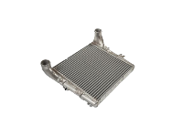
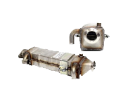
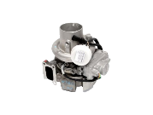
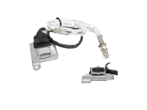
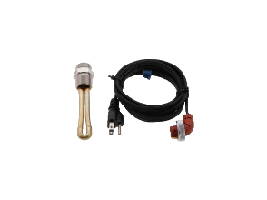
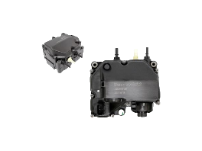
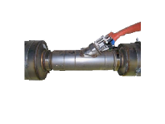
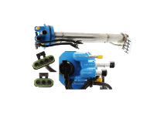
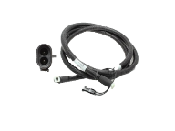
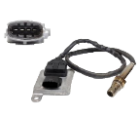
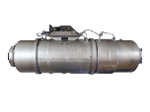
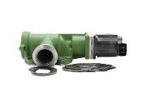
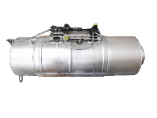
The Diesel We Know Today

Slide 15
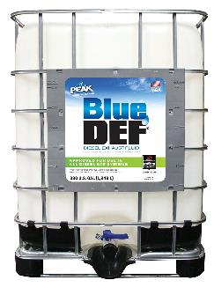
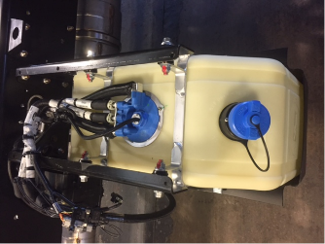
Maintenance
Propane eliminates the need for DEF and the possibility of putting the wrong fluid in a tank
Average diesel needs around 40 gallons / year

Slide 16
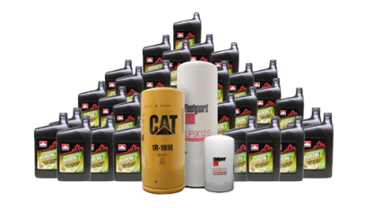
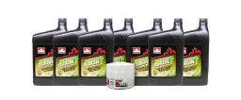
Preventative Maintenance
____________
Ford V10
Propane
7 Quarts
____________________________________________________
Various Engines
Diesel
17 – 30 Quarts

Slide 17
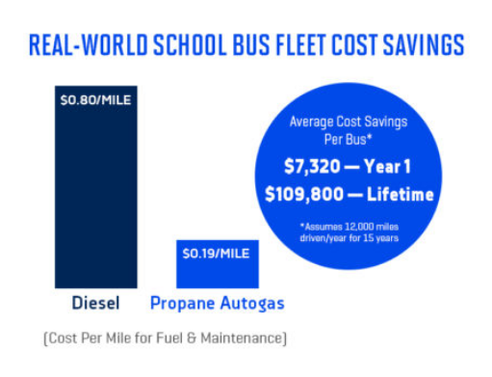

Slide 18
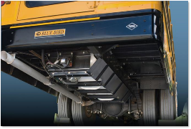
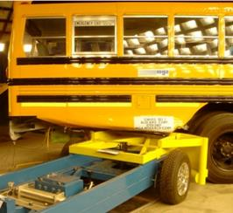
Tank Protection & Crash Testing
Followed CMVSS 301.1 protocol
4,000 lbs @ 40 MPH
Angled side and rear impact
220 PSI tank pressure
No leakage or no pressure drop in 30 minute test

Slide 19
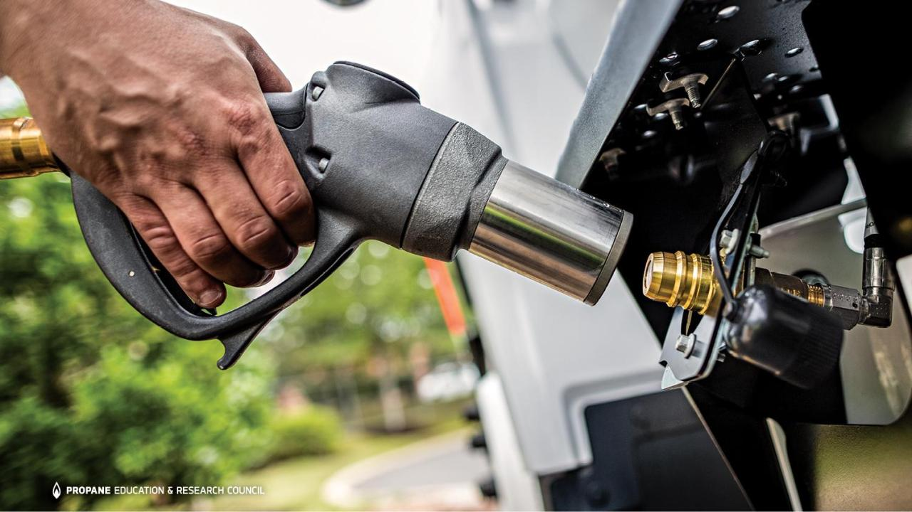
Notes:
The new K15 nozzle eliminates the need for gloves and eye protection. No risk of freeze burns.

Slide 20
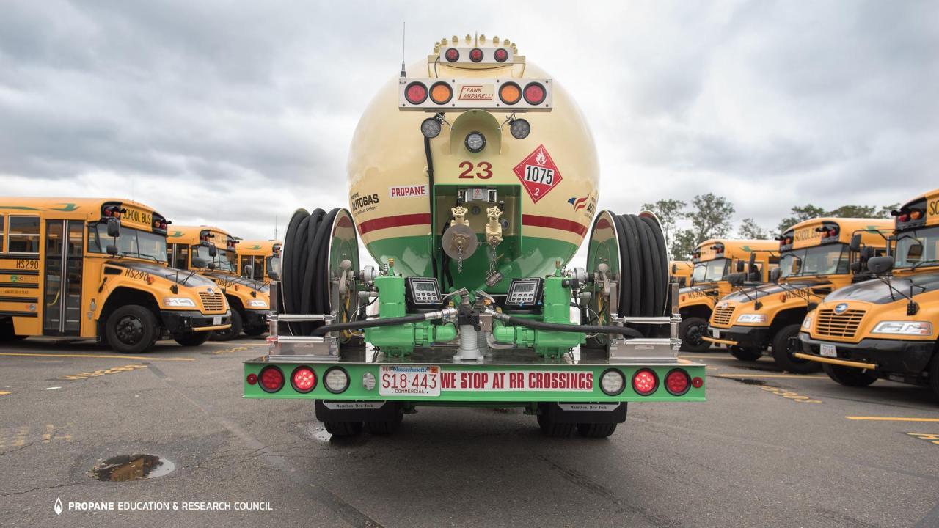
Notes:
Some propane marketers offer “wet fueling” to get you started. (In this photo, a propane delivery driver in a bobtail truck gets ready to fuel buses for Boston Public Schools.)

Slide 21
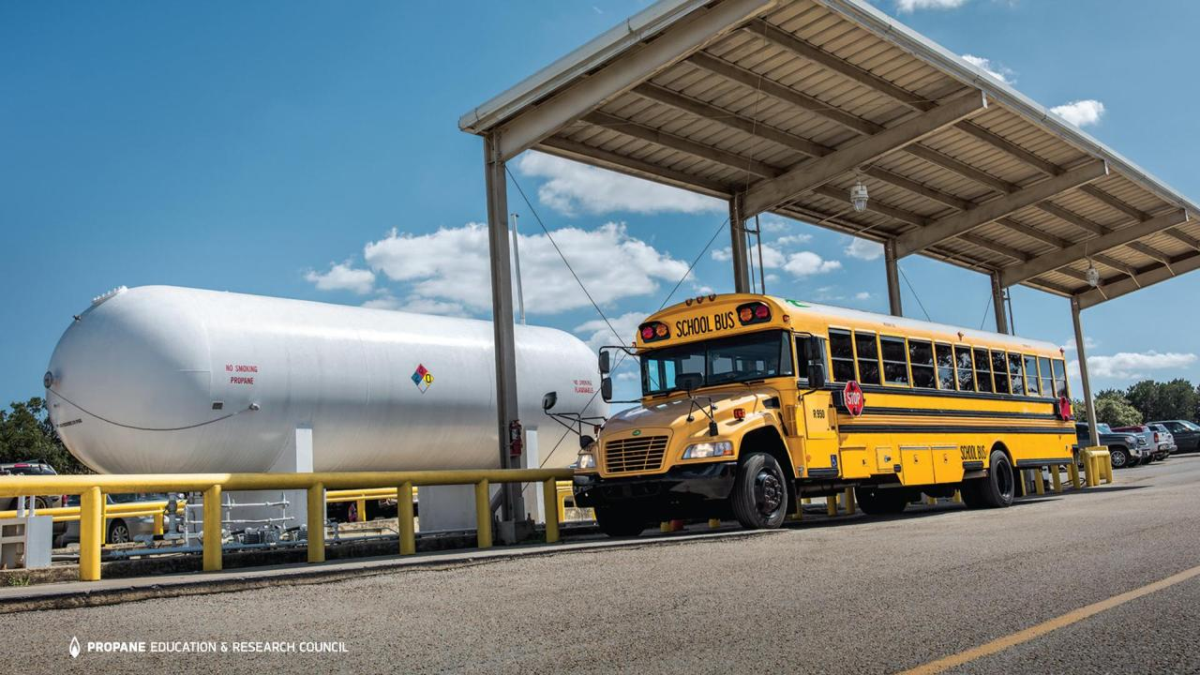
Notes:
Propane autogas fueling is scalable. As your fleet grows you can add onsite propane storage, such as this school bus fueling station.

Slide 22
Everyday, propane buses transport over 1 million students across the U.S.

Slide 23
Propane School Bus Deployments

Slide 24
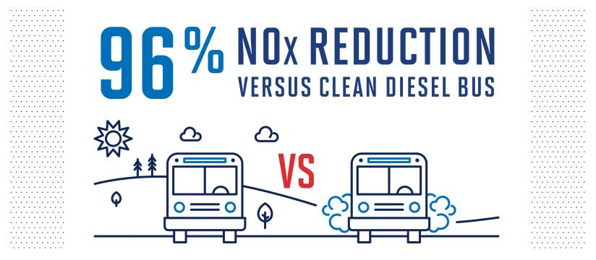
Emissions reduction
Source: 2018 West Virginia University study, comparing 2015 LPG Blue Bird School bus
(6.8L, 10 Cylinder) with 2014 ultra-low sulfur diesel Blue Bird school bus (6.7L 6 cylinder).

Slide 26
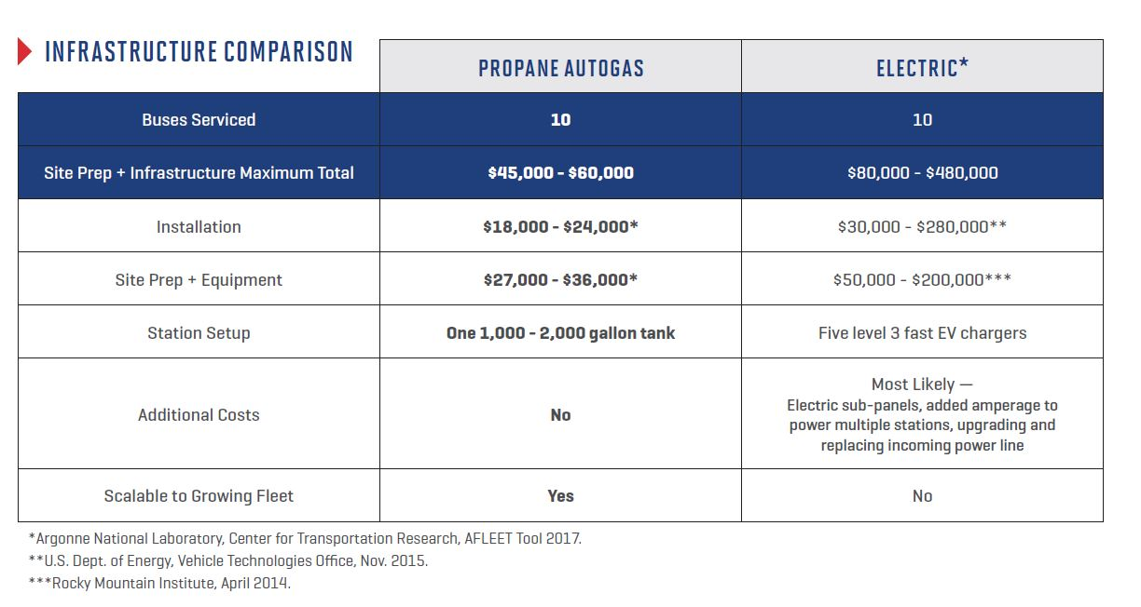
Refueling Infrastructure Cost Comparison

Slide 27
Similarly Equipped Blue Bird Type C Bus
Diesel, Cummins, ISB, 6.7L $98,500.00
LPG, Ford/Roush, 6.8L $107,000.00
CNG, Ford/Roush, 6.8L $134,000.00
Electric, Adomani, $375,000.00
Fuel Cost – Gallon Equivalent.
Diesel – Avg. 2.17
LPG – Avg. .78
CNG – Avg. .80
Electric - NA

Slide 28
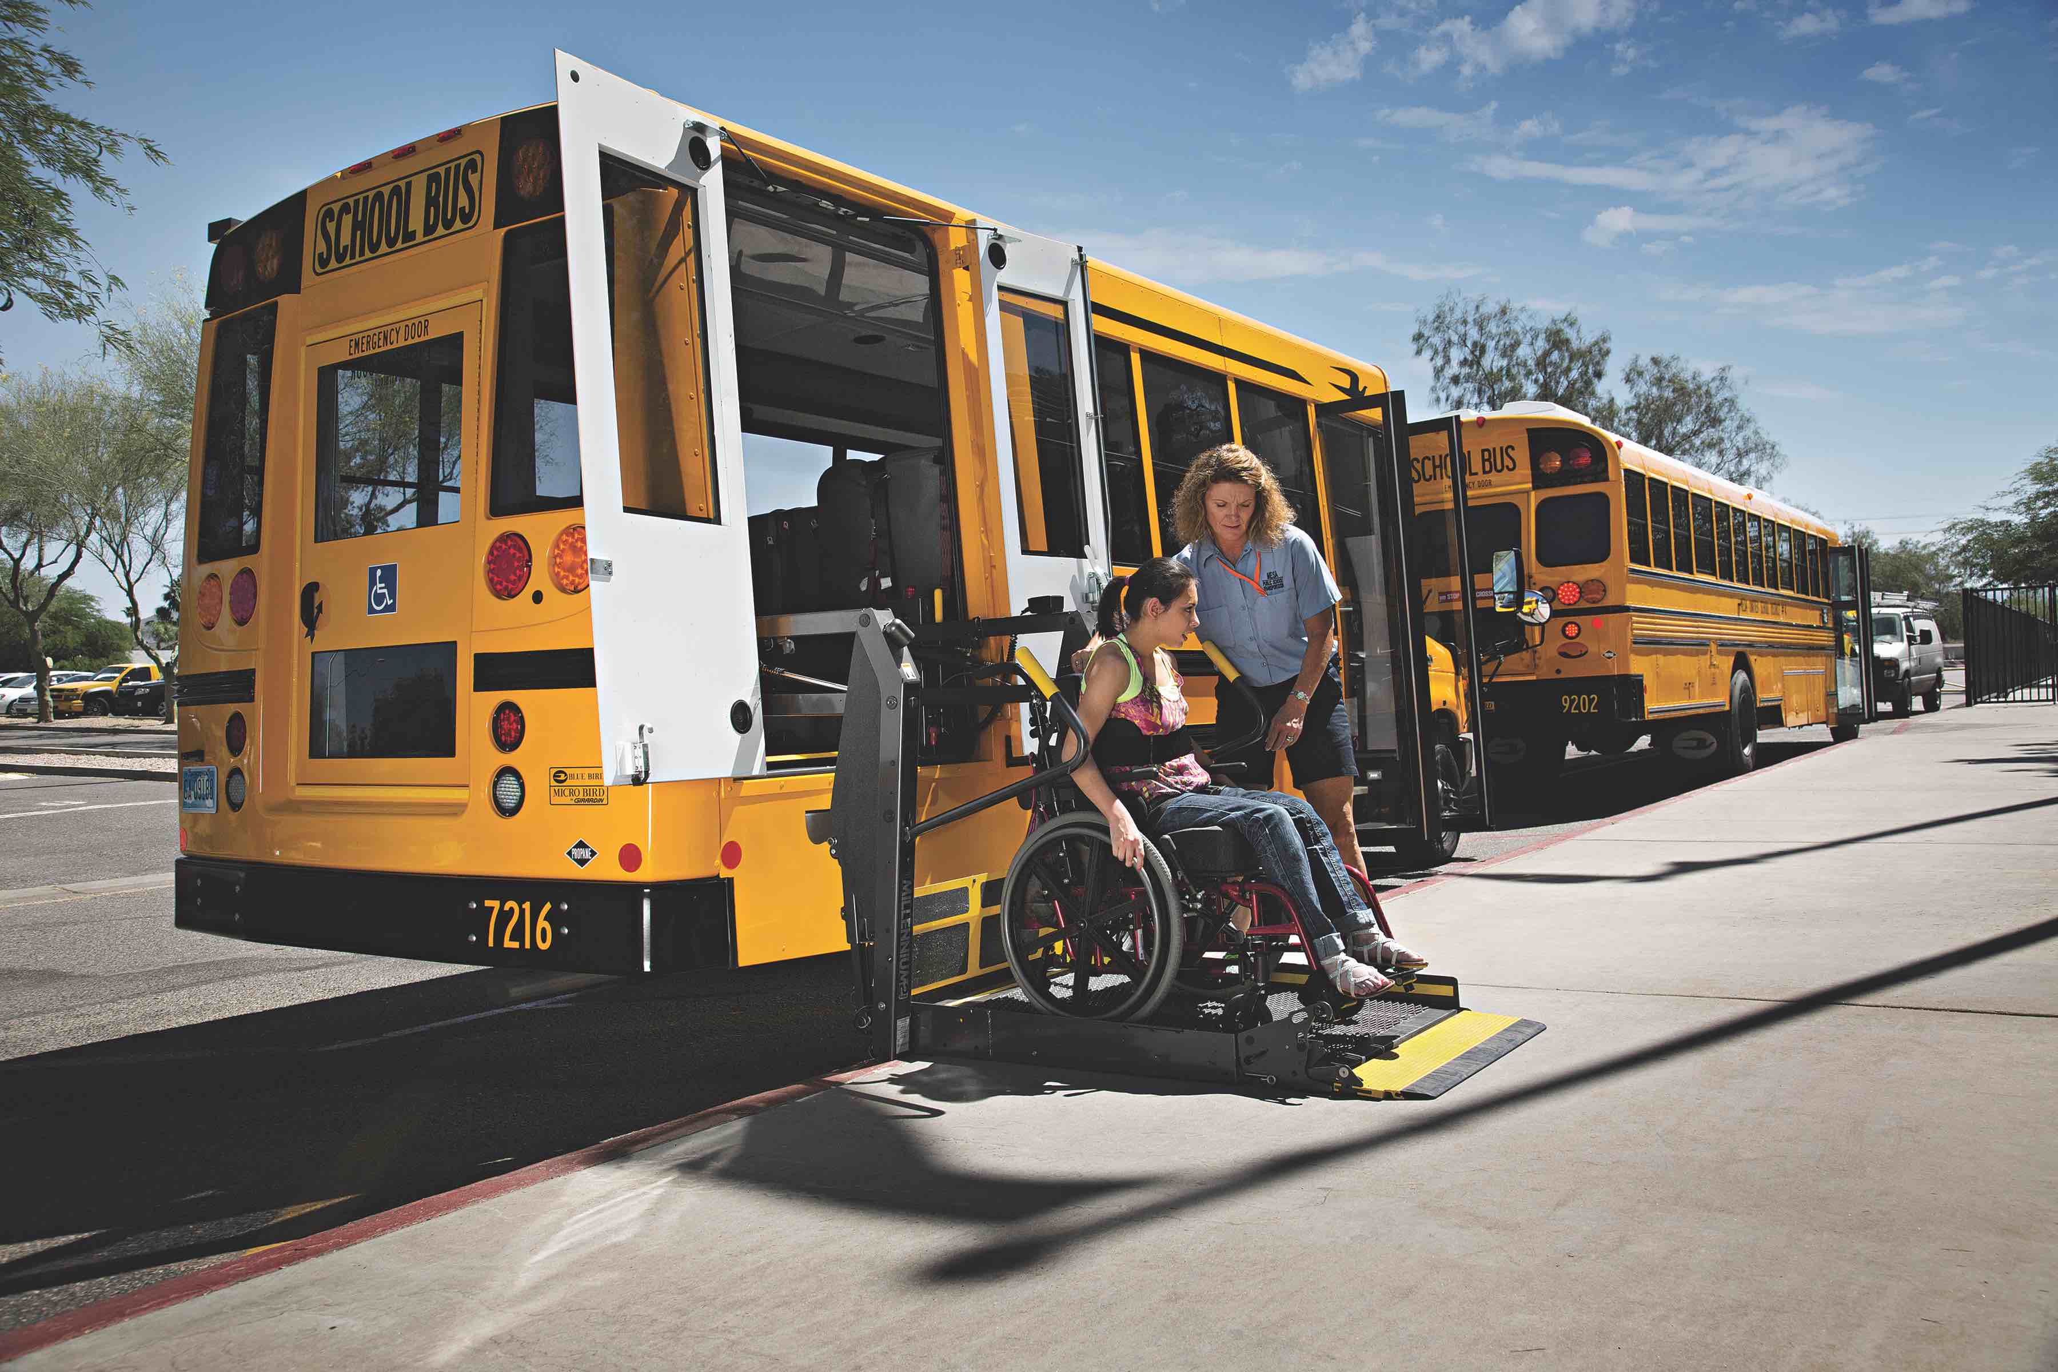
Emission Reductions Where Needed Most

Slide 29
For more information:
Stephen Whaley, Autogas Advisor
Propane Education & Research Council
stephen.whaley@propane.com
864-923-5000

