Slide 1









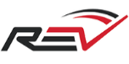






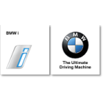







PROTERRA CORPORATE OVERVIEW
Proterra’s Mission
Advancing electric vehicle technology to deliver the world’s best-performing heavy-duty vehicles
Offices and manufacturing in CA and SC
450+ employees, with strong transportation expertise
>100 customers; >800 vehicles sold
>9,500,000 service miles
>57,000,000 pounds of CO2 emissions avoided
Strong Transportation Expertise
World-Class Financial Partners
Notes:
At Proterra, we are all about advancing electric vehicle technology to deliver to our customer’s the world’s best performing heavy-duty vehicles. It’s our mantra and our mission.
To fulfill this mission, we manufacture in the United States three facilities located in Silicon Valley, Los Angeles and South Carolina.
Proterra products are designed and manufactured by more than 500 employees with serious transportation expertise.
Many Proterra employees bring to the company knowledge and experience working for significant global vehicle manufacturers, including Tesla, GM, Nissan, Toyota and VW among others.
More than 75% of the components in Proterra products are sourced in the U.S. (FOR CANADA: NORTH AMERICA)—helping Proterra exceed Buy America requirements.
We have seen tremendous tractions and now have on our roster 90 customers spanning North America who have purchased more than 700 Proterra vehicles, battery systems and charging infrastructure.
Of the more than 300 Proterra vehicles on the road in large and small communities, they have achieved more than 8 million revenue miles and have avoided more than 44 million pounds of CO2
Backed by world-class transportation and utilities, including BMW I Ventures, Constellation, Daimler, Edison International, Franklin Templeton, GM Ventures, Generation, and Kleiner Perkins, Proterra financial partnerships demonstrate market confidence in the company’s products and strategy.

Slide 2
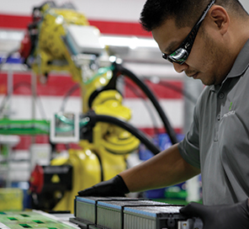
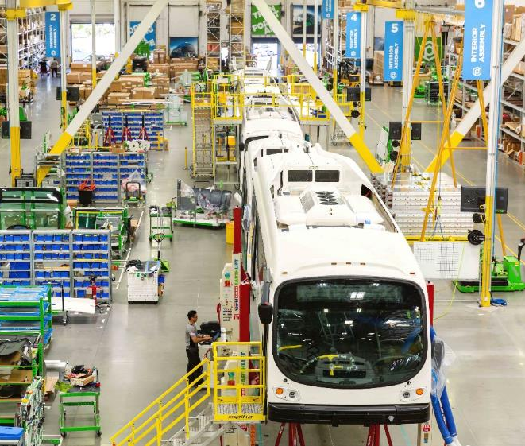
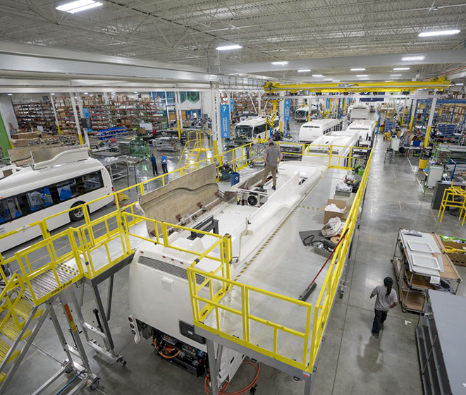
HIGH-QUALITY, ADVANCED MANUFACTURING FOR RAPID EV ADOPTION AT SCALE
Burlingame, California
Battery Manufacturing
Company HQ
Los Angeles, California
Bus Manufacturing
West Coast Operation
Greenville, South Carolina
Bus Manufacturing
East Coast Operation
Notes:
Building your own batteries is a big advantage.
And Proterra uses the latest, cutting-edge technology
Batteries stocked/ shipped to both factories

Slide 3
THE TRANSIT MARKET IS RAPIDLY SHIFTING TO EV
2010–2014
2015–2016
2017-2018
PROTERRA
PRICE
$1.2M
$800K
$700K
UNIT
SALES
EV Evangelists
Early Adopters
Early Majority
Tech Proven
Small Orders
Safety
Reliability
Full Route Adoption
Revenue Service
1,000,000 miles
Mainstream Financing
Fleet Replacement Begins
Price Parity to Hybrid
10% Penetration
Best Practices Developed

Slide 4






Major commitments to 100% EV transit
EV Transit Bus adoption continues to increase
Major cities adopting EV technology for transit buses
New York
Chicago
Washington D.C.
100% EV by 2040
4,700 buses
Piloting since 2014
2,100 buses
100% EV by 2045
1,900 buses
Seattle
Philadelphia
Miami
100% EV by 2034
1,500 buses
Piloting since 2017
1,500 buses
50% EV by 2035
800 buses
California mandates 100% electric transit buses by 2040
New purchase mandates
25%
→
50%
→
100%
by 2023
by 2026
by 2029
12,000 buses across California
(17% of nationwide fleet)
Source: Frost & Sullivan Heavy Duty Transit Bus North America Powertrain Adoption Forecast
Source: National Transit Database; agency websites; 2017 American Public Transportation Association Fact Book
Notes:
http://maynard.wickedlocal.com/news/20180618/state-senate-passes-clean-energy-bill
https://blog.ucsusa.org/daniel-gatti/massachusetts-senate-unanimously-endorses-a-bold-vision-for-clean-transportation

Slide 5
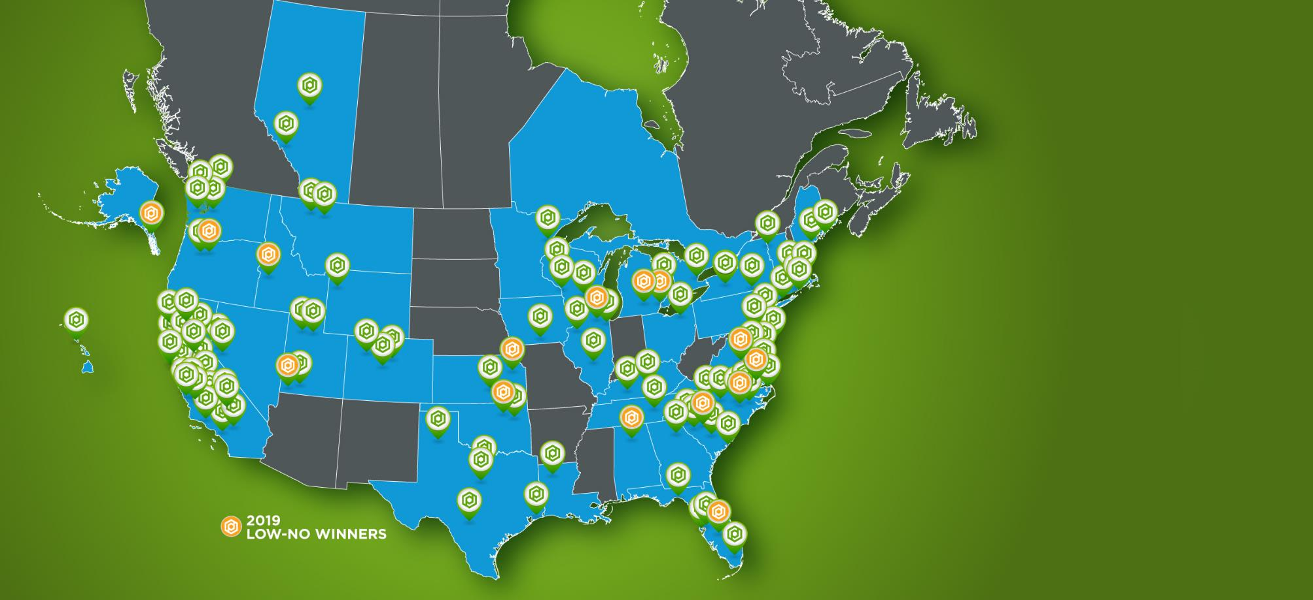
OUR CUSTOMERS
Proterra has the largest ev customer base in north America
100
customers
800
buses sold
41
states/provinces
15
Low-No wins - 2019

Slide 6
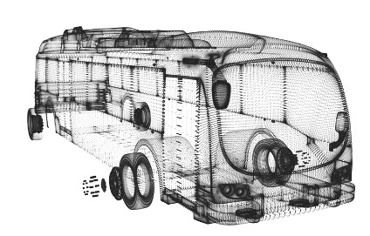
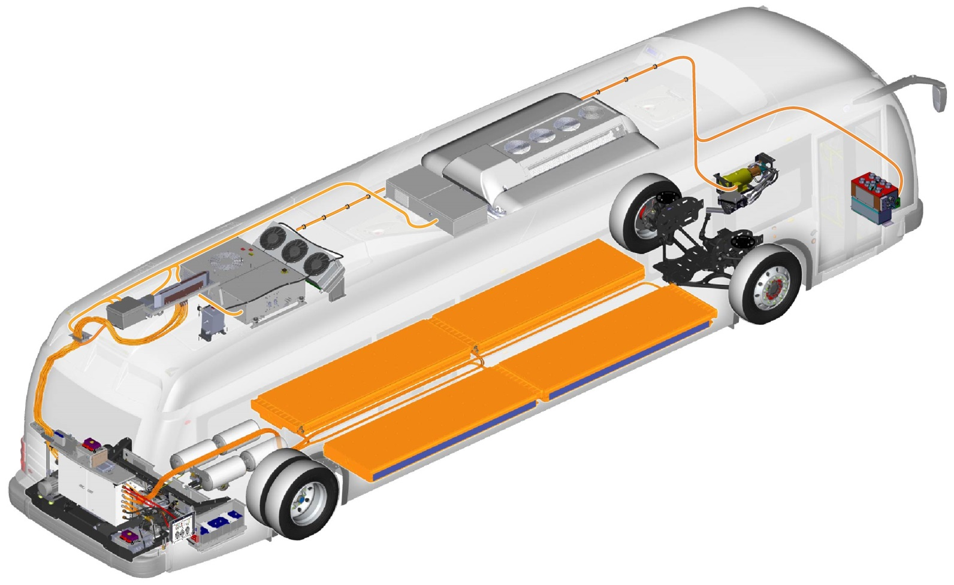
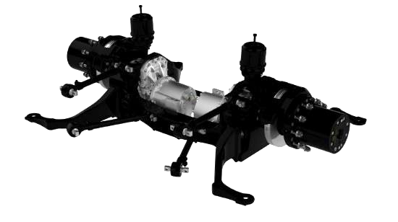
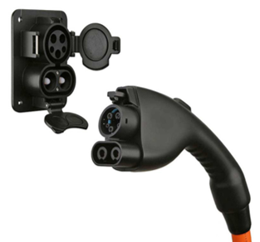
HIGHLY DIFFERENTIATED AND FULLY INTEGRATED
HEAVY DUTY TECHNOLOGY PLATFORM
Advanced Composite Body
Lightweight and durable
carbon-fiber-reinforced composite
Heavy Duty Battery Pack
High energy density, ruggedized battery packs purpose built for commercial vehicles
High Efficiency Drivetrain
5x efficiency of diesel Greatest horsepower
Fastest acceleration
Universal Charging
Industry standard plug-in and overhead high power Level 3 charging

Slide 7
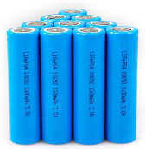
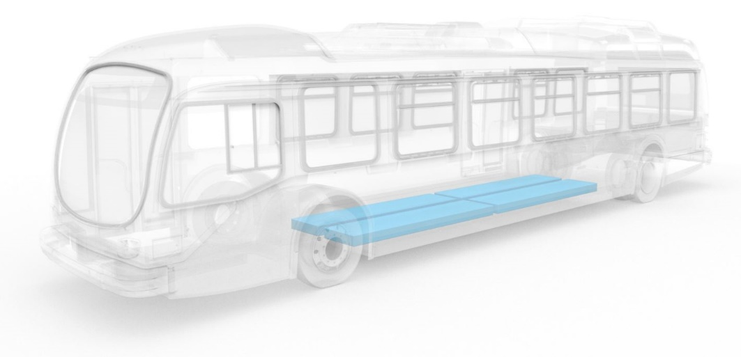
Cell > Module > pack > ESS
Engineered, Validated, and Manufactured by Proterra in California
Small Format Li-Ion Cells (Cylindrical)
Module
Pack
Energy Storage System (ESS)
Notes:
To achieve the on-board energy requirements required for full EV adoption, we turned to small format cylindrical cells. A form-factor that our engineering team is very experienced with.
An intense focus was placed on the mechanical and electrical interconnects of hundreds of cells to create a safe, durable, and robust heavy duty module.
These modules are electrically connected in series and mated with the non-cell ancillary components to create a self-contained battery pack.
Our ground up EV platform utilizes series parallel configurations of these packs to meet the energy requirements for the vehicle energy storage system.

Slide 8
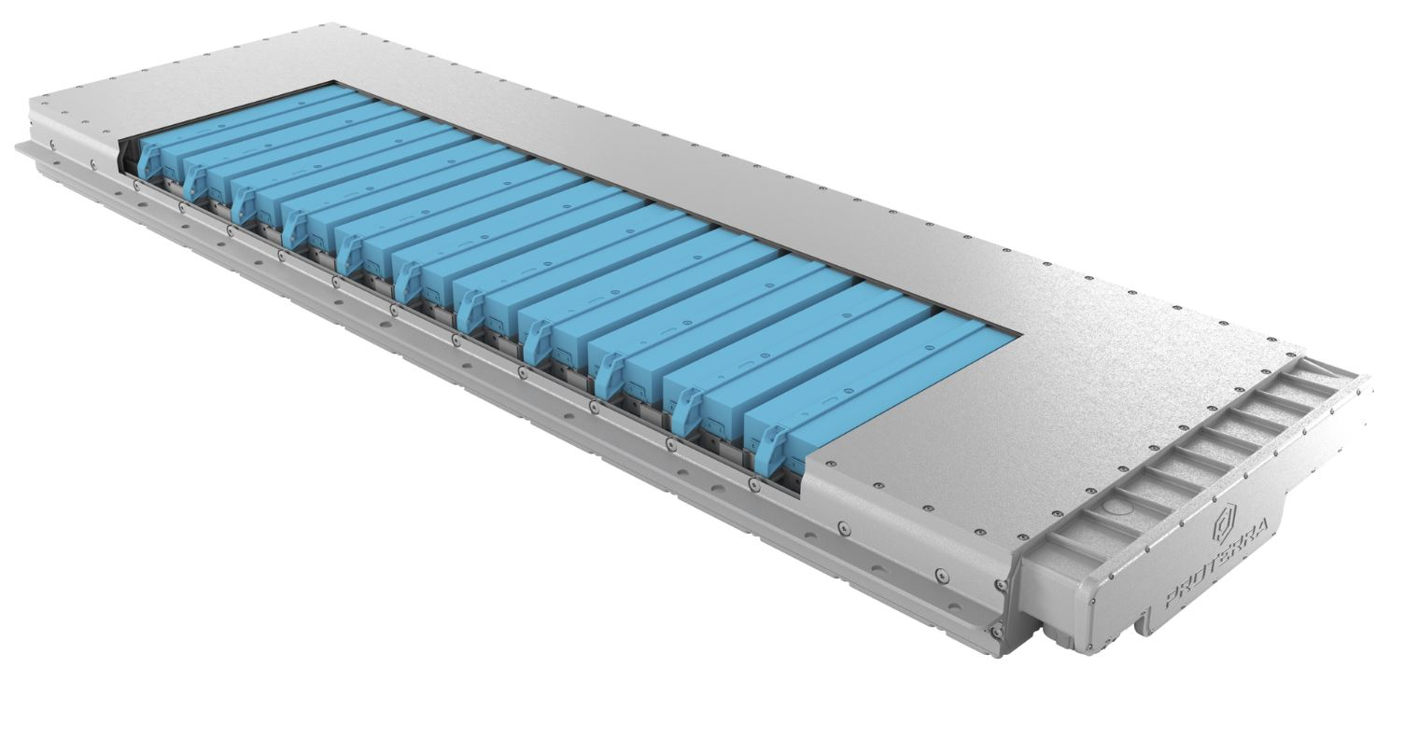
THE PROTERRA® BATTERY
SMART. SAFE. EFFICIENT. PROVEN.
Proterra battery packs are designed specifically for safe operation in heavy-duty transportation.
Protective, ruggedized enclosure made with ballistic-grade materials that can withstand the toughest conditions
Pack design ensures service technicians and operators are protected from high voltage components
Liquid cooling for active thermal management to ensure optimal operation in any climate
More than 70 sensors throughout each pack delivers continuous monitoring and diagnostics, enabling faster service
If a single cell within the battery fails, the pack is designed such that the defective cell will be isolated to a small region of the pack and not cause complications throughout the entire pack.
Rigorously tested and 3rd party validated
Notes:
Why liquid cooling is better than no cooling: better control of temperature for the battery, to optimize the life of the pack, performance, and also safety

Slide 9
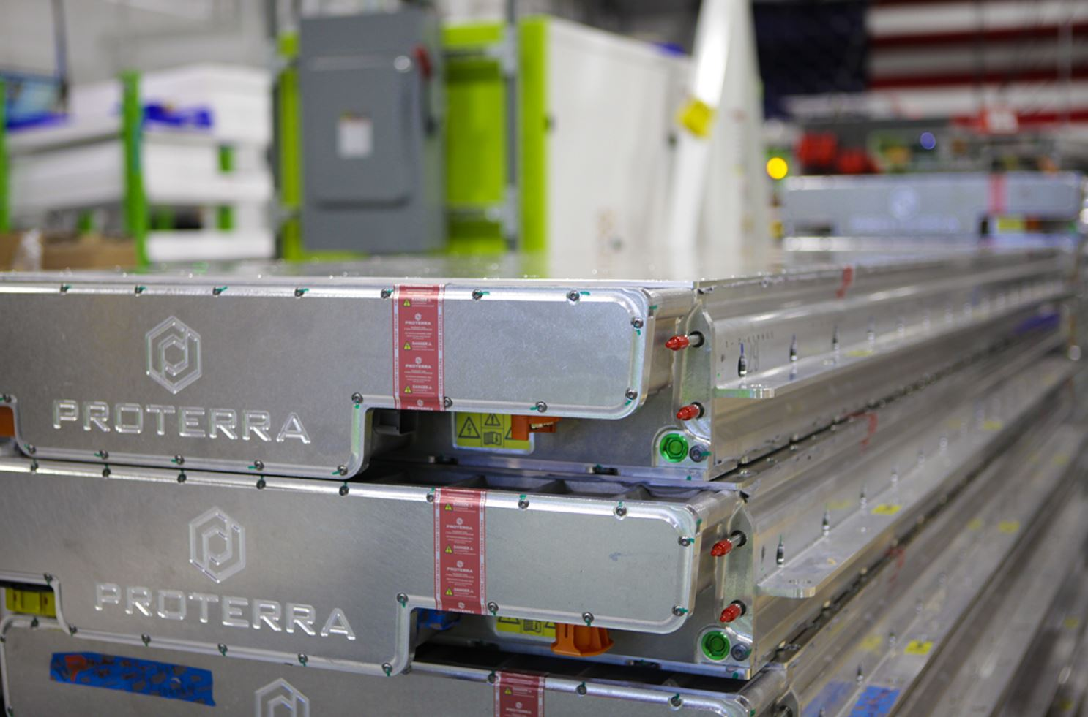
EXTENSIVE BATTERY TESTING
TO HIGHEST SAFETY STANDARDS
Proterra battery packs have undergone extensive testing to meet the highest safety standards.
Tests performed to account for possible incidents such as:
Vehicle crash
Road debris striking the battery pack
Street manhole cover explosion
Defective or failed cell within pack
Overcharge of high voltage system
Coolant flood internal to battery pack
Fuel fire external to the vehicle (collision with a combustion engine vehicle)
Notes:
Overcharge of high voltage system would happen if there was a failure of the charging controls and you just keep charging

Slide 10
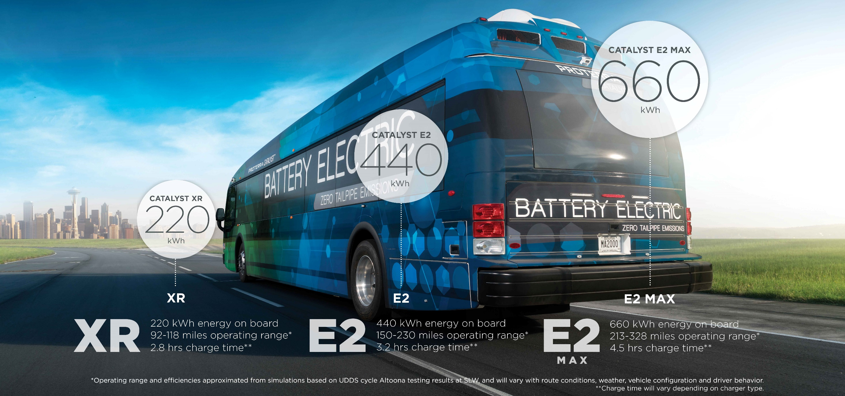
THE PROTERRA CATALYST MODELS

Slide 11
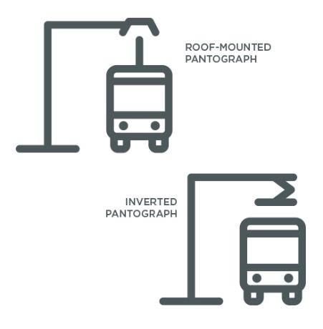












SMARTER CHARGING
compatible with industry-standard charging systems
OVERHEAD CHARGING
Keep your Catalyst buses rolling with easy depot or on-the-road charging, made simple by industry-standard SAE J3105 overhead systems.
Charge on the road for longer routes or enable 24/7 circulator operations
Low maintenance costs and high availability
Compatible with roof-mounted pantographs as well as inverted pantograph systems, offered by Schunk and other suppliers
PLUG IN CHARGING
Regardless of your fleet size, powering up your Proterra buses at the depot is as easy as plugging in a standard J1772-CCS Type 1 charger.
Universal chargers are offered by Proterra and other suppliers
Catalyst vehicles can be configured with two charge ports for flexibility at the depot
Electric buses, utility vehicles and cars can share the same standardized chargers
ADOPTED BY MAJOR OEMS
ADOPTED BY MAJOR OEMS
AUTOMOTIVE

Slide 12
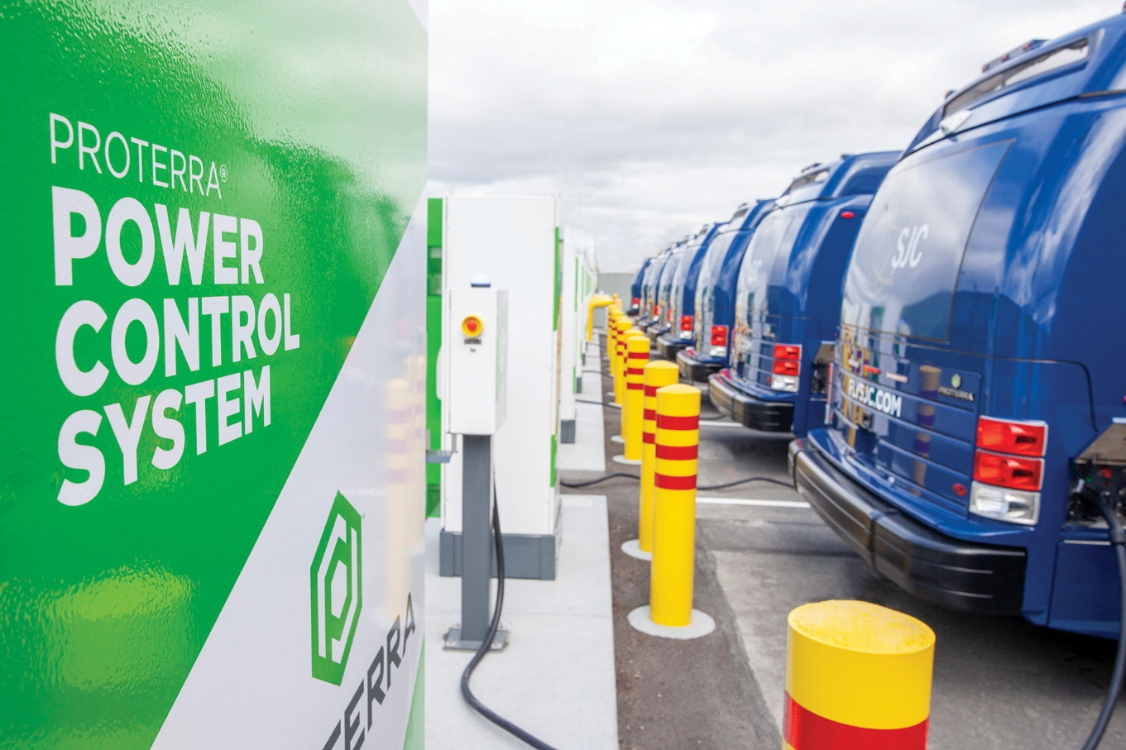
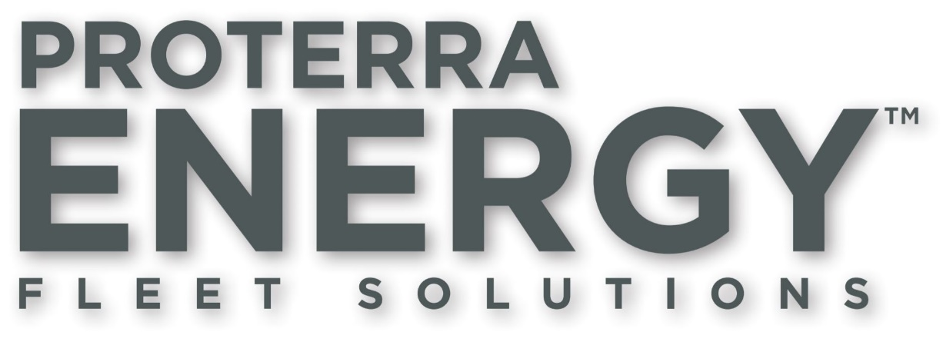
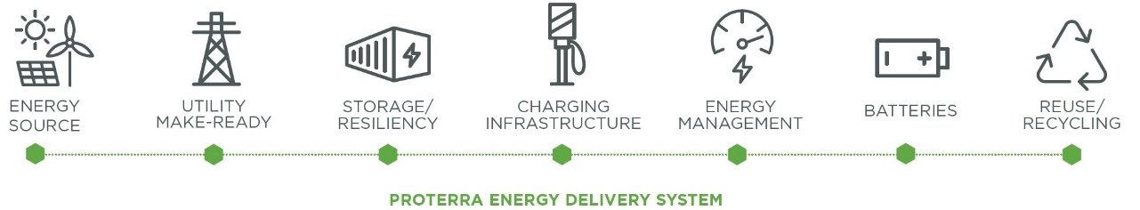
PROTERRA ENERGY FLEET SOLUTIONS
TURNKEY ENERGY DELIVERY FOR ELECTRIC FLEETS
Notes:
Transitioning your fleet to battery-electric technology introduces a new set of challenges that go well beyond the vehicles.
Proterra Energy™ fleet solutions offer a turnkey approach to delivering the complete energy ecosystem for heavy-duty electric fleets, including design, build, financing, operations, maintenance and energy optimization.
With this comprehensive solution, customers can lower upfront cost, reduce risk, and simplify the transition to electric vehicles.

Slide 13
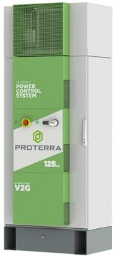
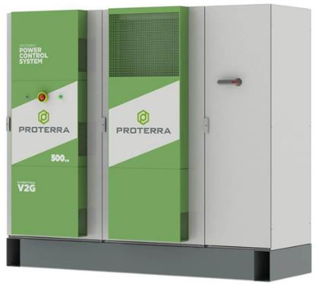
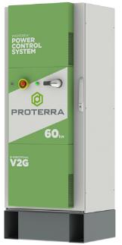
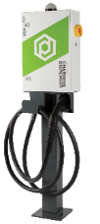
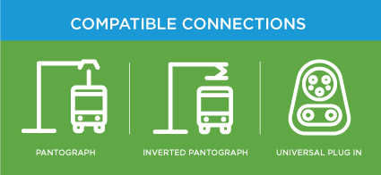


SMARTER CHARGING
PROTERRA POWER CONTROL SYSTEMS
60KW
For fleets with longer available charge times.
125KW
For fleets with high uptime requirements
500KW
For fleets with extended operating hours and high mileage requirements
INTELLIGENT
  Automated and rules-based
  vehicle charging
UNIVERSAL
  Standards-based, OCPP 1.6 open communications protocol-compatible
REMOTE
  Can be located up to 500 feet
  from dispenser
SCALABLE
  Can be installed side-to-side and back-to-back for high-density charger banks
Catalyst charge time:
~6 hours
Catalyst charge time:
~3 hours
Catalyst charge time:
~30 miles per 10 minutes
Notes:
Mention bi-directional capability for V2G capability
Importance of dispenser being separated
All systems can be used at depot for overhead charging, just depends on agency’s depot requirements/setup.
60kW and 125kW systems can be plug in or overhead. 500 kW system just overhead.

Slide 14
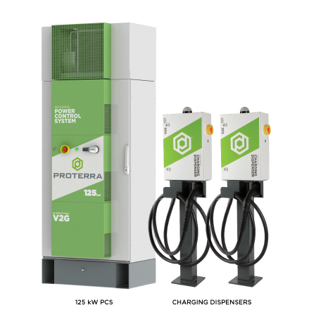
MULTI-DISPENSER CHARGING SOLUTION
OVERVIEW
Proterra charging systems can have multiple dispensers paired with a single Power Control System (PCS)
  Available for the 60 kW and 125 kW systems
  Enables automated sequential charging
Lowers cost of infrastructure
  Less hardware to purchase
  Less major equipment to install
Reduces space needed for charging systems
  Optimal for space-constrained depots
Notes:
It is possible to do this with a 60 kW charger, but you'd have to use 13 hours to charge 2 buses.

Slide 15
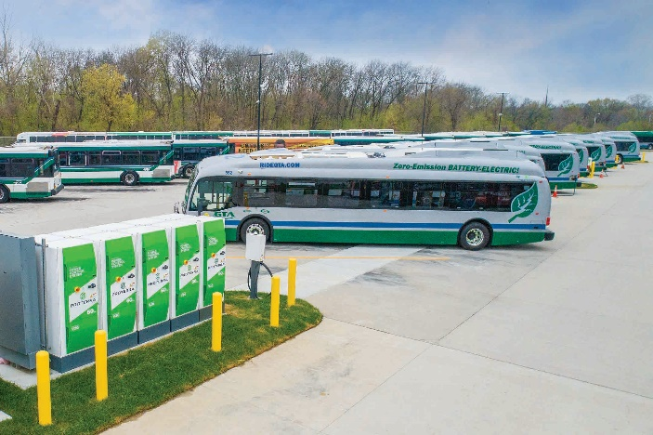
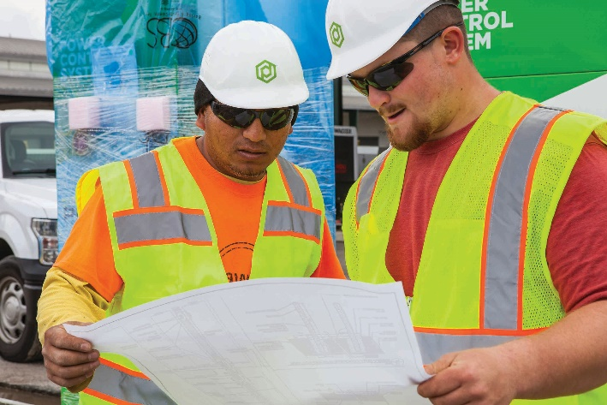
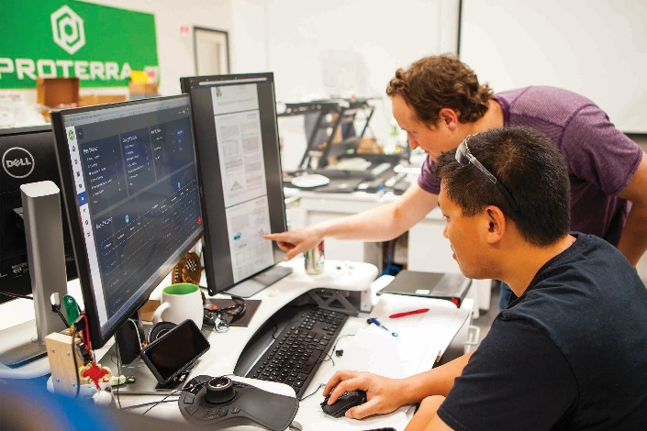
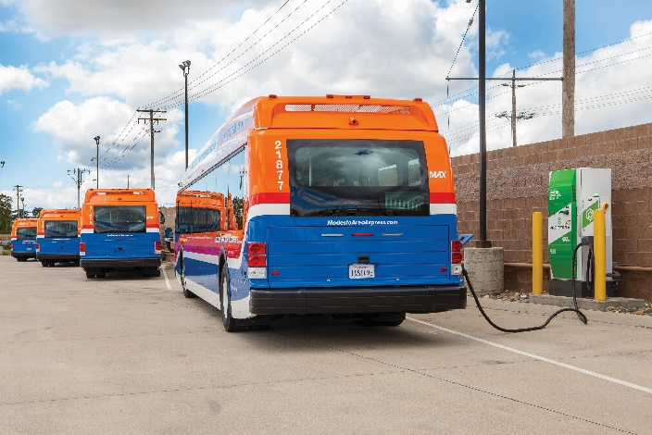
INTRODUCING PROTERRA ENERGY FLEET SOLUTIONS
TURNKEY ENERGY DELIVERY FOR ELECTRIC FLEETS
By providing a full suite of Proterra products and services in-house, we offer a comprehensive solution to help you meet your electrification goals.
SOPHISTICATED PLANNING
TURNKEY INFRASTRUCTURE INSTALLATION
SMART ENERGY MANAGEMENT
ADVANCED ENERGY STORAGE
PAY-AS-YOU-GO
Proterra has helped more than 45 fleet operators throughout North America install high-power charging systems.
Notes:
Proterra Energy Fleet Solutions provides a full suite of products and services in-house from Proterra, offering customers a comprehensive solution to meet their electrification goals

Slide 16
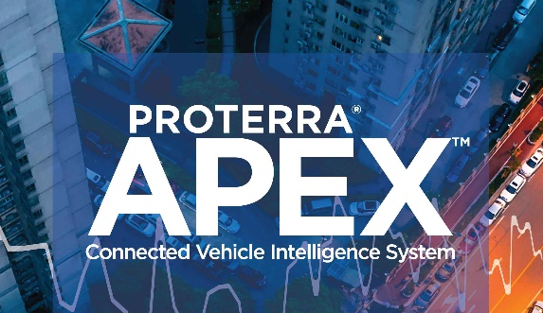
PROTERRA APEX
CONNECTED VEHICLE INTELLIGENCE SYSTEM
The Proterra APEX™ connected vehicle intelligence system is a cloud-based data platform, offering historical and real-time performance information about your battery electric vehicle fleet, to optimize bus and charging operations and reduce costs.
VEHICLE MONITORING
  Real-time information and historical charts on vehicle performance.
REMOTE DIAGNOSTICS
  Reduce on-site visits and solve problems remotely with alerts for vehicles and chargers.
PREVENTATIVE MAINTENANCE
  Notifications and recommendations for preventative maintenance.
CHARGER MANAGEMENT
  Monitor charger status, control charging remotely, and receive real-time updates.
Notes:
VEHICLE MONITORING
Access real-time information and historical charts on vehicle performance, such as speed, distance traveled, location, energy used and battery state of charge.
REMOTE DIAGNOSTICS
Reduce on-site visits and solve problems remotely with customizable alerts for vehicles and chargers.
PREVENTATIVE MAINTENANCE
Receive notifications and recommendations for preventative maintenance of vehicles and chargers.
CHARGER MANAGEMENT
Monitor charger status, control charging stations remotely, and receive real-time updates on charger activity.

Slide 17
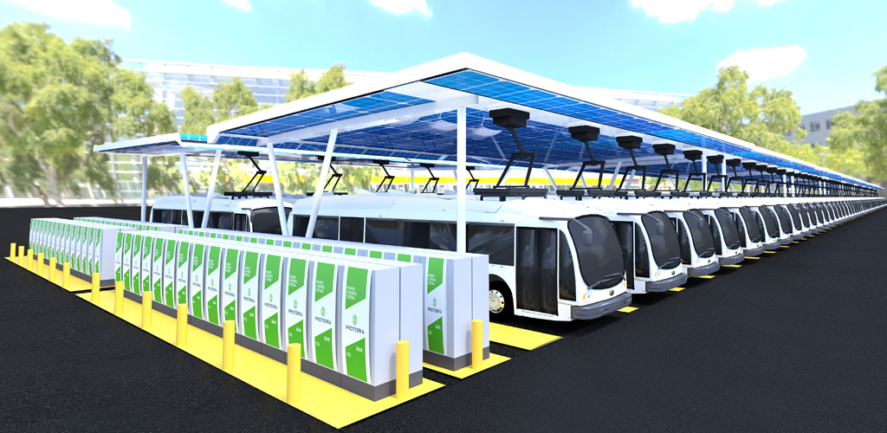
CHARGING AT SCALE
By providing a full suite of charging products and services in-house, Proterra offers a comprehensive solution to help you meet your electrification goals.
Proterra works closely with customer to recommend the appropriate charging solution for fleets and facilities planning for scale as the
demand for charging increases.
Notes:
This image really speaks to the future of transit, with fully electrified fleets powered by clean energy. Even though today you may only be installing enough chargers for a handful of electric buses, you need to be looking ahead to the future to plan for scale, and Proterra offers a full suite of solutions to help you do that.

Slide 18
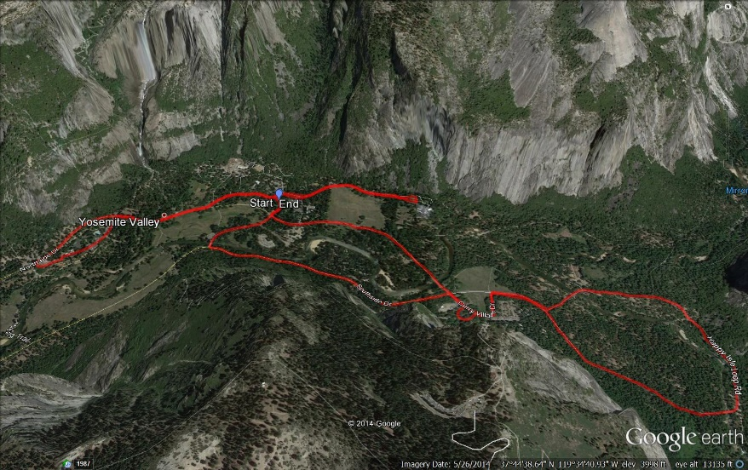
THE PROTERRA PROCESS OF ENGAGEMENT
  GPS tracking
  Route analysis
  Identify layovers
  Operations needs
Vehicle Configuration
Services
  Catalyst bus
  Energy storage amount & type
  Charging opportunities
  Type of charging needed
  Maintenance
  Data analytics
  Other
  Capital budget
  Finance constraints
  Procurement method
Data Collection
Charging Configuration
Financing Options
Proterra’s approach is to work with you to identify the most efficient, most cost-effective way to electrify your high-priority routes. From riding your routes to structuring a financing package, we take a consultative approach and support you throughout the entire process. Let’s get started!

Slide 19

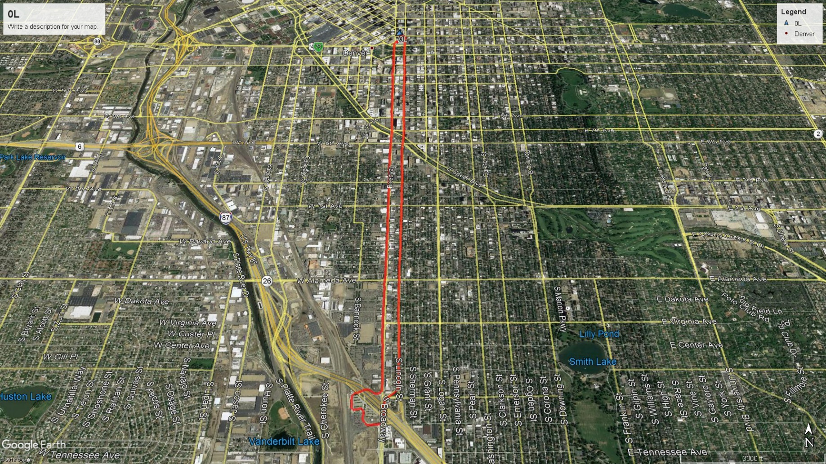
ROUTE SIMULATION RESULTS – Proterra Catalyst® 40ft
Route Information | E2 | E2MAX
Route Name | 0L (to I-25&Broadway)
Distance | 6 miles
Duration | 34 minutes
Average Speed | 10.4 mph
Maximum Speed | 33 mph
Maximum Grade | 1.2 %
Average Day Results
Passenger Count | 40
Ambient Temperature | 51°F
Efficiency | 1.887 kWh/mi | 1.952 kWh/mi
MPGe | 19.9 | 19.2
Total Energy Consumed | 11.3 kWh | 11.7 kWh
Estimated range with 1 full charge | 186 miles | 271 miles
System Energy Recaptured by Regen | 26% | 26%
1 Lap Final SOC | 95.5% | 97.5%
Estimated 1 Lap Recharge Time (On-route charger) | TBD | TBD
Environmental and Operating Impact
Hot Day
Passenger Count | 40
Ambient Temperature | 89°F
Efficiency | 2.332 kWh/mi | 2.397 kWh/mi
MPGe | 16.1 | 15.7
Estimated range with 1 full charge | 151 miles | 220 miles
Cold Day (*)
Passenger Count | 40
Ambient Temperature | 15°F
Efficiency | 3.346 kWh/mi | 3.443 kWh/mi
MPGe | 11.2 | 10.9
Estimated range with 1 full charge | 105 miles | 153 miles
Simulation results for DuoPower
High duty cycle operation for the doors
(*)Preconditioned cabin with HVAC setpoint 68°F and defroster in low
App FE Model version 1.7

Slide 20
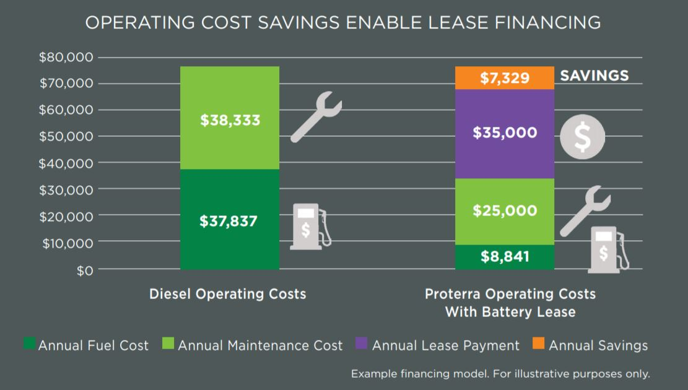
FINANCING YOUR ELECTRIC FLEET
Proterra can help you find the right combination of financing tools that map to your procurement plans
Battery Lease
A battery lease enables you to buy a Catalyst vehicle for roughly
the same price as a diesel bus, putting the operating savings toward
the battery lease. Proterra is responsible for the performance of the batteries through the life of the lease, removing operator risk.
Municipal Capital Lease
A generally low-cost financing tool for local governments with investment-grade credits. Can be paid for with FTA funds. Offers structured ownership that enables you to own a Proterra bus at the end of the lease term.
Operating Lease
Operating leases allow you to pay for the use of a bus over time, with the option to permanently transition the bus into your fleet.
No upfront capital costs.
Bus Rental Program
For fleet operators looking to “test drive” a Catalyst bus before
making a long-term commitment, Proterra offers the option to rent a
bus for up to 12 months before making a long-term purchasing decision.

Slide 21
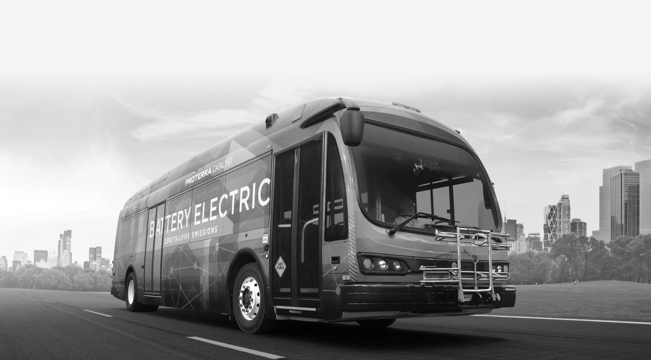

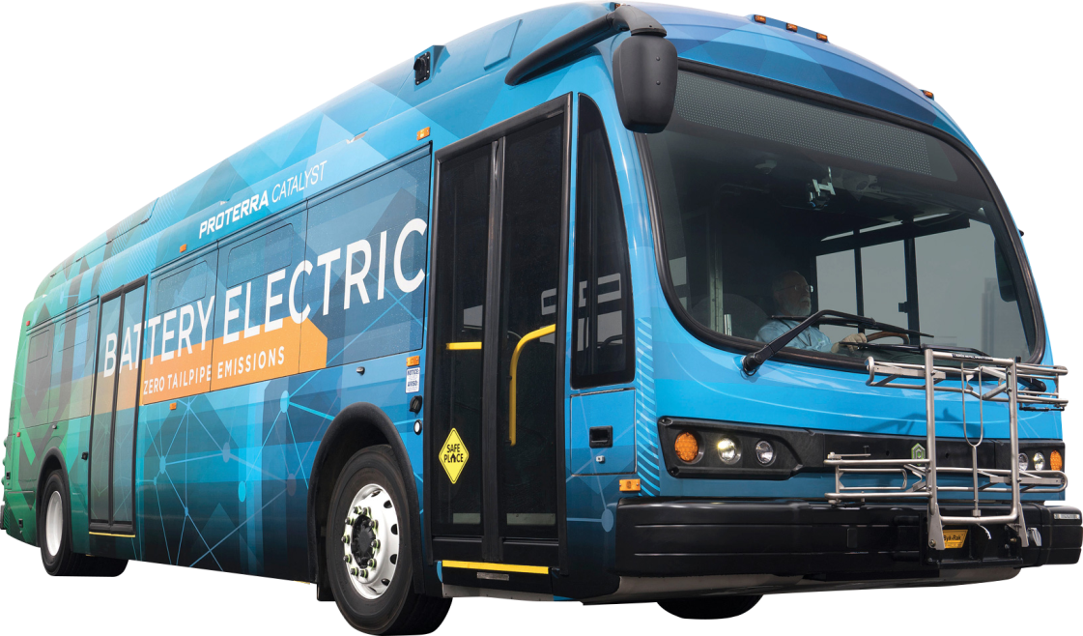
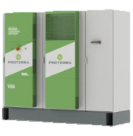
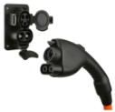
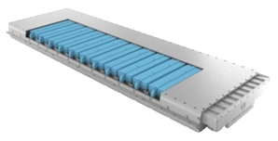
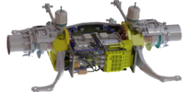
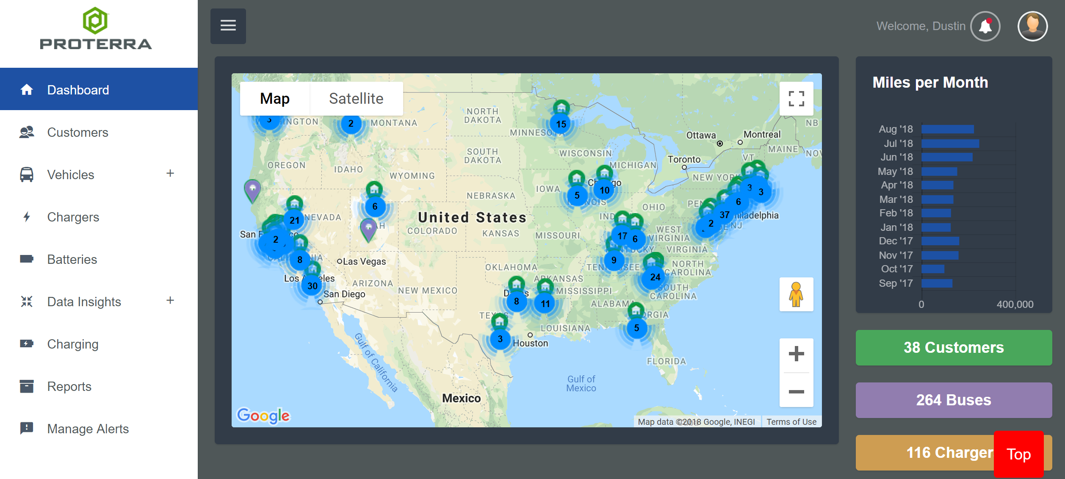
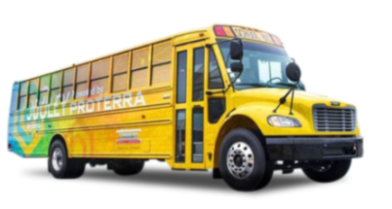
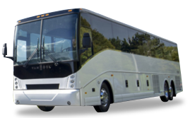
PROTERRA product overview
Leading provider of commercial electric vehicles and technology for fleets
Commercial electric fleet technology
Proterra city bus
High power
charging
Energy-dense battery pack
High efficiency drivetrain
Powered by Proterra
Connected vehicle platform
Thomas school bus
Van Hool coach bus

