Slide 1
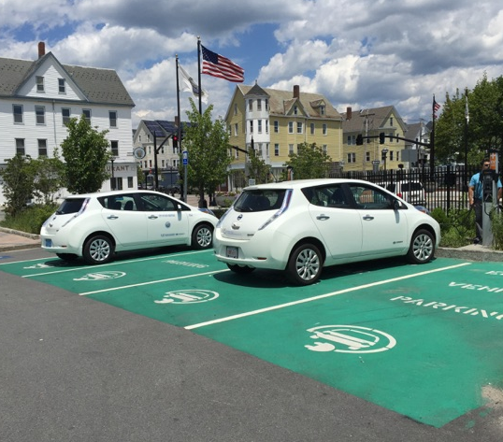
AltWheels
October 2, 2017
VEH 102
Massachusetts’ Alternative Fuel Vehicle Efforts
Available Contracts
New Bedford, MA – EVIP vehicles and charging stations
Notes:
Mark – thank everyone for coming, address partners and Natick and the vendors

Slide 2
Advanced Vehicle Technology Equipment, Supplies and Services Contract
Goal:
To build a state approved vendor list for the deployment of alt fuel vehicles (AFVs) and petroleum saving vehicle technology
Motivation:
To streamline the purchasing process for alt fuel technology acquisition in order to:
Minimize emissions
Improve air quality
Reduce fuel costs
Tap into domestic fuels that have less price volatility
Notes:
Premise – alt fuels are less widely deployed than they should be because 1) upfront costs are too high, 2) fleet managers aren’t yet comfortable with the changes that AFV deployment requires, 3) they need more support from regional leaders

Slide 3
Operational Services Division
Oversight agency of the Commonwealth within the Executive Office for Administration and Finance
Commonwealth’s Central Procurement Agency
Statewide Contracts
COMMBUYS
Programs and Services – Supplier Diversity office
Office of Vehicle Management
Notes:
Commonwealth’s central procurement agency:
Establishing Statewide Contracts for goods and services
Supporting the socioeconomic and environmental goals of the Commonwealth
Providing specific programs & services that support the procurement process
Establishing policy and procedures to ensure compliance with all state laws, regulations and executive orders
COMMBUYS:
Commonwealth's e-Procurement System-FREE!
Program and Services: that support the socioeconomic and environmental goals of the commonwealth, for example
Training and Outreach Services
Supplier Diversity Program
Environmentally Preferable Product Program
Surplus Property Program
Office of Vehicle Management
Commonwealth Print Services

Slide 4
Statewide Contracts
Overview
Contracts procured for specific commodities and services which may be used by any executive department or eligible entity.
Established by OSD or an OSD-Designated Department.
Follow “Best Value Procurement.”
Every contract has a Contract Manager.
MGL Chapter 30B
Cities and towns and others must follow M.G.L. c. 30B, although they may purchase from OSD statewide contracts.
per M.G.L. c. 7, §22A and M.G.L. c. 30B, §1(c).
Notes:
Statewide Contracts are for goods and services procured under 801 CMR 21.00 (Unless another law or regulation specifically applies). This regulation ensures a fair, open and competitive procurement process that result in a “Best Value” Contract. As an eligible entity you have access to all the terms and conditions available under the contract including pricing, discounts, special services or added value where available.
*be sure to mention eligible entity names
Contract Manager
Acts as the primary point of contact for all matters related to the contract-issues, questions, etc.

Slide 5
VEH102 Advanced Transportation Technology
General Tips:
Base prices for products established
Solicit Multiple Quotes through the awarded vendors
Labor services
Lower volume discount
Municipal Modernization Action - $50,000 threshold increase
Service Category 1: Electric Vehicle Supply Equipment (EVSE), Hardware, Software, and Ancillary Services
Provide Electric Vehicle Supply Equipment, hardware, software and ancillary services to eligible public entities.
Service Category 2: Idle Reduction Technologies for Heavy, Medium, and Light Duty Vehicles; and Heavy Duty Equipment
Provide Idle Reduction Technologies for – Heavy Duty Vehicles and Equipment, Medium Duty Vehicle, Light Duty Vehicle Categories.
Service Category 3: After-market conversion technologies– all vehicle classes
Provide after-market conversion systems modify vehicles and engines so that they can run on – or be supplemented by – fuels or technologies other than the ones for which they were originally designed.

Slide 6
ELECTRIC VEHICLE SUPPLY EQUIPMENT
Overnight charging for vehicles that will travel under 40 miles during the day
8-20+ hours
Most practical municipal applications, can add 10-25 miles of range in one hour of charging
4-8 hours
Applications make most sense along highways at rest areas for a short duration charge that provides range for long distance travel
30 mins
Image source: “Accommodating Garage Orphans” WXY, 2015
Notes:
The first service category covers charging stations. I’m guessing this is the category that everyone here is most familiar with.
There are three levels of charging station available:
Level 1, takes 8-20 hours for full charge and makes sense for vehicles that can charge overnight and travel mostly short trips during the day.
Level 2, takes 4-8 hours to change, has a lot of practical applications, makes a lot of sense to locate at work places where you might need to get a boost of energy in the short term.
DC fast charging stations take 30 minutes to achieve full charge, most sensible application for this technology is along a highway at rest areas.

Slide 7
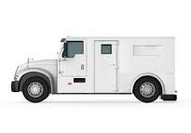
ANTI-IDLING TECHNOLOGY
Use of lights, radios, computers, radar and video cameras while monitoring traffic, assisting at accident scenes, writing reports, etc.
Power Management System
Heat Recovery System
Battery APU
Use of lights and other accessories while idled on call, water pumping requires additional power.
Battery APU
Use of lighting, communications, refrigeration, life support, heating and cooling while waiting for an Emergency Call
Battery APU or Power Pack
Electrified Parking Space
Frequent stops for deliveries and pickups, use of heating and cooling while idling
Battery APU
Heat Recovery System
Notes:
Second category on the contract is anti-idling technology
There is a wide range of anti-idling technology available on the market – all with the general purpose of reducing inefficient use of fuel while a vehicle is not in motion.
This can be done with a :
battery auxiliary power unit or battery power pack which stores power when the engine is running and then supplies it to the vehicle’s electrical devices when the engine is off,
heat recovery systems which use a small pump to circulate coolant from the warmed engine, provide heat to the passenger compartment after the engine has been turned off,
OR power management systems which allow the vehicle’s battery to power auxiliaries in engine off mode and monitor the battery’s state-of-charge
One example of a potential application of anti-idling technology are police cruisers– on average 60% of the operation time for police cruisers is spent idling (monitoring traffic, accident scenes, writing reports) this could be addressed by any of these technologies that enable use of lights, radios, computers, radar and cameras without using the engine.
Another application is in fire trucks - only 20% of fire truck dispatches are for fires, most are for medical emergencies or accidents, where water pumping is not needed. The uses needed at an accident or medical emergency can easily be powered by a Battery APU.
So the vendor eNow that was selected for the contract provides solar power directly on the vehicle as a source of energy to prevent idling.

Slide 8
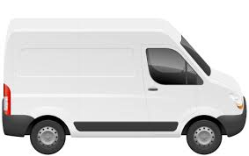
AFTER-MARKET CONVERSION TECHNOLOGY
Keep your favorite ride, while saving money and reducing your carbon footprint.
Medium & heavy duty vehicles for retrofit or up-fit
Vehicle downtime for installation minimal – typically one day on or offsite
20-35% reduction in fuel consumption – depending on vehicle type and usage.
Notes:
The third service category on the contract is after market conversion technology. This can be a great opportunity to reduce the cost of your fleet’s fuel while keeping an existing vehicle that your city of town employees are used to driving or might be a little attached to.
After market conversion systems modify vehicles so that they can run on fuels other than the ones for which they were originally designed for. In most cases this means hybrid-izing a traditional internal combustion engine vehicle so that it is capable of being fueled by electricity. We also have a vendor that converts from gasoline to CNG
Each vendor on the contract offers a slightly different form of after market conversion technology, but broadly speaking the conversion technology:
Can be installed for the medium and heavy duty vehicles within your fleet
Typically the amount of vehicle downtime is not more than one day and can be completed on or off site
And the benefits of the retrofit or up-fit are pretty great – of course, the conversion will reduce your fleet’s impact on the environment. But in addition to that, the average reduction in fuel consumption experienced is 20-35% which saves money that can then be used for other high priority projects. The fuel savings you experience is dependent on the amount and type of usage of the vehicle

Slide 9
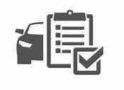
WHAT’S NEXT?
Assess your fleet and/or community charging infrastructure needs
Identify suitable applications within your fleet for green vehicle technology
Purchase easily off the statewide contract and work with the selected vendors to arrange install.
Notes:
With these new technologies, we’d recommend taking a holistic look at your fleets needs and your communities needs for green vehicle technology
Then identify suitable applications – where you’ll have the best return on your investment through reduced fuel consumption and emissions.
And finally, use the statewide contract to access these technologies – Lana will explain in more detail shortly just how you can do this.
And through all this MAPC is here to help! We’re happy to talk with you about your needs and interests and guide you through the process of using the statewide contract.

Slide 10
COMMBUYS
www.COMMBUYS.com

Slide 11
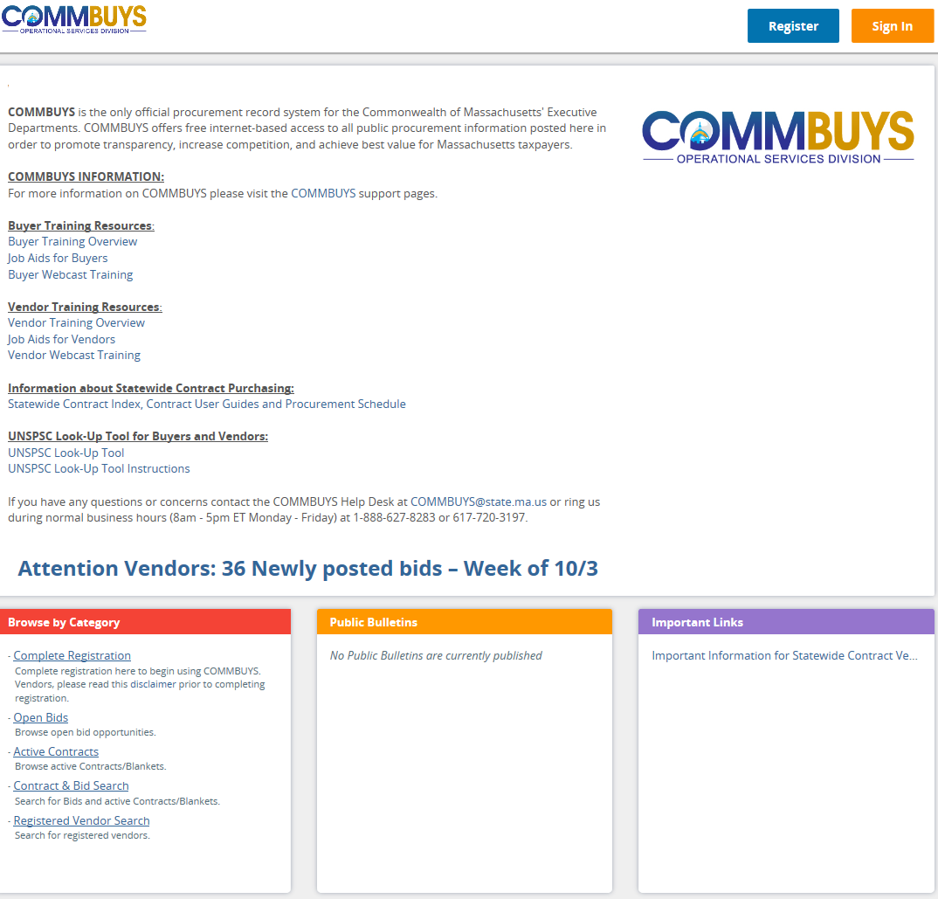
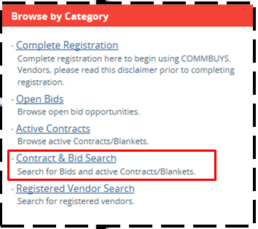

Slide 12
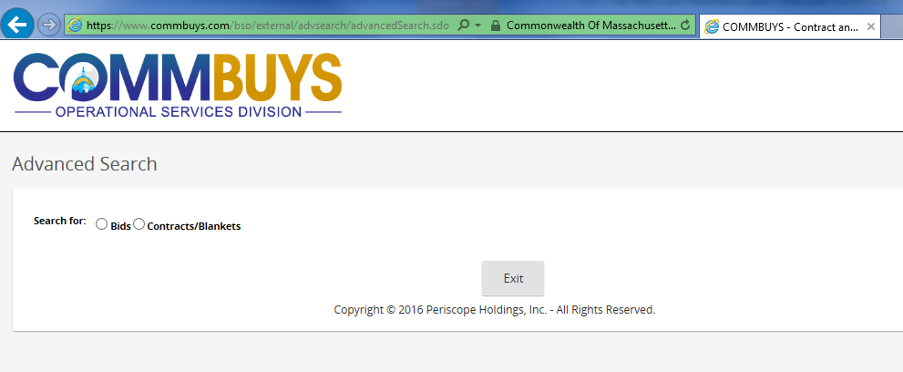

Slide 13
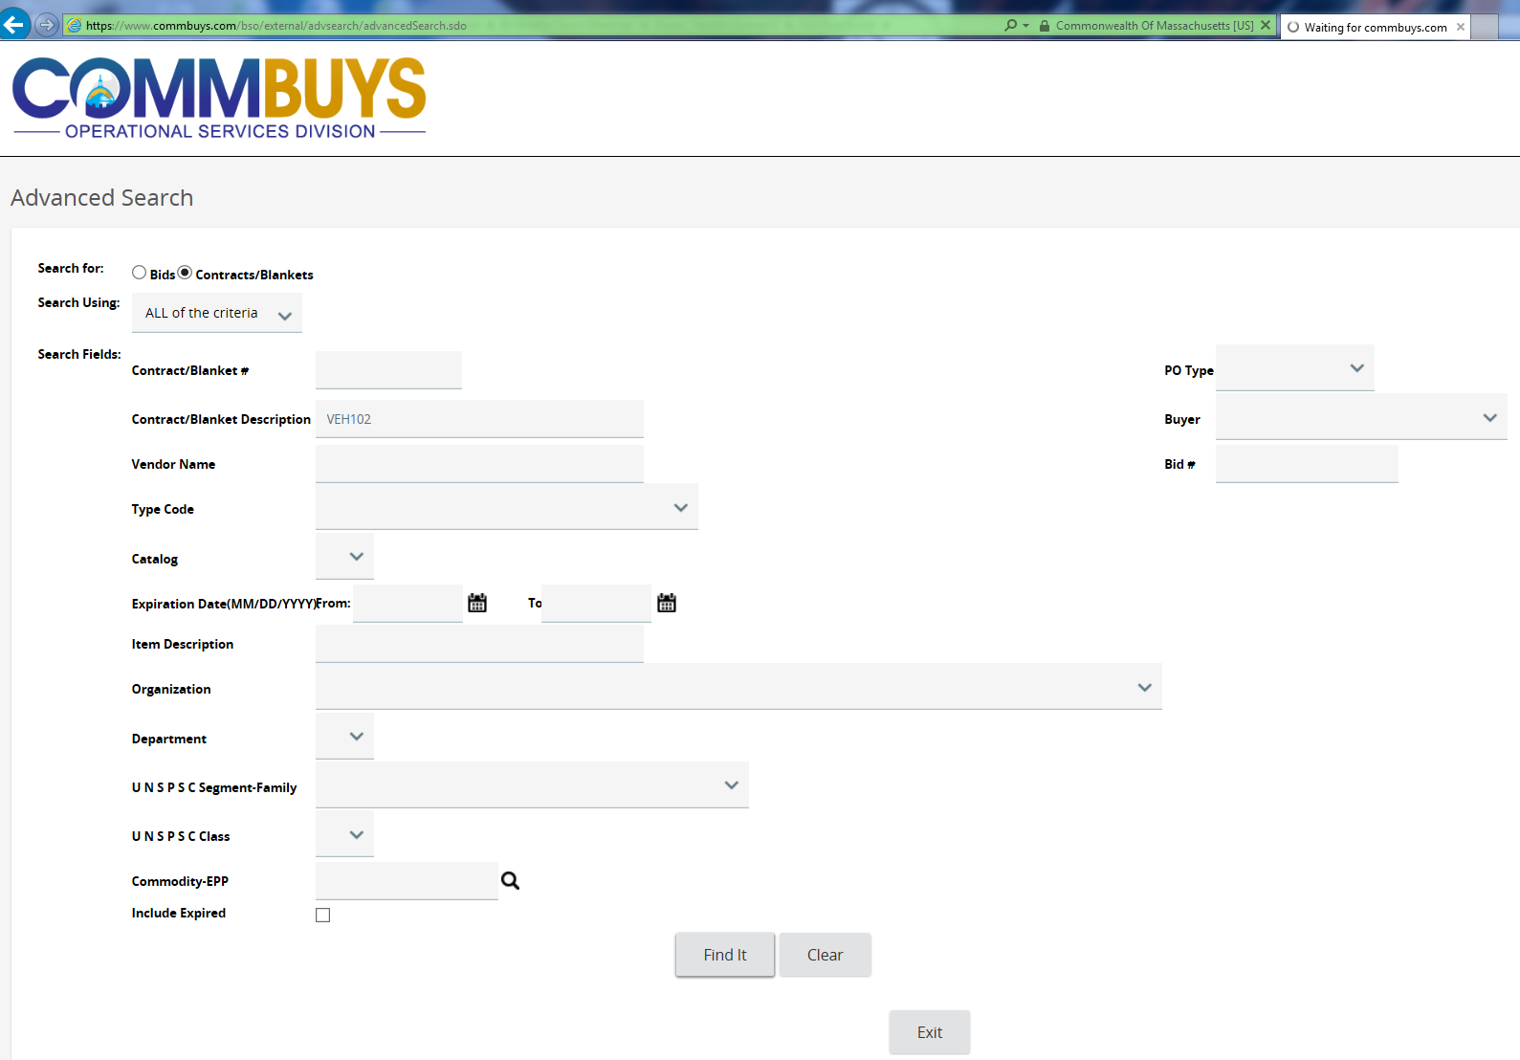

Slide 14
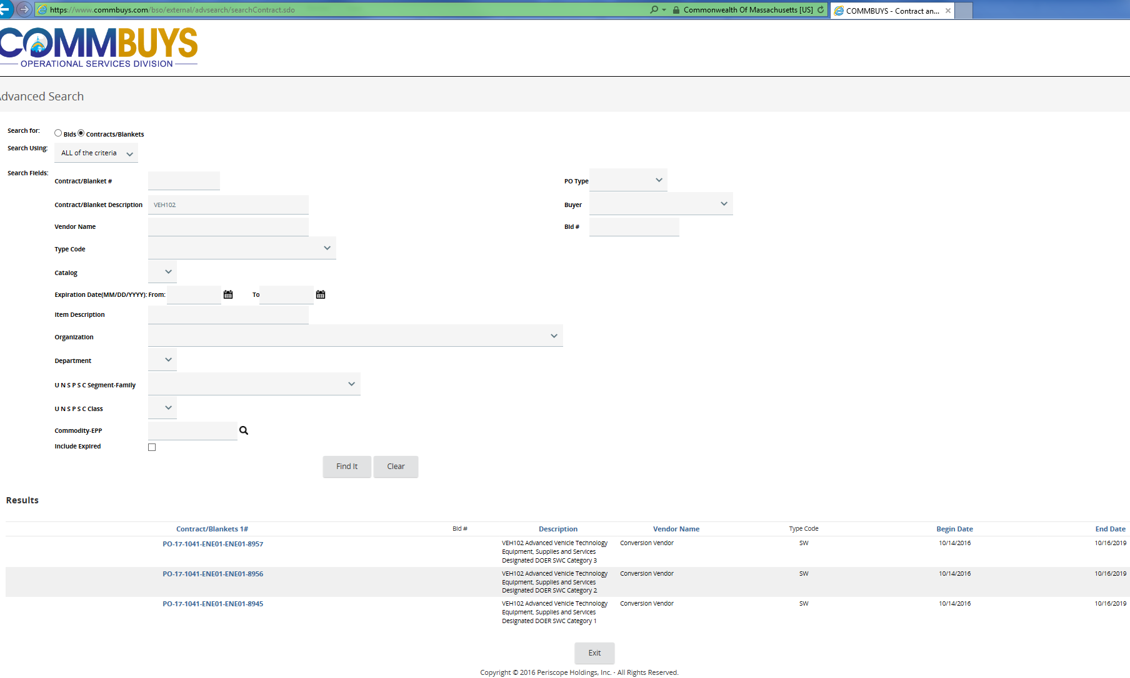

Slide 15
Contact Information
For information on alternative fuel vehicles Clean Cities contact:
Stephen Russell
Stephen.russell@state.ma.us
Michelle Broussard
Michelle.broussard@state.ma.us
For information on purchasing contact:
Lisa Westgate
Lisa.westgate@MassMail.state.ma.us
For information on COMMBUYS contact:
Charlie Tuttle
Charles.tuttle@state.ma.us
For information on the MASSEVIP program at DEP contact:
Sejal Shah
Sejal.shah@state.ma.us
Notes:
Thank you and I invite any questions.
Please let me know if you need the Web site addresses or any additional information regarding the information I presented here today.

