Slide 1
Mike Morrissey – ALT WHEELS Clean Corridors – Propane Pride Station – Hartford, CT

Slide 2
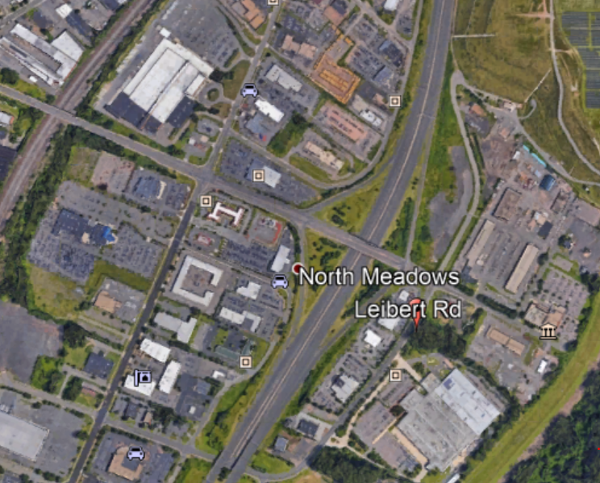
Aerial View of Leibert RD location

Slide 3
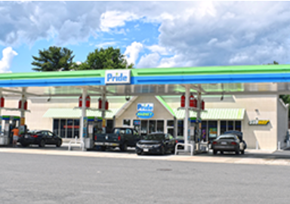
Leibert Road Hartford CT

Slide 4
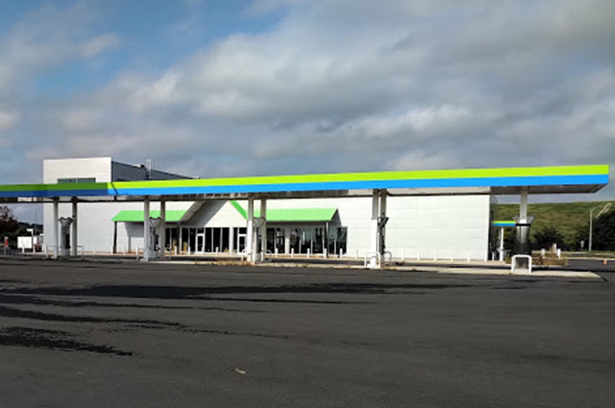
Now under construction

Slide 5
Alternative Fuels – Pride Store

Slide 6
Compressed Natural Gas - Future

Slide 7
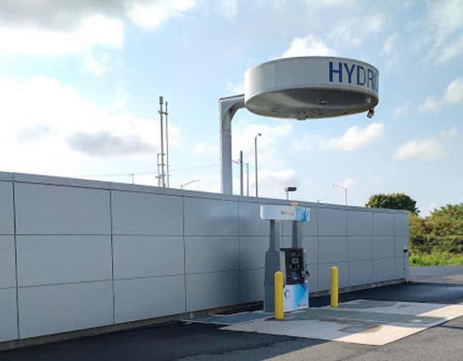
Hydrogen - Toyota /Air Liquide

Slide 8
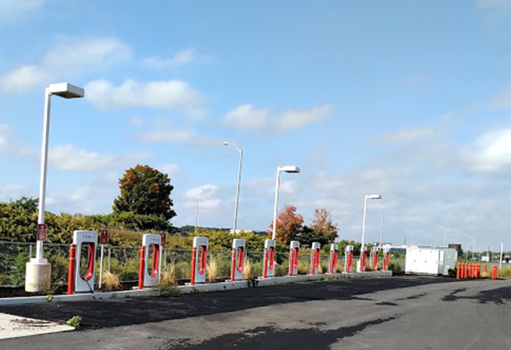
EV Charging - Tesla

Slide 9
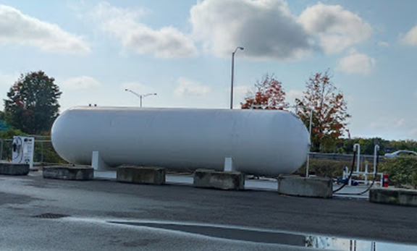
Propane – 18K Above Ground

Slide 10
Features of Hocon Autogas System
18K Above ground storage with an associated Bulk Plant capability
Single Dual Hose Autogas Dispenser under weather canopy
2nd Autogas Dispenser will be installed in the future
Dispensers rated at 15 gallons/minute comparable to gasoline/diesel pumps
Low Emission Nozzles – No PPM required
Dispensers are fully integrated, customizable web-based unit
Accommodates Transport Delivery
Back up storage to support Electric Generation equipment

Slide 11
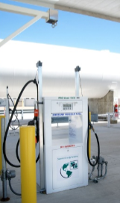
Dual Hose Dispenser on Island

Slide 12
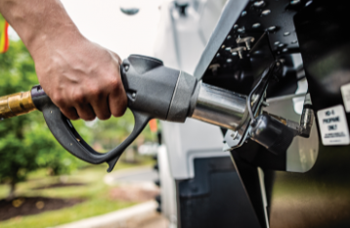
Low Emission Nozzle

Slide 13
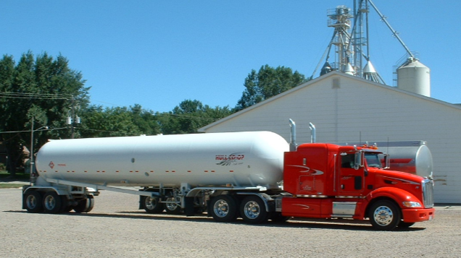
Transport Delivery

Slide 14
Thank you for your time – Go Autogas!

