Slide 1
Notes:
FLEET Screensaver slide. Leave this up til ready to begin presentation.

Slide 2
Beyond The Pilot Phase
David Breault, Sr. Manager, Fleet Solutions
Alt Wheels 2019

Slide 3
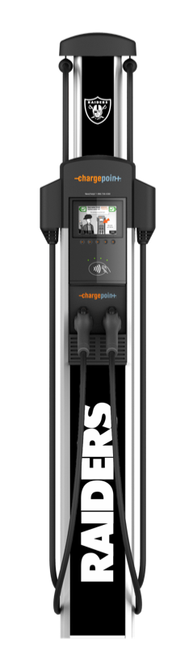
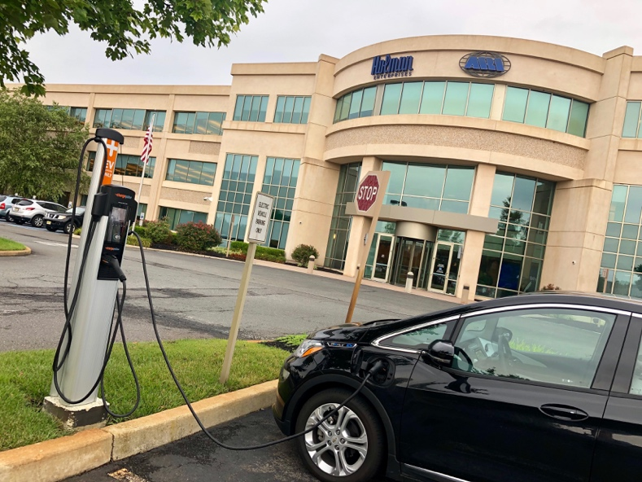
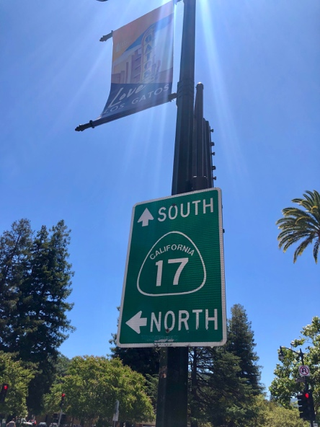
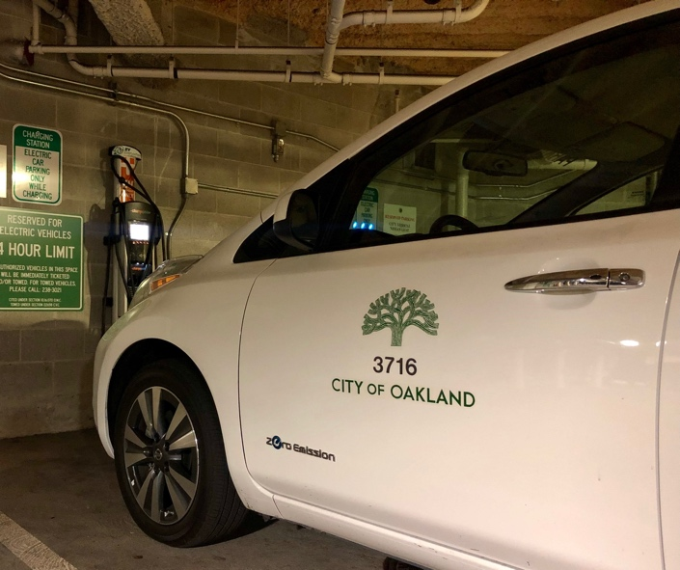


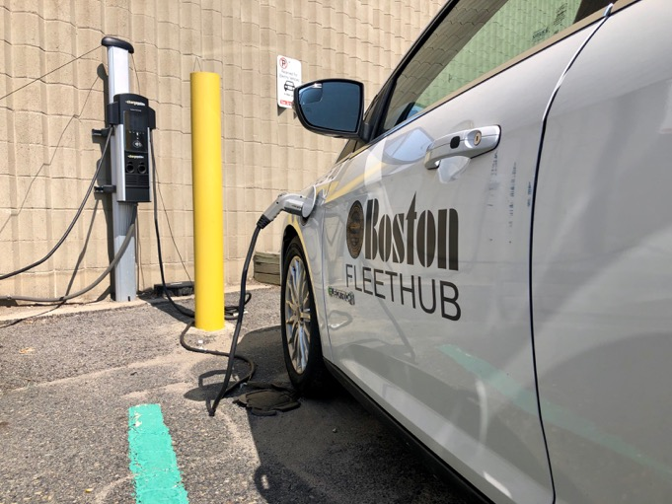
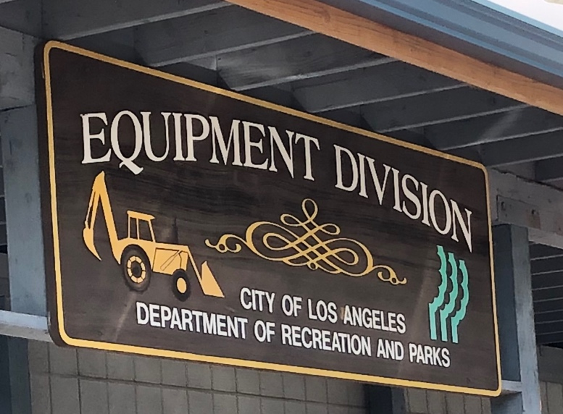
My Last 90 days

Slide 4
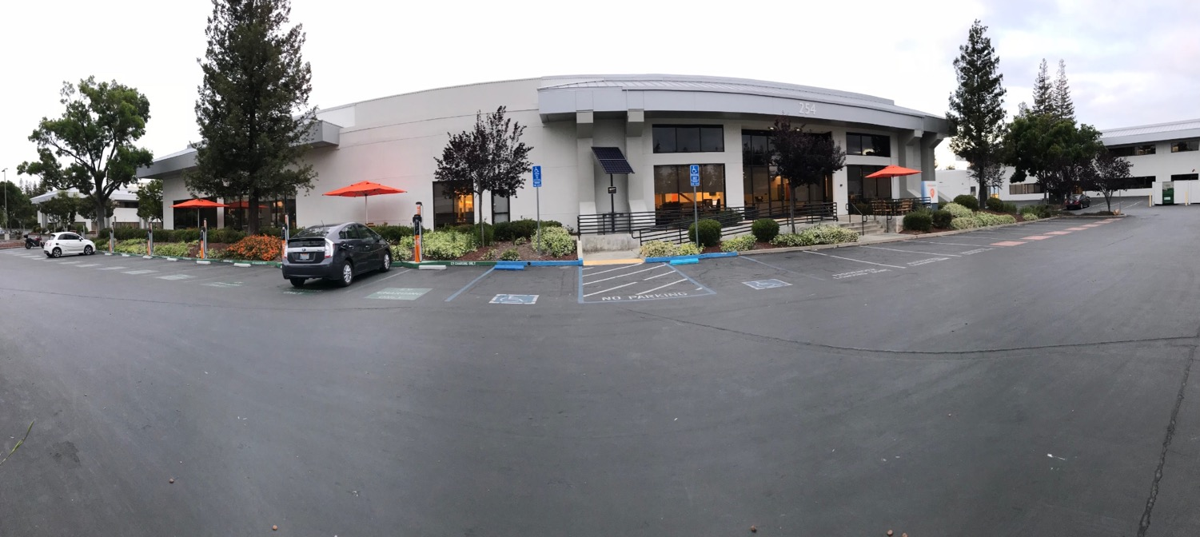






ChargePoint at a Glance
2007
Founded in Campbell, CA
650+
Employees globally
200+
Engineering staff globally
Offices Located:
United States Campbell, CA (HQ) Oakland, CA
Scottsdale, AZ
Europe Amsterdam
Pangbourne (UK)
Munich
Paris
India Haryana
Market Leadership
100,000+ Places to charge!
World’s largest and most open EV charging network
All 50 States and 6 different countries
Over 65 million charges delivered
Highest rated mobile app

Slide 5





Three Quick Takeaways
Electric Vehicle Revolution
Manage the Load
How we do it

Slide 6
Electric Vehicle Revolution
Have you been asked to look into EV’s for your fleet?

Slide 7






Beyond Compact Cars
Automotive OEM’s
  Billions in investment and speed to market
  Wider choices, options and availability
Ford/GM - 36 fully electric vehicles by 2023
Consumers
  Are six times more likely to purchase an EV if they have workplace charging available.
Utilities
  Many are incenting the market and developing programs to expand adoption
  Opportunity for leadership

Slide 8
Scale Your EV Fleet
How do you scale your EV fleet without costly upgrades?

Slide 9
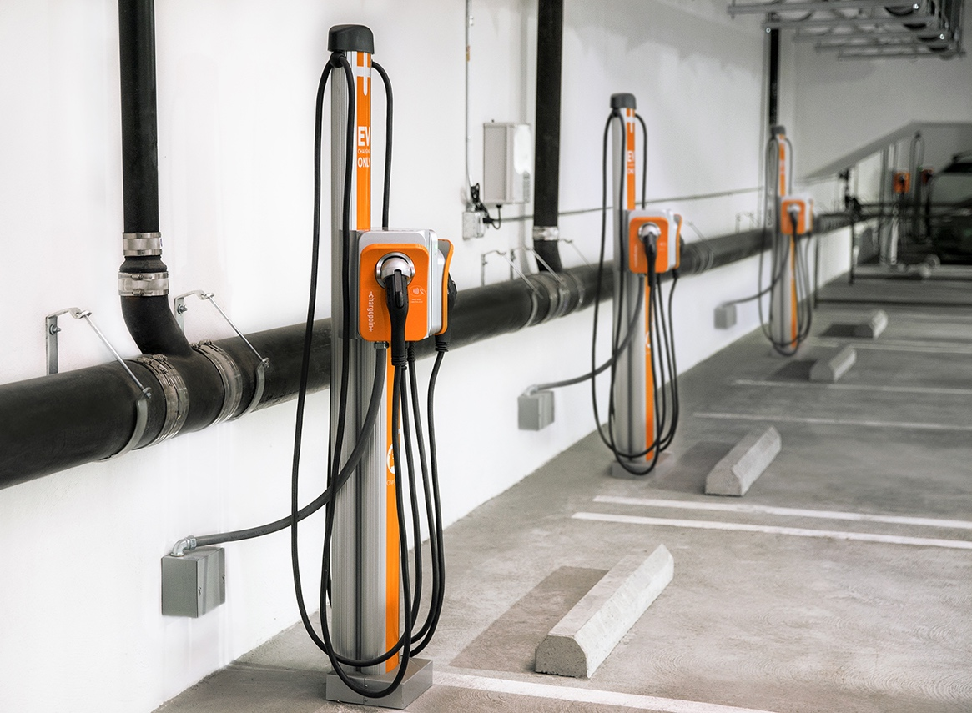
Manage the Load
Locations Fleets Charge
  Depot, On Route, Mixed-Use, Home
If a package delivery fleet purchases 200 electric Class 8 trucks in Boston, how do we manage the demand load?
  Many vehicles, single locations
Homeowners
  Smaller number of cars spread out into various neighborhoods.
Multifamily
Workplace

Slide 10
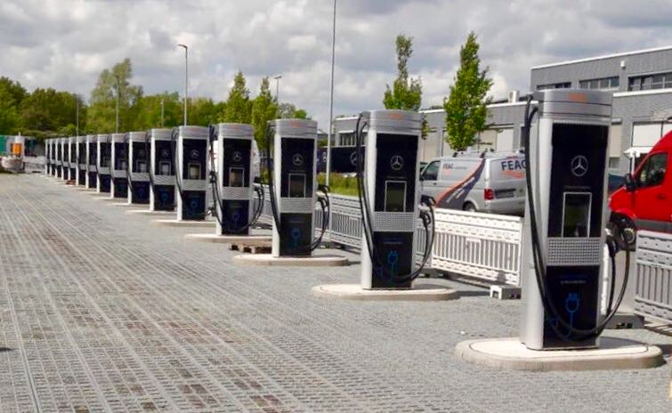
Uptime, Vocation, and Expense
Design for Reliability
The electric fueling solution must fit within current workflow to ease the adoption of electric vehicles and to support key business functions
Fuel in the most economic way possible

Slide 11
Manage the Demand
How we do it.

Slide 12





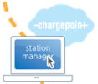
Value of Networked Charging for Fleets
 | Smart Charger | Non-networked Charger
Dispense Electricity | ✓ | ✓
Visible to Drivers * through mobile app, turn by turn directions, nearby amenities, real-time availability, 24/7/365 driver support | ✓ | ❒
Waitlist & Driver Alerts * reserve a station, know when car is fully charged | ✓ | ❒
Access Control for Owners * public/private, loyalty rewards, fleet services | ✓ | ❒
Recover Revenue: Session Fees * charge per kWh, hourly, or per driver group | ✓ | ❒
Data Analytics * station usage, # of unique drivers, charging behavior, utilization, revenue, costs, and GHG offset | ✓ | ❒
Remote Access and Maintenance * proactive monitoring & fixes, software updates | ✓ | ❒

Slide 13



Take Control of your Electric Fueling
Power Management
  Included on all ChargePoint products
Fleet Charging Algorithms
  First-in-first-out
  Last-in-first-out
  Random
  Optimized
  Driver-based
  Custom
Energy Solutions
  Next level of power management

Slide 14
Current site load can significantly impact charging plan

Slide 15
Charging loads can increase site power requirements

Slide 16
Optimized charging can dramatically reduce peak
Lower peak power reduces TCO
+ Reduced utility infrastructure upgrade costs
+ Lower demand charges or demand reservation fees on electrical bill

Slide 17


Energy Solutions Team
ECO Fleet – Provides workflow and energy management for fleet charging
  Can be integrated with your Fleet Management software and Telematics systems
  Workflow and alert features
ECO Site – Manages workplace charging to minimize peak energy usage
  Curtails charging to limit load to fixed capacity or reduced demand to lower demand charges
  Adds building to power management allowing additional charging capacity
ECO Grid – Integrates solar and stationary battery storage for corridor DC fast charging
ChargePoint Energy Solutions
  Minimize demand/costs without a compromise to operations
  Have vehicles ready to go when the shift starts

Slide 18



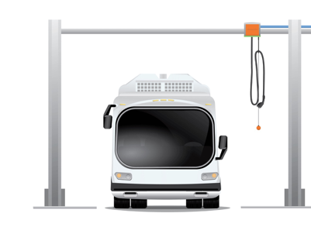

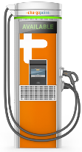
Santa Clara Valley Transit Authority (VTA) Fleet
Bus Profile:
Battery Size (kWh)
Efficiency (km/kWh)
Max Charge Speed (kW)
Route Data:
Range Needed,
Departure Time
ECO Fleet
Bus Profile
Route/Dispatch
Management
SOC, Telematics Data
Utility Rate Data
Demand Charges & TOU
Truck/Bus
Cloud
Vehicle ID,
SOC, etc.
Load Control and
Charging Schedule
Utilities

Slide 19
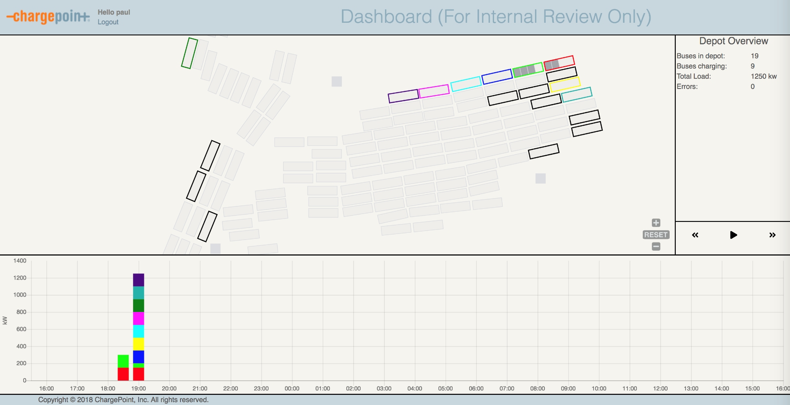
Depot Dashboard: Evening Pull-In

Slide 20
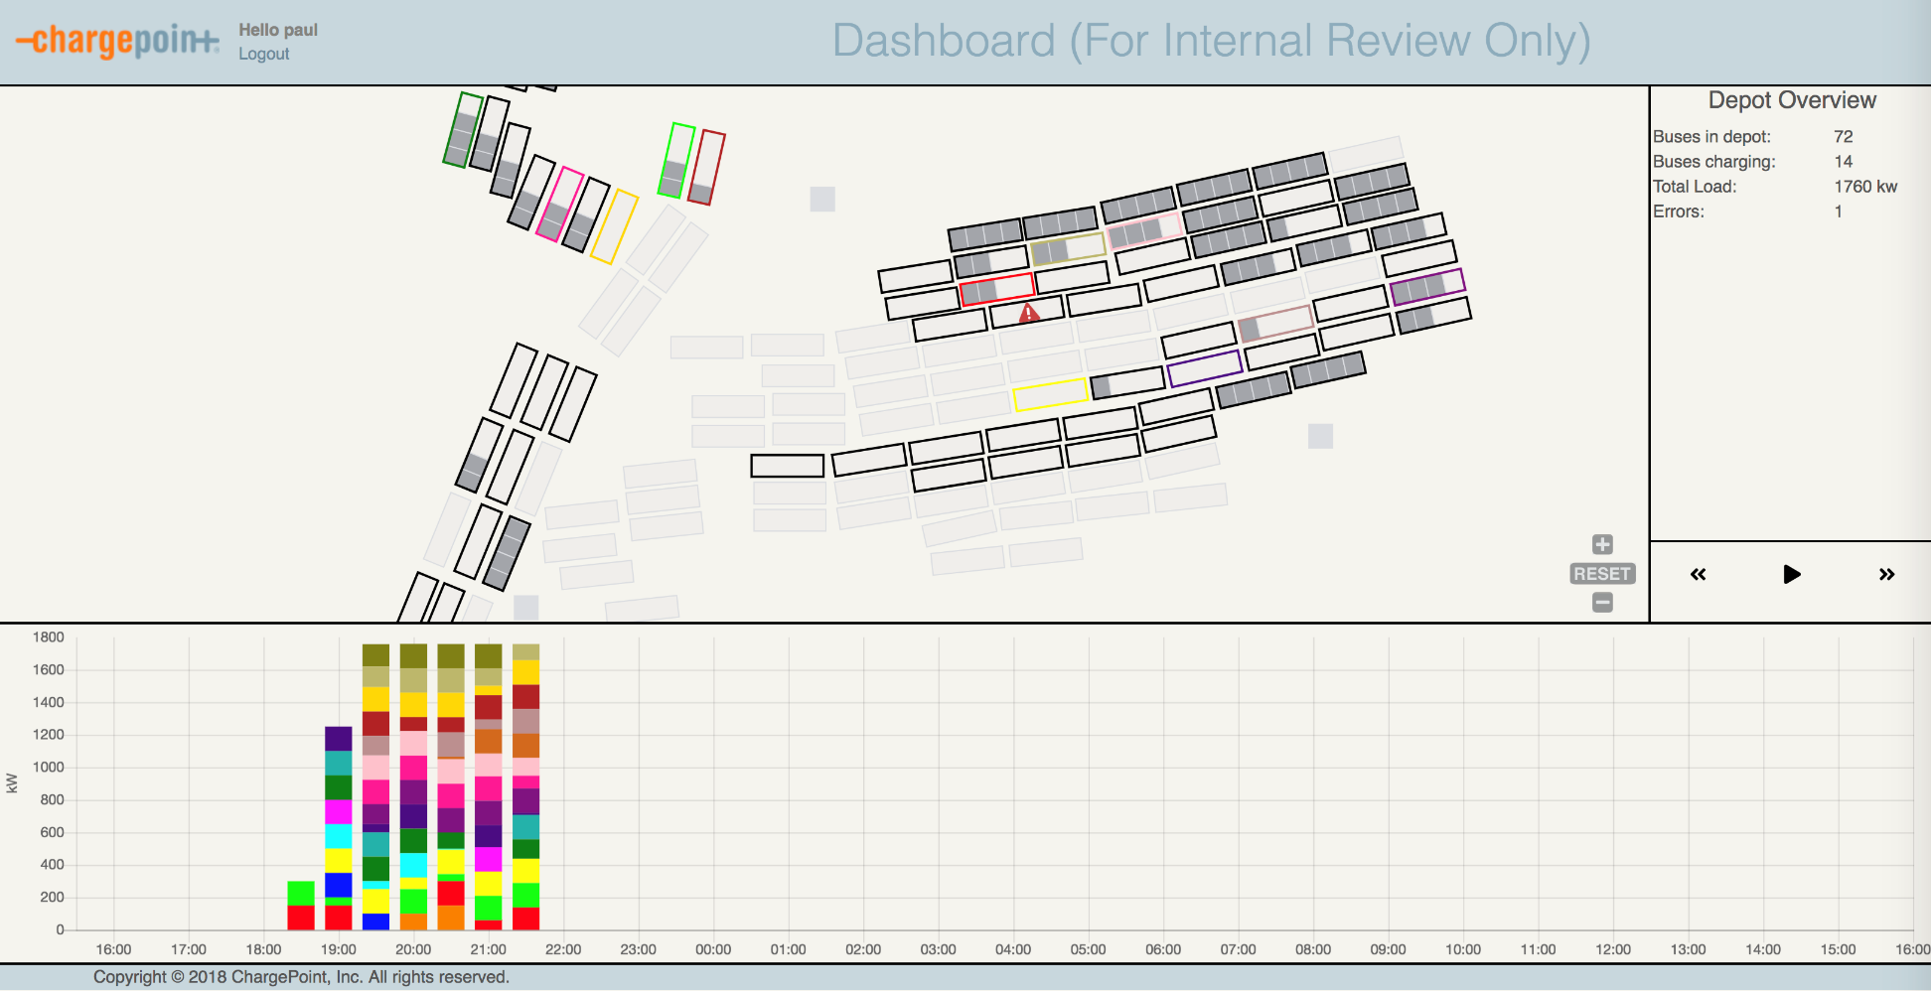
Depot Dashboard: Mid Evening Charging

Slide 21
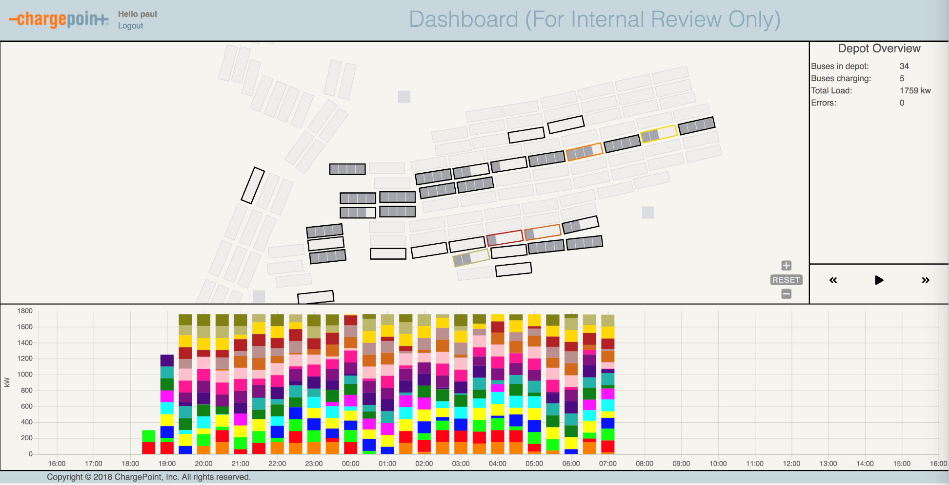
Depot Dashboard: Early Morning Pull-Outs

Slide 22
Simplified Experience
ChargePoint commits to delivering software and services that simplify your experience.

Slide 23







Most Advanced Charging Software and Services
Dashboard & Analytics
Station owners see how stations are being used and when it’s time to add capacity.
Waitlist
Drivers can get in line and get notified when a station is available, improving utilization.
Energy Management
Efficiently and automatically utilize power available for charging vehicles. Save money on costly upgrades and avoid demand charges.
Flexible Pricing
Price by hour, kWh, time of day, customer type or any combination.
Access Control
Limit who can use the charging stations and when. Station owners can disable charging during “closed” times.
Fleet Services
Fleet managers can track vehicle charging and pay for electricity if the vehicles need to charge at other stations.
Driver Services
Automatically notify drivers of a full charge, available station, changes in power and more.
APIs
Most functions are also available through SOAP/XML and REST APIs that follow the same data access rules as the UI.
Notes:
*recycled from corporate deck

Slide 24





Fleet Partners
Fleet Card /
Fuel Management System
Fleet Operations
Software
Vehicle
Telematics

Slide 25


Services for Planning, Installation and Ongoing Support
Site Assessment, Scoping and Project Management
  Accurate site qualification, quality site preparation and professional installation
  Nationwide network of O&M partners who provide setup services
  Initial Activation and Configuration service provides a specialist to consult directly with station setup and activation
Ongoing Service Support
  Standard warranty coverage for one year; includes parts only when installed by ChargePoint dealer
  ChargePoint Assure is the industry’s most comprehensive EV charging station maintenance and management program
  Station owner phone support during business hours
  24/7 driver support in multiple languages
Notes:
*recycled from corporate deck

Slide 26
ChargePoint can help …
  with the right charging station
Notes:
Here is an example of some of our products. With ChargePoint, you have the flexibility to spec our product features up or down based on your budget or application.
Want a simple wall-mounted charger for behind the fence use?
Want a complete solution for mixed-use (private/public charging) that provides a color user-interface screen and the best cord management?
Are you purchasing an electric bus, forklift, refuse, or yard truck?
We can help you with a variety of AC and DC chargers in multiple options and capacities.

Slide 27
Three Quick Takeaways
Huge EV Opportunity
Manage the Load
How we do it
Fleet: HD, MD. LD
Power & Energy management
ChargePoint® Network

Slide 28
Thank You
For further information on this topic,
please contact David Breault:
david.breault@chargepoint.com
+1.978.496.5899 (mobile)

