Slide 1
Transitioning to Electric Fleet Vehicles (“EFVs”)
October 2019

Slide 2
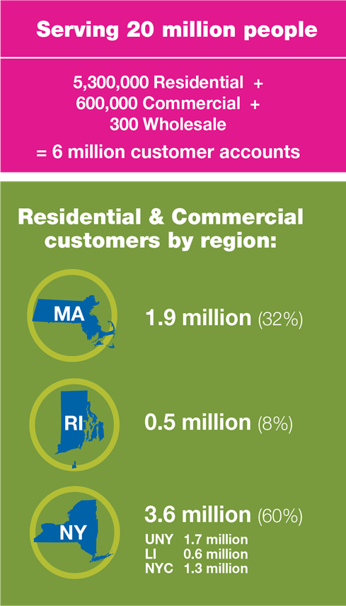
About National Grid US
Residential & Commercial Customers by Region:
National Grid US:
National Grid is a US energy company, delivering electric, gas, and clean energy to communities in NY, MA, and RI.
Serving 20 Million
National Grid Ventures (NGV):
A distinct commercial unit that owns and operates energy businesses in competitive markets in the UK and US.
National Grid UK:
Owns and operates the electricity transmission network in England and Wales. Operates Scottish Networks. Owns and operates gas National Transmission System in Great Britain.

Slide 3
The National Grid Northeast 80x50 Pathway
40% x 2030
80% x 2050
Transport | Reach more than 10 million light-duty electric vehicles on Northeast roads (50% of all light-duty vehicles) vs. < 75,000 today | More than 20 million light-duty vehicles (100% of the fleet) Low-carbon heavy duty, rail, and off-road transportation Reductions in vehicle miles traveled
Our 80x50 Pathway is ambitious and comprehensive, with implications for customers, communities, utilities, automakers, and policymakers.

Slide 4
MA & RI FLEET OFFERINGS
Funding of Charging Infrastructure
Fleet Program (future)
Fleet Advisory Studies

Slide 5
Learn more @
www.ngrid.com/ma-evcharging
www.ngrid.com/ri-evcharging
EVNationalGrid@nationalgrid.com

