Slide 1
Massachusetts Electric Vehicle Incentive Program (MassEVIP)
Sejal P. Shah
MassDEP
OCOTBER 2, 2017

Slide 2
WHY EVs?
Price volatility of gasoline -- How long do you think gas prices will stay low?
Over the lifetime of an EV, an owner can save thousands of dollars in fuel and maintenance costs.
EVs not only decrease greenhouse gas (GHG) emissions but also significantly reduce smog forming emissions.
Same performance as a conventional ICE (Internal Combustion Engine) vehicle.

Slide 3
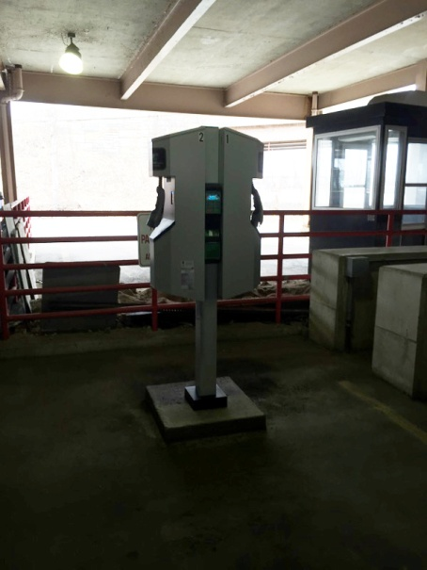
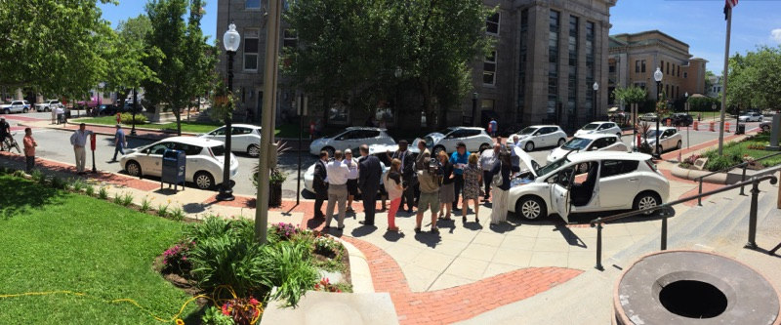
MassEVIP
TWO SEPARATE PROGRAMS
MassEVIP: Fleets
MassEVIP: Workplace Charging Program
Notes:
Covering only MassEVIP Fleets today

Slide 4
MassEVIP: Fleets
Launched on Earth Day 2013
$2.67 million in funding
Open to municipalities, public universities and colleges and state fleet
Financial assistance up to $15,000 for the installation of Level 2 dual port charging station

Slide 5
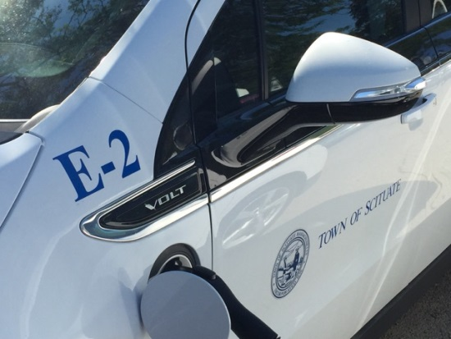
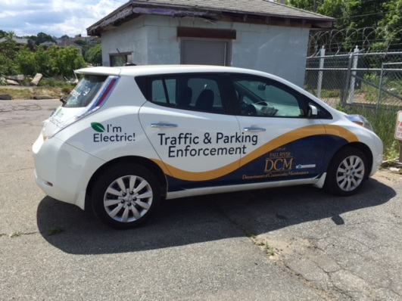
MassEVIP: Fleets – Vehicle Incentives
$7,500 acquire* Battery Electric Vehicle (BEV)
$5,000 acquire* Plug-in
Hybrid Vehicle (PHEVs)
*Acquire = Purchase or Lease
Fall River – Nissan Leaf (4)
Scituate – Chevy Volts (2)
$750 to purchase Zero Emission Motorcycle (ZEM)

Slide 6
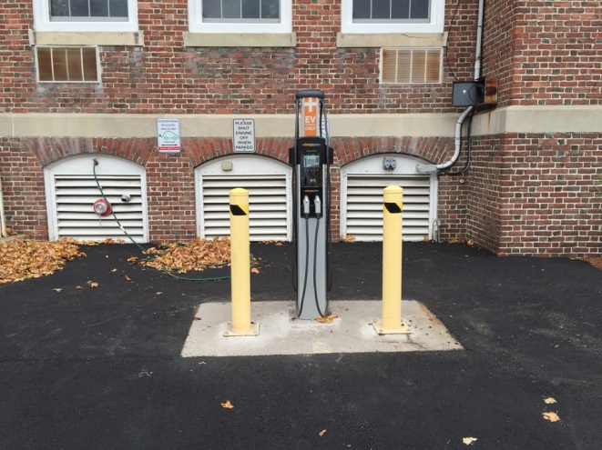
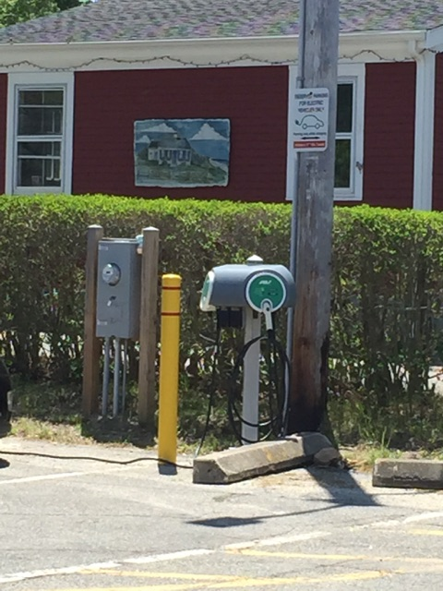
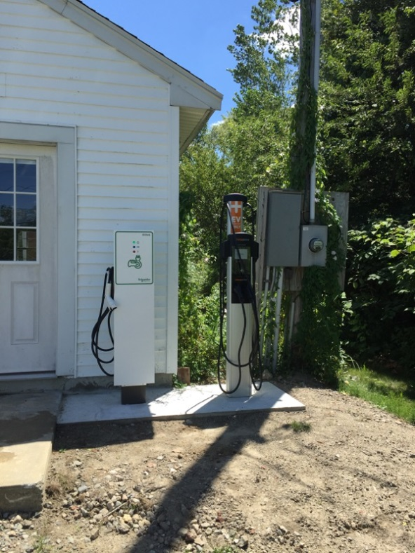
Charging Stations
Chelmsford
Barnstable
Brockton

Slide 7
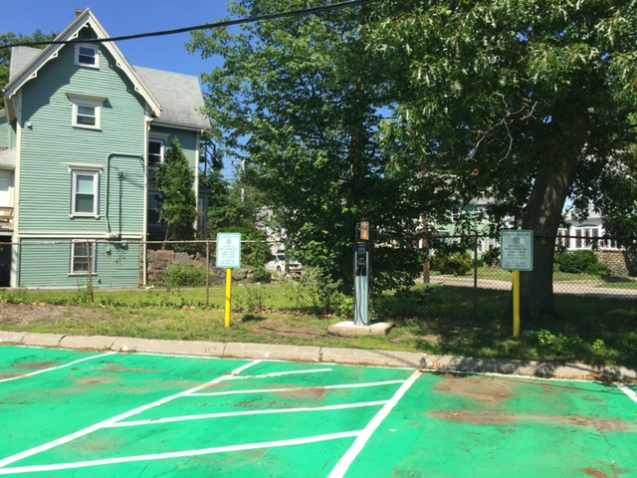
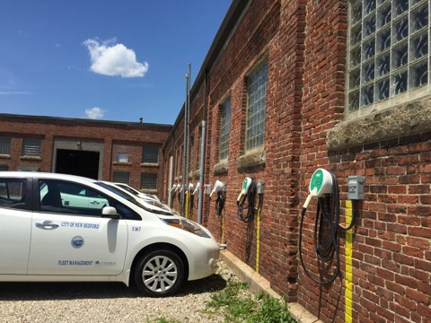
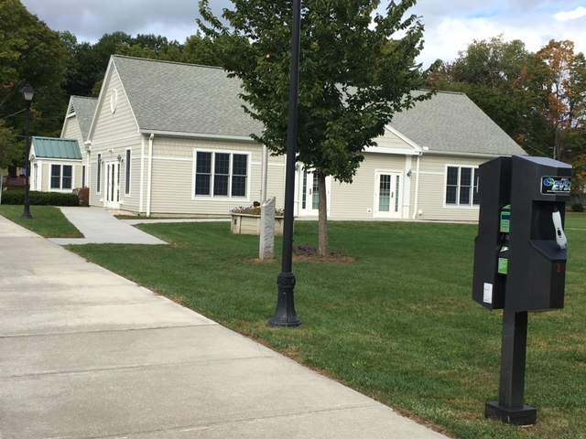
Where are the charging stations?
Level 2 at Braintree Town Hall
Level 2 New Bedford DPW Yard
To find Electric vehicle charging stations in Mass go to: http://www.afdc.energy.gov/
Level 2 at Dalton Senior Center

Slide 8
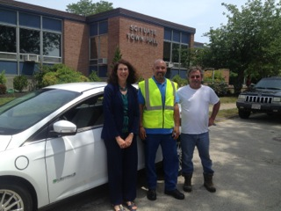
MassEVIP Fleets Awards
86 entities with 121 applications
$2.6 million in incentive funding
267 EVs: 211 BEVs, 55 PHEVs, 1 ZEM
92 Level 2 dual-port charging stations
~90% Projects Completed
Town of Scituate – Ford Focus BEV
Notes:
226 EVs Acquired, 70 Charging Stations Installed and Operational,

Slide 9
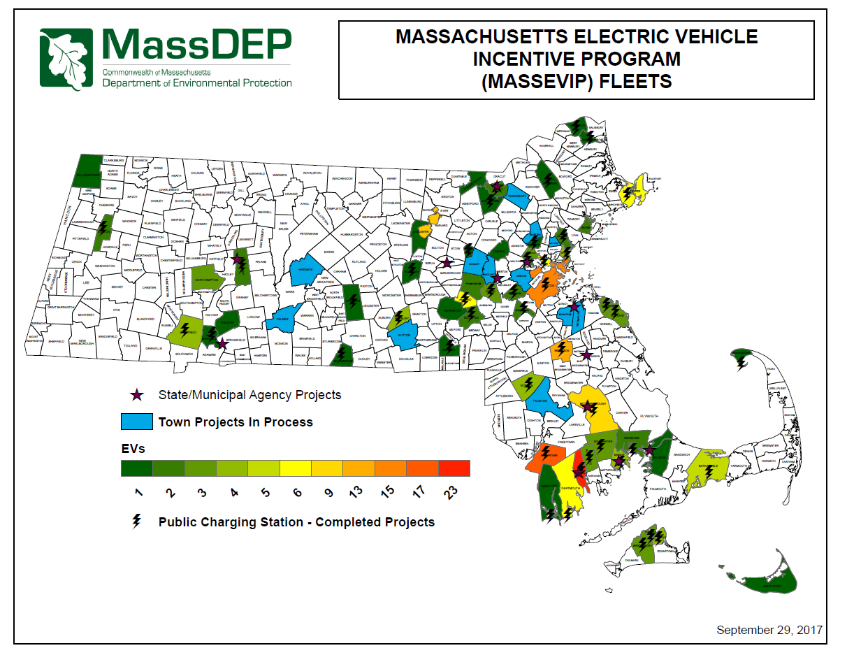

Slide 10
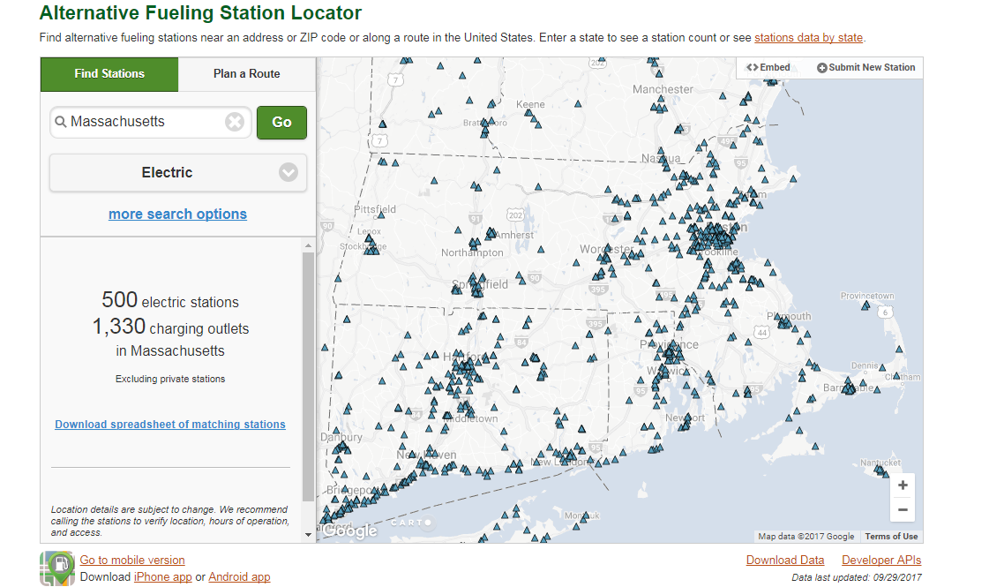
AFDC Public Charging as of 9/29/2017

Slide 11
MassEVIP
TWO SEPARATE PROGRAMS
MassEVIP: Fleets
MassEVIP: Workplace Charging Program
Notes:
Covering only MassEVIP Fleets today

Slide 12
MassEVIP: Workplace Charging Program
Launched in June 2014
Goal to stimulate the adoption of EV charging stations at workplaces throughout the Commonwealth
Provides 50% of hardware cost for electric vehicle charging station Level 1 or Level 2 up to $25,000 per site

Slide 13
MassEVIP: Workplace Charging Program
Eligibility
Employer with 15 or More Employees in a Non-Residential Place of Business
Employer Provides Remaining 50% of hardware cost
Employer Provides full installation cost
Employer Demonstrates adequate power supply (or intent to upgrade power supply).
Employer commits to using the charging station(s) in the Commonwealth for 36 months

Slide 14
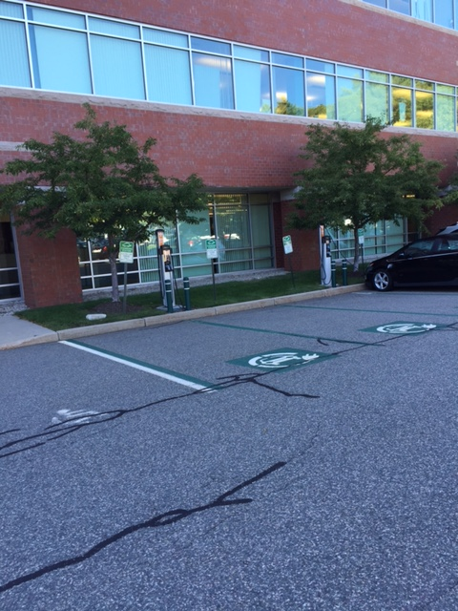
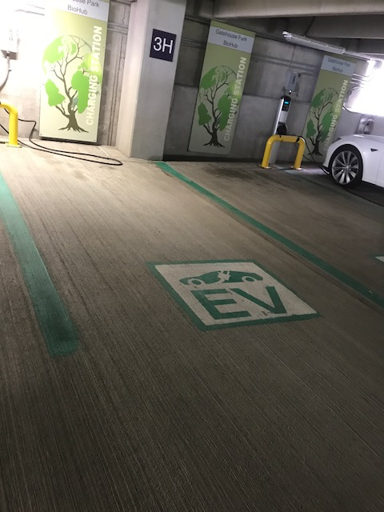
MassEVIP: Workplace Charging Program
232 employers have requested:
$1.55 million in incentives
542 charging stations
266 Separate Street Addresses
87% Projects Completed
Notes:
So far -- 435 units, 702 ports, 213 separate street addresses
Projects to be completed by December of 2017.

Slide 15
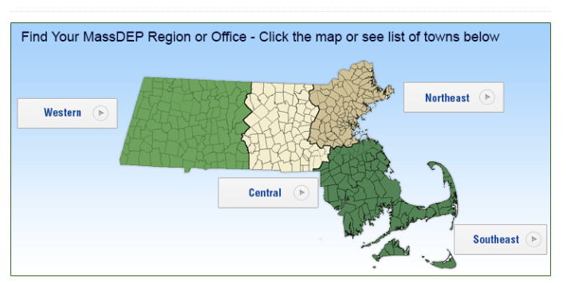
MassEVIP: Workplace Charging Program

Slide 16
MassEVIP: Workplace Charging Program -- Application Process
Application period: FIRST COME FIRST SERVED
Complete and submit to MassDEP an Application Form
Form and instructions found at:
Workplace Charging: http://www.mass.gov/eea/agencies/massdep/air/grants/workplace-charging.html
Applications are reviewed
MassDEP will issue a Grant Approval within 30 days of receipt of the application
Entity must sign an End-User Agreement
Upon receipt of the signed End-User Agreement by MassDEP, entity has 180 days to acquire and install charging station

Slide 17
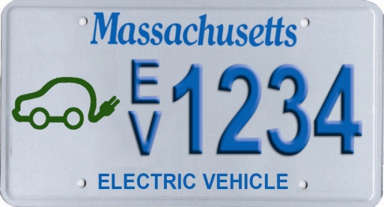
Contact Information and Webpage
Massachusetts Electric Vehicle Incentive Program web site:
www.mass.gov/eea/agencies/massdep/air/grants/massevip.html
For information on the MASSEVIP programs contact:
Ms. Sejal Shah
Sejal.shah@state.ma.us

