Slide 1


Purchasing Programs & Funding Opportunities
How to Transition Your Fleet to Alternative Fuels
Metropolitan Area Planning Council (MAPC)
October 2, 2017
AltWheels Conference

Slide 2
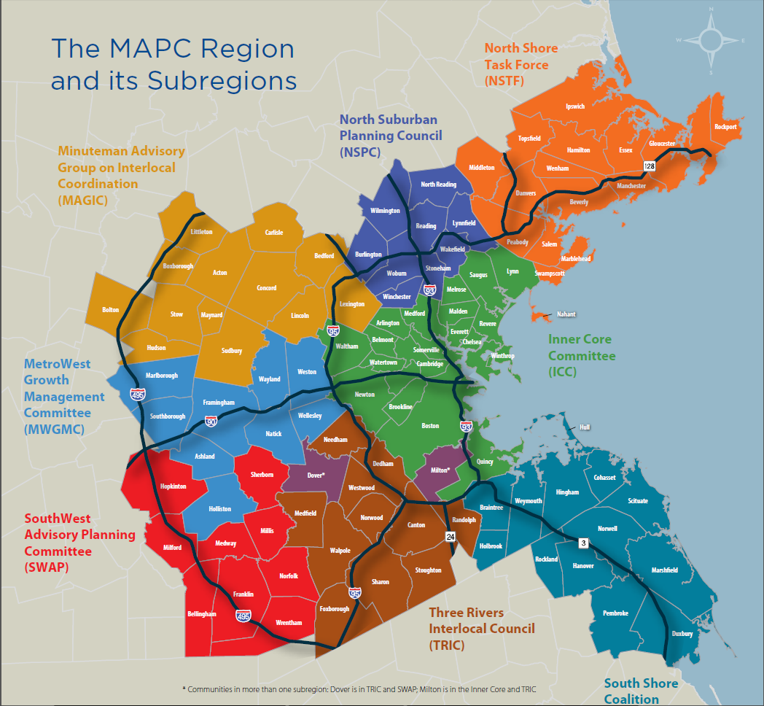
MAPC: ABOUT US
  Regional Planning Agency
  101 cities and towns
  90+ employees
  Wide range of planning expertise

Slide 3
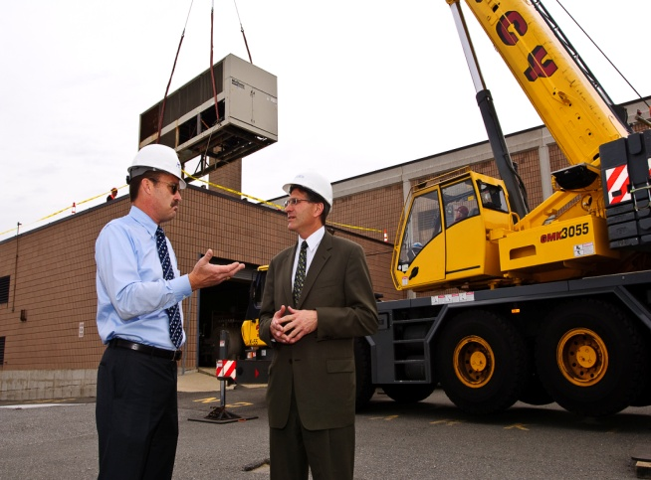
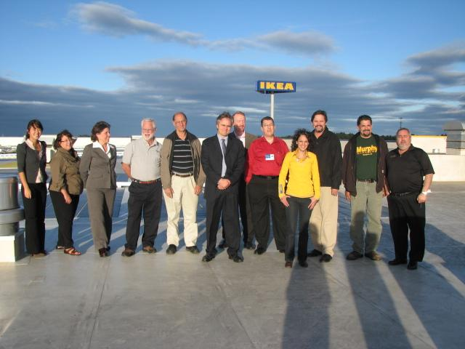
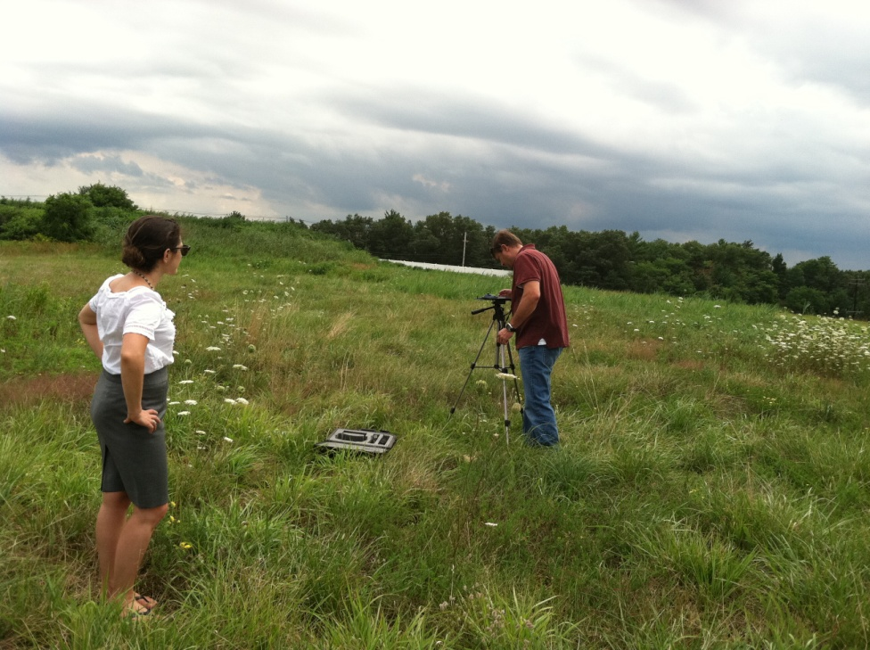

MAPC: CLEAN ENERGY
Regional Clean Energy Projects
Climate and Clean Energy Planning
Clean Energy Technical Assistance
ESCO Procurement
Regional Solar Initiative
LED Streetlight Purchasing Program
Community Electricity Aggregation
Green Mobility Program
Energy Resiliency
Connecting municipalities with incentives + plug-and-play programs
Community energy and climate baselining, planning, and strategizing
Outreach programming and education
Net Zero Planning
Grant Writing
Green Communities Support
Methane Leaks
Solar Permitting and Zoning
State and Local Policy
Net Zero Guidance & Education
Notes:
Police Vehicle Cooperative Purchasing
Fire Apparatus Group Purchasing
Clean Energy Group Purchasing
LED streetlights
ESCOs
Solar development
Aggregation

Slide 4
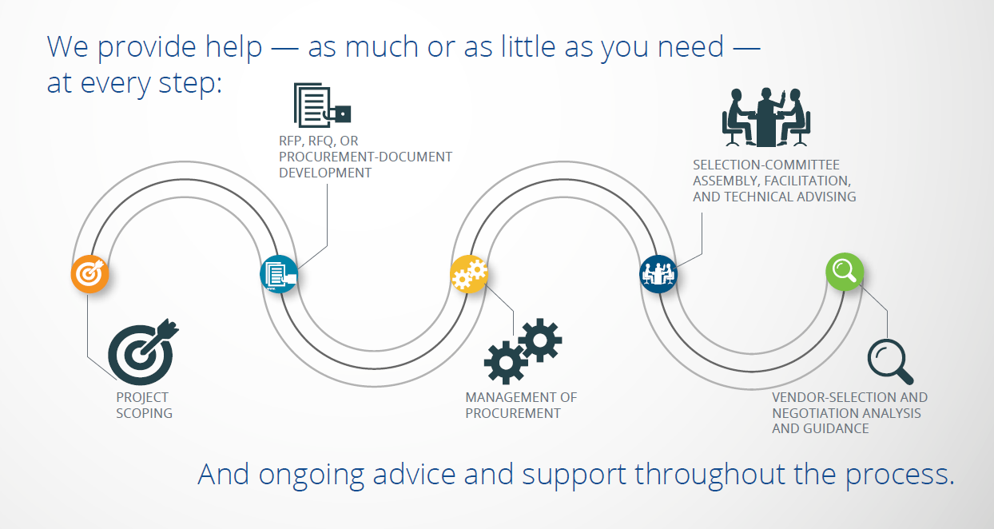
MAPC: GROUP PURCHASING
Notes:
Police Vehicle Cooperative Purchasing
Fire Apparatus Group Purchasing
Clean Energy Group Purchasing
LED streetlights
ESCOs
Solar development
Aggregation

Slide 5
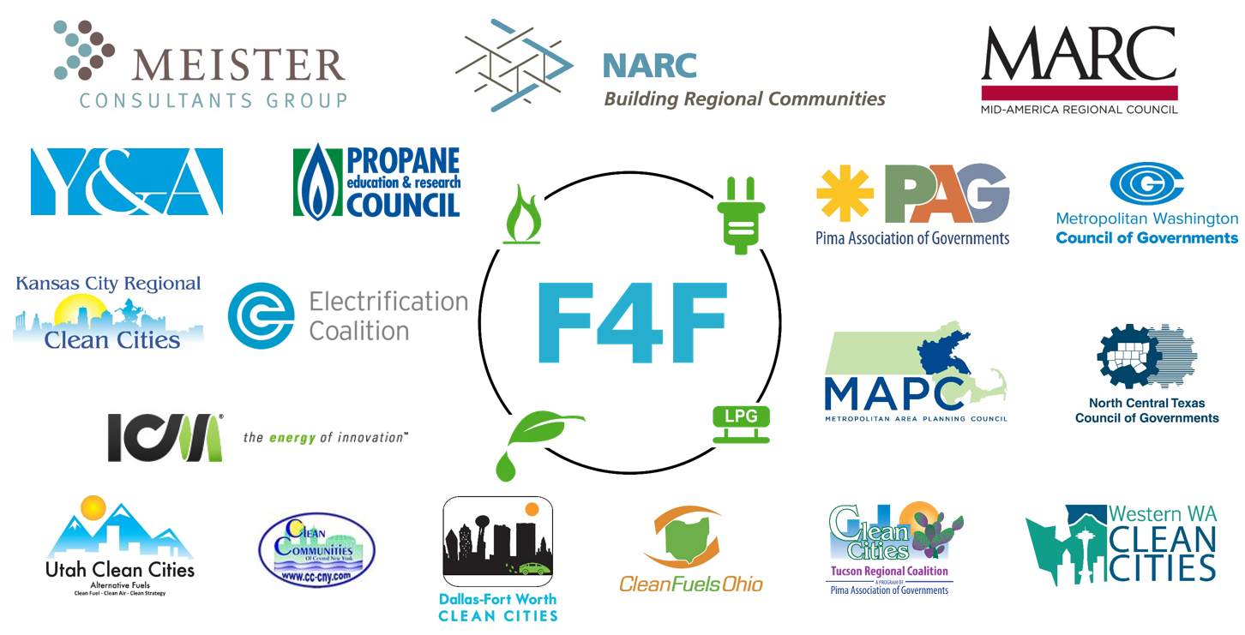
FLEETS FOR THE FUTURE
  Accelerate the deployment of alt. fuel vehicles (AFVs) by reducing their incremental costs and building fleet capacity to plan procurements.
  Propane, electric, and natural gas vehicles and infrastructure

Slide 6
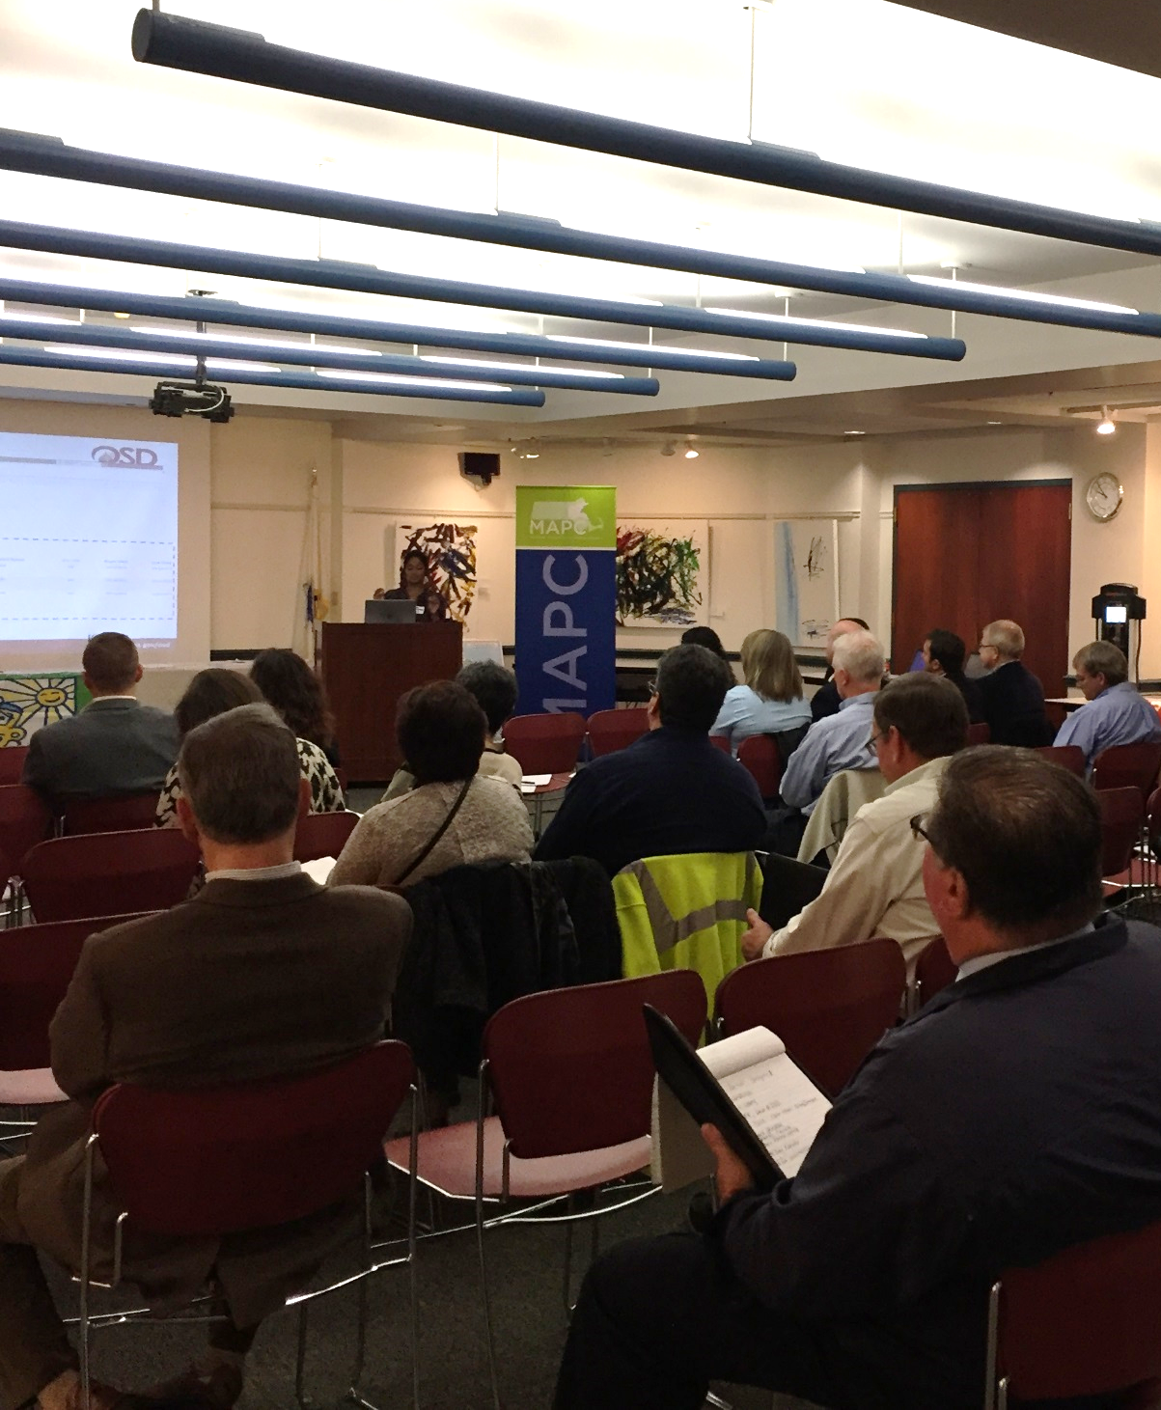
PROGRAM PARTNERS
  National Association of Regional Councils: partners in the D.O.E. funded Fleets for the Future project
  Green Mobility Group Purchasing Advisory Committee: Mix of state, regional and municipal entities with varying expertise in alt. fuels
  Department of Energy Resources & Operational Services Division: partners in developing the VEH102 Statewide Contract for Advanced Vehicle Technology

Slide 7
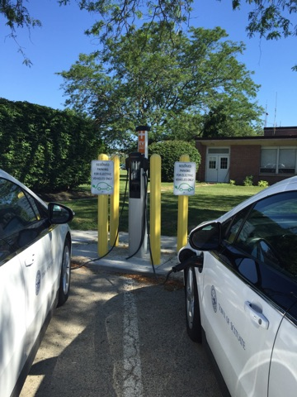
VEH102 SERVICE CATEGORIES
Scituate, MA – EVIP vehicles and charging stations
Service Category 1: Electric Vehicle Supply Equipment (EVSE), Hardware, Software, and Ancillary Services
Service Category 2: Idle Reduction Technologies for Heavy, Medium, and Light Duty Vehicles; and Heavy Duty Equipment
Service Category 3: After-market conversion technologies– all vehicle classes

Slide 8
MAPC’s Green Mobility
Group Purchasing Program
Project Overview, Upcoming Rounds, & Purchasing Process

Slide 9





OPPORTUNITY IDENTIFICATION
Nearly 50% of municipal fleet vehicles are
Green Communities - Common Vehicle Types
Other popular makes include

Slide 10
VEHICLE TYPES

Slide 11
VEHICLE TYPES

Slide 12
PROCESS & TIMELINE
FEBRUARY – APRIL
MAY
JUNE
JULY
AUGUST
OCTOBER
JANUARY 2018
Public entities submit Letters of Interest & Vehicle Interest Lists
MAPC collects vehicle specifications for ROUND 1
MAPC partners with OSD and DOER on ROUND 1
MAPC/DOER issue Statement of Work to XL Hybrids
30 day accelerated discount window closes 8/25
60 day accelerated discount window closes 10/25
Bulk Pricing Agreement with XL Hybrids closes 1/27/18

Slide 13
ELIGIBLE ENTITIES
PUBLIC ENTITIES NATIONWIDE
Municipalities
Public libraries
State agencies
Public schools
Ind. public authorities/quasi-public agencies
Public higher ed.
Public hospitals
Public purchasing cooperatives
Non-profit certified orgs. working with Massachusetts

Slide 14



GROUP PURCHASE BENEFITS
Access bulk discounts.
Save time & money.
Lead by example.

Slide 15

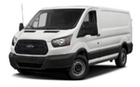

GROUP PURCHASE RESULTS
25 Class 2 HEV Retrofits (GM, Ford vans)
1 Class 3-6 HEV
Retrofits (GM,
Ford, or Isuzu
Chassis)
11 – 19% discount
($1000s)

Slide 16
Thank You!
Cammy Peterson
Director of Clean Energy
cpeterson@mapc.org
617-933-0791

Slide 17
APPENDICES

Slide 18



ALTERNATIVE FUEL ADOPTION IN MASSACHUSETTS
Notes:
As you can see over the past 5 years the number of people within the state of Massachusetts that are using alternative fuel vehicles has increase significantly. Especially the use of electric, hybrid and plug in vehicles – the green bar in the chart on the right. The number of public fuel stations for electric vehicles has also increase significantly, but there are still steps to be taken before the infrastructure is universal throughout the state.
Alternative Fuels
Biodiesel (B100)
Electricity
Ethanol (E85)
Hydrogen
Natural gas
Propane
Fuel Blends – commonly used
Biodiesel/diesel blends (B2, B5, B20)
Ethanol/gasoline blends (E10)
Hydrogen/natural gas blends (HCNG)
Diesel/CNG

Slide 19
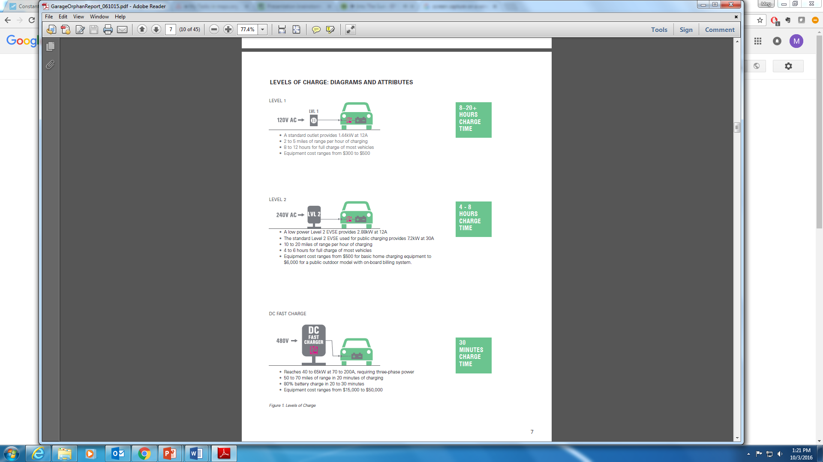
ELECTRIC VEHICLE SUPPLY EQUIPMENT
8-20+ hours
Overnight charging for vehicles that will travel under 40 miles during the day
Most practical municipal applications, can add 10-25 miles of range in one hour of charging
4-8 hours
Applications make most sense along highways at rest areas for a short duration charge that provides range for long distance travel
30 mins
Image source: “Accommodating Garage Orphans” WXY, 2015
Notes:
The first service category on the contract is electric vehicle supply equipment or charging stations.
There are three levels of charging station available:
Level 1, takes 8-20 hours for full charge and makes sense for vehicles that can charge overnight and travel mostly short trips during the day.
Level 2, takes 4-8 hours to change, has a lot of practical applications, makes a lot of sense to locate at work places where you might need to get a boost of energy in the short term.
DC fast charging stations take 30 minutes to achieve full charge, most sensible application for this technology is along a highway at rest areas.
The electrical vehicle supply equipment vendors on the contract offer all of these services, along with software options and installation for a turnkey solution.

Slide 20



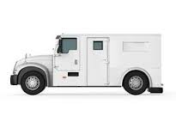
ANTI-IDLING TECHNOLOGY
Use of lights, radios, computers, radar and video cameras while monitoring traffic, assisting at accident scenes, writing reports, etc.
Power Management System (0.2)
Heat Recovery System (0.1)
Battery APU (0.6)
80% of fire truck dispatches are for medical emergencies or accidents, use of lights and other accessories while idled on call, water pumping requires additional power.
Diesel APU (2.9)
Use of lighting, communications, refrigeration, life support, heating and cooling while waiting for an Emergency Call
Battery Power Pack (2-8)
Electrified Parking Space (2.5)
Frequent stops for deliveries and pickups, use of heating and cooling while idling
Battery APU (3.8)
Notes:
Second service category on the contract is anti-idling technology
Slide: the left hand side describes the typical needs of the vehicle/what makes the vehicles unique, and the right hand side describes the types of anti-idling technology that is applicable in this instance, the number in the parentheses is the typically ROI from those technologies in this application.
Most beneficial applications from top to bottom of the slide: police cruisers, fire trucks, ambulances, and armored trucks. The vendor that was selected for the contract provides solar power directly on the vehicle as a source of energy to prevent idling
Types of anti-idling technology we issued the RFR for:
Battery/Auxiliary Power Units or Generator Sets (APU/GSs)
Cab or bunk heaters
Coolant Heaters
Electric Transportation Refrigeration Units (e-TRUs)
Air heaters
Waste heat recovery systems
Electrical block heaters
Small onboard diesel cabin heaters
Backup battery systems for police cruisers
Battery monitoring systems (i.e. no backup battery) for police cruisers, highway services, construction, etc.

Slide 21
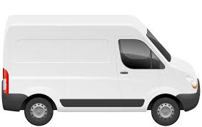


HYBRID RETROFIT TECHNOLOGY
Keep your favorite ride, while saving money and reducing your carbon footprint.
Light & medium duty vehicles for retrofit or up-fit
Vehicle downtime for installation minimal – typically one day on or offsite
20-35% reduction in fuel consumption – depending on vehicle type and usage.
Notes:
The third service category on the contract is after market conversion technology. This can be a great opportunity to reduce the cost of your fleet’s fuel while keeping an existing vehicle that your city of town employees are used to driving or might be a little attached to.
Simply put, after-market conversion systems modify vehicles so that they can run on – or be supplemented by – fuels or technologies other than the ones for which they were originally designed for. In most cases this means hybrid-izing a traditional internal combustion engine vehicle so that it is capable of being fueled by electricity.
Each vendor on the contract offers a slightly different form of after market conversion technology, but broadly speaking the conversation technology:
Can be installed for the light and medium duty vehicles within your fleet
Installation also not an inconvenient process - Typically the amount of vehicle downtime is not more than one day and can be completed on or off site depending on the vendor. It’s also important to note that in most cases the OEM warranty is not effected.
And the benefits of the retrofit or up-fit are pretty great – of course, the conversion will reduce your fleet’s impact on the environment. But in addition to that, the average reduction in fuel consumption experienced is 20-35% which saves money that can then be used for other high priority projects. The fuel savings you experience is dependent on the amount and type of usage of the vehicle, but the return on investment breakeven typically occurs after 70,000-130,000 miles are driven.

Slide 22
SELECTED VENDORS – VEH102 CONTRACT
 | Category 1 | Category 2 | Category 3
VENDOR | ELECTRIC VEHICLE SUPPLY EQUIPMENT | ANTI-IDLING TECHNOLOGY | HYBRID RETROFIT TECHNOLOGY
ClipperCreek, Inc. | √
EVSE, LLC | √
Graybar Electric Company, Inc. | √
LiquidSky Technologies | √
Telefonix, Inc. | √
Verdek | √ |  | √
Voltrek, LLC | √
eNow, Inc. |  | √
Magmotor Technologies, Inc. |  |  | √
National Van Builders, Inc. |  |  | √
XL Hybrids |  |  | √
Notes:
So now that we’ve covered a quick 101 on the services available on the contract – I would like to introduce the selected vendors on the VEH102 contract. There are 11 vendors in total with 7 providing electric vehicle supply equipment, 1 providing anti-idling technology, and 4 offering hybrid retrofit technology.
If you are interested in learning more about these vendors please come visit our table and we can direct your to those who are here today.

