Slide 1
Frank Dean
Business Development Manager – Green Fleet
205-531-0604 / frank.dean@altec.com

Slide 2
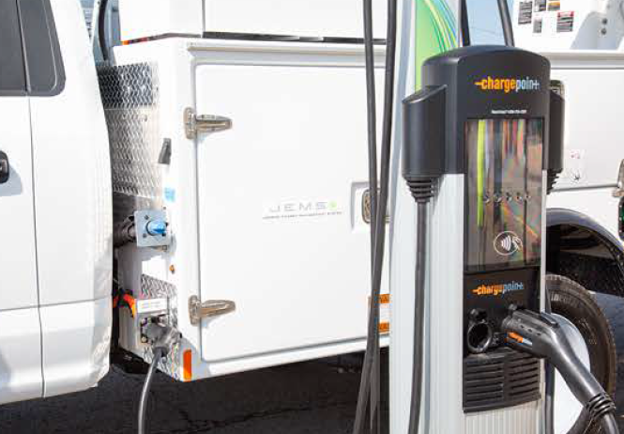
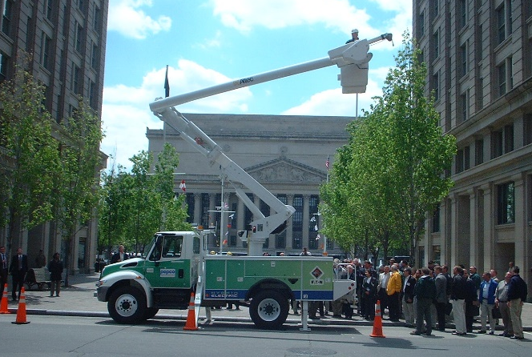
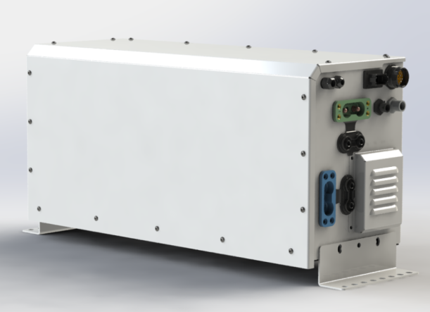
JEMS
Plug-in technology for reducing engine idle
Intuitively manages engine idle – providing work crews with cleaner, quieter, and, safer jobsites
Reduces engine hours, fuel consumption, emissions, and vehicle maintenance
ePTO market leader with JEMS technology deployed all across North America
Market Drivers: Sustainability and Data

Slide 3
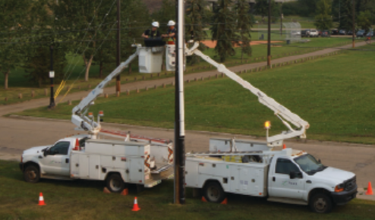
Massachusetts Anti-Idling Law
Massachusetts General Law (MGL) Chapter 90, Section 16A
Cannot be idling more than five minutes
Penalty by fine
Applies to all motor vehicles
Every gallon of gas burned produces more than 20 pounds of greenhouse gases
Excessive idling wastes an enormous amount of fuel and money and generates needless air pollution and greenhouse gases
“Improve air quality by reducing unnecessary air pollution from idling vehicles” – MassDEP

Slide 4
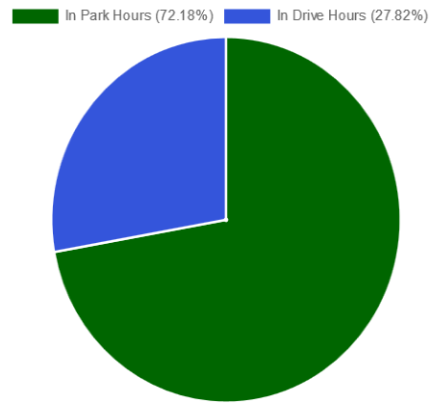
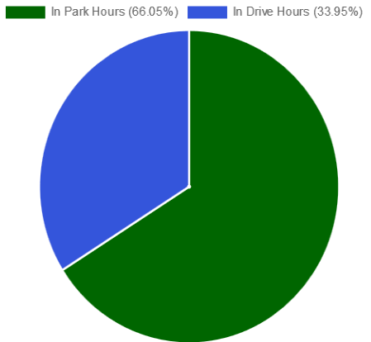
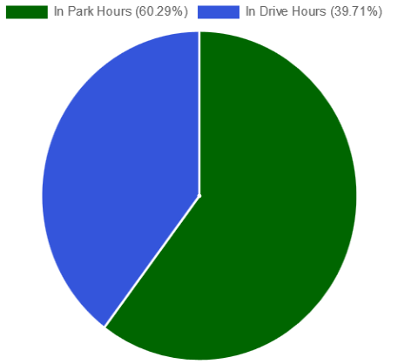
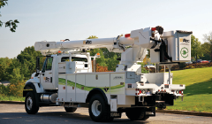
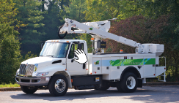
How much do trucks idle?
55’ Material Handler
Telecom Aerial
Trouble Truck

Slide 5
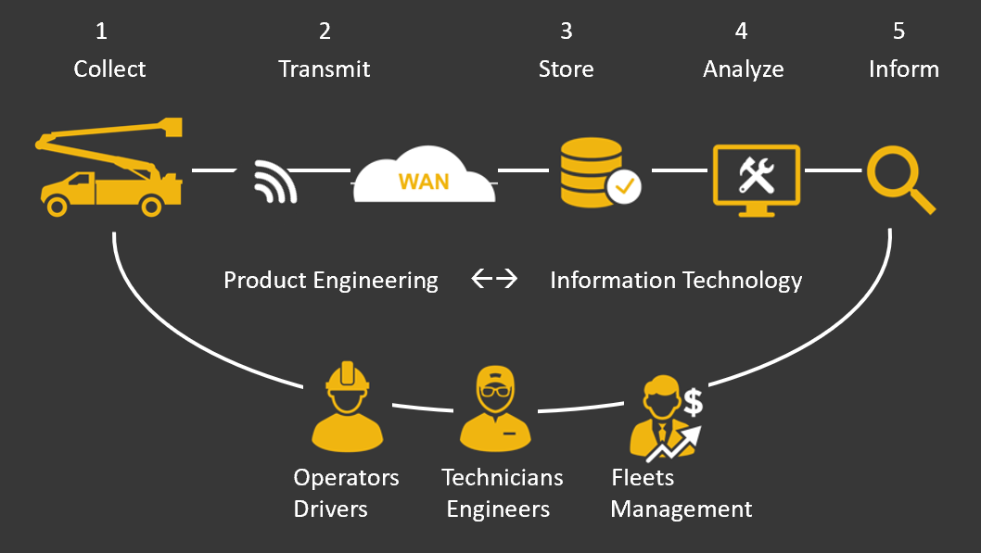
Data Ecosystem
Integrating Plug-In Idle Mitigation technology in a fleet along with a data management strategy ensures the technology is optimized

Slide 6
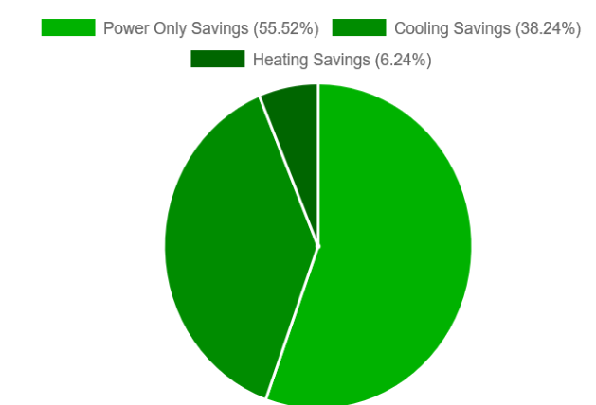
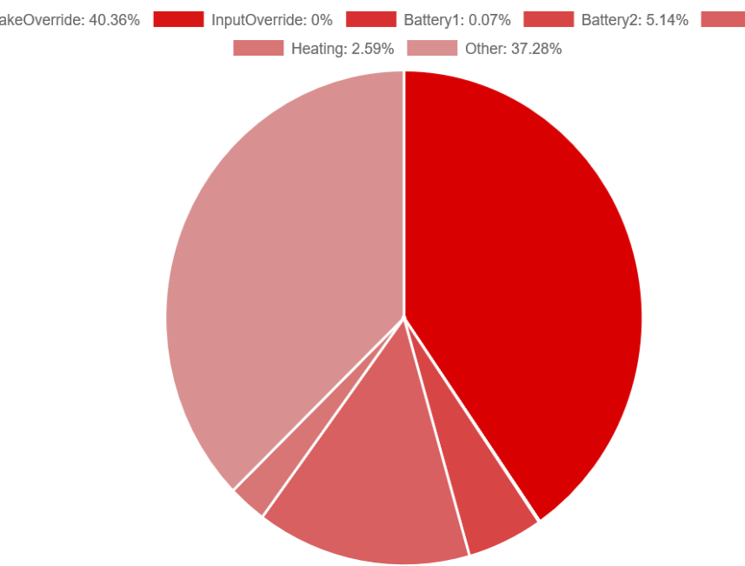
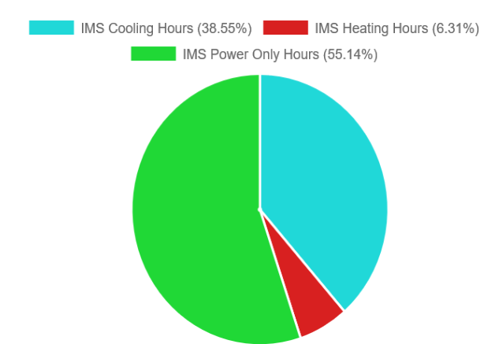
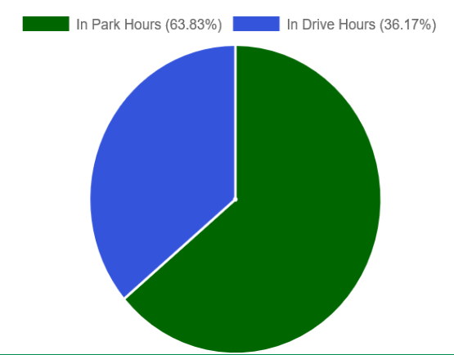
Actionable Fleet Data Reports
Fuel Savings
Avoidable Idle
Idle Mitigation By Category
Utilization
Emissions Reduction

Slide 7
Data Driven Approach
Training & Education (continuous)
Vehicle Operator
Fleet Management and Analyst
Fleet Utilization & Data Management
Track JEMS usage across the Fleet and Individual assets
User Portal and Dashboard with Actionable Data
Leverage Data
Operator Performance Improvements and Training
Maintenance
Sustainability Stakeholders
Establish and Monitor KPIs
Manage Vehicle Alerts (Maintenance and Diagnostics)
Reduce Operating Costs
Improve Uptime and Manage Service Schedules
Reduce emissions
Monitor Operator Compliance

Slide 8
Thank You
“Improve air quality by reducing unnecessary air pollution from idling vehicles” – MassDEP
Frank Dean
Business Development Manager – Green Fleet
205-531-0604 / frank.dean@altec.com

